Slide 1
AIET
BACHELOR OF TECHNOLOGY COMPUTER SCIENCE & ENGINEERING
AIET
UNDER GUIDANCE OF:-
MRS.SHASHI BHUTANI

Slide 2

INTRODUCTION
DESCRIPTION
SYSTEM STUDY
MODULES
DFD
TECHNOLOGIES USED
FACILITIES REQUIRED
PROJECT SNAPSHOT
CONCLUSION

Slide 3

Company Profile
Project Undertaken:Education Xperts
Estimated duration: 6 weeks
Name of the Organization: EME Technologies, Chandigarh
Address of Organization: SCO 85-86 ,sec 34 A Chandigarh
Contact No(s): +91-7355158188
External Supervisor Name: Ms. Shashi Bhutani
Nature of Project/Job assigned: WEB SITE

Slide 4
INTRODUCTION
The main aim of the project “FASHION STORE” The way we shop for fashion is different from how we buy cameras—especially online.
With fashion, reviews and specs are less important; fashion shopping is about discovering something that fits your taste and feels right.
The web works well for buying cameras and other hard goods but for soft goods, such as clothing and accessories, it’s not the same as shopping in a store.

Slide 5
DESCRIPTION
In our website
USER’S ACCESS:-
Online Shopping.
Buy clothes.
Information about Latest CLOTHES.
Enquiry form.

Slide 6
System Study

Slide 7
Problem Statement
Trainers often charge huge amount of fees from learners, as a result many poor and middle-class people don’t join the coaching classes.
Even the rich who afford fees for coaching classes do not learn too much, because of the neglactance of their Guide and of their careless attitude and ignorance.
A survey conducted in the year 2015 find out that in many coaching institutes trainers are not perfect, they are not expert.

Slide 8
Proposed System
We develop our project by considering ease and comfortable level of every user
It is very convenient for every user to use our site and to take maximum benefit from us free of cost.
There is a Live Chat option through which users can contact us online at any time, and subscribe for Latest Updates about various competitive Exams.

Slide 9
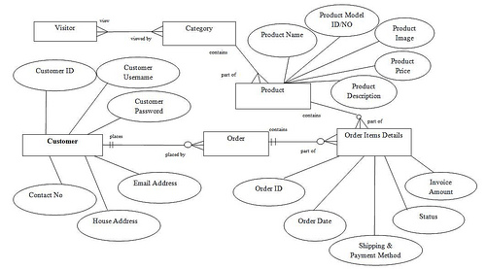
DFD FOR EMPLOYEE LOGIN

Slide 10
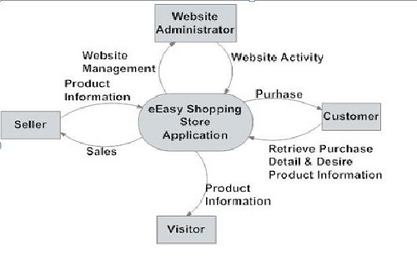
DFD FOR STUDENT LOGIN

Slide 11




TECHNOLOGIES USED
FRONT END TOOL
PHP-
Hypertext Preprocessor
HTML-
Hyper Text Markup Language
CSS-
Cascading Style Sheet
BACK END TOOL
MYSQL-
Used for Database Connectivity

Slide 12
FACILITES REQUIRED
HARDWARE
SOFTWARE
Processor: Intel Pentium IV or Equivalent running @ 1.6 GHz or more.
RAM: 256 MB
SYSTEM BUS: 32 or 64 bits
RAM: 256 MB of RAM
HDD: 40 GB or higher
MySQL: Database server providing robust and scalable data storage/retrieval.
OS :MS WINDOWS 8 ,7.
XAMPP SERVER: Feature-rich web server that works well with PHP.
Front end: HTML, CSS, PHP :

Slide 13
PROJECT SNAPSHOTS

Slide 14
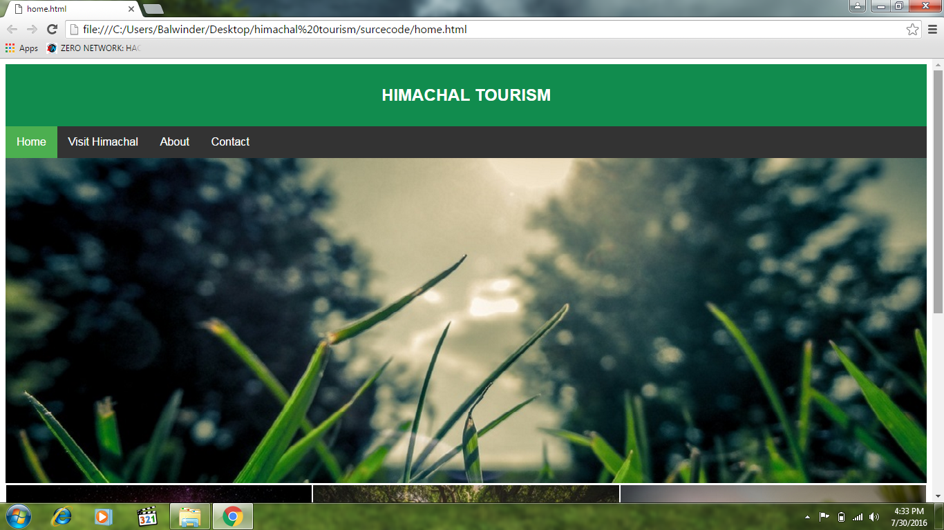
HOME PAGE
The
Home
Page
Of
our
website

Slide 15
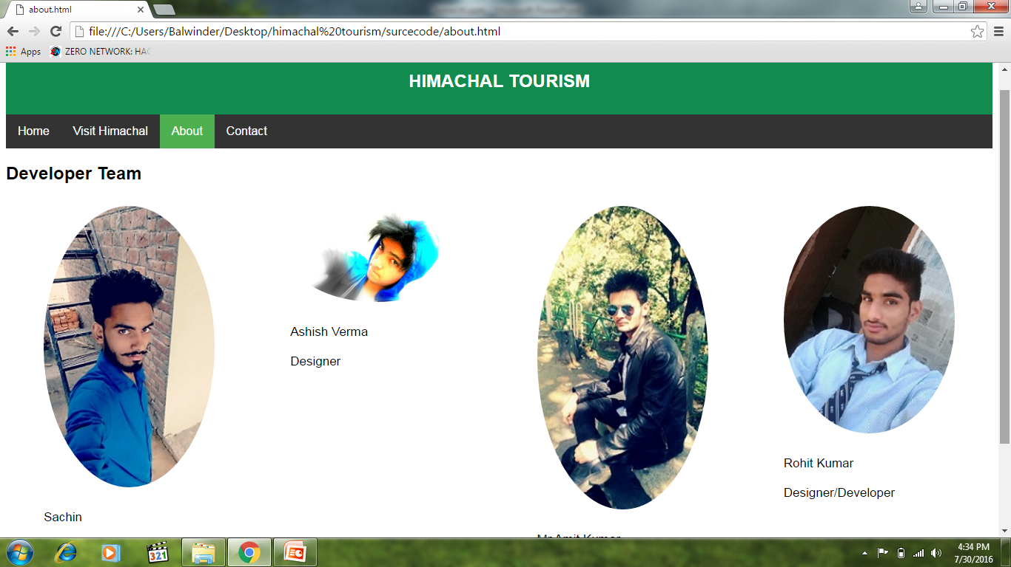
ABOUT US

Slide 16
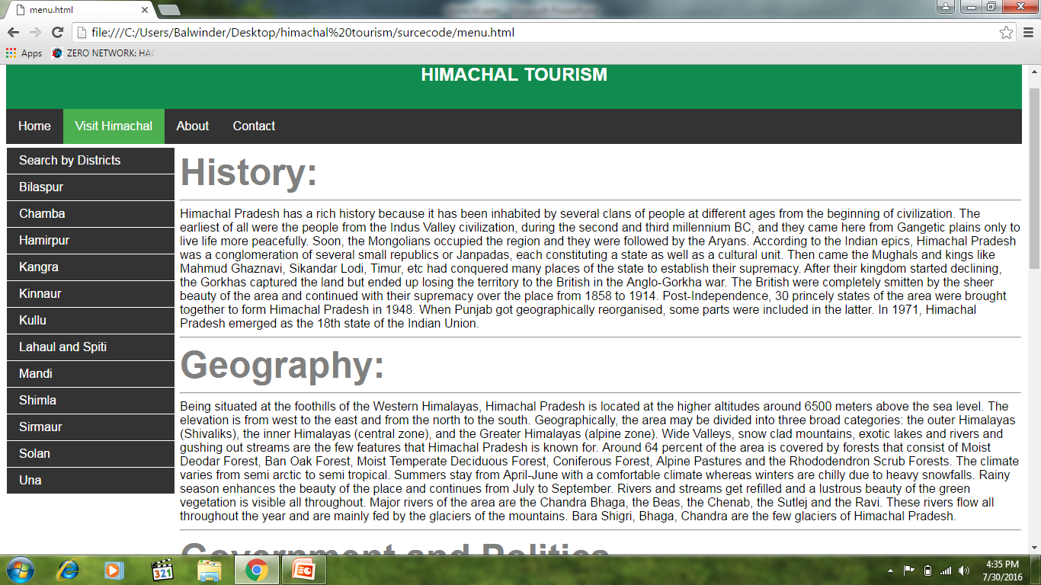
Visit Himachal

Slide 17
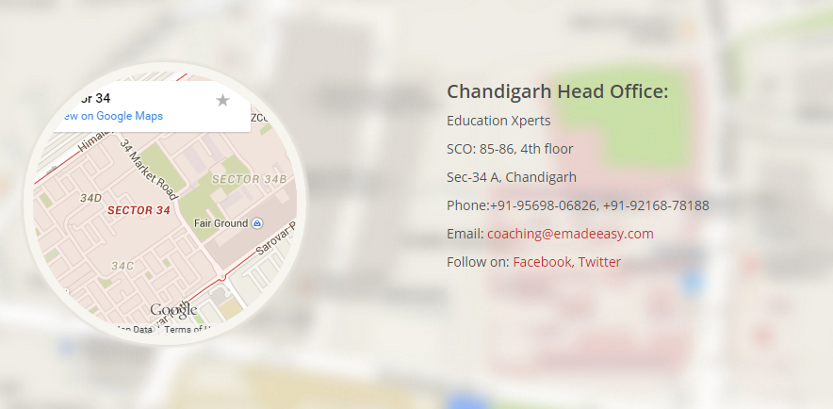
CONTACT US
Users
Can
Contact
Us
Through
Google
Map

Slide 18
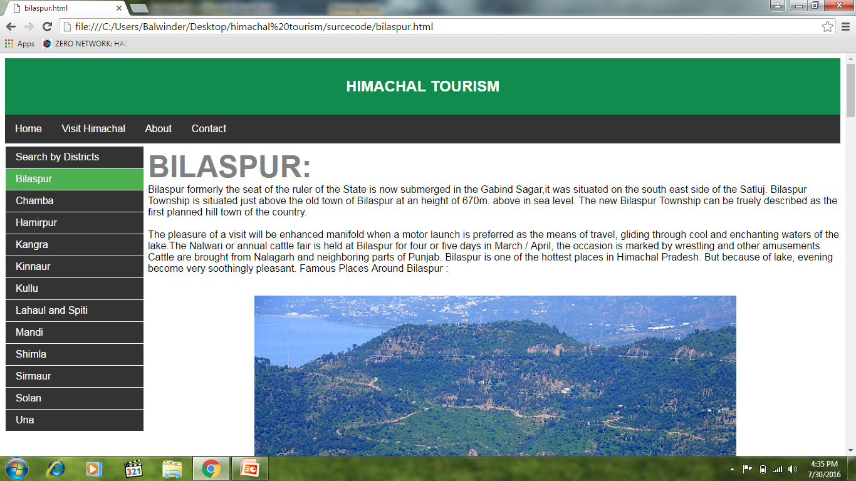
Bilaspur

Slide 19
CONCLUSION

Slide 20
CONCLUSION
In our project, users can online registered themselves and can access to contents of our site.
The main aim of this project was to put whatever was learnt in PHP into practice.
One most important feature of our project is that it is completely secured, no one can access without userid and password. Control of the site is with administrator.

Slide 21
THANK YOU

