Slide 1

KNN

Slide 2
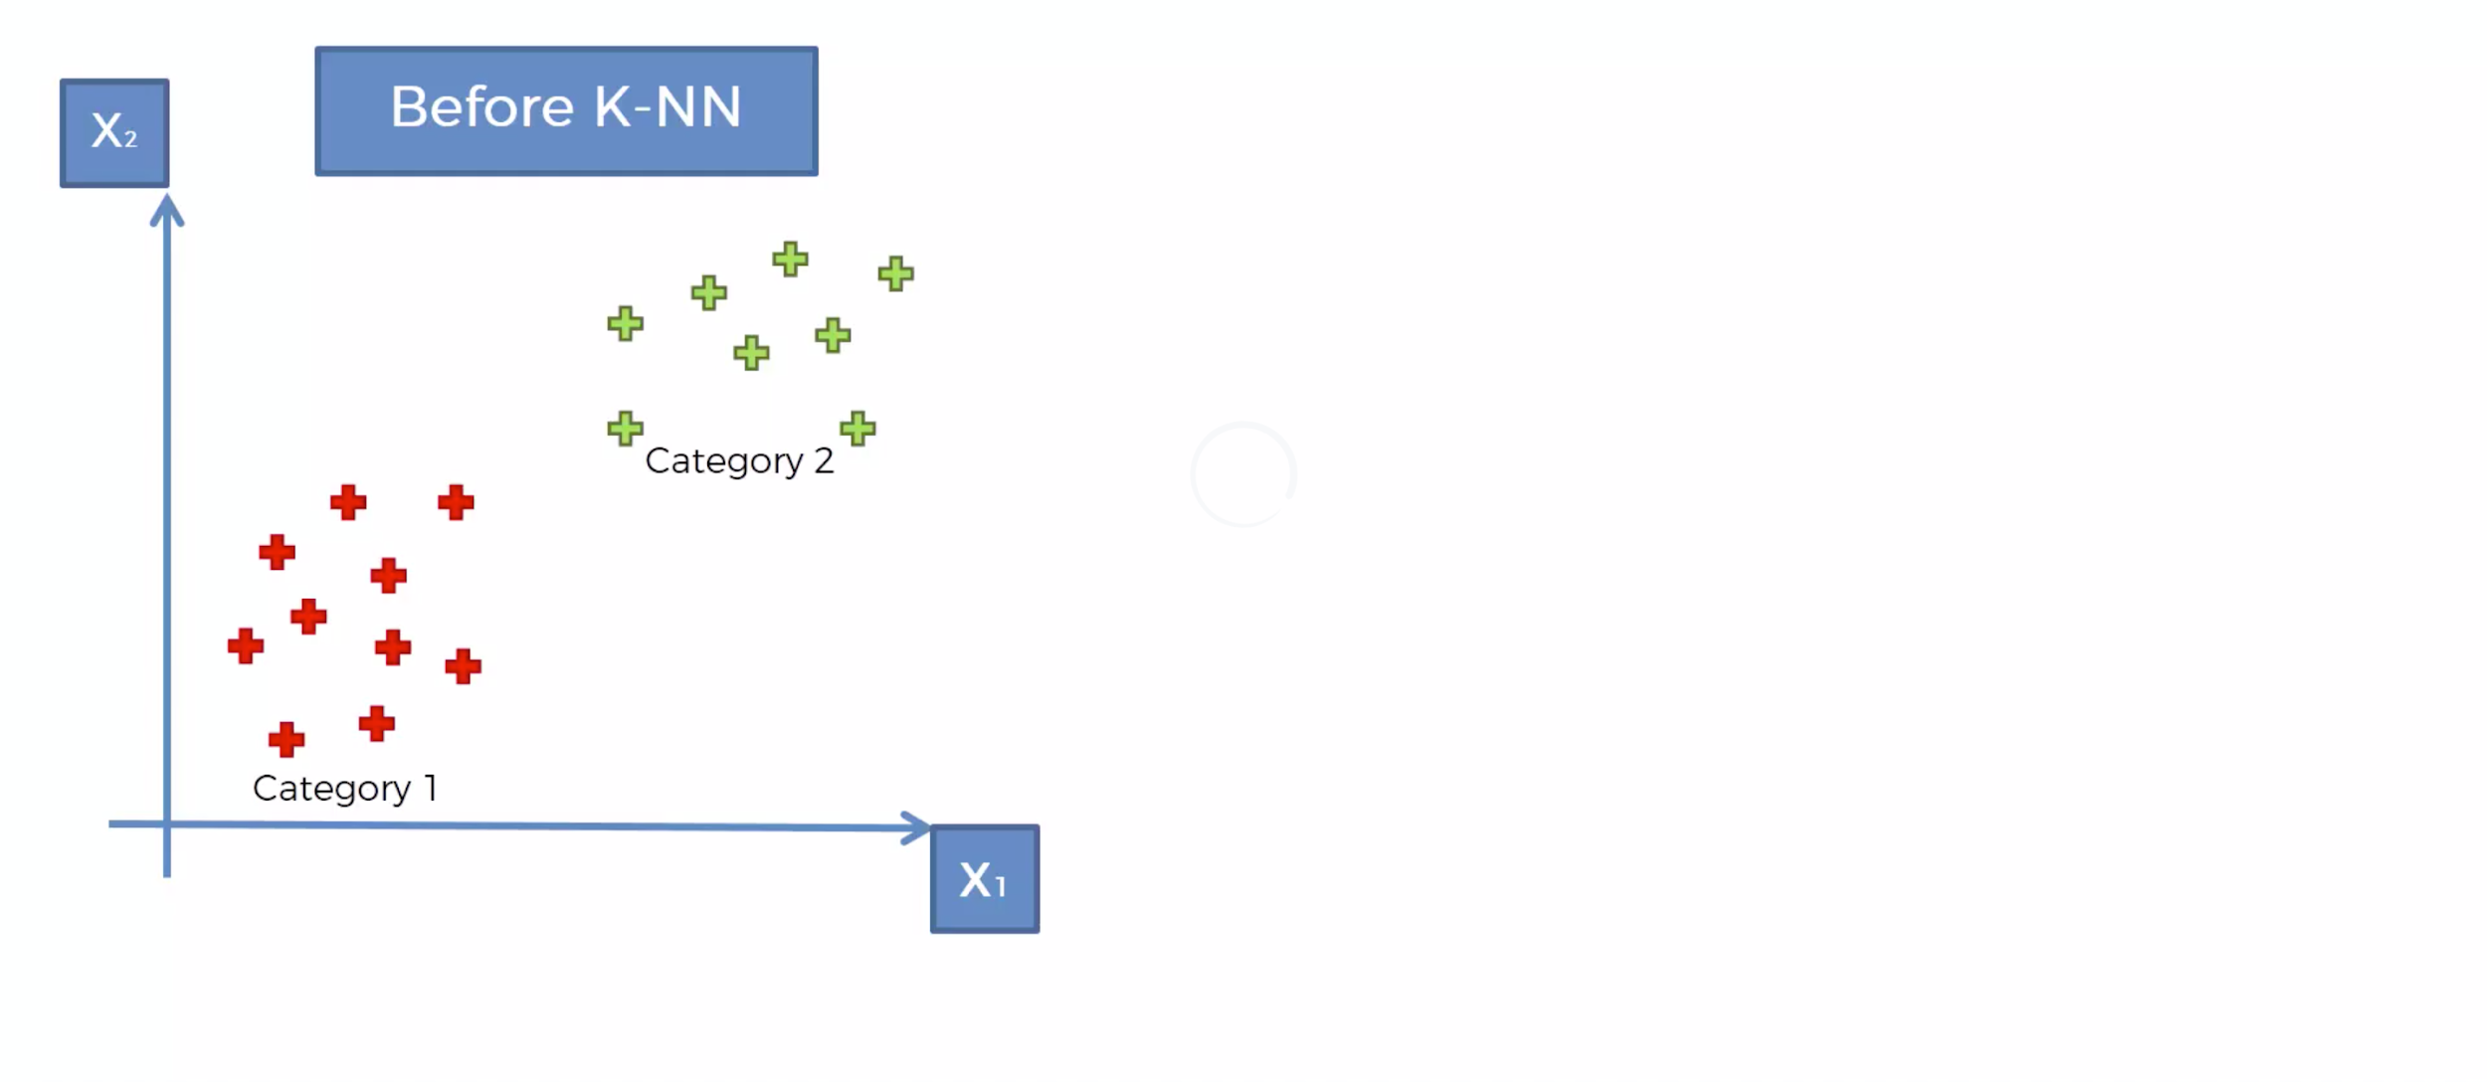
What K-NN does for you
Notes:
What is Neighbour

Slide 3
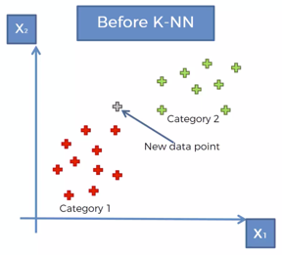
What K-NN does for you

Slide 4
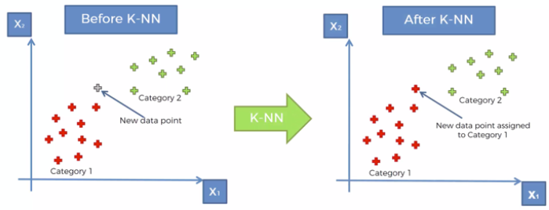
What K-NN does for you

Slide 5
How did it do that?

Slide 6
How did it do that?
STEP 1: Choose the number K of neighbours

Slide 7
How did it do that?
STEP 1: Choose the number K of neighbours
STEP 2: Take the K nearest neighbour of the new data point, according to Euclidean distance

Slide 8
How did it do that?
STEP 1: Choose the number K of neighbours
STEP 2: Take the K nearest neighbour of the new data point, according to Euclidean distance
STEP 3: Among these K neighbours, count the number of data points in each category

Slide 9
How did it do that?
STEP 1: Choose the number K of neighbours
STEP 2: Take the K nearest neighbour of the new data point, according to Euclidean distance
STEP 3: Among these K neighbours, count the number of data points in each category
STEP 4: Assign the new data point to the category where you counted the most neighbours

Slide 10
How did it do that?
STEP 1: Choose the number K of neighbours
STEP 2: Take the K nearest neighbour of the new data point, according to Euclidean distance
STEP 3: Among these K neighbours, count the number of data points in each category
STEP 4: Assign the new data point to the category where you counted the most neighbours
Your model is ready

Slide 11


Slide 12
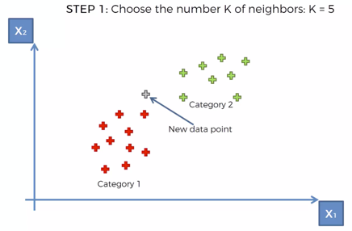
K-NN algorithm

Slide 13
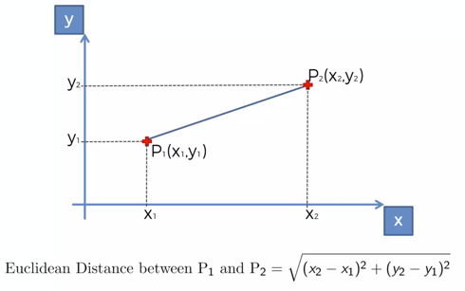
Euclidean Distance

Slide 14
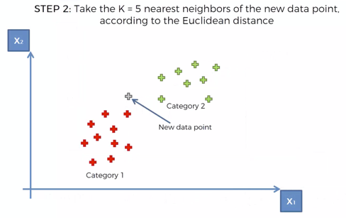
K-NN algorithm

Slide 15
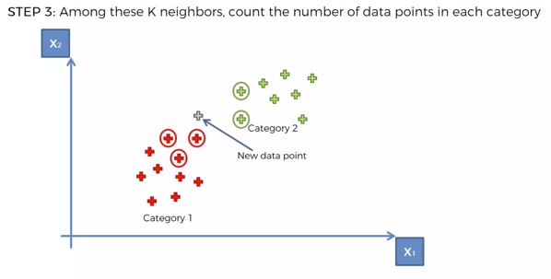
K-NN algorithm

Slide 16
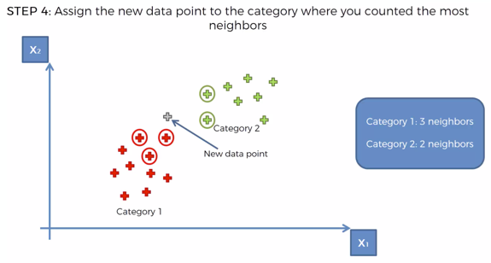
K-NN algorithm

Slide 17
K-NN algorithm
Your model is ready

