Slide 1



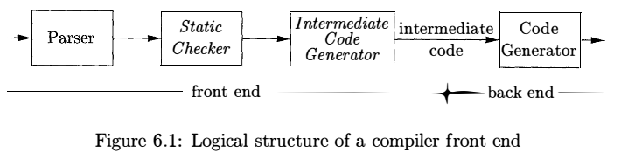

CS320: Syntax Analysis

Slide 2
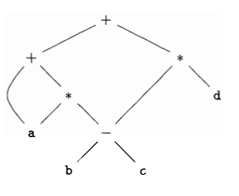
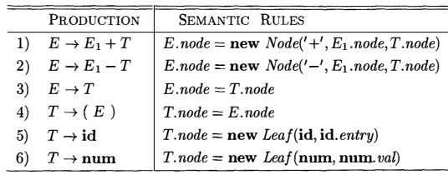
CS320: Syntax Analysis
A directed acyclic graph (DAG) for an expression identifies the common subexpressions of the expression.

Slide 3
CS320: Syntax Analysis

Slide 4
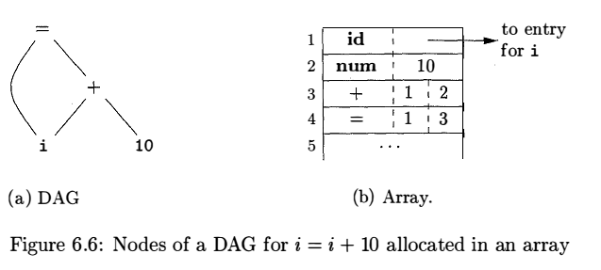
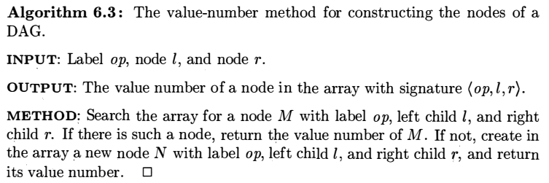
CS320: Syntax Analysis

Slide 5
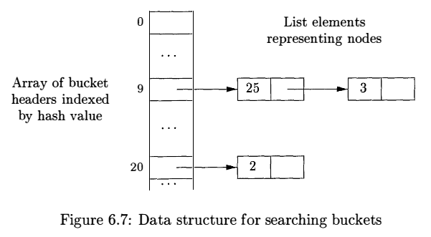
CS320: Syntax Analysis

Slide 6

CS320: Syntax Analysis

Slide 7


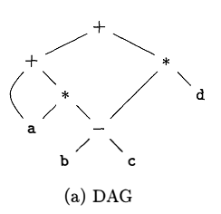
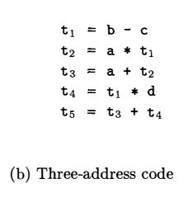
CS320: Syntax Analysis
In three-address code, there is at most one operator on the right side of an instruction.
Three-address code is a linearized representation of a syntax tree or a DAG

Slide 8

CS320: Syntax Analysis

Slide 9
CS320: Syntax Analysis

Slide 10
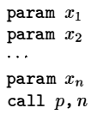

CS320: Syntax Analysis

Slide 11

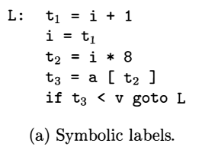
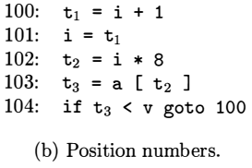
CS320: Syntax Analysis

Slide 12

CS320: Syntax Analysis
The choice of allowable operators is an important issue in the design of an intermediate form.
The operator set clearly must be rich enough to implement the operations in the source language.
Operators that are close to machine instructions make it easier to implement the intermediate form on a target machine.

Slide 13

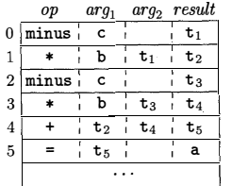
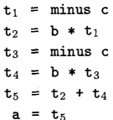
CS320: Syntax Analysis

Slide 14
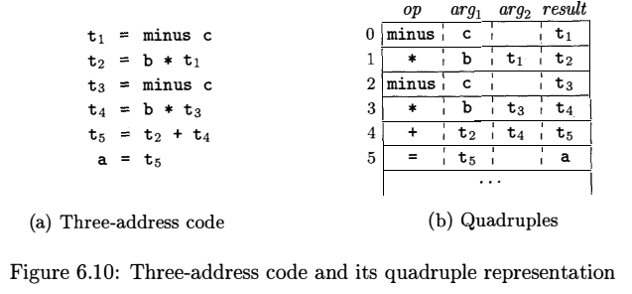
CS320: Syntax Analysis

Slide 15
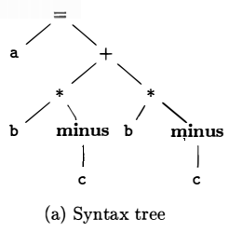
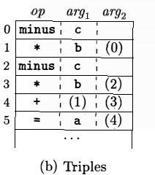
CS320: Syntax Analysis

Slide 16
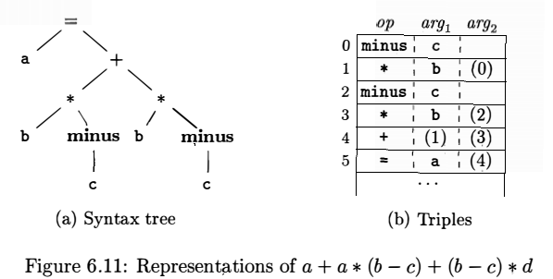
CS320: Syntax Analysis

Slide 17
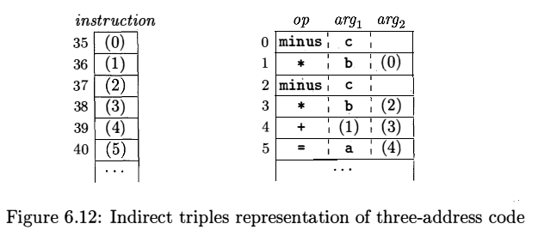
CS320: Syntax Analysis
A benefit of quadruples over triples can be seen in an optimizing compiler, where instructions are often moved around.
With quadruples, if we move an instruction that computes a temporary t, then the instructions that use t require no change.
With triples, the result of an operation is referred to by its position, so moving an instruction may require us to change all references to that result.
This problem does not occur with indirect triples.

Slide 18
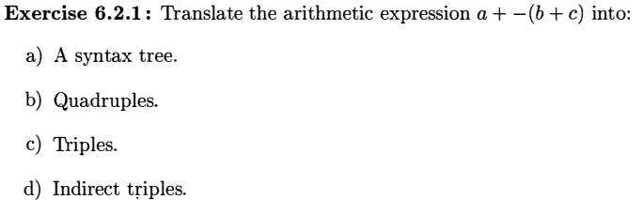
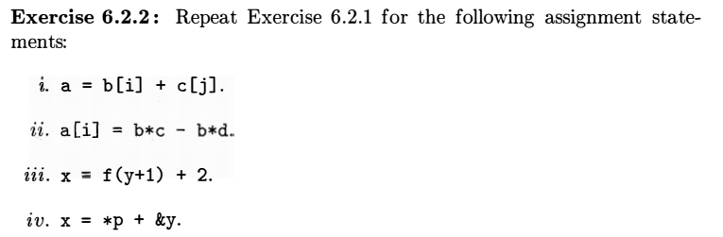
CS320: Syntax Analysis

Slide 19
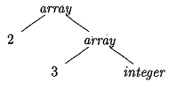
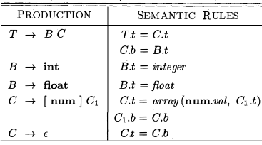
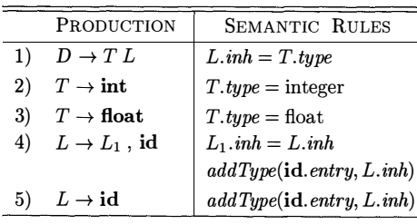
CS320: Syntax Analysis

Slide 20
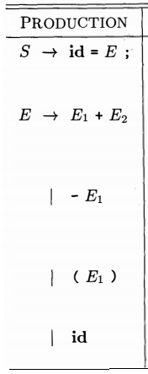




CS320: Syntax Analysis

Slide 21

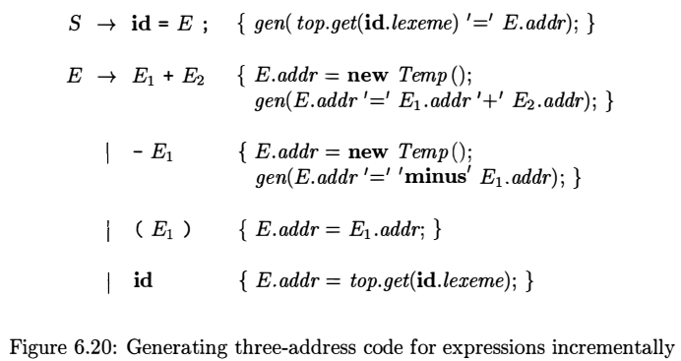
CS320: Syntax Analysis

Slide 22



CS320: Syntax Analysis

Slide 23





CS320: Syntax Analysis

Slide 24
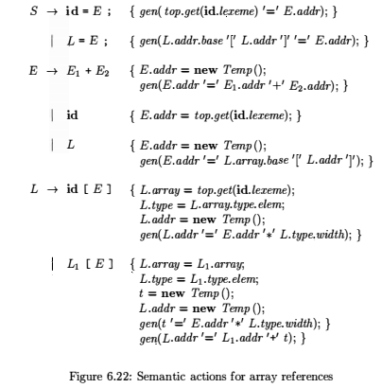
CS320: Syntax Analysis

Slide 25
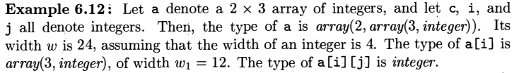
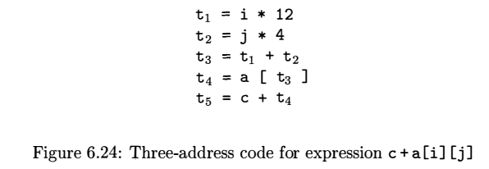
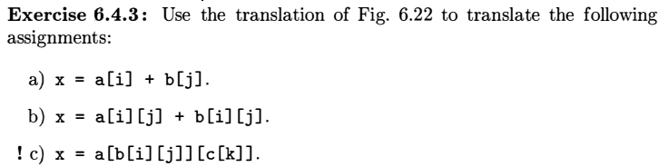
CS320: Syntax Analysis

Slide 26

CS320: Syntax Analysis
It takes as input the intermediate representation (IR) produced by the front end of the compiler, along with relevant symbol table information, and produces as output a semantically equivalent target program

Slide 27
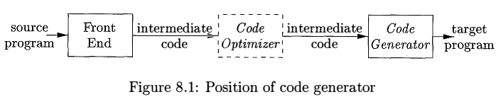
CS320: Syntax Analysis
This chapter presents algorithms that code generators can use to translate the IR into a sequence of target language instructions for simple register machines.

Slide 28

CS320: Syntax Analysis
Correctness, Instruction selection, register allocation and assignment etc.
Three address code, DAG etc.

Slide 29

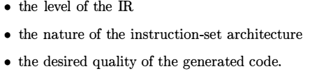

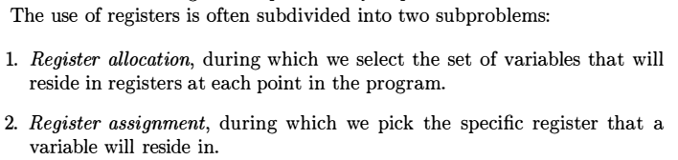
CS320: Syntax Analysis

Slide 30

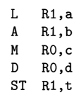
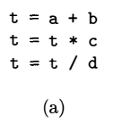


CS320: Syntax Analysis

Slide 31

CS320: Syntax Analysis

Slide 32
CS320: Syntax Analysis

Slide 33
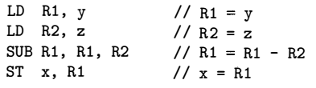
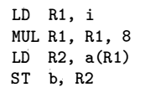
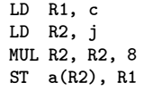


CS320: Syntax Analysis

Slide 34

CS320: Syntax Analysis

Slide 35
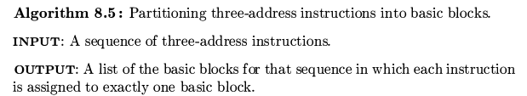

CS320: Syntax Analysis

Slide 36
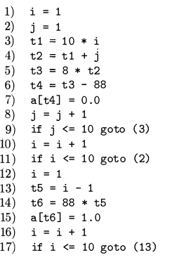
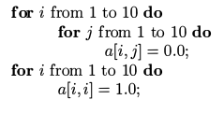
CS320: Syntax Analysis
In generating the intermediate code, we have assumed that the real-valued array elements take 8 bytes each, and that the matrix a is stored in row-major form.

Slide 37
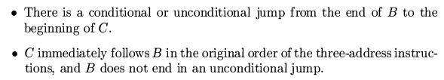
CS320: Syntax Analysis
There is an edge from block B to block C if and only if it is possible for the first instruction in block C to immediately follow the last instruction in block B.

Slide 38
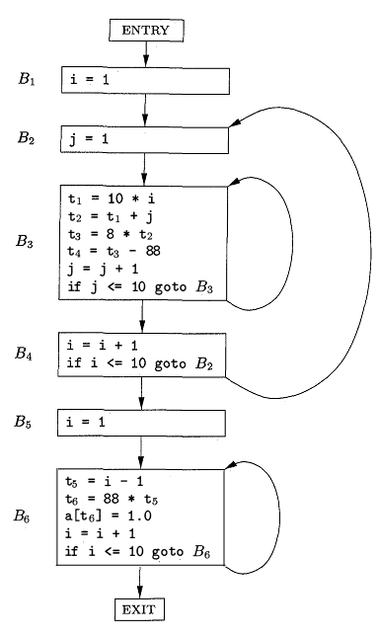
CS320: Syntax Analysis

Slide 39

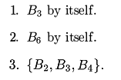
CS320: Syntax Analysis

Slide 40

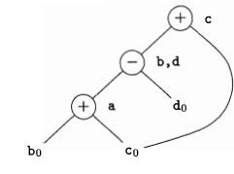



CS320: Syntax Analysis

Slide 41
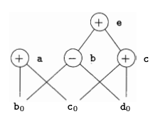

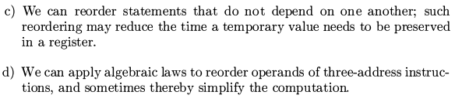
CS320: Syntax Analysis

Slide 42


CS320: Syntax Analysis

Slide 43
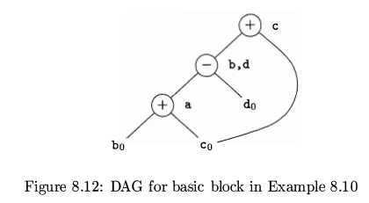




CS320: Syntax Analysis

Slide 44
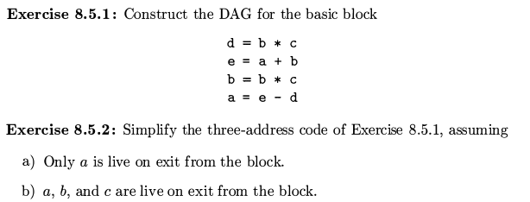
CS320: Syntax Analysis

Slide 45



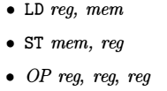
CS320: Syntax Analysis

Slide 46
CS320: Syntax Analysis

Slide 47



CS320: Syntax Analysis

Slide 48

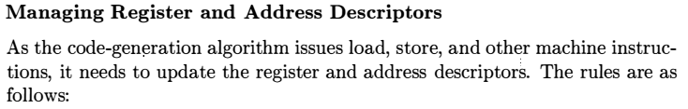

CS320: Syntax Analysis

Slide 49


CS320: Syntax Analysis

Slide 50


CS320: Syntax Analysis

Slide 51






CS320: Syntax Analysis

Slide 52


CS320: Syntax Analysis
After the instruction I, there are no further uses of v, and if v is live on exit from the block, then v is recomputed within the block

Slide 53
CS320: Syntax Analysis

Slide 54

CS320: Syntax Analysis
x
Rx
3

Slide 55
CS320: Syntax Analysis
x
Rx
3

Slide 56
CS320: Syntax Analysis

