Slide 1
Q. Write an program in YACC which can construct Directed Acyclic Graph( DAG) for any string generated by the following grammar.
S→E
E→ E+T | E-T | E*T | T
T→(E)|id
The DAG should be in value-number format as described in next slide .
Input to your program: Any expression generated by the grammar.
Output: The corresponding DAG in value-number format.
For more details see my class slides attached with this mail.

Slide 2
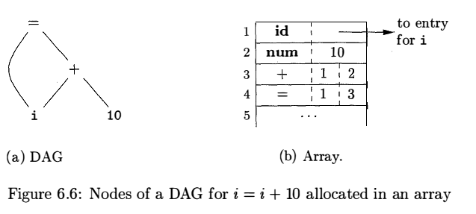
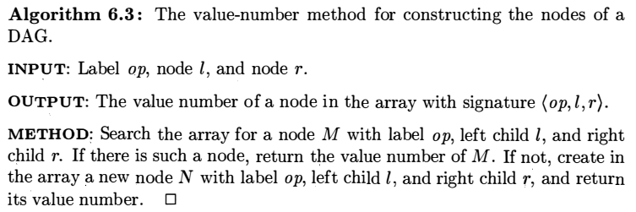
CS320: Syntax Analysis

