Slide 1

A Social Media Website SocialNest
Submitted by:
Ankush Pratap Singh (12323127)
Geetika Pandey (12323686)
Submitted to:
Prof. Gagandeep Sethi

Slide 2

Introduction to Problem Statement
In today's fast-paced digital environment, social media has become an essential platform for users to connect, share, and engage with others. However, many social media applications present significant challenges that can hinder user experience:
Content Management: Users often find it difficult to create, organize, and manage their posts effectively. This can lead to cluttered profiles and missed opportunities for interaction.
User Interaction: Many platforms lack intuitive features for engaging with content, such as liking and commenting. This can make it challenging for users to participate in conversations and build a community.
Security and User Authentication: Ensuring secure access for users is crucial. Without a robust login system, users may face risks of unauthorized access to their accounts.

Slide 3

Introduction to Project
The primary objective of this project is to develop a simple yet powerful social media web application for managing user interactions and content. The system will enable users to:
Create Posts: Easily add new posts with a user-friendly interface.
Like Posts: Engage with content by liking posts made by others.
Comment on Posts: Share thoughts and feedback on posts through comments.
Delete Posts: Remove posts that are no longer needed to keep the feed relevant.
Delete Comments: Manage discussions by removing comments as necessary.
On-Time Image Uploads: Upload images seamlessly with each post.
Dynamic and Responsive Design: Ensure the application works well on various devices.

Slide 4

Features
The social media application will incorporate several key features to enhance functionality and user experience:
User Authentication: A secure login and signup system that allows users to create accounts and access their profiles safely.
Post Creation and Management: Users can easily create new posts, edit existing ones, and delete posts they no longer want to keep, ensuring their content remains current.
Like and Comment Functionality: Users can engage with posts by liking and commenting, fostering interaction and community building.
Image Uploads: Users can upload images with their posts in real-time, enhancing the richness of their shared content.
Responsive Design: The application will be designed to work smoothly on both mobile and desktop devices, ensuring a great user experience regardless of the platform.
Dynamic Dashboard: An interactive dashboard that displays real-time statistics on posts, including likes and comments, helping users monitor engagement with their content.

Slide 5
Tech Stack Used
This project uses a carefully chosen set of technologies to ensure great performance and a smooth user experience:
Frontend Technologies: The user interface will be built using HTML for structure, CSS for styling, and JavaScript for interactive elements. We will use Bootstrap to create a mobile-friendly design that looks good on any device.
Backend Technologies: The backend will be developed with PHP, which will take care of the application logic and communication with the server. The Laravel framework will make development easier by providing tools for routing and data management. We will use MySQL as the database to store user accounts, posts, comments, and other important data efficiently.

Slide 6
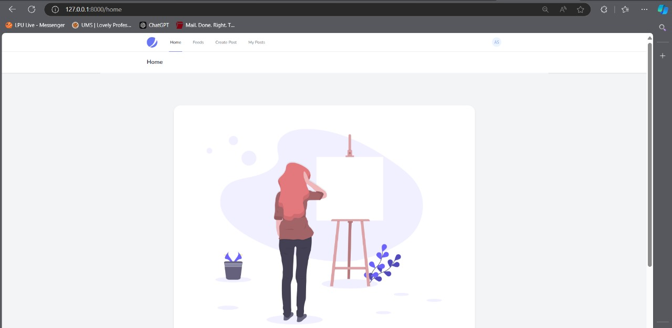
Screenshots of UI

Slide 7
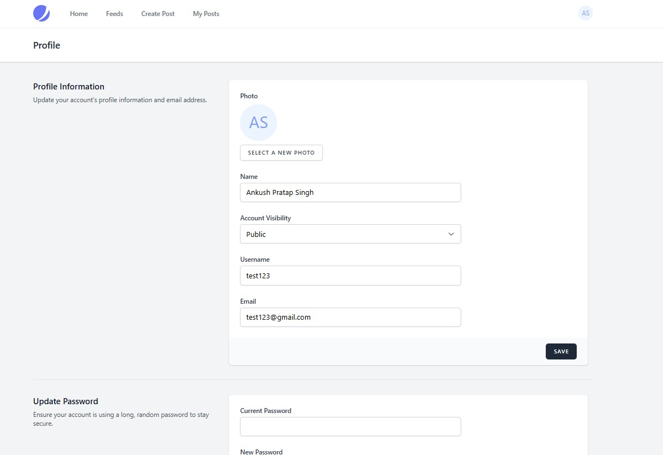

Slide 8

Topics Covered from Syllabus
PHP Program for User Input: Accept user input from an HTML form and display a formatted message with validation.
Indexed and Associative Arrays: Demonstrate adding, removing, and updating elements in both array types, displaying results in an HTML table.
PHP Class for Real-world Entity: Model entities like users or posts with methods for properties and demonstrate inheritance.
MYSQLi Database Connection: Retrieve and display user data on a webpage, including search and filter functionality.
CRUD Application in PHP: Implement Create, Read, Update, and Delete features with a MYSQLi database.
Sessions and Cookies for Authentication: Manage user login state across pages using sessions.
Laravel Form with Validation: Create a form with input fields and handle validation errors.
Laravel Project with MYSQLi: Integrate a MYSQLi database for data operations.
Version Control with Git: Use Git for branching, committing, and merging code.
Random Password Generation: Create a function to generate secure random passwords.
String Manipulation Script: Accept a string, convert to uppercase, replace spaces with underscores, and count characters.

Slide 9

Conclusion
In conclusion, this project successfully demonstrates the development of a user-friendly social media web application built with Laravel Jetstream and Livewire. Key takeaways include:
The seamless management of user-generated content through an intuitive interface for creating, liking, commenting on, and deleting posts.
The implementation of secure user authentication to ensure safe access to the platform.
A dynamic and responsive design that enhances accessibility for users across various devices.
Challenges faced during development included resolving issues with session management for user authentication and ensuring the smooth functionality of real-time updates. These challenges were effectively addressed through thorough debugging and testing.

Slide 10

Thank you for your attention! I would like to acknowledge the guidance and support from my mentors throughout this project.

