Slide 1


SMART INDIA HACKATHON 2024
TITLE PAGE
Problem Statement ID - SIH1638
Problem Statement Title - AI - Driven Crop Disease Prediction and Management System
Theme- Agriculture, FoodTech & Rural Development
PS Category- Software
Team ID- Team Prevails
Team Name - Team Prevails

Slide 2
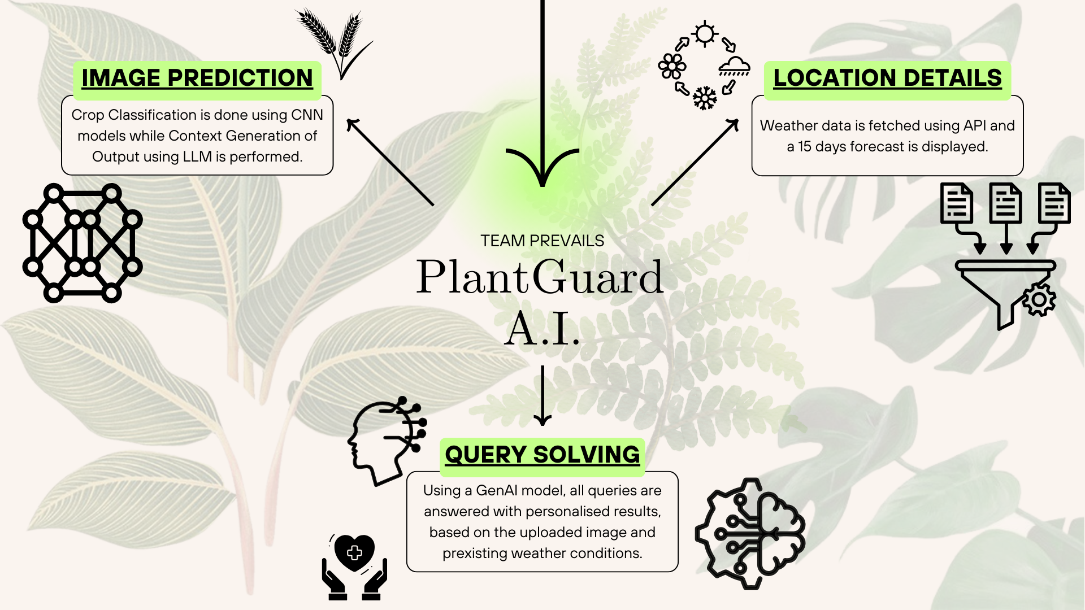
IDEA TITLE
Team Prevails
Detailed explanation of the proposed solution
A pre-trained CNN(EfficientNetB0), is fine-tuned on our crop disease dataset to improve detection accuracy. The model is then integrated with real-time environmental data, providing analysis to mitigate risks.
How it addresses the problem
Identifies patterns in crop images and allows for early detection.
Real-time weather data linked to user’s location using Visual Crossing API.
Personalized Solutions based on User’s Dynamic Queries.
Proposed Solution

Slide 3
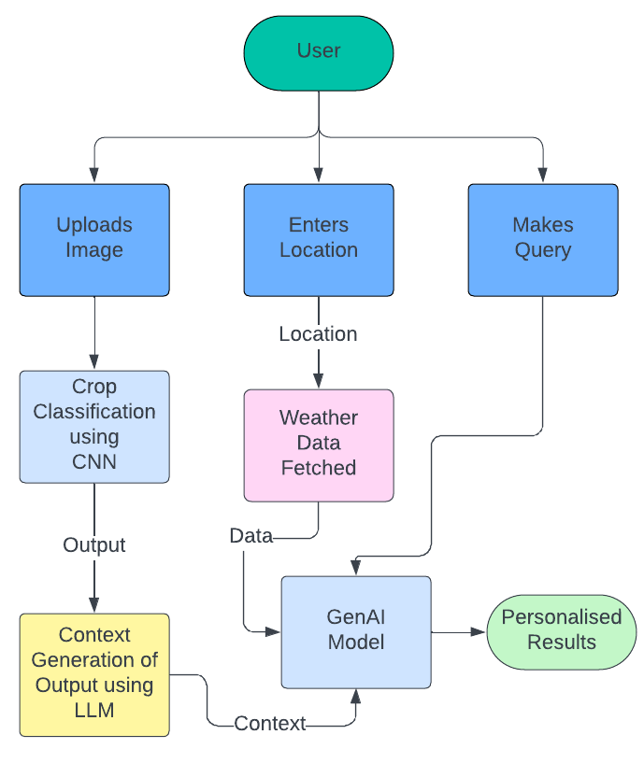




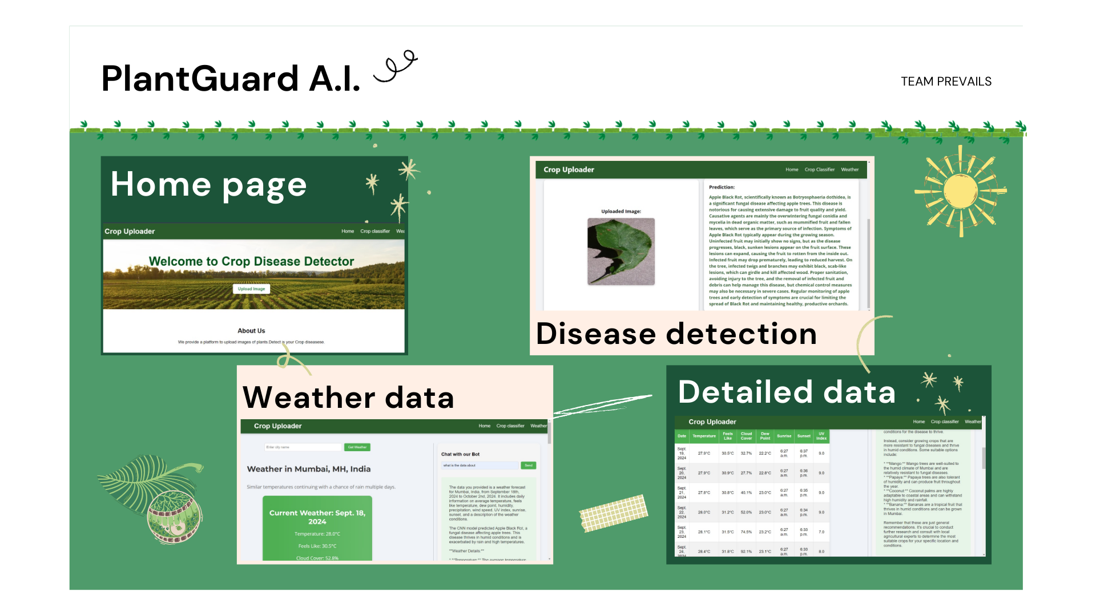






TECHNICAL APPROACH
Team Prevails
Technologies to be used
Framework
Logic & Development
Database
Flowchart
Process
Implementation

Slide 4
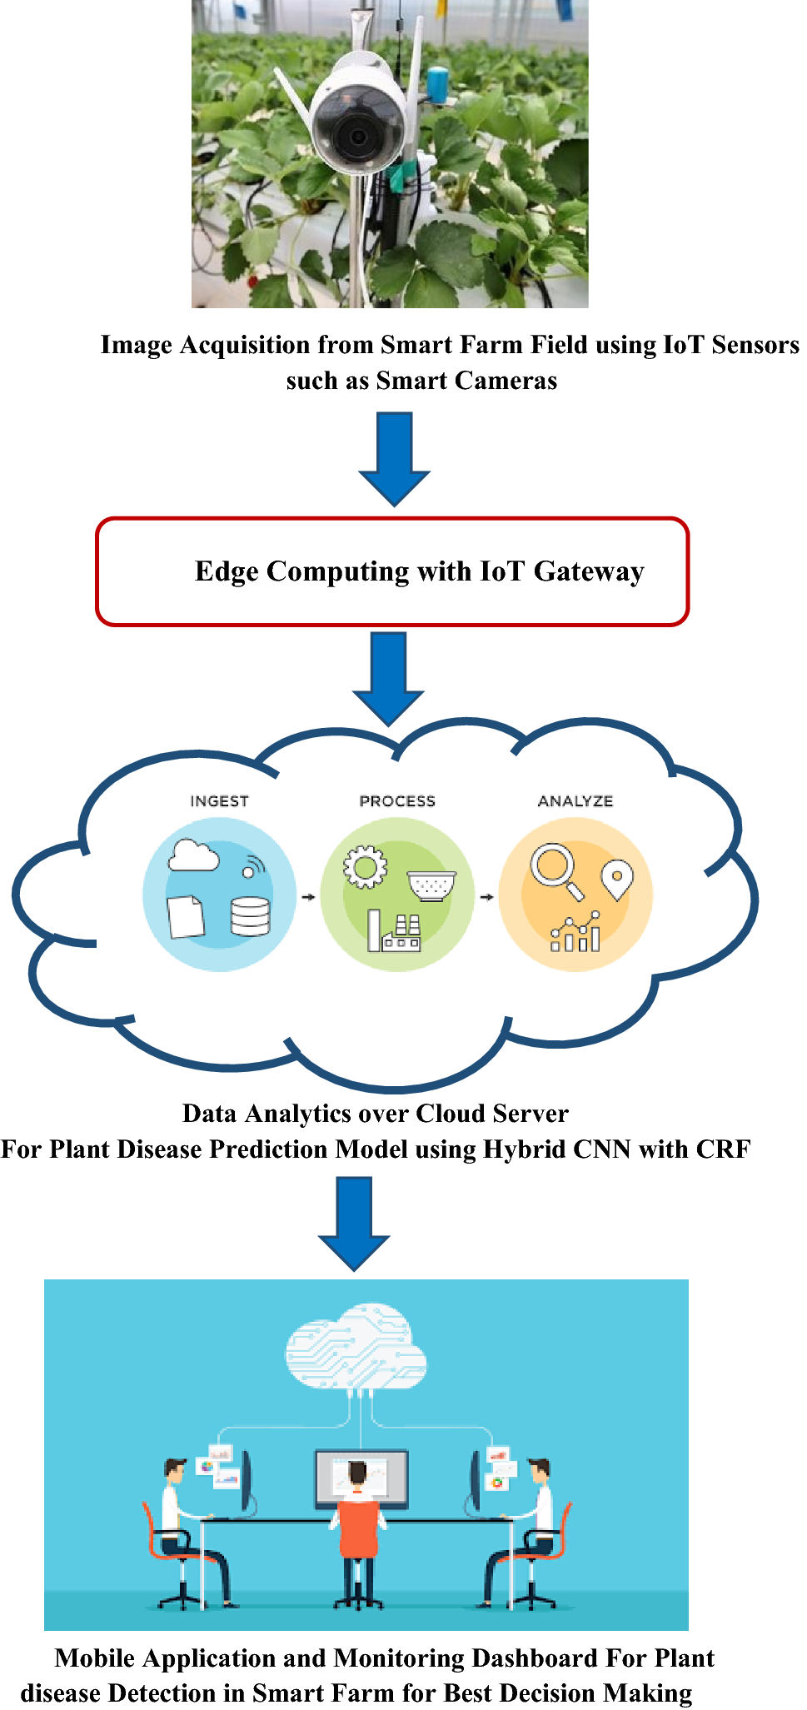
FEASIBILITY AND VIABILITY
Team Prevails
Analysis of the feasibility of the idea:
Operational Feasibility- Easy-to-use interface
Economic Feasibility- Cost savings for farmers, affordable.
Scalability- Can be scaled to support multiple languages.
Potential challenges and risks:
Ensuring the model remains accurate across a wide variety of crops and diseases as it scales.
Slow disease detection due to manual image upload processes, especially in remote areas.
Strategies for overcoming these challenges:
Fine-tuning the model with user-provided feedback for improved generalization.
Implementing IoT feature that allows direct image uploads from mobile devices will streamline detection.

Slide 5
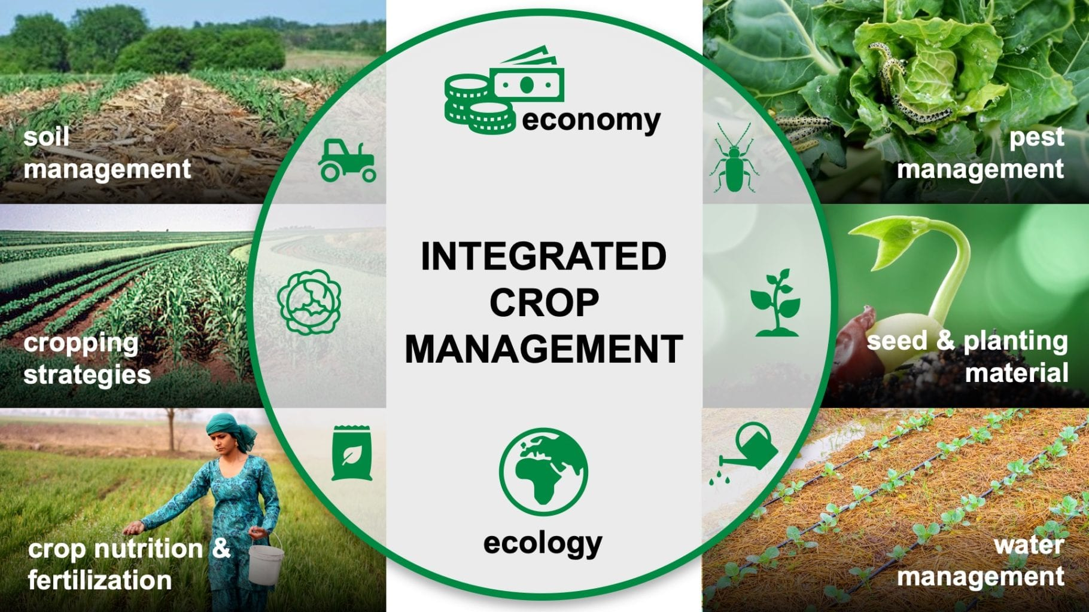
IMPACT AND BENEFITS
Team Prevails
Potential impact on the target audience:
Improved crop health monitoring, to reduced disease-related losses, higher yields, and more informed decision-making.
Integration of user feedback and IoT features can make the system more accessible and user-friendly.
Benefits of the solution:
Reduces crop failure risks, contributing to crop management.
Minimizes yield losses through early detection.
Enhances resource management, reducing water and soil degradation.

Slide 6
RESEARCH AND REFERENCES
Team Prevails
Details / Links of the reference and research work:
https://www.researchgate.net/publication/378629402_Plant_Diseases_Diagnosis_with_Artificial_Intelligence_AI
https://www.researchgate.net/publication/371540306_Developing_a_Crop_Disease_Detection_Using_Deep_LearningArtificial_Intelligence_Approach_for_Precision_Agriculture
https://www.sciencedirect.com/science/article/pii/S2772375523000680
https://www.frontiersin.org/journals/plant-science/articles/10.3389/fpls.2024.1356260/ful

