Slide 1
Functions of a Database Management System

Slide 2
Functions of a DBMS
C.J. Date
Indexing
Views
Security
Integrity
Concurrency
Backup/Recovery
Design
Documentation
Update/Query

Slide 3
Views
Custom representations of a database that correspond to the needs of a class of users. Stored SELECT statements.

Slide 4
Views
Views Provide: representations of data for different users to
  protect data quality
  insulate users from changes in structure
CREATE VIEW
VIEWNAME {VIEW ATTRIBUTES}
AS (SELECT ..WHERE ..)

Slide 5
Views
Views Permit
Maintaining a constant user interface
Restricting access to specified attributes
Specifying user rights

Slide 6
Views
3 Schema Architecture
User Views (Views or Queries)
LOGICAL
Database administrators model for the data (E-R diagrams)
CONCEPTUAL
Actual data placement and
structure (SQL statements)
PHYSICAL

Slide 7
Security
Components that limit access or actions to limit potential damage to data.

Slide 8
Security
Limit data access to properly authorized users or programs. Protect data against accidental or intentional damage.
      Deter
      Detect
      Minimize
      Recover
      Investigate

Slide 9
Security Approaches
Views limit access and actions
Authorization Rules identify users and restrict actions
User Defined Procedures in addition to database security functions
Encryption encode stored data
Authentication positively identify users

Slide 10
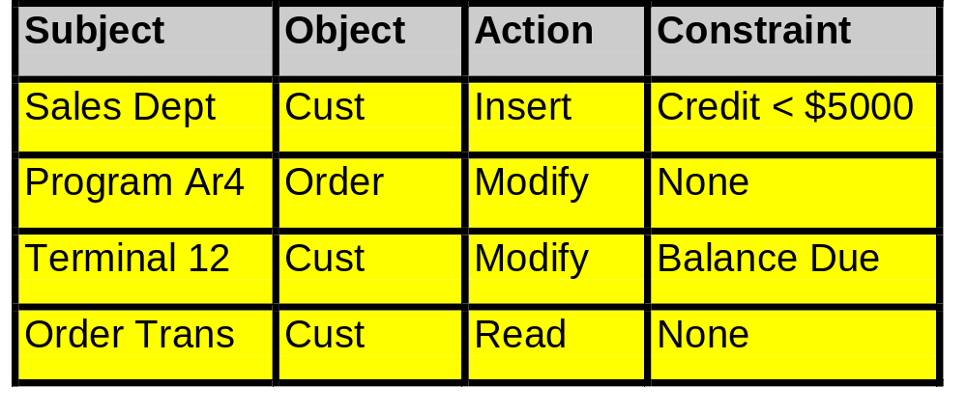
Authorization Rules

Slide 11
Authorization Rules
Some DBMS products authorize actions based on specific records and functional descriptions. However, most DBMS’s limit actions on tables to one of:
  Read: view but not change
  Insert: read and add records
  Update: read, insert and change records
  Alter/Delete: read, insert, update and delete records, change table structure

Slide 12
User Defined Procedures
Code modules that enforce security procedures are run during processing
User
Procedures
DBMS
Constraints
DBMS

Slide 13
Integrity
Components that preserve the relationship among different related records in the database

Slide 14
Integrity
The relationship among records in the database
Referential Integrity
Non Key Integrity
Derived Conditions

Slide 15
Constraints in SQL
CREATE TABLE … or
  ALTER TABLE … ADD
CHECK(condition)
PRIMARY KEY attribute-name
FOREIGN KEY attribute-name REFERENCES parent-table
The parent table must already have a primary key defined

Slide 16
Concurrency
Preventing two users from interfering with each other when they use the same information

Slide 17
Concurrency
Lockout
  Restricting access to users who could be misled by partial transactions
Versioning
  Making trial updates on versions of the database and denying one if there is a data conflict.

Slide 18
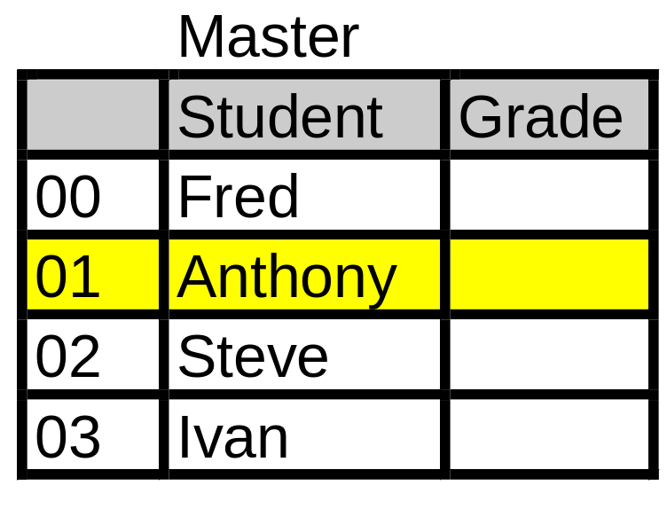
Locks
Program 1 locks record
<exclusive>.
  No other program can
  read the record.
  No program can have
  an active lock.
Program 2 locks record
<shared>
  Other programs can
  read, but not change
  record.
  No program can have
  an exclusive lock.

Slide 19
Locks
On INSERT or UPDATE statements
SELECT column-names
FROM table-names
WHERE …
FOR UPDATE OF column-names
NOWAIT;

Slide 20
Concurrency
Locks
Granularity
  Field
  Record
  Table
  Database
Exclusivity
  Exclusive
  Shared

Slide 21
Concurrency
Deadlock
Two programs request conflicting sets of data lock up the database while awaiting access.
  Program 1 locks record A
  Program 2 locks record B
  Program 1 requests lock on record B; waits
  Program 2 requests lock on record A; waits
System either times out and restarts each transaction after a random wait or recognizes the deadlock to abort one program.

Slide 22
Versioning
Version 1
Time 1
Version 2
Time 2
Version 3
Time 3
Commits version 3 only after changes to versions 1
and 2 have been rolled back.

Slide 23
Backup and Recovery
Processes to confirm and repeat transactions so that database can be restored to a valid state after a problem.

Slide 24
Backup and Recovery
Backup Copies
  Master
  Transaction Log
Journalization
  Forward Log
  Backward Log
Checkpoints

Slide 25
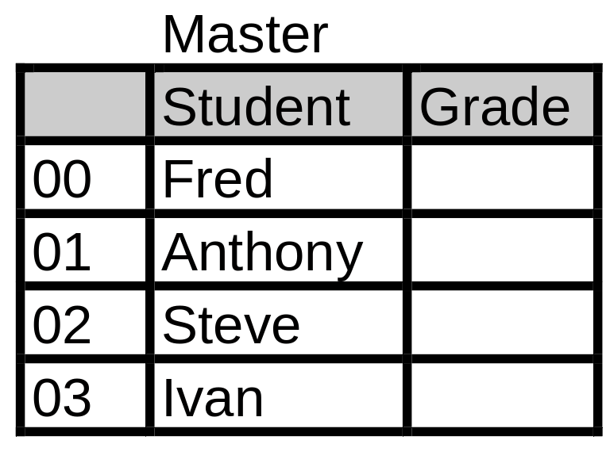
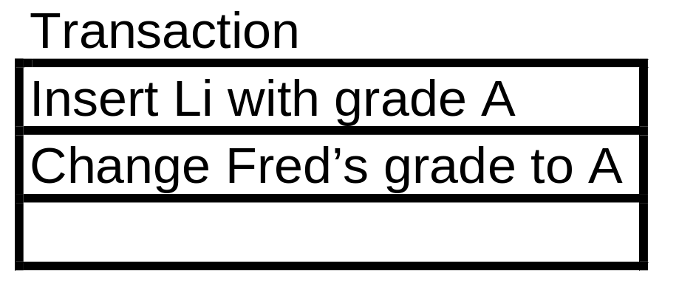
DBMS Logs

Slide 26
Recover from Backup
Transac-
tion
Recovered
Database
Backup
+
=
Slow
May give different answers from original

Slide 27
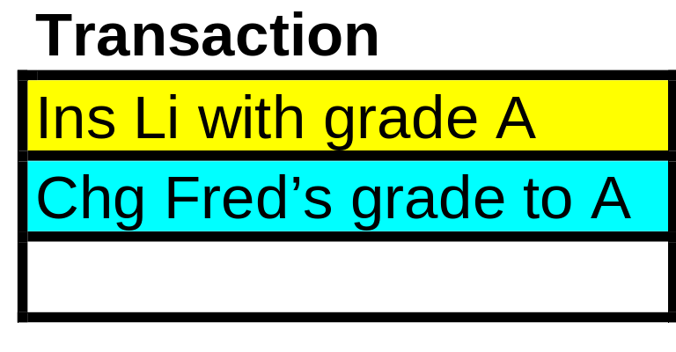
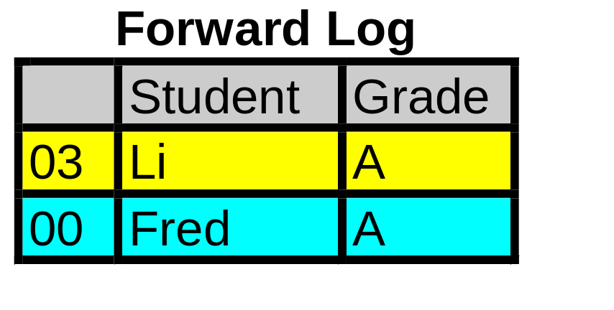
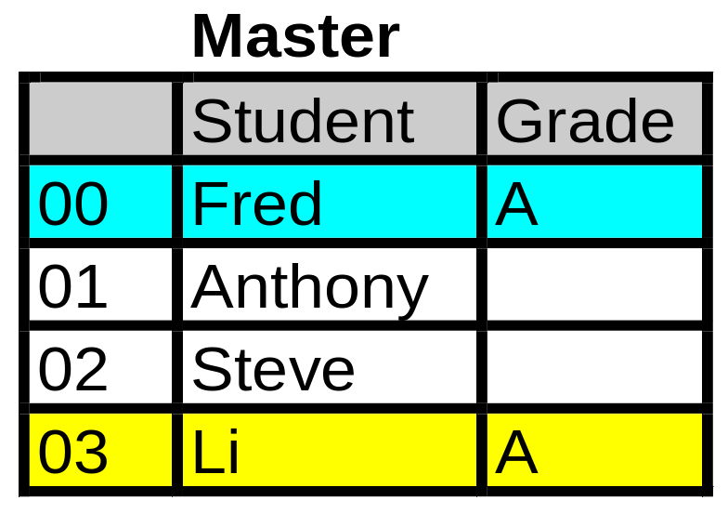
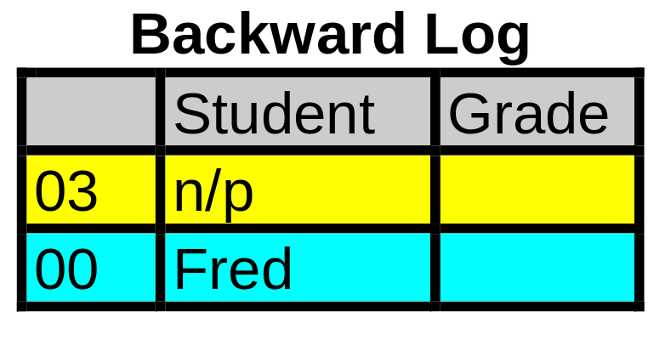
DBMS Logs

Slide 28
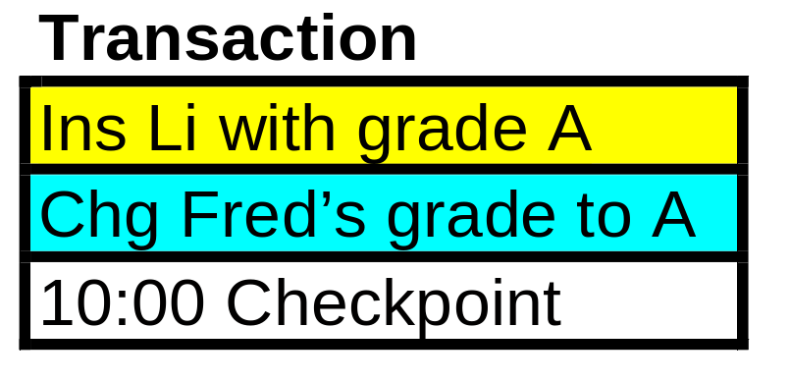
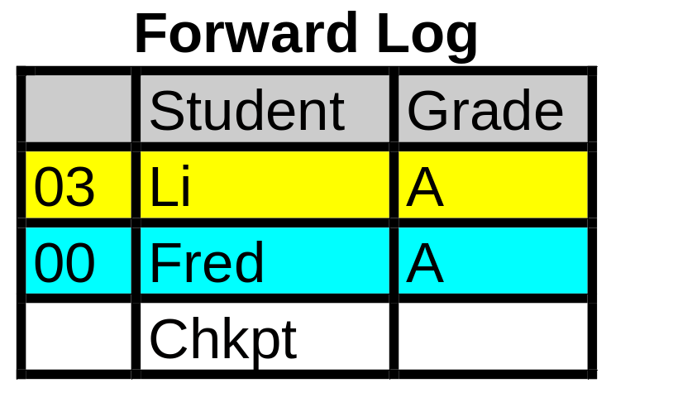
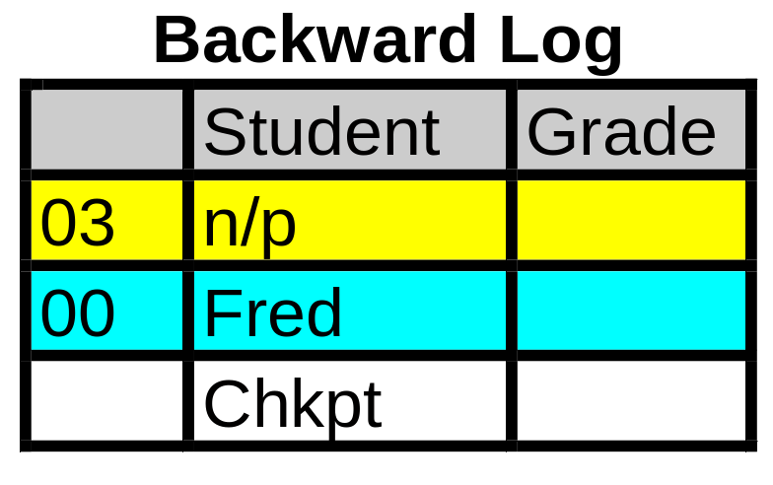
DBMS Logs

Slide 29
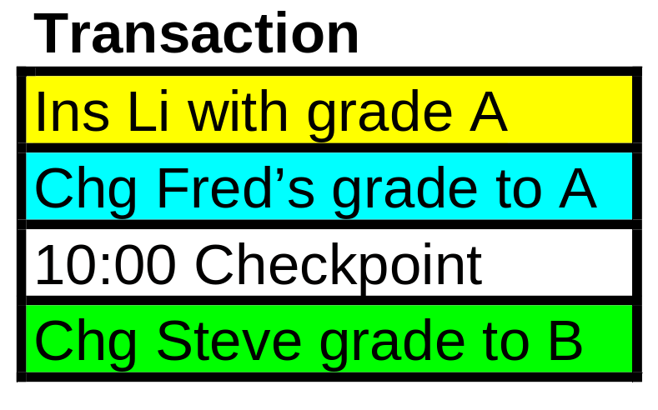
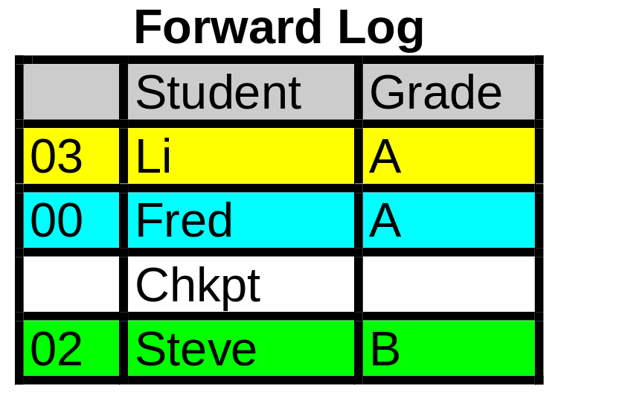
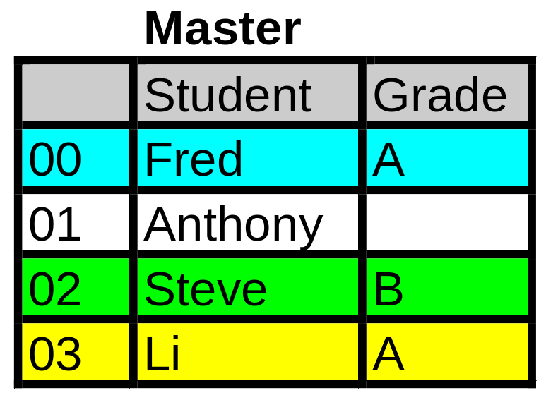
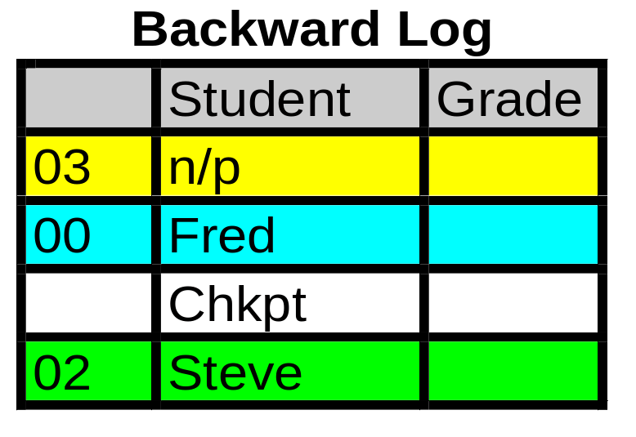
DBMS Logs

Slide 30
Recover to Checkpoint
Using Logs
Contaminated
Database
Backward
Log
Correct at
Checkpoint
-
=
Recent
Transactions
Recovered
Database
+
=

Slide 31
Transaction Processing
A set of computer operations required to process a single unit of work.
A transaction must conclude with the database in a valid state whether the transaction terminates correctly or abnormally

Slide 32
Transaction Processing
Transaction Boundary
  Locking
    Exclusive Shared
  Logging
    Forward Backward Transaction
  Modification
    Delete Insert Update
  Commitment
    Commit Rollback

Slide 33
Transaction Boundaries
Set Boundary
  Obtain Locks
  Execute Code Modules
  Evaluate Correctness
Commit or Rollback
  Release Locks

Slide 34
Transaction Boundaries
Set savepoint:
SAVEPOINT order_save;
Commit or rollback:
ROLLBACK TO order_save;

Slide 35
Transaction Boundaries
Premiere Products Example
SALESREP
CUSTOMER
ORDER
PRODUCT
ORDER-PRODUCT
Place an order for a new customer
with a 1500 credit limit

Slide 36
Transaction Boundaries
Premiere Products Example
SALESREP
CUSTOMER
ORDER
PRODUCT
ORDER-PRODUCT
Insert CUSTOMER Record
Update CUSTOMER with SALESREP Foreign Key
Insert ORDER Record
Insert ORDER-PRODUCT with Foreign Keys
Update ProductOnHand in PRODUCT
Check Credit Limit

Slide 37
Transaction Processing
Programming Logic
Two phased locking requires obtaining locks on all necessary records before releasing locks on any records.
Obtain locks on all records needed
Perform calculations
Release locks

Slide 38
Functions of a DBMS
C.J. Date
Indexing
Views
Security
Integrity
Concurrency
Backup/Recovery
Design
Documentation
Update/Query

