Slide 1

Capstone Project: Credit Card Fraud Detection System
By
- Ankush Patil
- Abhishek Kurri

Slide 2
Agenda:
Objective
Background
Key Insights
Cost Benefit Analysis
Appendix
Data Attributes
Data Imbalance Handling
Models
References
Capstone Project: Credit Card Fraud Detection System

Slide 3
Objective :
We need to recommend a credit card fraud detection system to Finex, a leading financial provider in the USA, to reduce the costs incurred due to fraudulent transactions and enhance the customer experience.
Capstone Project: Credit Card Fraud Detection System

Slide 4
Background :
Finex is a leading financial service provider based in Florida, USA. It offers a wide range of products and business services to customers through various channels, including in-person banking, ATMs, and online banking. In recent years, Finex has observed a significant increase in unauthorized transactions through credit cards. Reports indicate that fraudsters use stolen or lost cards and hack private systems to access the personal and sensitive data of many cardholders.
In many cases, customers become aware of these fraudulent transactions quite late, as they are often unaware of ongoing fraud. This delay leads to late complaint registration with Finex, and by the time the cases are flagged as fraudulent, the bank incurs substantial losses and ends up reimbursing the lost amounts to their cardholders.
Additionally, Finex lacks the latest technologies necessary to effectively track and prevent these activities. The Bank's manager now aims to identify the root causes and areas for action.
Capstone Project: Credit Card Fraud Detection System

Slide 5
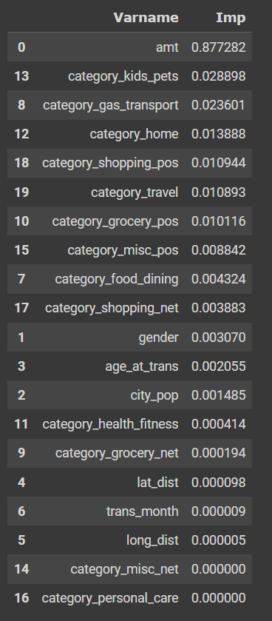
Key Insights :
Transaction amount, category and gender are the most important variables
Kids & Pets, Gas and transport, Home are the top three categories
Capstone Project: Credit Card Fraud Detection System

Slide 6
Current Incurred Losses :
The average number of transactions per month is approximately # 77,183.
The average number of fraudulent transactions per month is approximately # 402.13
The average amount for fraudulent transactions is approximately $530.66.
Total cost incurred from the fraud detection $213,394.30
Capstone Project: Credit Card Fraud Detection System

Slide 7
After new model deployment:
The model detected 8,757 fraudulent transactions, incurring a cost of $1.5 each for customer support. This totals $13,136.5.
Additionally, there were 27 fraudulent transactions that the model did not detect, resulting in a loss of $14,173.08
The total cost incurred after deploying the new model is $27,309.58
After implementing the new model, the final savings amount to $186,082.64, representing an 87% reduction in losses.
Capstone Project: Credit Card Fraud Detection System

Slide 8
Appendix: Data Attributes
index - Unique Identifier for each row
transdatetrans_time - Transaction DateTime
cc_num - Credit Card Number of Customer
merchant - Merchant Name
category - Category of Merchant
amt - Amount of Transaction
first - First Name of Credit Card Holder
last - Last Name of Credit Card Holder
gender - Gender of Credit Card Holder
street - Street Address of Credit Card Holder
city - City of Credit Card Holder
state - State of Credit Card Holder
zip - Zip of Credit Card Holder
Capstone Project: Credit Card Fraud Detection System

Slide 9
Appendix: Data Methodology
A random forest classifier was built on top of a Kaggle-simulated dataset.
Class imbalance was addressed using the Adaptive Synthetic (ADASYN) sampling method.
Manual hyperparameter tuning was performed due to the extensive computational time required when using Grid Search Cross Validation
Capstone Project: Credit Card Fraud Detection System

Slide 10
ATTACHED FILE
Cost Benefit Analysis: Cost+Benefit+Analysis.xlsx
Random Forest Classifier Model: DS49_fraud_detection_model_v2.ipynb
Capstone Project: Credit Card Fraud Detection System

Slide 11

Thank You !
- Ankush Patil
- Abhishek Kurri

