Slide 1
Exoplanet Detection
Executed by - Ankush Raut
B.Tech. 3rd year, Production and Industrial Engineering
Inter IIT Tech Meet, Jan 2018

Slide 2
Problem Statement
To build a machine learning algorithm to classify Kepler Objects of Interest (KOIs) as having exoplanets/not having exoplanet.

Slide 3
Machine Learning Pipeline
PS
Exploratory Data Analysis
Modelling
Validation

Slide 4
Data
3960 KOIs described using 3000 different features
Either labelled as 1 or 2
Label imbalance: 1 - 3927, 2 - 33
Possible approaches - Feature decomposition, LASSO, Gradient Boosting Trees (probabilistic output)

Slide 5

Data separation and baseline
Stratified split into training set, validation set and test set.
Training and validation set - 90% of the data
Training set - 85% of the training and validation set combined
For baseline, label = mode of the labels (Category 1)
Performance:

Slide 6
Model - Fitting (XGBoost)
Binary logistic classification using gradient boosting trees
L1 regularization parameters = 5
L2 regularization parameter = 5
Evaluation metric - Negative log likelihood

Slide 7
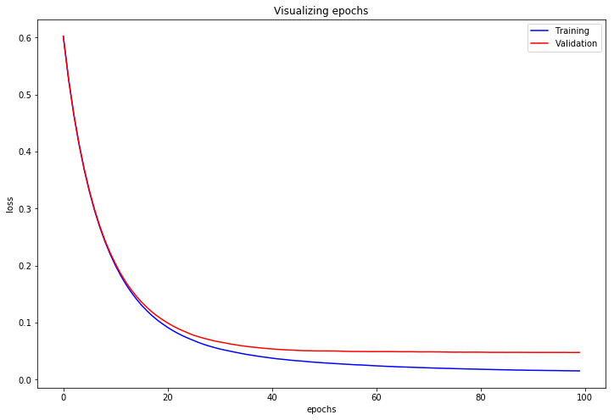
Model - Loss v/s epochs

Slide 8
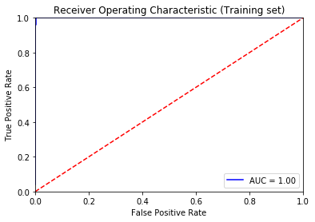
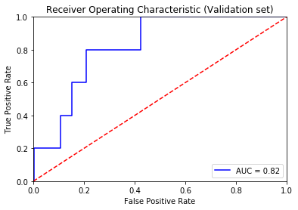
Receiver operator characteristics

Slide 9
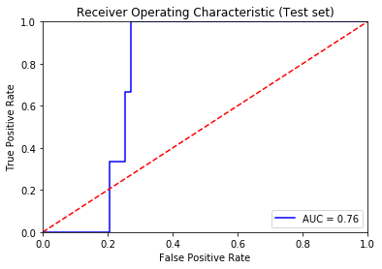
Receiver Operator Characteristics

Slide 10
Performance
Probability threshold = 0.16 (based on visualizing ROC)
Micro f1-score -> Training set = 0.999, Validation set = 0.987 Test set = 0.982
Macro f1-score -> Training set = 0.968, Validation set = 0.608 Test set = 0.496

Slide 11
Confusion matrix
Training set
LABEL | Predicted 1 | Predicted 2
Actual 1 | 3004 | 0
Actual 2 | 3 | 22

Slide 12
Confusion matrix
Validation set
LABEL | Predicted 1 | Predicted 2
Actual 1 | 527 | 3
Actual 2 | 4 | 1

Slide 13
Confusion matrix
Test set
LABEL | Predicted 1 | Predicted 2
Actual 1 | 389 | 4
Actual 2 | 3 | 0

Slide 14
Thanks!

