Slide 1
Agriculta Drumseeder Sales Analysis
Team name - AKAI
Members - Ankush Raut | Sanchit Minocha

Slide 2
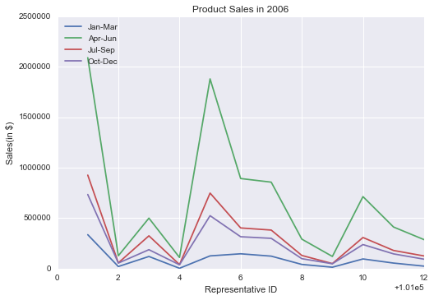
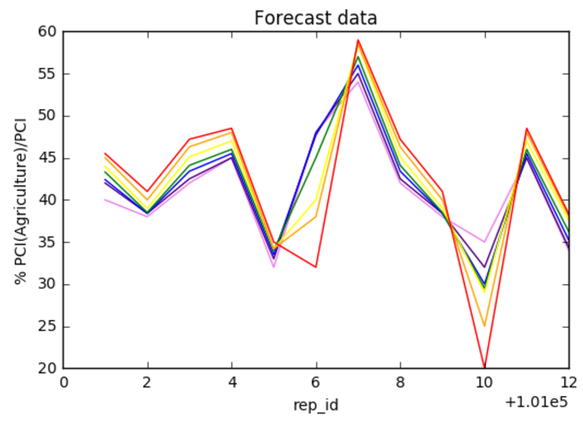
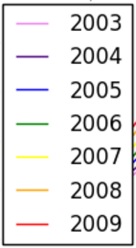
Product Sales (2006)- trends and probable causes
Ariland - Maximum sales irrespective of season
probable cause: Michael McCallister working well; inclination of per capita income towards agriculture at an average value amongst all regions, hence, improvement not that difficult
Direland - Minimum sales irrespective of season
probable cause: Luanne Morris not working well, since inclination of per capita income towards agriculture is increasing gradually from 2003 to 2009
Apr-Jun experience maximum sales irrespective of region
probable cause: Drum seeders are needed mostly in this season, since paddy is extensively sown
Jan-Mar experience minimum sales irrespective of region
probable cause: off-season for paddy sowing
Firoland and Goland experience almost same amount of sales
probable cause - Anthony Searcy is working much better as compared to Marsha Brawley since inclination of per capita income towards agriculture is always less in Firoland as compared to Goland
Kendrick Carpenter performing exceptionally well; exceptionally high sales in Eupland for Apr-Jun

Slide 3
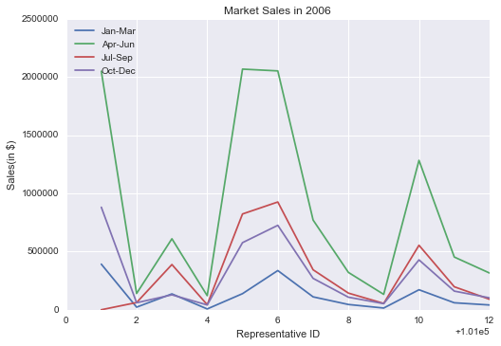
Market Sales (2006) - trends and probable causes
Product not marketed at all in Ariland in Jul-Sep
Product neither marketed well nor did the respective sales representatives performed well inBaseland, Direland, Iroland and Lonland

Slide 4
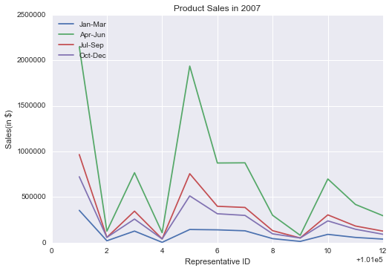
Product Sales (2007) - trends and probable causes
Same trends as compared to product sales in 2006; same probable causes
Exception : Iroland has minimum sales in Apr-Jun instead of Direland (anomaly)

Slide 5
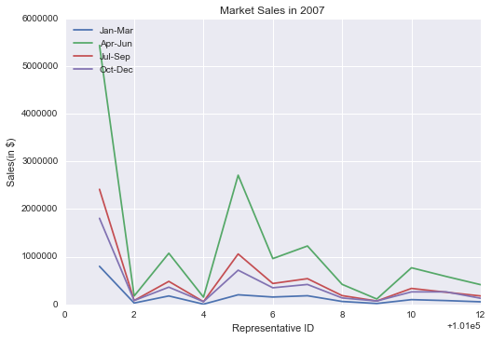
Market Sales (2007) - trends and probable causes
Ariland experiences tremendous marketing advantage in Apr-Jun season
Marketing intensity decreases substantially in Eupland for Apr-Jun season

Slide 6
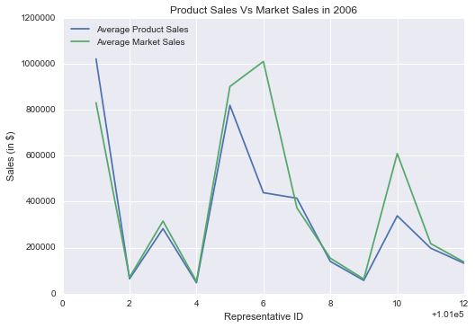
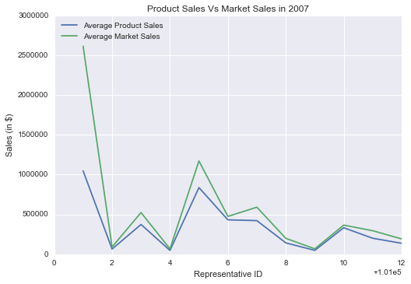
Product sales vs Market sales
In general, market sales are greater than the product sales

Slide 7
Incentive compensation design
Given factors to be considered
A = %(PCI from agriculture/ PCI), Product sales
IC = Incentive compensation ɑ (Product sales, A)
The incentive compensation should be substantial for the sales representatives that brought about nice amount of product sales irrespective of less 'A'
So, IC = f(Product sales/ A)

Slide 8
Conclusion
The company's performance on an overall basis has been dismal, given that some regions with gradual growth in 'A' over the years have experienced a downfall in product sales as well as market sales
More desired factors for incentive compensation
Number of hours dedicated to the job
Current pay of the sales representatives

