Slide 1
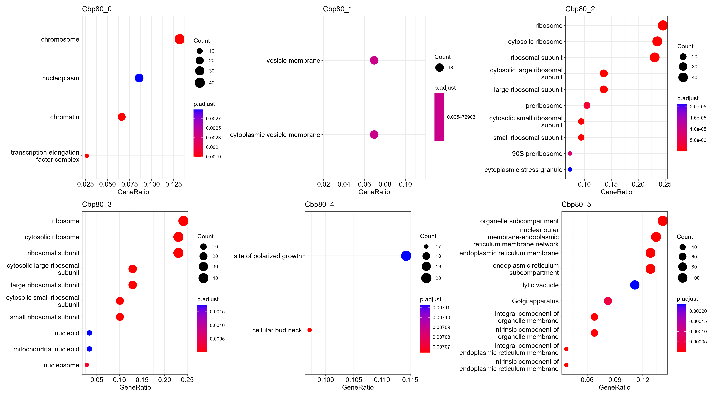

Slide 2
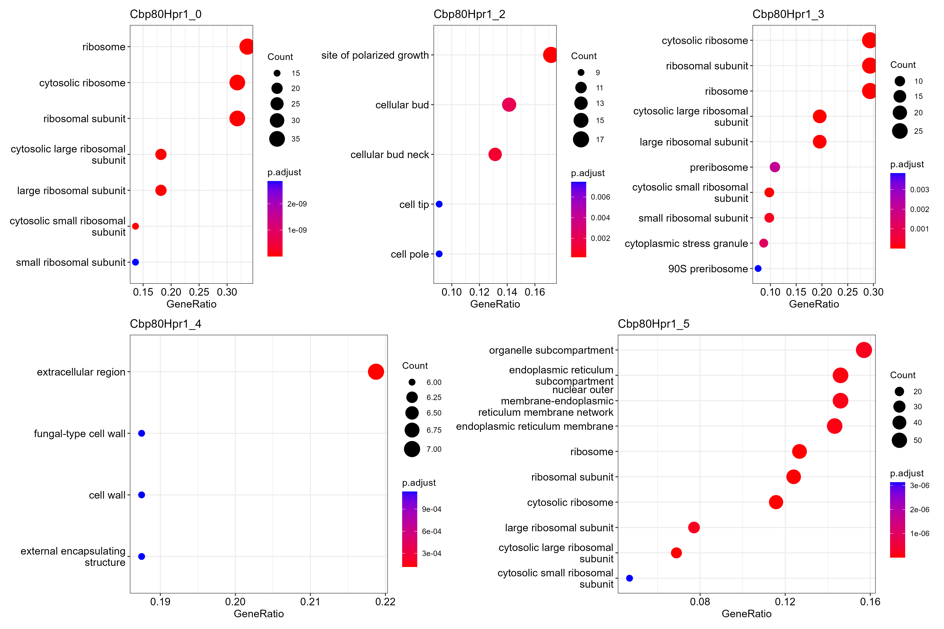

Slide 3
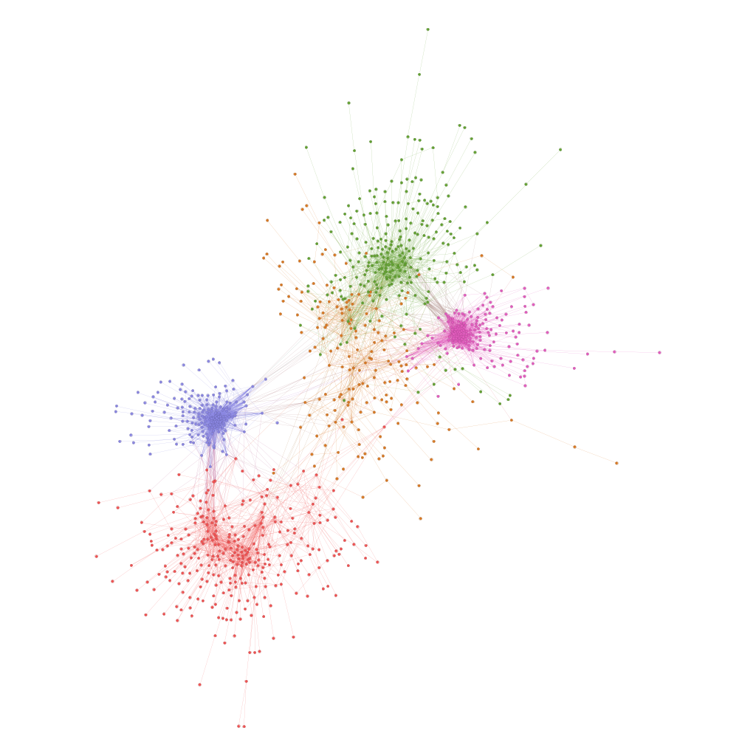
K-mer clustering and Motif enrichment for Cbp80-associated transcripts
1
SITES | GeneID | Annotation | Community
114 | NAB2 | YGL122C | 0
88 | MSL5 | YLR116W | 0
54 | PRP24 | YMR268C | 0
48 | PRP24 | YMR268C | 0
257 | RNA15 | YGL044C | 1
96 | NAB3 | YPL190C | 1
45 | NAB3 | YPL190C | 1
76 | RNA15 | YGL044C | 2
129 | NAB2 | YGL122C | 2
70 | EMG1 | YLR186W | 2
47 | EMG1 | YLR186W | 2
81 | RPB2 | YOR151C | 2
10 | RPB2 | YOR151C | 2
176 | VTS1 | YOR359W | 2
105 | VTS1 | YOR359W | 2
129 | RPO21 | YDL140C | 3
155 | MSL5 | YLR116W | 3
129 | EMG1 | YLR186W | 3
58 | EMG1 | YLR186W | 3
44 | VTS1 | YOR359W | 3
50 | NAB3 | YPL190C | 3
42 | RPO21 | YDL140C | 4
60 | NAB3 | YPL190C | 4
3
2
4
Excluded Motifs that did not have a corresponding annotation
0

Slide 4
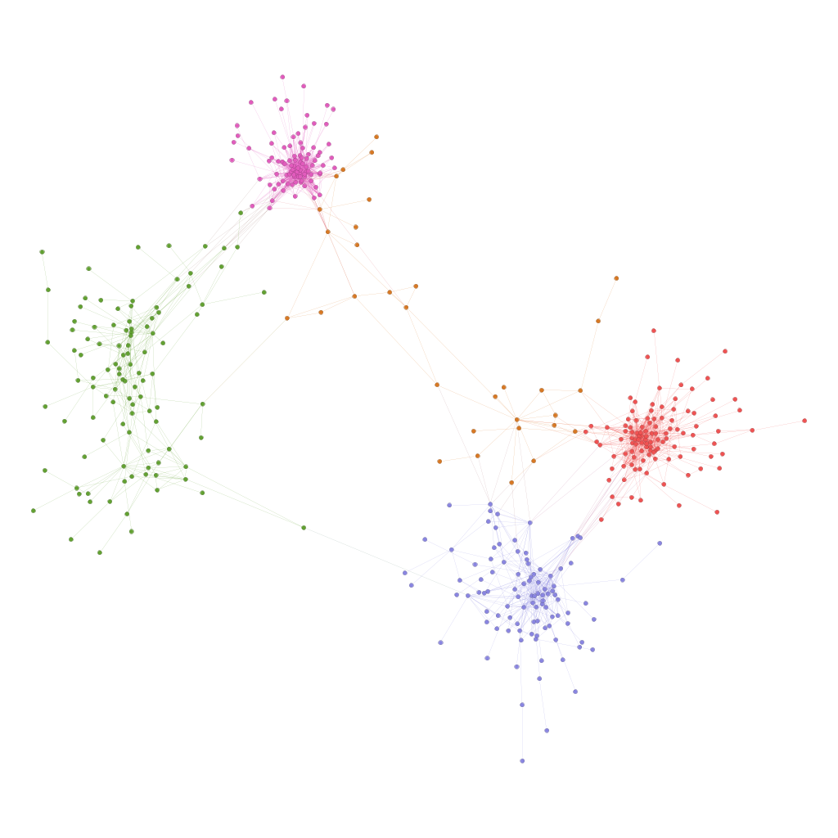
K-mer clustering and Motif enrichment for Cbp80Hpr1-associated transcripts
3
SITES | GeneID | Annotation | Community
51 | RPO21 | YDL140C | 0
50 | MSL5 | YLR116W | 0
109 | MSL5 | YLR116W | 0
86 | EMG1 | YLR186W | 0
40 | NAB3 | YPL190C | 0
43 | NAB2 | YGL122C | 1
50 | MTR4 | YJL050W | 1
50 | MPT5 | YGL178W | 2
31 | VTS1 | YOR359W | 2
98 | NAB3 | YPL190C | 2
42 | NAB3 | YPL190C | 2
49 | NAB3 | YPL190C | 2
70 | MSS116 | YDR194C | 3
33 | NAB2 | YGL122C | 3
40 | NAB2 | YGL122C | 3
83 | MSL5 | YLR116W | 3
91 | EMG1 | YLR186W | 3
28 | RPB2 | YOR151C | 3
33 | VTS1 | YOR359W | 3
87 | VTS1 | YOR359W | 3
55 | VTS1 | YOR359W | 3
85 | VTS1 | YOR359W | 3
70 | VTS1 | YOR359W | 3
74 | NAB2 | YGL122C | 4
294 | EMG1 | YLR186W | 4
284 | VTS1 | YOR359W | 4
113 | VTS1 | YOR359W | 4
112 | NAB3 | YPL190C | 4
0
1
4
2
1. Kirk, J.M., Kim, S.O., Inoue, K., Smola, M.J., Lee, D.M., Schertzer, M.D., Wooten, J.S., Baker, A.R., Sprague, D., Collins, D.W., et al. (2018). Functional classification of long non-coding RNAs by k-mer content. Nat Genet 50, 1474–1482. 10.1038/s41588-018-0207-8.
2. Giudice, G., Sánchez-Cabo, F., Torroja, C., and Lara-Pezzi, E. (2016). ATtRACT—a database of RNA-binding proteins and associated motifs. Database 2016, baw035. 10.1093/database/baw035.

Slide 5
