Slide 1
D3 Tutorial
DIT/IDF
24.04.2015
Bruno Tavares
bruno-f-tavares@telecom.pt

Slide 2
ÍNDICE
1. D3
1.1 What 04
1.2 Why 05
1.3 Where 06
2. TUTORIAL
2.1 selectAll 08
2.2 data 09
2.3 exit 10
2.4 enter 11
2.5 “update” 12
3. HANDS ON

Slide 3

1. D3

Slide 4
1.1 D3
What
D3.js is a JavaScript library for manipulating documents based on data.
D3 helps you bring data to life using HTML, SVG and CSS.
Combining powerful visualization components and a data-driven approach to DOM manipulation.

Slide 5
1.2 D3
Why
Pro Cons
Flexible Learning Curve
Usefull Methods Mindset
Examples and Documentation With Great Power...

Slide 6
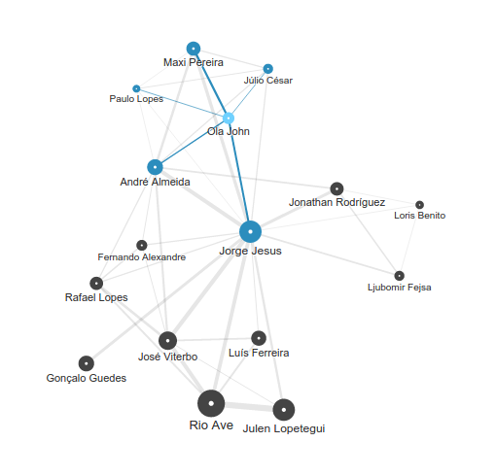

1.3 D3
Where
Twitteuro – http://twitteuro.sapo.pt
MVDi – http://voxx.sapo.pt/mvdi/
Grande Area – http://grandearea.desporto.sapo.pt

Slide 7
2. TUTORIAL
var d3Elem = d3.select( '#demo' );
var dataElem = d3Elem.selectAll( '.demo' )
.data( [ { Id : 2 , value : 'H' } ,
{ Id : 1 , value : 'E' } ,
{ Id : 3 , value : 'L' } ,
{ Id : 5 , value : 'L' } ,
{ Id : 4 , value : 'O' } ] , function( d ) { return d.Id; });
dataElem.enter( )
.append( 'span' )
.attr( 'class' , 'demo' );
dataElem.exit( )
.remove( );
dataElem.text(function( d ) { return d.value; });

Slide 8
2.1 TUTORIAL
selectAll
Selects all elements that match the specified selector. The elements will be selected in document traversal order (top-to-bottom). If no elements in the current document match the specified selector, returns the empty selection.
var elem = d3.select( <selector> );
var selection = elem.selectAll( <selectors> );
var selection = d3.select( <selector> )
.selectAll( <selectors> )

Slide 9
2.2 TUTORIAL
data
Joins the specified array of data with the current selection. The specified values is an array of data values (e.g. numbers or objects), or a function that returns an array of values. If a key function is not specified, then the first datum in values is assigned to the first element in the current selection, the second datum to the second selected element, and so on. When data is assigned to an element, it is stored in the property __data__, thus making the data "sticky" so that the data is available on re-selection.
var dataElem = d3.select( <selector> )
.selectAll( <selectors> )
.data( <datum> );
...
.data( <datum> , function( d ) { return d.Id; });

Slide 10
2.3 TUTORIAL
exit
Returns the exit selection: existing DOM elements in the current selection for which no new data element was found. This method is only defined on the update selection, which is returned by the data operator. The exit selection defines all the normal operators, though typically the main one you'll want to use is remove; the other operators exist primarily so you can define an exiting transition as desired. Note that the exit operator merely returns a reference to the exit selection, and it is up to you to remove the new nodes.
dataElem.exit( )
…;
elem.selectAll( <selectors> )
.data( [ ] )
.exit( )
.remove( );

Slide 11
2.4 TUTORIAL
enter
Returns the enter selection: placeholder nodes for each data element for which no corresponding existing DOM element was found in the current selection. This method is only defined on the update selection, which is returned by the data operator. In addition, the enter selection only defines the append, insert, select and call operators; you must use these operators to instantiate the entering elements before modifying any content. Enter selections also support empty and size.
dataElem.enter( )
.append( 'span' )
.attr( 'class' , <”selectors”> )
…;

Slide 12
2.5 TUTORIAL
“update”
Don't have!
dataElem.exit( )
.remove( );
dataElem.enter( )
.append( 'span' )
.attr( 'class' , <”selectors”> );
dataElem…;

Slide 13
3. HANDS ON

Slide 14
3 HANDS ON
dataElem.exit( )
.transition( )
.duration( 1000 )
.style( 'opacity' , 0 )
.remove( );
dataElem.enter( )
.append( 'span' )
.attr( 'class' , <”selectors”> )
.style( 'opacity' , 0 );
dataElem…
.transition( )
.duration( 1000 )
.style( 'opacity' , 1 );

Slide 15
3 HANDS ON
dataElem.exit( ).transition( ).duration( 1000 )
.tween( 'text' , function( d ) {
var i = d3.interpolateRound( parseInt( this.textContent , 10 ) , 0 );
return function( t ) { this.textContent = i( t ); };
}).remove( );
dataElem.enter( ).append( 'span' ).attr( 'class' , <”selectors”> ).text( 0 );
dataElem….transition( ).duration( 1000 )
.tween( 'text' , function( d ) {
var i = d3.interpolateRound( parseInt( this.textContent , 10 ) , d.value );
return function( t ) { this.textContent = i( t ); };
});

Slide 16
Executado por:
Bruno Tavares
DIT/IDF
bruno-f-tavares@telecom.pt

