Slide 1
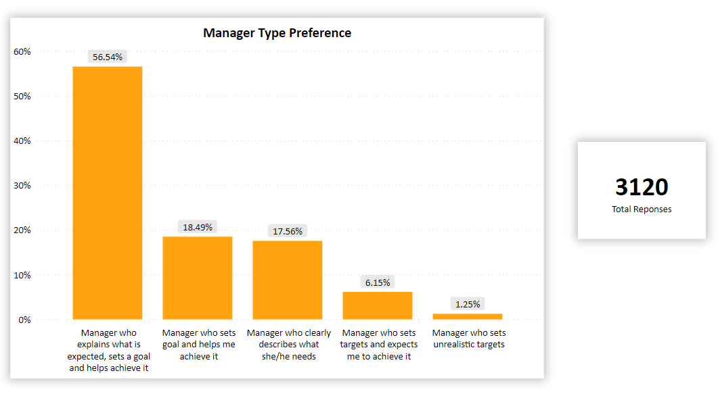
Management Recommendation for IBM
Chart Area
About the Company
Founded in 1911.
Provides hardware, software, and consulting services.
Their current employer overall rating is 4.1/5 & Senior Management is 3.8/5.
Problem
2594 reviews shows that Management is Poor.
Recommendations
Set a clear goal & guide their employees on how to achieve it.
Specifies the expectation they need from their employees.
Consider better treatment & well-being of all the employees.

Slide 2
Thank You

