Slide 1
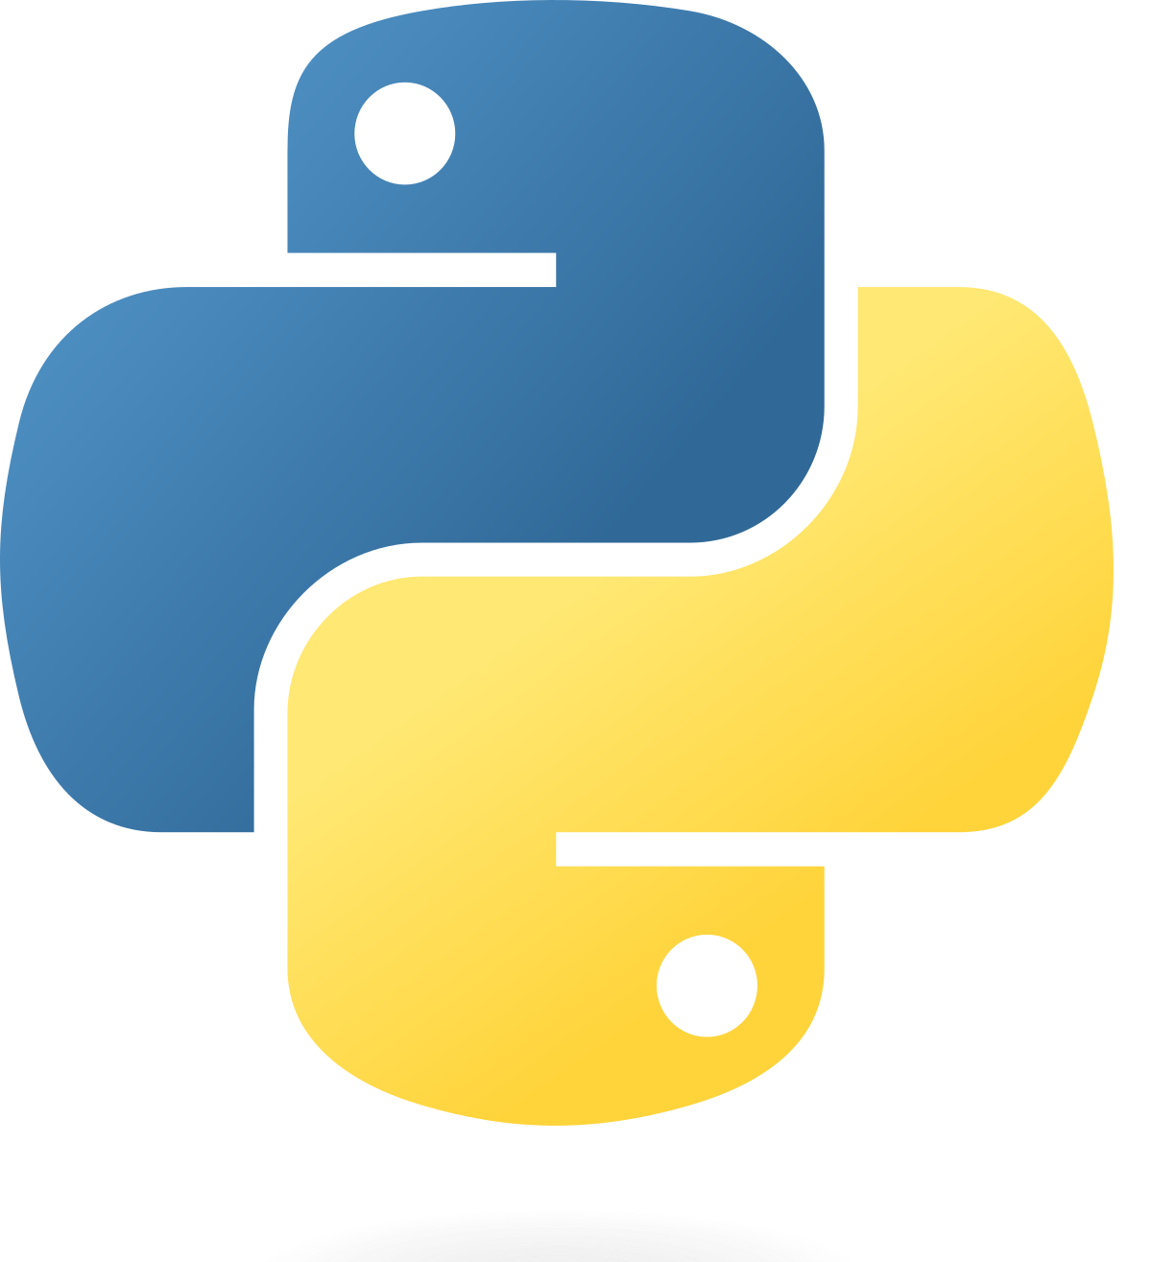
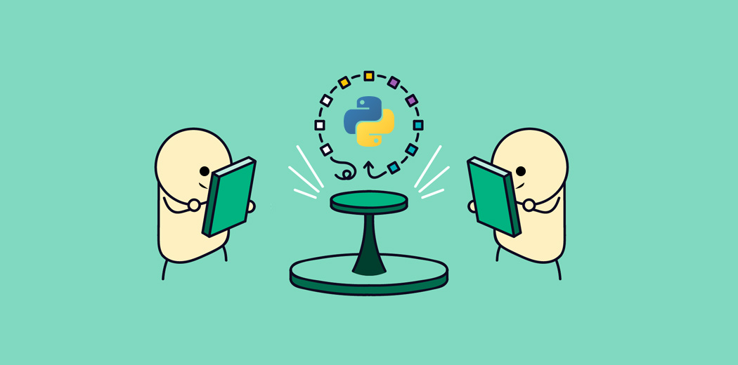
Let’s Learn Python

Slide 2
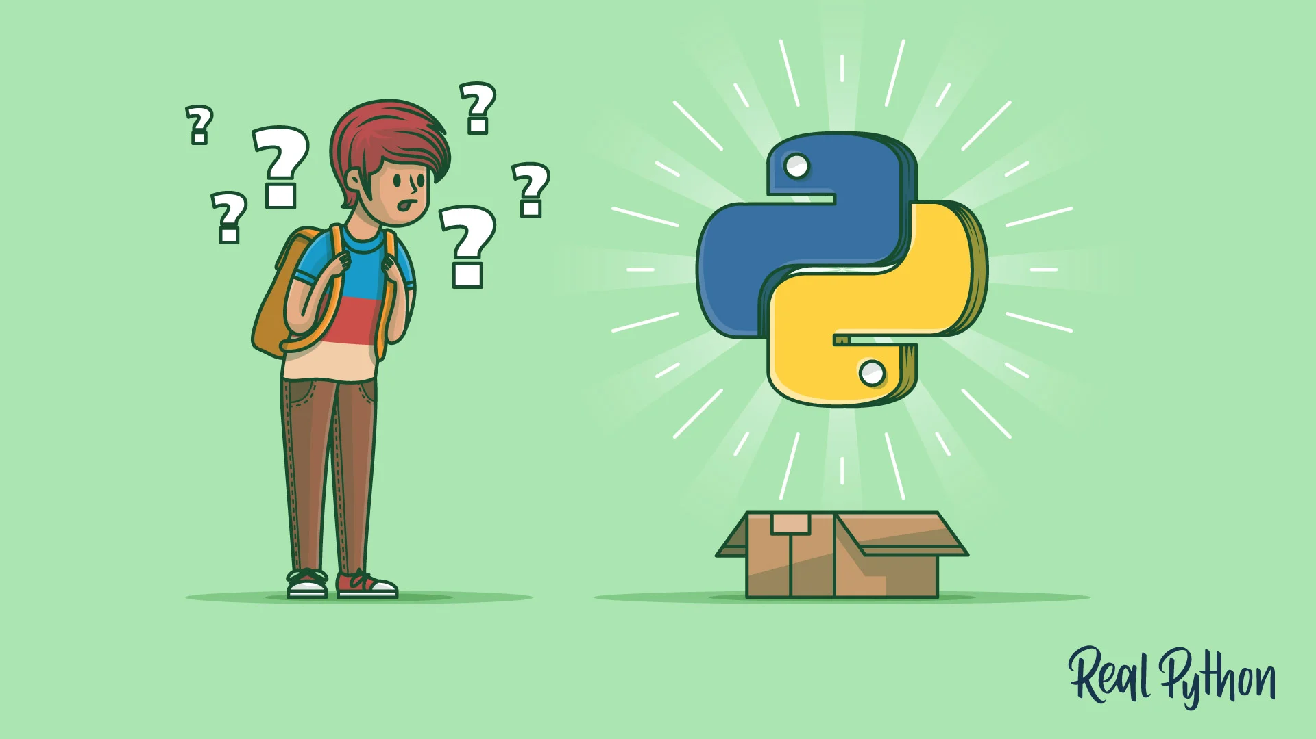
What is Python?

Slide 3
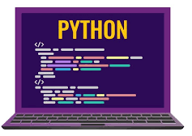
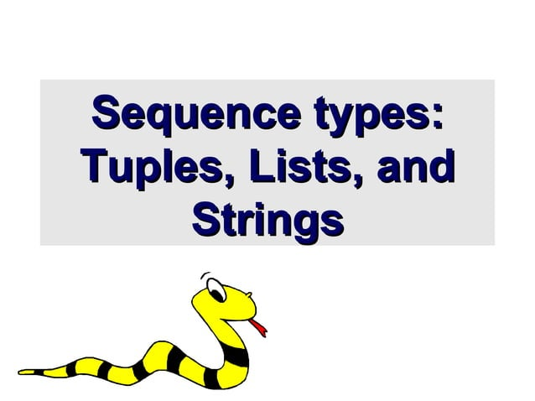
What is Python?
Python: A Powerful and Versatile Programming Language
1. High-level, General-Purpose Language:
- Beginner-friendly and versatile across fields.
2. Interpreted Language:
- Line-by-line execution for flexibility and speed.
3. Readable Syntax:
- Natural language-like structure for clarity.
4. Versatile Tool:
- Web Development (e.g., Django, Flask)’
- Data Science and Machine Learning (e.g., NumPy, Pandas)
- Automation and Scripting (e.g., task automation)
- Game Development (e.g., Pygame)

Slide 4
History of Python ?
Python programming language was developed by Guido Van Rossum in late 1980s at CWI in Netherlands.
The of developing Python taken from ABC and Modula programming languages.
Fact behind choosing name python –
Guido Van Rossum was big fan of popular BBC comedy show at that time : “ Monty Python’s Flying Circus ”.

Slide 5
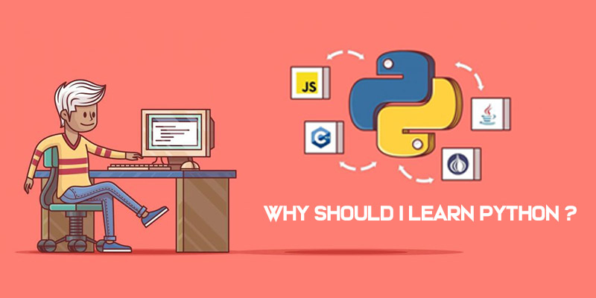
Why Python?

Slide 6
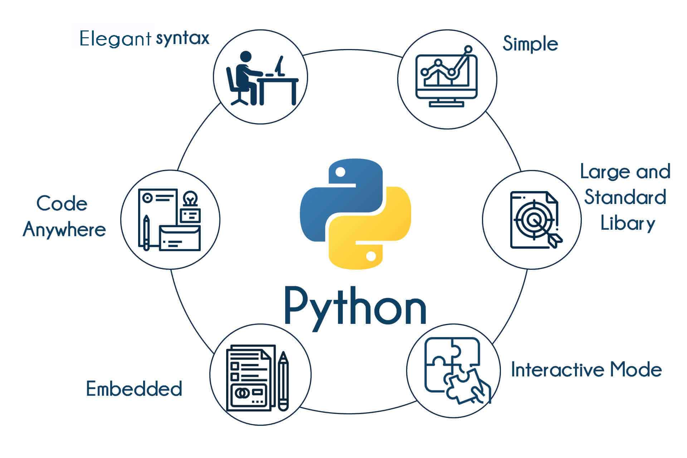

Slide 7
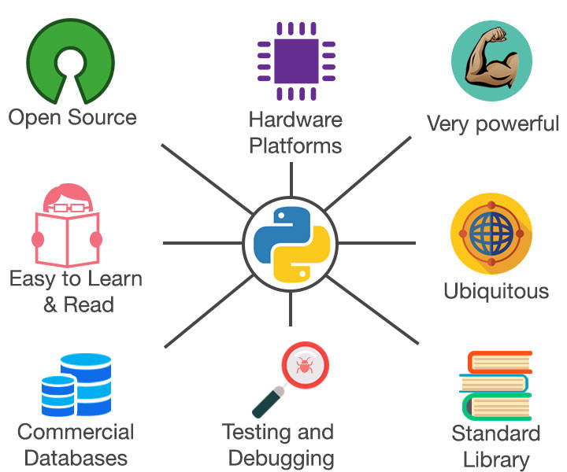

Slide 8
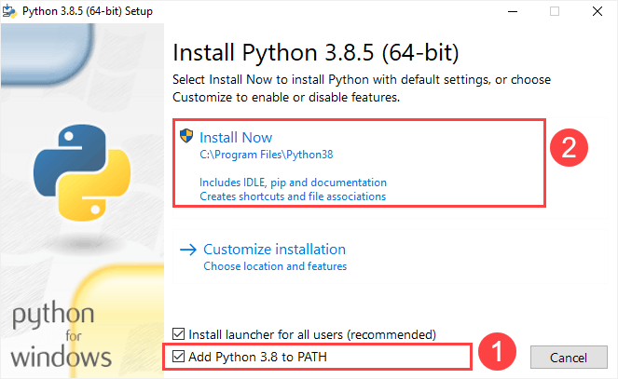
Installing Python…
Step 1: Download latest python version from web link
Step 2: Install python in your device. Follow the below image.

Slide 9
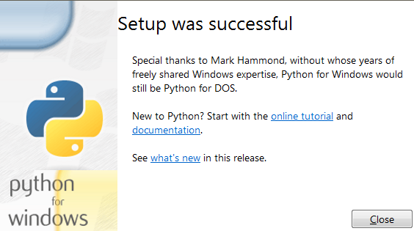
Continue…
Step 3: Once installation complete. This will display on screen.

Slide 10
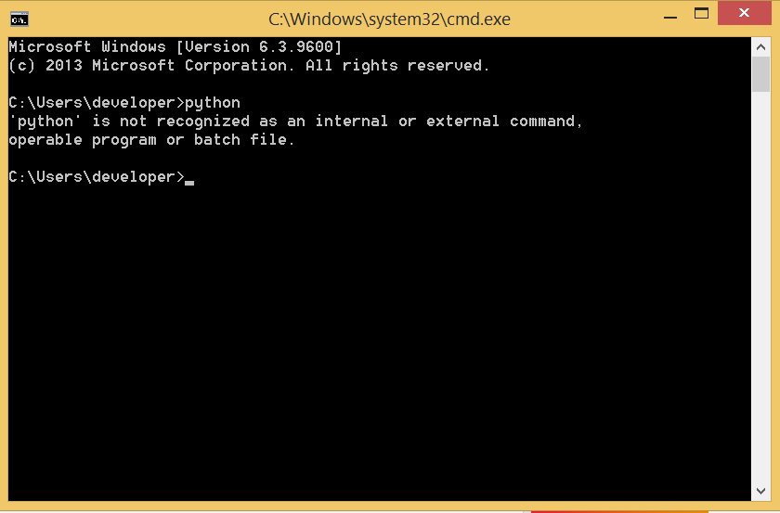
Step 4: Open Command Prompt and type “python” and press enter. You will successfully enter into python environment.
Note : To exit from it , type “exit()” and press enter.

