Slide 1
SECURE OS
Stopping Phishing and Cyber Scams in Real Time—Before You Click
Team Name: Secure OS Solutions
Team Members: Anmol Malviya (Leader), Sachin Yaduwanshi, Saanvi Gupta, Tanay Agrawal, Shailendra Singh

Slide 2
The Cybersecurity Crisis We Face
Why Traditional Security Fails Us
• Over 80% of cyberattacks start with a simple phishing link, costing people their hard-earned money and identities.
• Scam websites pop up and vanish in under 24 hours, completely bypassing standard browser blocklists.
• QR code scams ('Quishing') are on the rise, tricking users into scanning malicious links in public spaces.
• Fake characters (like Cyrillic look-alikes) make fraudulent links look identical to trusted brands.
THE DANGEROUS SECURITY GAP
⚠️ Regular citizens have no safe way to inspect a link before clicking it.
⚠️ Email headers hold the key to spotting spoofs, but they are completely unreadable to the average person.
⚠️ Existing mobile security apps drain your battery and won't work without internet.

Slide 3
Meet Secure OS: Your Digital Shield
A smart, multi-layered defense system that stops scams on your phone and in the cloud.
1. Instant Mobile Protection
A lightweight, offline AI running on your phone to scan links instantly with zero delay—saving your battery and working without internet.
2. Cloud Deep-Scan API
An advanced server that digs deeper—verifying website domains, checking SSL certificates, and inspecting page code for hidden credential thieves.
3. Safe View Sandbox
A secure, isolated preview window that lets you look inside a website safely without downloading malware or trackers.

Slide 4
How It Works: Step-by-Step Defense
1
2
3
4
Scan or Paste
You copy a link, scan a physical QR code, or paste an email header.
Instant Text Check
The app instantly looks for look-alike brand names, fake characters, and random letter patterns.
Offline AI Analysis
A lightweight machine learning model runs right on your phone to give you an immediate safety score.
Deep Cloud Inspection
If something looks off, our servers audit the website's registration details and inspect the code for scams.

Slide 5
The Secure OS Ecosystem
Native Android App
Scans links automatically from your clipboard, decodes QR codes safely, and runs offline AI checks directly on your device with zero latency.
Web Security Hub
A beautiful Next.js dashboard to manually check suspicious links, view detailed scan histories, and learn cybersecurity basics.
Deep-Scan Servers
A powerful backend API that investigates domains, checks SSL certification validity, and analyzes page HTML structure.
Safe View & Email Auditor
Renders dangerous pages inside a script-disabled visual sandbox and breaks down confusing email headers into plain English.

Slide 6
Our Tech Stack & Core Algorithms
The Technology Behind Secure OS
💻 Mobile App:
Native Kotlin, Android SDK, and offline heuristics
💻 Web Dashboard:
Next.js 16 (React), Vanilla CSS with premium glassmorphism styles
💻 Cloud API:
Next.js serverless API routes running on Node.js
💻 Utilities:
HTML5 QR-code reader and secure Web Cryptography
💻 Data Pipeline:
Python scripts for dataset processing and model weights translation
The Algorithms Keeping You Safe
⚙️ Typosquatting Checker (Levenshtein):
Calculates text similarity to catch links mimicking popular brand names (like `paypa1.com`).
⚙️ Threat Classifier (Logistic Regression):
Analyzes structural features of a URL to calculate an instant probability score.
⚙️ Randomness Detector (Shannon Entropy):
Detects randomly generated domains frequently used by botnets and automated spammers.
⚙️ Homograph Decoder (Punycode):
Exposes scams using foreign characters that mimic standard English letters.

Slide 7
Making a Real-World Impact
🎯 Preventing Scams, Not Just Reporting Them
While traditional browsers warn you after a site is already flagged, Secure OS analyzes site structure instantly to block brand-new (zero-day) attacks.
🎯 The QR Code (Quishing) Shield
Protects citizens from physical scams—like fake parking ticket stickers or public poster codes—by decoding links safely and previewing them first.
🎯 Making Email Security Simple
Takes the technical jargon out of email headers, showing a clear, understandable rating on whether the sender is authentic.
🎯 Training the Human Layer
Builds lasting digital safety habits using interactive, gamified quizzes to teach citizens how to spot phishing flags on their own.

Slide 8
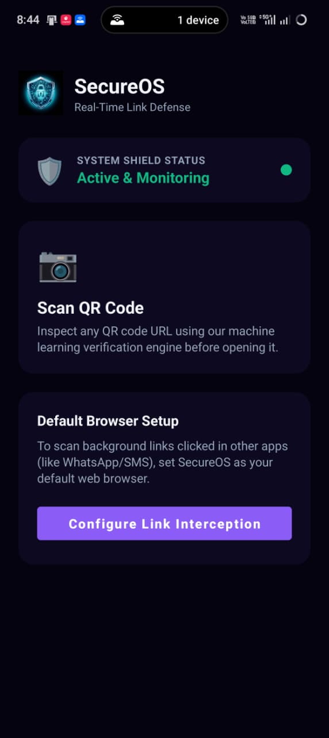
Our Live Working Prototype
Experience Secure OS in Action
⚡ Interactive Dashboard: A real-time web interface running at localhost:3000 to scan and preview links safely.
⚡ Live QR Scanner: Instant, webcam-integrated scanning to parse and analyze physical codes.
⚡ Cloud-Based Audits: A live backend that triggers DNS lookups and certificate validation on the fly.
⚡ Native Mobile Diagnostics: Offline Kotlin engine checking links on the go directly in the Android app.

Slide 9
SECURE OS
Shielding Citizens from Cyber Scams
Thank You! Any Questions?

