Slide 1
Data Structures & Algorithms
Project Review
String Search Algorithms

Slide 2
Introduction
In computer science, string-searching algorithms, sometimes called string-matching algorithms, are an important class of string algorithms that try to find a place where one or several strings (also called patterns) are found within a larger string or text.

Slide 3
Algorithms
Naive String-search Algorithms
Rabin-Karp Algorithm
Knuth-Morris-Pratt algorithm
Boyer-Moore string search algorithm

Slide 4
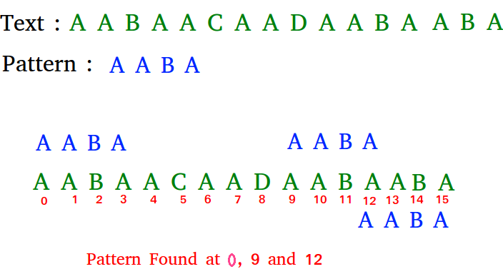
Naive String-Search
Slide the pattern over text one by one and check for a match. If a match is found, then slides by 1 again to check for subsequent matches.

Slide 5
Naive String-Search
Worst Case | Best Case
1) When all characters of the text and pattern are same. txt[] = "AAAAAAAAAAAAAAAAAA"; pat[] = "AAAAA"; 2) Worst case also occurs when only the last character is different. txt[] = "AAAAAAAAAAAAAAAAAB"; pat[] = "AAAAB"; | The best case occurs when the first character of the pattern is not present in text at all. txt[] = "AABCCAADDEE"; pat[] = "FAA"; The number of comparisons in best case is O(n)

Slide 6
Rabin–Karp algorithm
Like the Naive Algorithm, Rabin-Karp algorithm also slides the pattern one by one. But unlike the Naive algorithm, Rabin Karp algorithm matches the hash value of the pattern with the hash value of current substring of text, and if the hash values match then only it starts matching individual characters. So Rabin Karp algorithm needs to calculate hash values for following strings.
Since we need to efficiently calculate hash values for all the substrings of size m of text, we must have a hash function which has following property.
Hash at the next shift must be efficiently computable from the current hash value and next character in text or we can say hash(txt[s+1 .. s+m]) must be efficiently computable from hash(txt[s .. s+m-1]) and txt[s+m] i.e., hash(txt[s+1 .. s+m])= rehash(txt[s+m], hash(txt[s .. s+m-1]) and rehash must be O(1) operation.

Slide 7
Rabin-Karp algorithm
The hash function suggested by Rabin and Karp calculates an integer value. The integer value for a string is numeric value of a string. For example, if all possible characters are from 1 to 10, the numeric value of “122” will be 122.
The number of possible characters is higher than 10 (256 in general) and pattern length can be large. So the numeric values cannot be practically stored as an integer. Therefore, the numeric value is calculated using modular arithmetic to make sure that the hash values can be stored in an integer variable (can fit in memory words).

Slide 8
Rabin-Karp algorithm
To do rehashing, we need to take off the most significant digit and add the new least significant digit for in hash value. Rehashing is done using the following formula.
hash( txt[s+1 .. s+m] ) = ( d ( hash( txt[s .. s+m-1]) – txt[s]*h ) + txt[s + m] ) mod q
hash( txt[s .. s+m-1] ) : Hash value at shift s.
hash( txt[s+1 .. s+m] ) : Hash value at next shift (or shift s+1)
d: Number of characters in the alphabet
q: A prime number
h: d^(m-1)

Slide 9
Rabin-Karp algorithm
The average and best case running time of the Rabin-Karp algorithm is O(n+m), but its worst-case time is O(nm). Worst case of Rabin-Karp algorithm occurs when all characters of pattern and text are same as the hash values of all the substrings of txt[] match with hash value of pat[]. For example pat[] = “AAA” and txt[] = “AAAAAAA”.

Slide 10
Knuth Morris Pratt (KMP) Algorithm
The KMP matching algorithm uses degenerating property (pattern having same sub-patterns appearing more than once in the pattern) of the pattern and improves the worst case complexity to O(n)
The basic idea behind KMP’s algorithm is: whenever we detect a mismatch (after some matches), we already know some of the characters in the text of the next window. We take advantage of this information to avoid matching the characters that we know will anyway match.

Slide 11
Matching Overview
txt = "AAAAABAAABA"
pat = "AAAA"
We compare first window of txt with pat
txt = "AAAAABAAABA"
pat = "AAAA" [Initial position]
We find a match. This is same as Naive String Matching.
In the next step, we compare next window of txt with pat.
txt = "AAAAABAAABA"
pat = "AAAA" [Pattern shifted one position]
This is where KMP does optimization over Naive. In this second window, we only compare fourth A of pattern with fourth character of current window of text to decide whether current window matches or not. Since we know first three characters will anyway match, we skipped matching first three characters.
Need of Preprocessing?
An important question arises from the above explanation,how to know how many characters to be skipped. To know this, we pre-process pattern and prepare an integer array lps[] that tells us the count of characters to be skipped.

Slide 12
KMP Pre-Processing
KMP algorithm preprocesses pat[] and constructs an auxiliary lps[] of size m (same as size of pattern) which is used to skip characters while matching.
name lps indicates longest proper prefix which is also suffix.. A proper prefix is prefix with whole string not allowed. For example, prefixes of “ABC” are “”, “A”, “AB” and “ABC”. Proper prefixes are “”, “A” and “AB”. Suffixes of the string are “”, “C”, “BC” and “ABC”.
We search for lps in sub-patterns. More clearly we focus on sub-strings of patterns that are either prefix and suffix.
For each sub-pattern pat[0..i] where i = 0 to m-1, lps[i] stores length of the maximum matching proper prefix which is also a suffix of the sub-pattern pat[0..i].
lps[i] = the longest proper prefix of pat[0..i] which is also a suffix of pat[0..i].

Slide 13
KMP
Unlike Naive algorithm, where we slide the pattern by one and compare all characters at each shift, we use a value from lps[] to decide the next characters to be matched.
We start comparison of pat[j] with j = 0 with characters of current window of text.
We keep matching characters txt[i] and pat[j] and keep incrementing i and j while pat[j] and txt[i] keep matching.
When we see a mismatch
  We know that characters pat[0..j-1] match with txt[i-j…i-1] (Note that j starts with 0 and increment it only when there is a match).
  We also know (from above definition) that lps[j-1] is count of characters of pat[0…j-1] that are both proper prefix and suffix.
  From above two points, we can conclude that we do not need to match these lps[j-1] characters with txt[i-j…i-1] because we know that these characters will anyway match. Let us consider above example to understand this.

Slide 14
KMP Example
https://notepad.pw/uzbz8q1k

