Slide 1
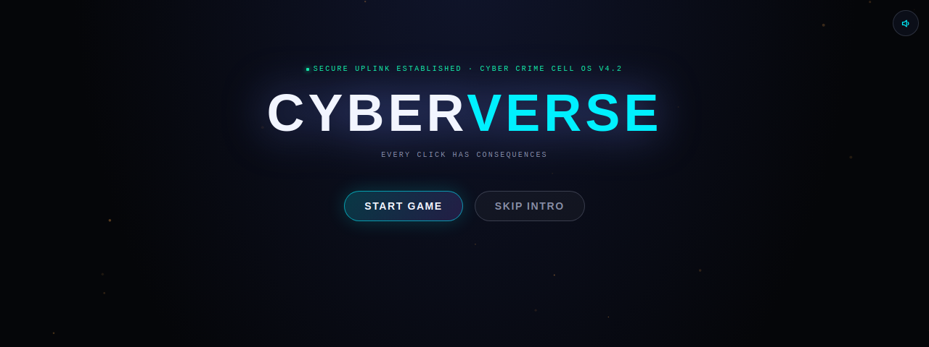
AI-POWERED CYBER SURVIVAL EXPERIENCE
CYBERVERSE
Every click has consequences.
by MIDNIGHT BUILDERS
A cinematic cybersecurity game that teaches Indians to recognize and survive real digital fraud — by living through it, not answering quiz questions about it.
10
4
1930
PLAYABLE CASES
LIVING SYSTEMS
REAL HELPLINE BUILT-IN
01

Slide 2
THE TEAM
Midnight Builders
Building through the night, one system at a time.
AS
HB
Anmol Singh
Harsh Bamer
TEAM LEAD
TEAM MEMBER
02

Slide 3



A QUICK PRIMER
What is cybersecurity, really?
The practice of protecting devices, networks, and data from unauthorized access, damage, or theft — technical defenses like encryption, but just as much about training people to recognize manipulation.
Protecting systems
Preventing, not reacting
Everyone's responsibility
Networks, devices, and data defended from unauthorized access or theft.
Spotting an attack before it happens beats cleaning up after it succeeds.
The biggest vulnerability usually isn't code — it's human trust, exploited by social engineering.
03

Slide 4
THE PROBLEM — THIS IS NOT HYPOTHETICAL
India's cybercrime crisis, in real numbers
2.3M+
5x
cybercrime complaints reported in 2024 alone
growth in reports since 2021 — NCRP
1,23,672
₹7,130Cr+
digital arrest incidents in 2024, up from 39,925 in 2022
saved via the 1930 helpline — proof reporting works, if people know how
Source: National Cyber Crime Reporting Portal (NCRP), Indian Cyber Crime Coordination Centre (I4C), Ministry of Home Affairs.
04

Slide 5
WHY EXISTING SOLUTIONS FAIL
Nobody remembers a quiz they took once
THE OLD WAY
THE CYBERVERSE WAY
✕ Multiple-choice quizzes you forget in a week
✓ You investigate real fake SMS, emails, and calls yourself
✕ Static dashboards nobody opens twice
✓ A ticking clock recreates real scam pressure
✕ Generic advice with no emotional stakes
✓ Wrong choices cost Health — there's an actual game over
✕ One-size-fits-all content, same for everyone
✓ Every case ends by testing recognition, not memory
05

Slide 6




THE CORE MECHANIC
Investigate. Don't guess.
Every mission replaces a multiple-choice question with a real device you have to search yourself.
1
2
3
4
Enter the scene
→
Pick up the phone
→
Inspect the evidence
→
Act under pressure
Walk into a location — an apartment, a metro, a market — each with its own lighting and mood.
A real in-world device: messages, calls, QR scanner, email — whatever the scam uses.
Tap the suspicious parts of the message yourself. Nothing is highlighted for you.
A countdown — shaped by your Stress — forces a real decision before you're ready.
06

Slide 7
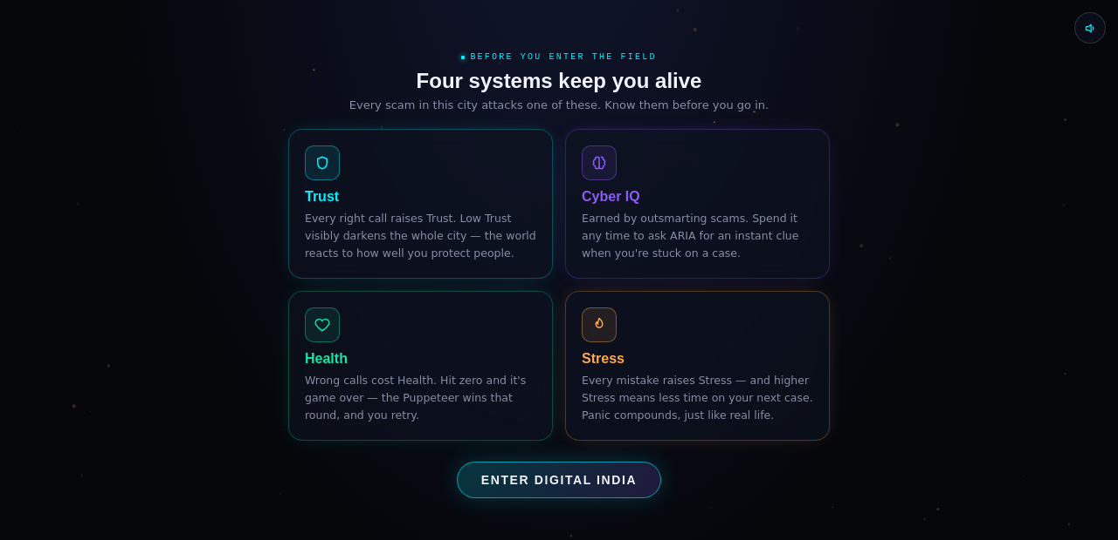



SYSTEMS, NOT STATS
Four pillars that actually do something
Every number on screen changes gameplay — none of them are decorative.
Trust
Cyber IQ
Health
Stress
Darkens or brightens the whole city.
Spend it to ask the mentor for a hint.
Zero means a real game over.
Shortens your timer on the next case.
Actual in-game screenshot — the briefing screen shown before every player's first case.
Real HUD, live in the game — not a mockup:
07

Slide 8
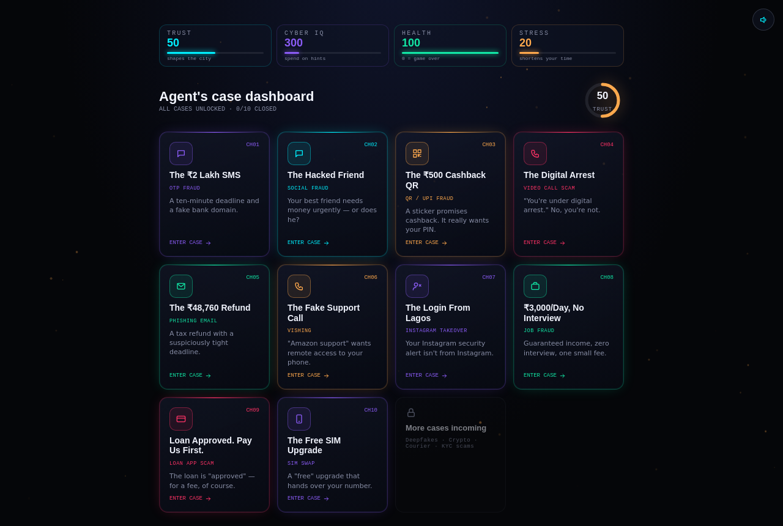
THIS IS REAL, AND IT RUNS
10 playable cases. All unlocked. All real scams.
This is the actual case dashboard — not a concept mockup. Every card is a fully playable mission.
08

Slide 9










REAL CASES, REAL CRIMES
Every category maps to an active scam in India today
01 OTP fraud
02 Social fraud
03 QR / UPI scam
04 Digital arrest
05 Phishing email
06 Vishing
07 Account takeover
08 Job fraud
09 Loan app scam
10 SIM swap
+ deepfakes, crypto fraud, courier scams, and Aadhaar/PAN KYC scams on the roadmap.
09

Slide 10


THE LEARNING SYSTEM
Recognition, not memorization
Every case ends the same disciplined way — an AI debrief, then a test of what you actually learned.
AI Mentor debrief
"Spot the Fake"
• Why the scam worked
A real vs. fake message, domain, or request — side by side. The player has to pick which one is the scam.
• The exact warning signs to watch for
• What to do right now
This is the difference between a game and a learning platform — applied recognition beats remembered facts.
• Recovery steps if it's too late
• The real Indian helpline: 1930 / cybercrime.gov.in
10

Slide 11



WHAT JUDGES WILL REMEMBER
A living 3D phone, not a chat window
3D interactive phone
A city that reacts to you
Real time pressure
Drag to rotate it in your hand before it wakes up. Every case starts here — calls, chats, QR scans, email.
Trust doesn't just go up or down — it visibly changes the lighting and mood of the whole world.
A countdown shaped by your Stress recreates the exact urgency scammers manufacture on purpose.
11

Slide 12
UNDER THE HOOD
Built to scale past the hackathon
React + Vite
Zustand
Tone.js
Component-driven game engine, fast iteration
Lightweight state for player progress & stats
Generative ambient score that reacts to tension
Firebase
Gemini API
PWA
Auth, save-state sync, mission caching
Server-side mission & scam-content generation
Installable, offline-capable for low-connectivity areas
12

Slide 13

WHERE THIS GOES NEXT
From 10 cases to a national curriculum
Phase 1 — Now
Phase 2 — AI generation
Phase 3 — Scale
10 hand-crafted cases across OTP, UPI, phishing, vishing, digital arrest, job & loan fraud, SIM swap.
Gemini-generated missions so no two players ever see the same scam twice.
Deepfake voice/video, crypto fraud, courier scams, Aadhaar/PAN KYC — plus school & college rollout.
13

Slide 14

EVERY CLICK HAS CONSEQUENCES
Play it. Feel it. Then you'll remember it.
CyberVerse turns India's most dangerous scams into an experience you survive — not a slide you skip.
Built for cybersecurity education
Team Midnight Builders
Anmol Singh · Team Lead Harsh Bamer · Team Member
Thank you
14

