Slide 1
Supplementary Material
Survival Analysis of Colorectal and Stomach Cancers
Student ID: 3068804 | Supervisor: Dr Sudip Mondal
MSc Health Data Science | University of Birmingham

Slide 2
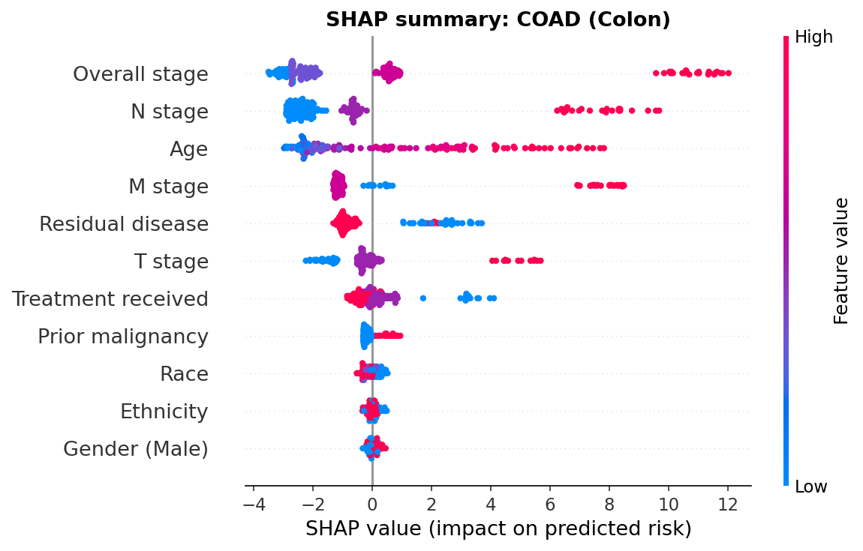
SHAP Summary: Colon (COAD)
Colon. Each dot is a patient, coloured by feature value. Overall stage, N stage and age dominate, and later stage and residual disease push predicted risk higher. Same direction of effect as stomach in the main deck, which is what makes the transfer work.
2

Slide 3
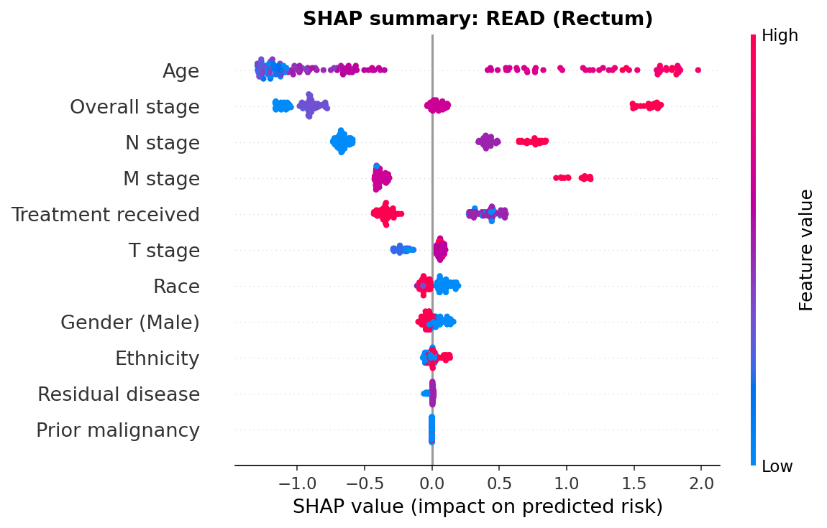
SHAP Summary: Rectum (READ)
Rectum. Age is the strongest single feature here, ahead of overall stage, matching both the Cox model and the permutation importance. Direction of effect is the same as colon and stomach, but with only 27 deaths the spread is wider.
3

Slide 4
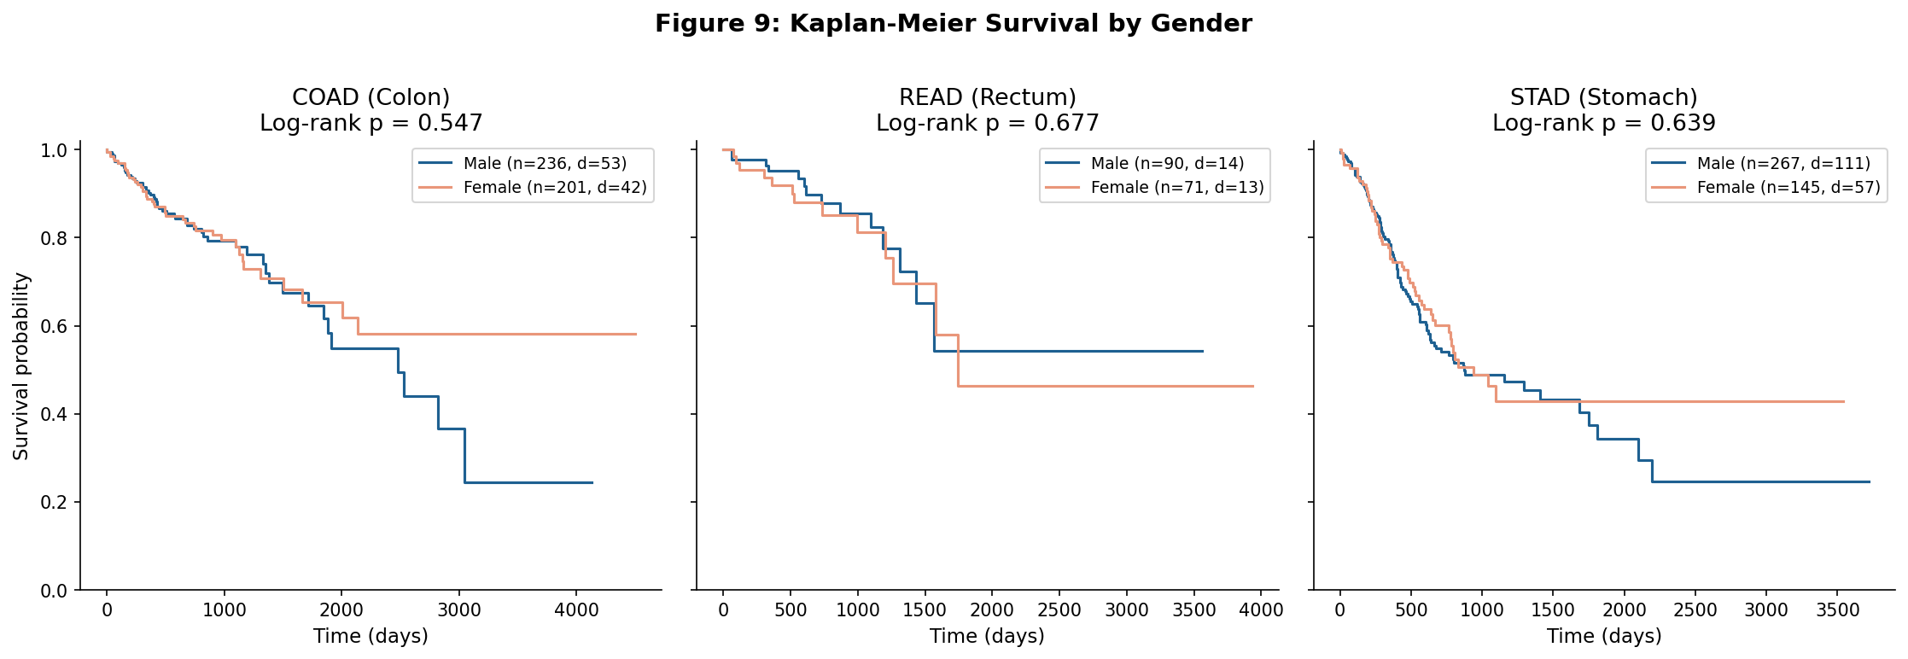
Kaplan-Meier: Survival by Sex
No significant survival difference by sex in any cancer (colon p = 0.55, rectum p = 0.68, stomach p = 0.64). Notable for stomach, which is 65% male: the imbalance in cohort composition does not translate into a survival difference.
4

Slide 5
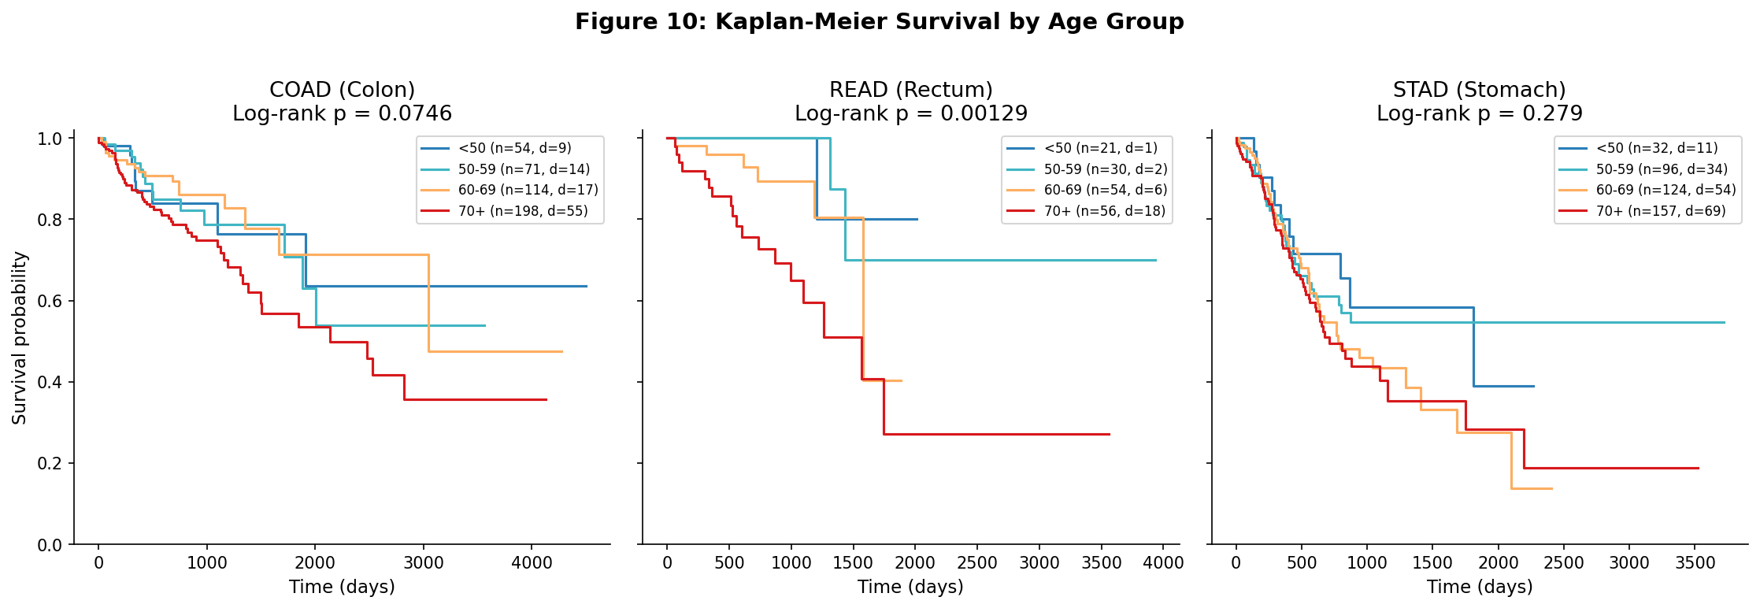
Kaplan-Meier: Survival by Age Group
Significant in rectum (p = 0.001) but not colon (p = 0.075) or stomach (p = 0.28). Older groups fare worse in rectum, with the same non-significant gradient visible in colon. Steep drops in the tails are where few patients remain at risk.
5

Slide 6
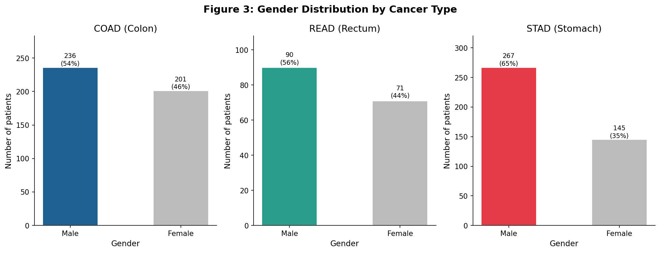
Sex Distribution by Cancer
Colon and rectum are close to balanced (54% and 56% male); stomach is markedly male-skewed at 65%, consistent with the known epidemiology of gastric cancer. Sex is carried as a covariate and adjusted for in the cross-cancer comparison.
6

Slide 7
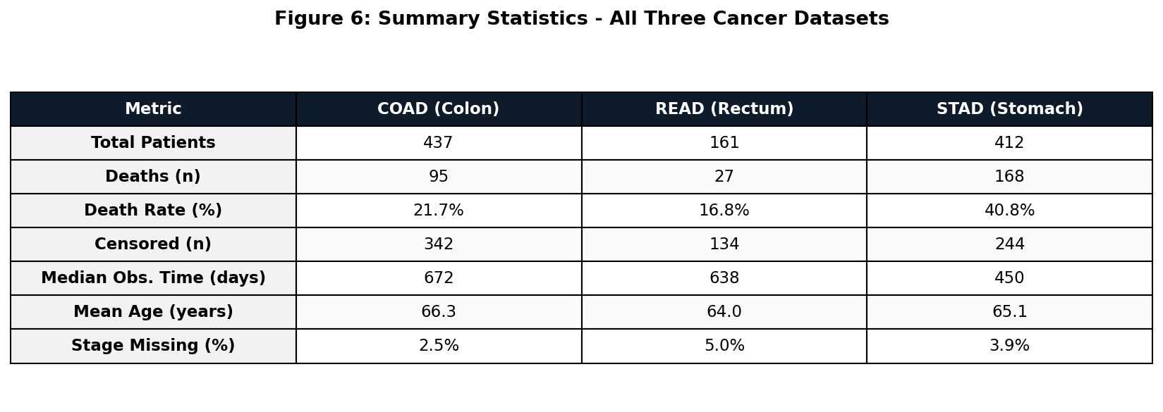
Cohort Summary Statistics
Cohorts after deduplication and exclusion of records with missing survival time. Stomach has roughly double the death rate of colorectal and a median observed time around 30% shorter, despite near-identical age profiles across all three.
7

Slide 8
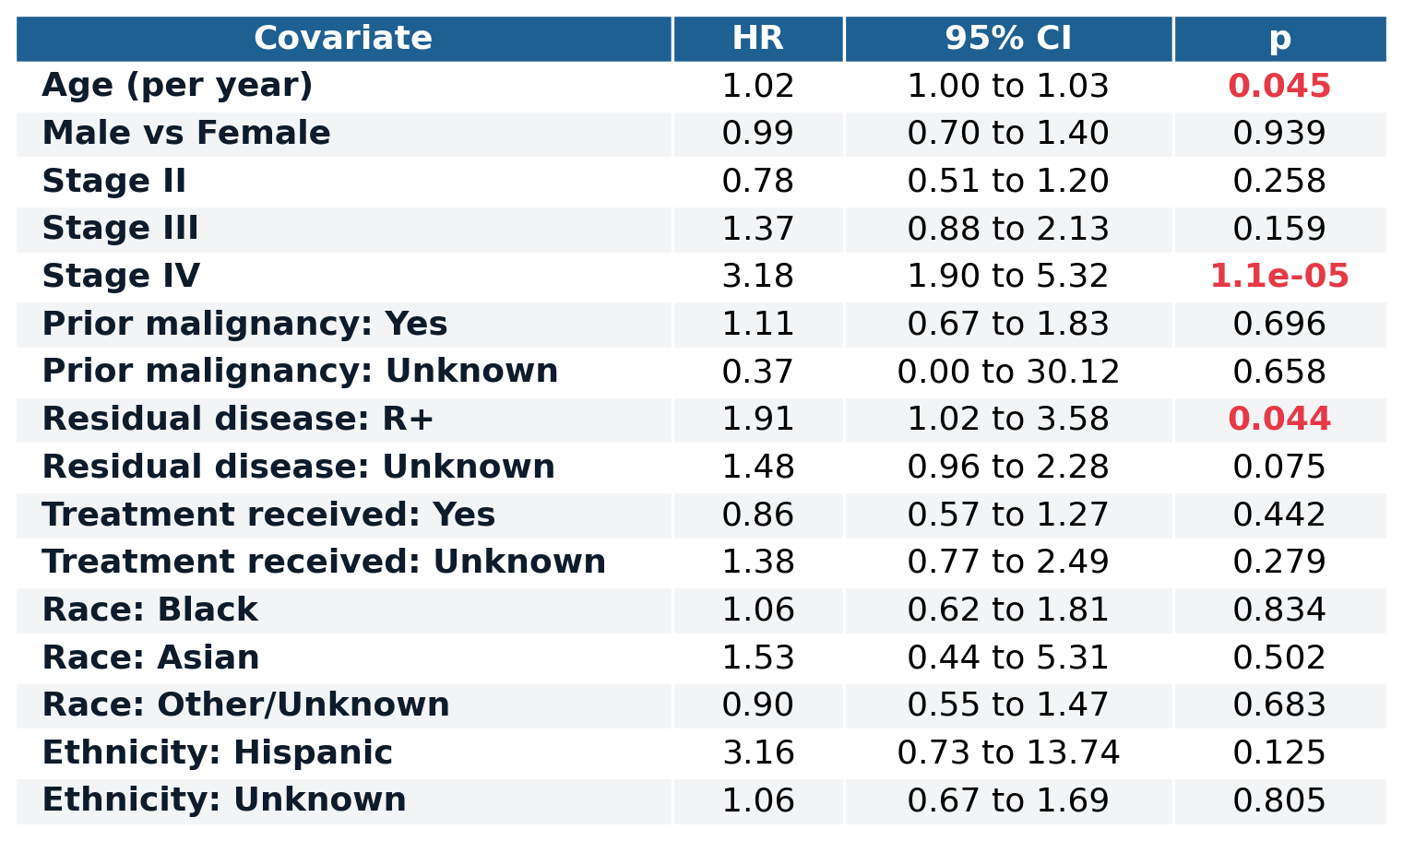
Full Cox Estimates: Colon (COAD)
Every covariate in the penalised Cox model, with 95% confidence intervals. Stage IV (HR 3.18) and residual disease (HR 1.91) are significant, and age is borderline. The race and ethnicity terms rest on very small subgroups and are not interpreted.
8

Slide 9
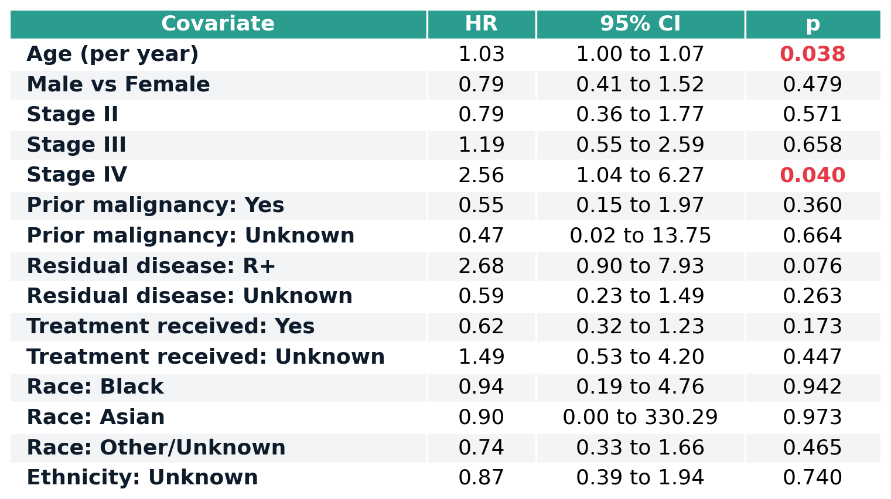
Full Cox Estimates: Rectum (READ)
Only Stage IV (HR 2.56) and age reach significance. This cohort has 24 deaths supporting roughly fifteen coefficients, well below the ten-events-per-coefficient guideline, so the estimates are heavily regularised and read as indicative rather than definitive.
9

Slide 10
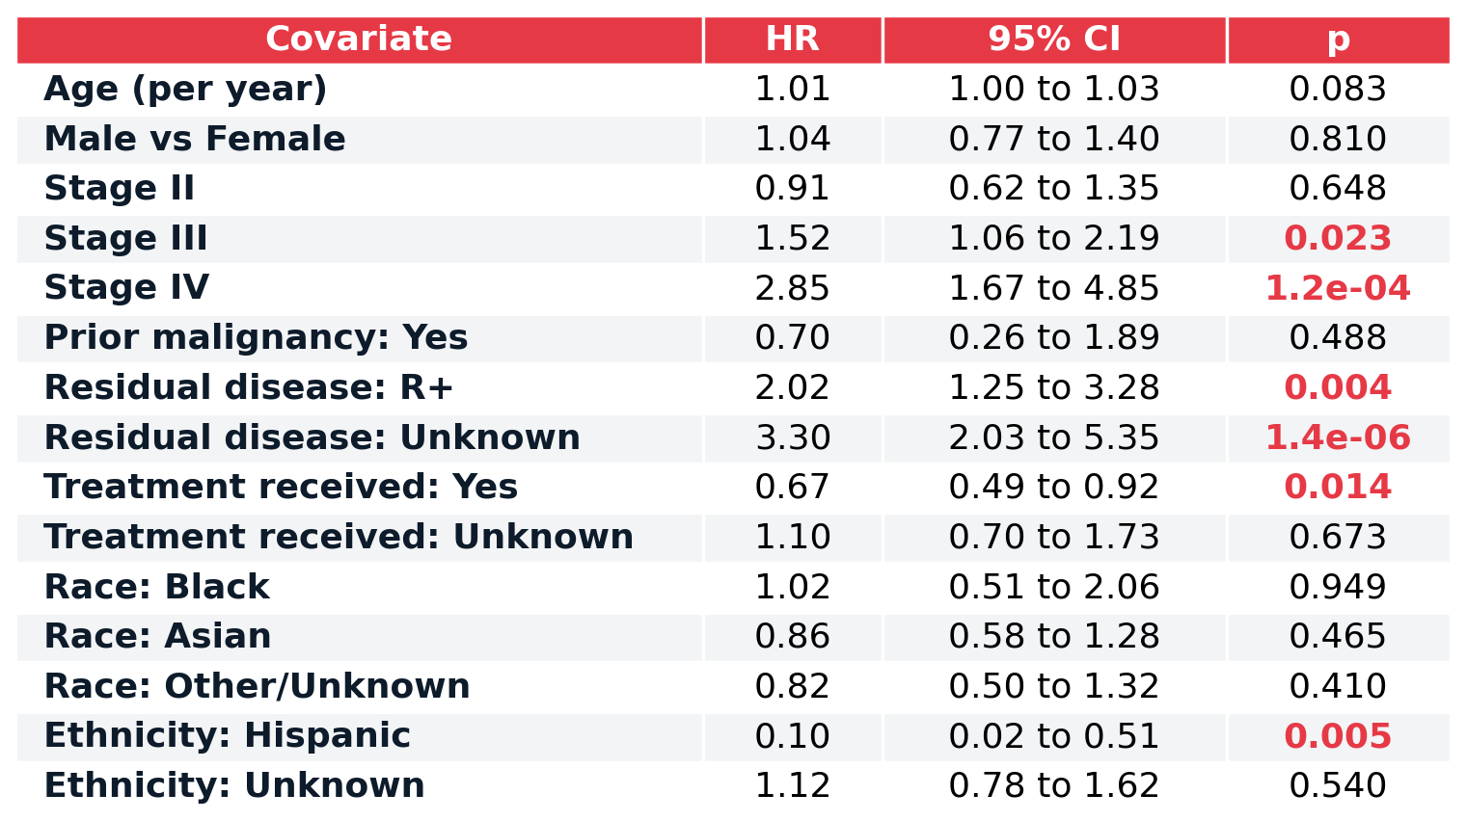
Full Cox Estimates: Stomach (STAD)
Stage III and IV, residual disease and treatment received are all significant. The apparently protective ethnicity term rests on five patients, so it is a small-sample artefact rather than a finding, and treatment is confounded by indication.
10

Slide 11
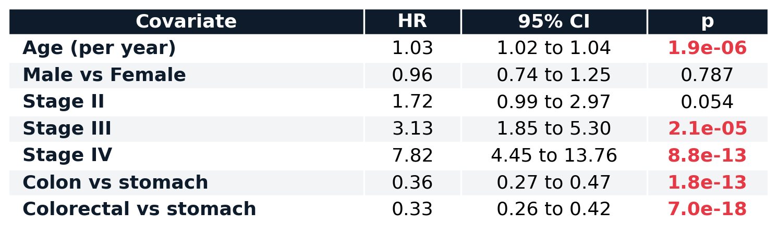
Adjusted Between-Cancer Comparison
Pooling the cohorts and adjusting for age, stage and sex, colon has a hazard ratio of 0.36 against stomach and colorectal 0.33. Stomach is roughly three times worse stage-for-stage, so the excess is intrinsic rather than a consequence of later diagnosis.
11

Slide 12
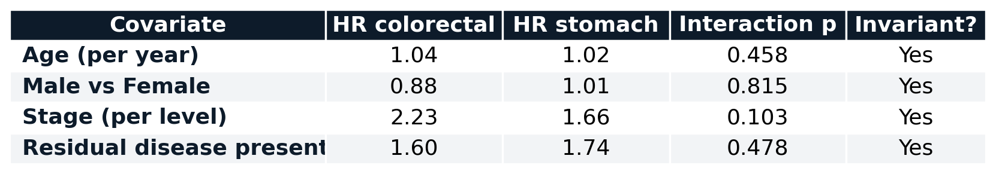
Invariance of Predictors Across Cancers
Each covariate fitted separately in colorectal and stomach, with a likelihood-ratio test on the covariate-by-cancer interaction. All four interactions are non-significant, so the effects are invariant across the two cancers. This is the mechanism behind the transfer.
12

Slide 13
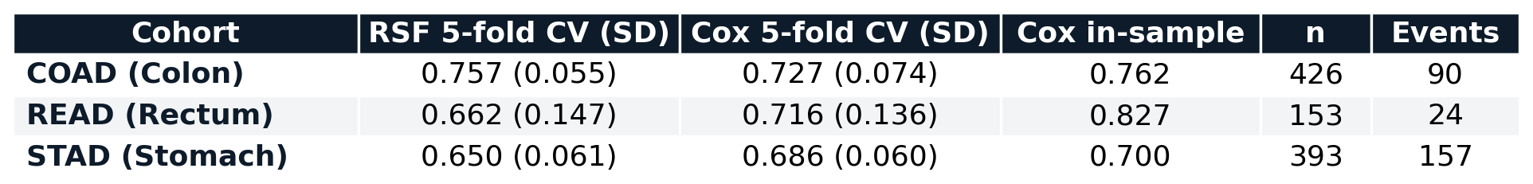
Model Performance: Forest vs Cox
Five-fold cross-validation on identical folds. The forest beats Cox only in colon; Cox is competitive or better in rectum and stomach. The in-sample column shows the optimism that cross-validation removes, most starkly in rectum (0.827 down to 0.716).
13

Slide 14
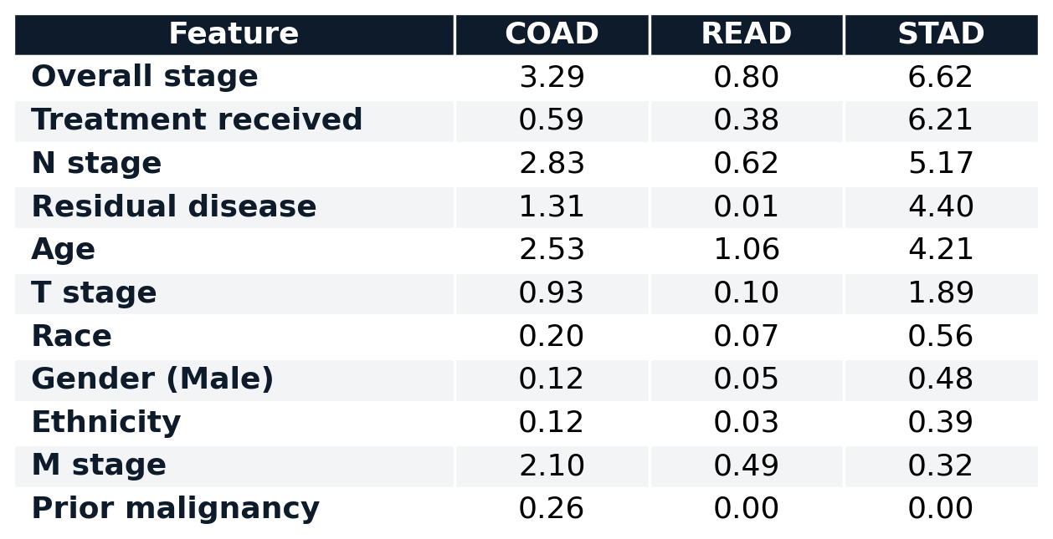
Global SHAP Importance (values)
Mean absolute SHAP value per feature, the numbers behind the importance figure. Staging leads in colon and stomach, age leads in rectum, and treatment received ranks second in stomach with the confounding-by-indication caveat.
14

Slide 15
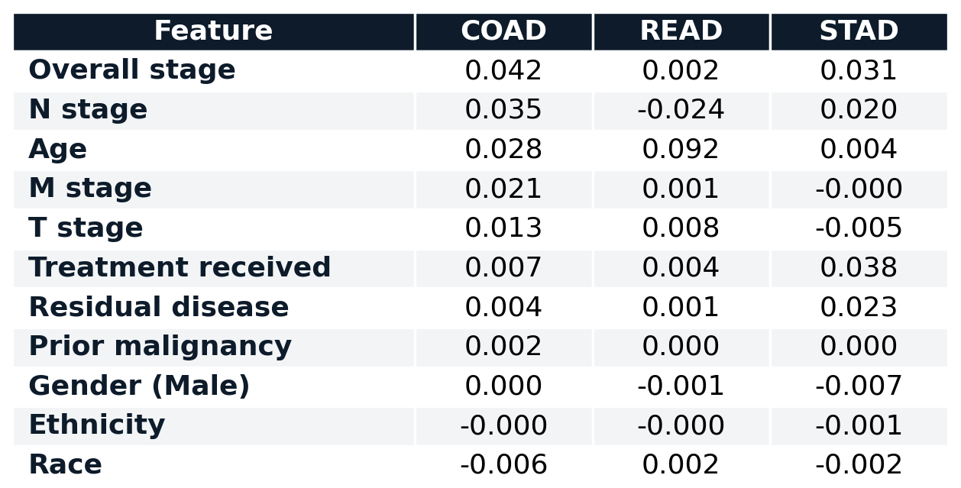
Permutation Importance (values)
Mean drop in concordance when each feature is shuffled, averaged across folds. Negative values mean shuffling slightly improved the score, which is noise around zero and indicates no usable signal from that feature.
15

Slide 16
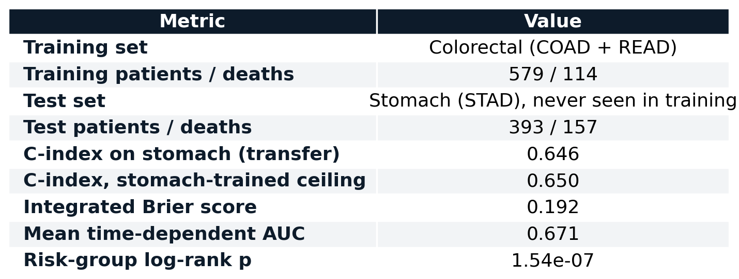
Cross-Cancer Transfer: Full Metrics
A forest trained on 579 colorectal patients, never shown a stomach patient, scores 0.646 on stomach against a 0.650 ceiling from a stomach-trained model. Discrimination transfers almost perfectly; calibration is weaker (Brier 0.192).
16

