Slide 1
Survival Analysis of Colorectal
A Comparative Study Using TCGA Clinical Data
Student ID: 3068804 | Supervisor: Dr Sudip Mondal
MSc Health Data Science | University of Birmingham

Slide 2
Project Overview
Primary Aim
Methods Pipeline
Key Challenge
Investigate survival outcomes in colorectal cancer (COAD + READ) and compare them with stomach cancer (STAD) using TCGA clinical data.
Kaplan-Meier survival curves → Cox proportional hazards regression → Random Survival Forest with SHAP explainability → transfer step linking colorectal to stomach.
COAD/READ and STAD represent different patient cohorts. Cross-cohort trend comparison requires careful methodological justification.
Data Source: The Cancer Genome Atlas (TCGA) via GDC Portal, portal.gdc.cancer.gov
2

Slide 3




Project Workflow
1. Data & Preprocessing
2. Exploration
3. Survival Models
4. Cross-Cancer Analysis
• TCGA: COAD, READ, STAD
• Deduplicated to one row/patient
• 437 / 161 / 412 patients
• 11 clinical features
• Distributions per cancer
• Cohorts matched on age
• Stomach worst: 40.8% deaths
• Kaplan-Meier + log-rank
• Cox: 11 features, penalised
• Random Forest + SHAP
• C-index 0.76 / 0.83 / 0.70
• Q1 3x worse stage-for-stage
• Q2 transfers, C-index 0.646
• Q3 predictors invariant
Key finding: the same clinical predictors drive survival in all three cancers, so a colorectal model transfers to stomach, yet stomach remains intrinsically about three times worse stage-for-stage.
3

Slide 4
Dataset Overview
COAD
(Colon)
READ
(Rectum)
STAD
(Stomach)
437
161
412
patients (after preprocessing)
patients (after preprocessing)
patients (after preprocessing)
Deaths
95 (22%)
Deaths
27 (17%)
Deaths
168 (41%)
Stage missing
3%
Stage missing
5%
Stage missing
4%
Columns
201
Columns
201
Columns
201
Note: Counts are unique patients after deduplicating the multi-row TCGA files; patients with missing survival time were then removed (COAD: 24, READ: 11, STAD: 31)
4

Slide 5
Key Variables for Survival Analysis
Variable | Column Name | Role | Notes
Vital Status | demographic.vital_status | Event indicator | Alive / Dead, no missing values
Days to Death | demographic.days_to_death | Survival time (dead) | Missing for alive patients, expected
Days to Last Follow-up | diagnoses.days_to_last_follow_up | Survival time (censored) | Used when patient is alive
Pathologic Stage | diagnoses.ajcc_pathologic_stage | Key covariate | ~3-5% missing across datasets
Age at Index | demographic.age_at_index | Covariate | Near-complete, <1% missing
Gender | demographic.gender | Covariate | Complete, no missing values
Cox and forest models use 11 clinical covariates, adding T/N/M stage, prior malignancy, residual disease, treatment and demographics. Excluded: classification of tumour (post-baseline leakage) and prior treatment (near-zero variance).
5

Slide 6
Data Quality & Missingness
Days to Death, high missingness
Expected: most patients are alive. Alive patients have no death date. These are censored observations, not data errors.
Stage, 3-5% missing
Low across all three cancers; stage is well recorded. Rows with missing survival time were excluded.
Vital status, complete
No missing values across all datasets. Reliable event indicator for survival modelling.
6

Slide 7
Preprocessing: Key Methodological Decisions
Why exclude rows with missing survival time?
Why simplify stage to 4 groups (I to IV)?
Survival time is the outcome, so you can't impute it without making up data. Dropping those rows is the only defensible option. This affects COAD (24 patients, 5%), READ (11, 6%) and STAD (31, 7%).
TCGA sub-stages like IIA and IIIC create small cell sizes that sap statistical power in log-rank tests. Collapsing them into broader categories is standard practice, following Mondal et al. (2021) and Jiang et al. (2020).
Alternative considered: Imputation, rejected
Alternative considered: Retain sub-stages, rejected
Why treat alive patients as censored (not excluded)?
Why use median survival, not mean?
Excluding alive patients would introduce survivorship bias, making survival look worse than it is. KM and Cox regression are built specifically to handle censored observations.
Survival data is right-skewed with long tails, and the mean gets pulled around by extreme values. The median is more robust and is the standard reporting metric in the survival analysis literature.
Alternative considered: Exclude alive patients, rejected
Alternative considered: Mean survival, rejected
7

Slide 8
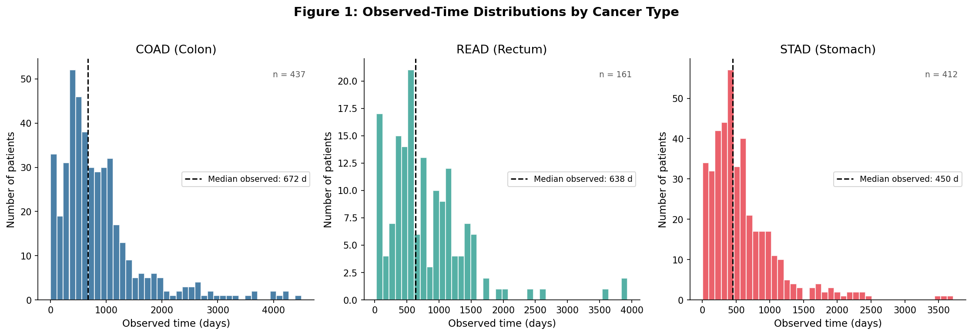
EDA: Observed-Time Distributions
COAD: right-skewed, median observed 672 days, long tail to 4,500 days
READ: similar spread to COAD, median observed 638 days
STAD: sharply peaked early, median observed only 450 days, markedly worse prognosis
Stomach cancer patients have a median observed time ~30% shorter than colorectal, a key finding that drives the KM curve differences.
8

Slide 9
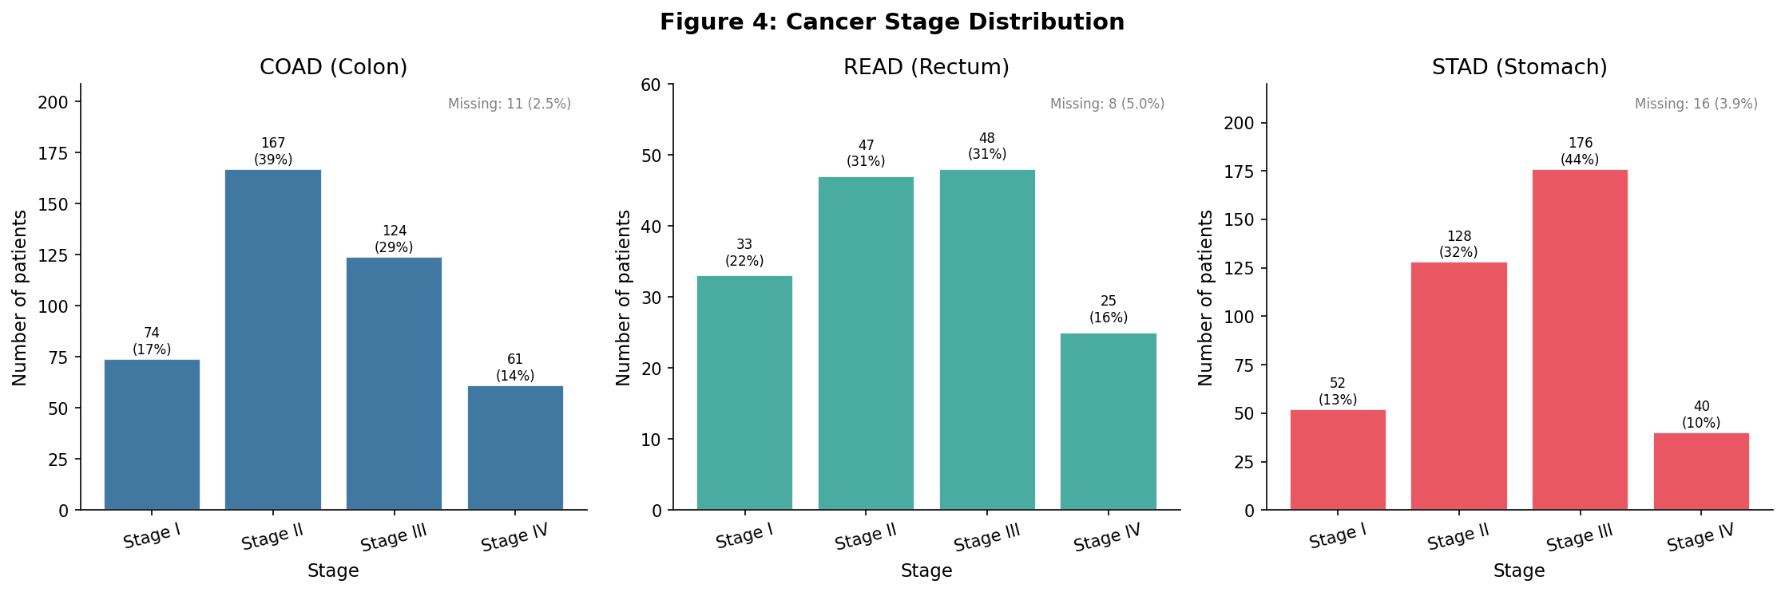
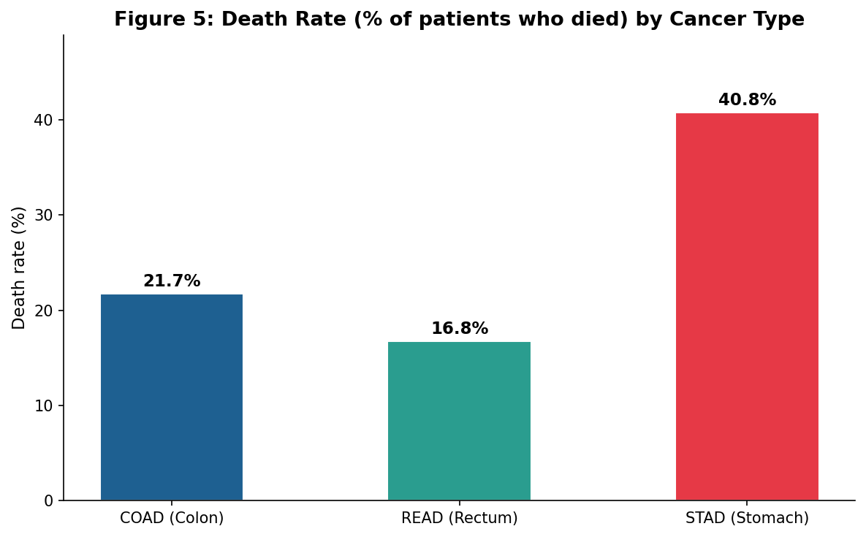
EDA: Stage Distribution & Death Rate
STAD is Stage III-dominant; COAD is mostly Stage II; READ splits II/III late diagnosis is common
STAD has the smallest Stage IV share (10%) vs COAD (14%) and READ (16%)
Stage well recorded across all three (3-5% missing)
Key Finding
STAD death rate (40.8%) is more than double READ (16.8%) and markedly higher than COAD (21.7%). This difference is not explained by age or stage distribution, it reflects the inherently poorer prognosis of gastric cancer, consistent with Mondal et al. (2021).
9

Slide 10
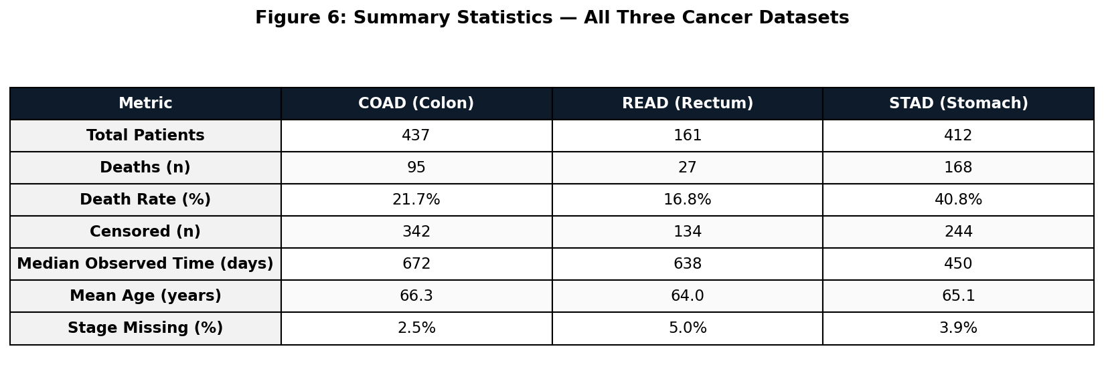
EDA: Summary Statistics
Interpretation
Median observed time in stomach cancer (450 days) is around 30% shorter than colorectal cancers (638-672 days). Age profiles are near-identical across cancers (mean 64-66 years), confirming age is not a confounding factor in cross-cancer survival comparisons. Stage is well recorded across all three cancers (3-5% missing).
10

Slide 11
The Cross-Cohort Comparison Problem
⚠ The Problem
COAD/READ and STAD are completely separate patient cohorts, with no patient appearing in both. Comparing their survival curves directly risks mistaking cohort differences, things like clinical protocol, follow-up duration and demographics, for real biological differences in cancer prognosis.
Our 4-Step Strategy (informed by Saegusa et al., 2021)
01
Analyse each cancer separately first
02
Compare trends, not absolute values
KM, Cox, and RF models built independently for COAD/READ and STAD before any cross-cancer comparison.
Focus on the direction and magnitude of covariate effects, like the HR for Stage IV versus I, rather than raw median survival times.
03
Standardise covariates
04
Acknowledge limitations explicitly
Age profiles are near-identical across cohorts (mean 64 to 66 years), so it's not a confounder. The gender skew in STAD (65% male) is controlled for in the Cox model.
Different censoring distributions and follow-up durations reported as limitations in the discussion, per Saegusa et al. (2021).
11
EDA confirms age is not a confounding factor (mean 64-66 across all cancers). Key difference in death rate (STAD 41% vs CRC 17-22%) reflects cancer biology, not demographics.

Slide 12
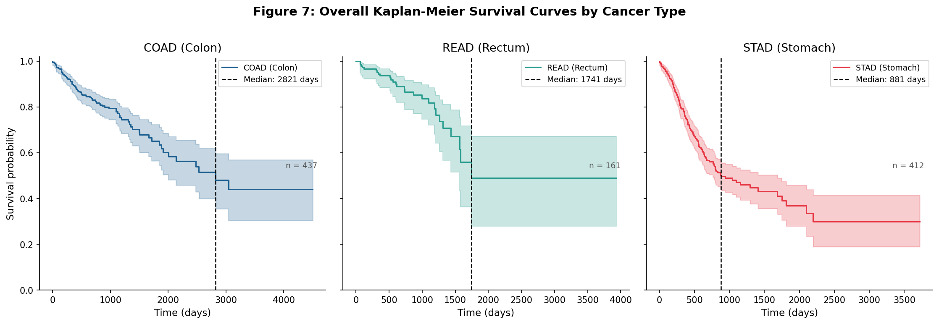
Kaplan-Meier: Overall Survival
COAD: median survival 2,821 days
READ: median survival 1,741 days
STAD: median survival 881 days, far worse
Curves were fitted per cancer, then stratified by stage, sex and age with a log-rank test; stage is highly significant in all three (p < 0.001). These censoring-aware medians exceed the naive EDA medians because the estimator accounts for censored patients.
12

Slide 13
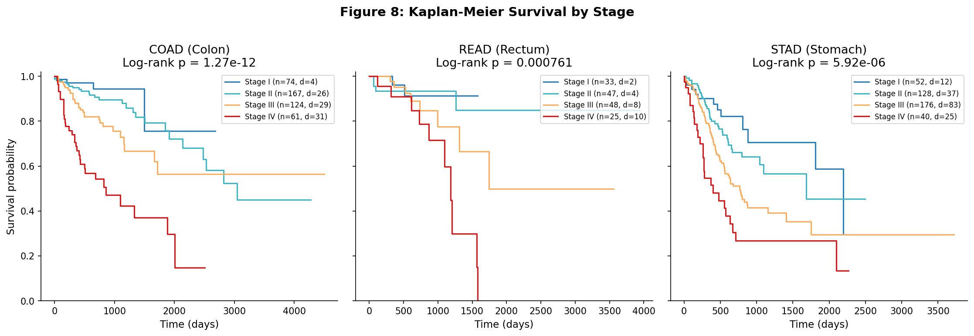
Kaplan-Meier: Survival by Stage
COAD: clean stage separation (p = 1.3e-12)
READ: separation (p = 7.6e-4)
STAD: significant (p = 5.9e-6); tail unstable
Stage is the strongest and most consistent predictor of survival, highly significant in all three cancers. READ Stage I/II have few events; STAD ordering inverts in the long tail where few remain at risk.
13

Slide 14
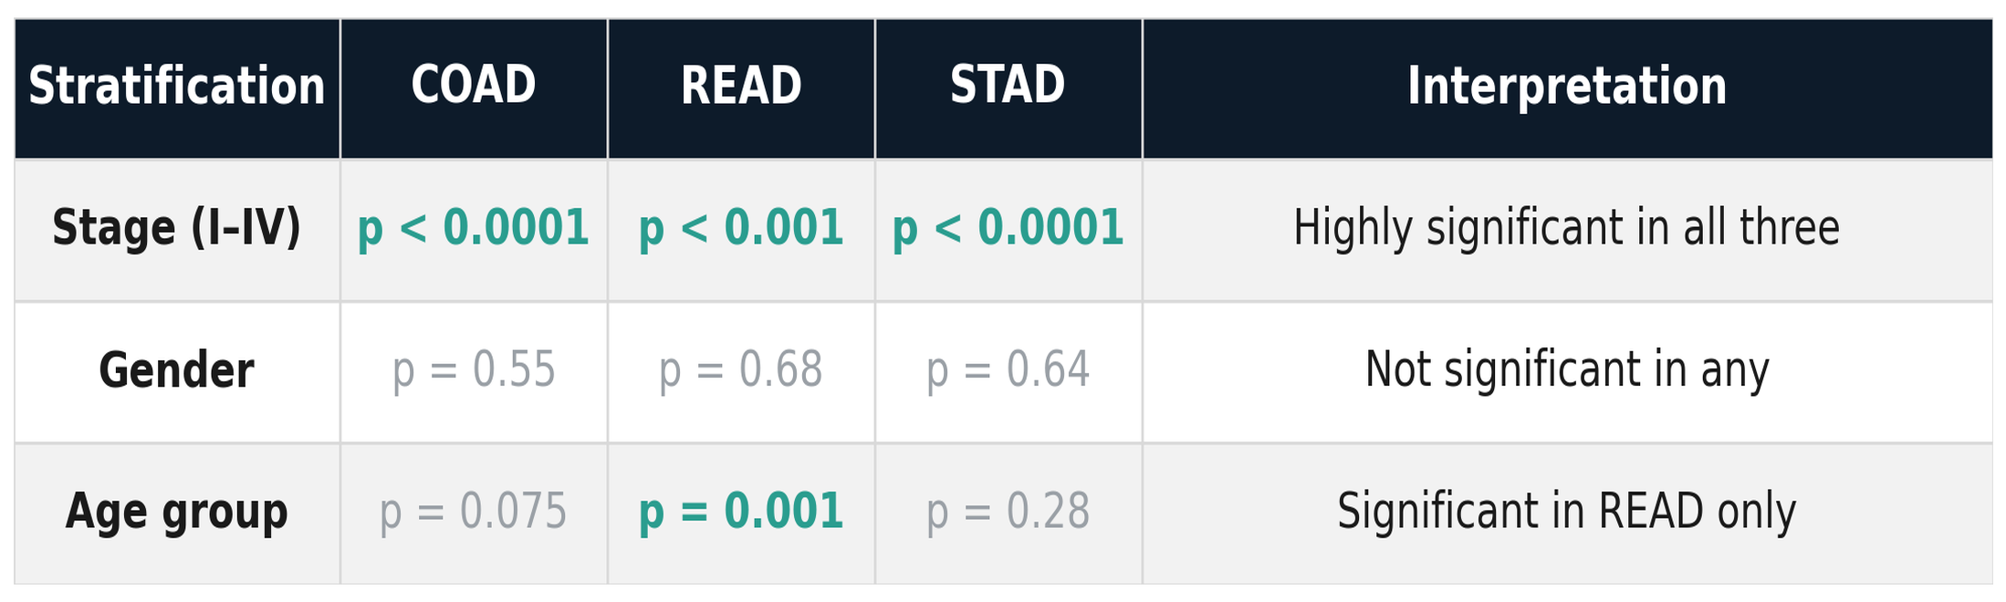
Log-Rank Test Summary
Interpretation
Stage is the dominant predictor, significant in every cancer. Age is significant in READ only; gender is not significant in any cohort (unadjusted). Stage, age and gender are the stratifiers tested here; the Cox model in Phase 4 additionally adjusts for T/N/M stage, prior malignancy, residual disease, treatment and demographics.
14

Slide 15
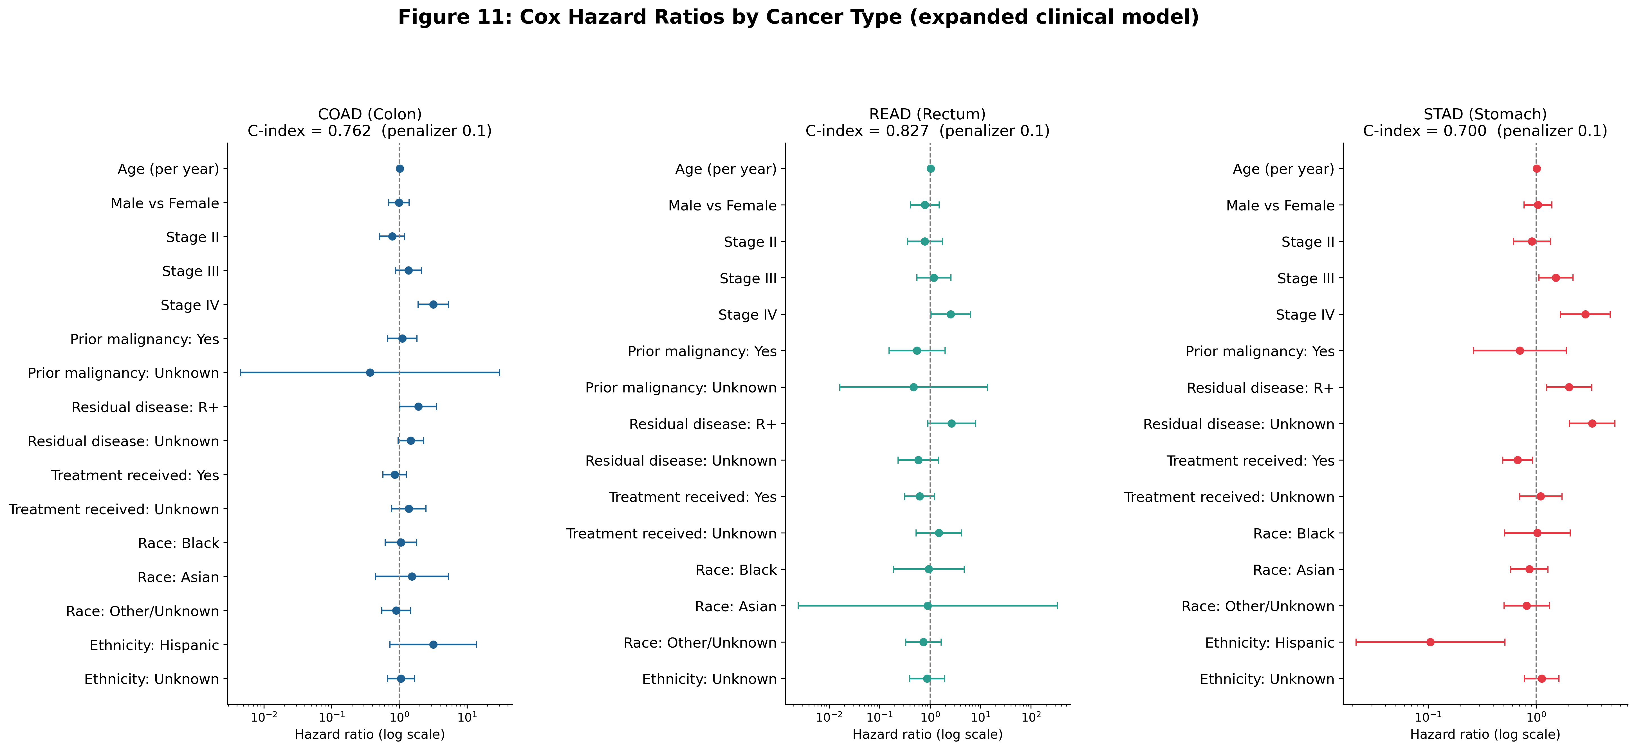
Cox Regression: Hazard Ratios
Stage IV carries roughly 3x the Stage I risk in every cancer, with residual disease the next signal. Penalised C-index 0.76 / 0.83 / 0.70.
15

Slide 16
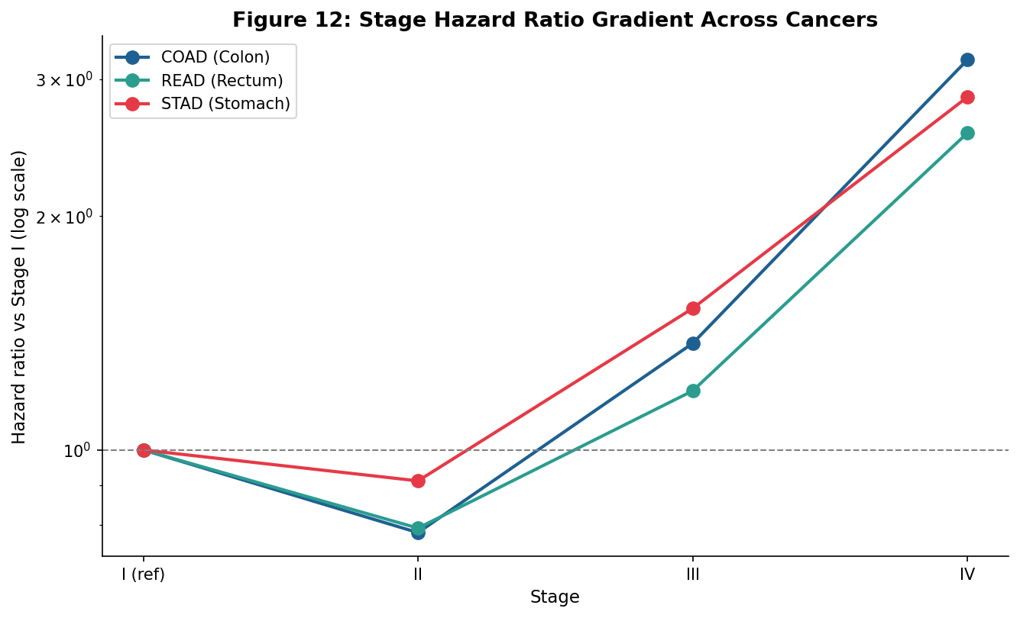
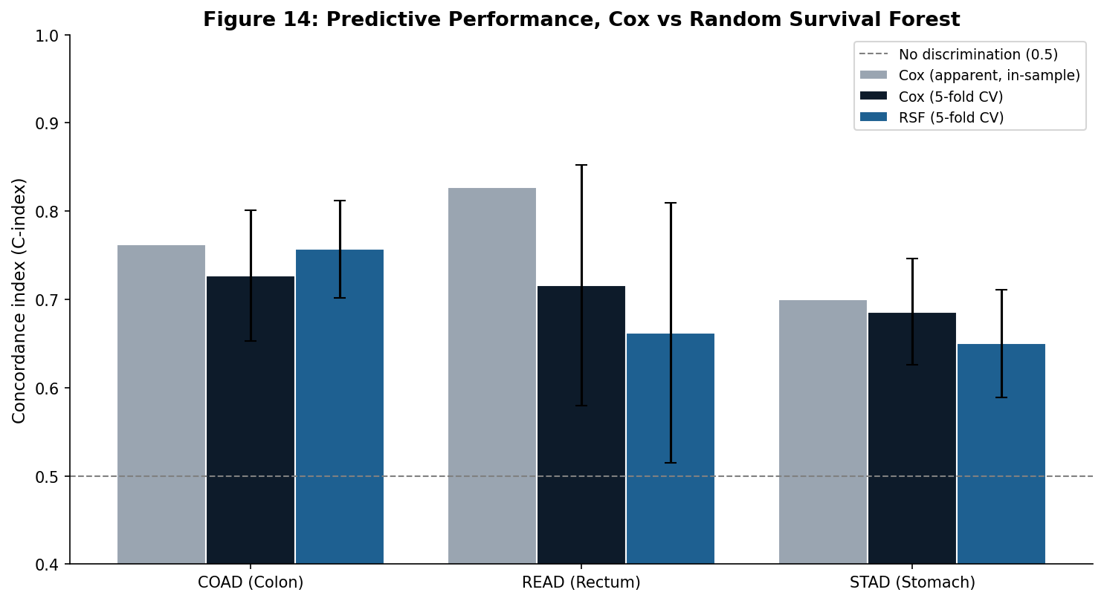
Stage Gradient and Model Comparison
Adjusted risk climbs steeply to Stage IV in all three cancers, the same direction across cohorts. This shared gradient is the defensible cross-cohort comparison.
Under matched 5-fold cross-validation the two models discriminate comparably, so there is no substantial gain over Cox. Cox is kept as the primary, interpretable model.
16

Slide 17
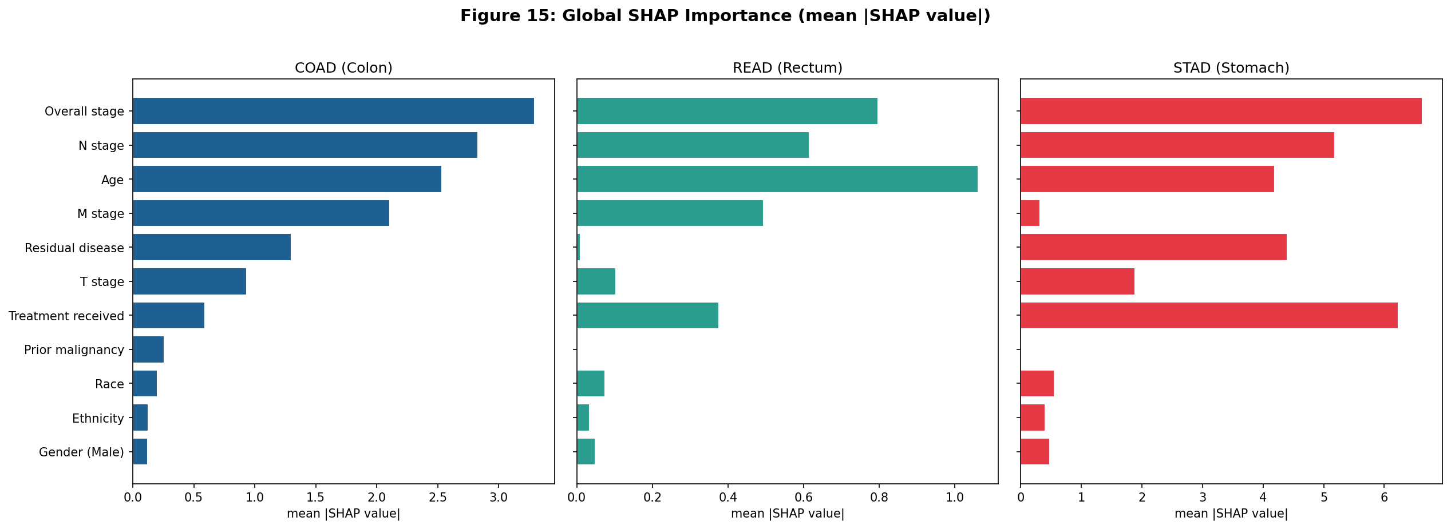
Feature Importance (SHAP)
SHAP on the forest confirms staging drives risk across all three cancers, with age also prominent and the single strongest factor in rectum. Residual disease matters in colon and stomach, and in stomach treatment received ranks among the top predictors. Race, ethnicity and gender are negligible throughout.
17

Slide 18
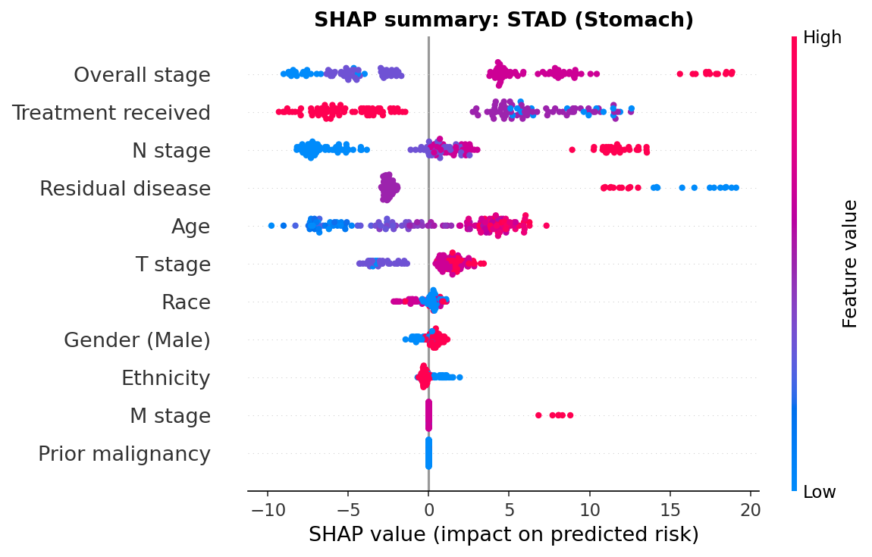
How Features Drive Predicted Risk (SHAP)
Stomach shown. Each dot is a patient, coloured by feature value. Later stage, residual disease and older age push predicted risk higher (positive SHAP), while receiving treatment lowers it, consistent with the Cox model though treatment is likely confounded by indication. Demographics have little effect. Colon and rectum are in the supplementary slides.
18

Slide 19
Adjusted Comparison: Colon vs Stomach
The Question
The Answer
Why It Matters
Does colon have worse survival than stomach once we adjust for age, stage and sex? Unadjusted, stomach looks far worse, but it is also caught at a later stage, so a fair test has to hold stage constant.
No. Pooling both cancers in one Cox model, colon carries 0.36 times the risk of stomach (colorectal 0.33 times), p < 0.0001. Stomach is about three times worse.
Because stage is already held constant, stomach is worse stage-for-stage. Its poor prognosis is intrinsic to the disease, not just a result of being diagnosed later.
19

Slide 20
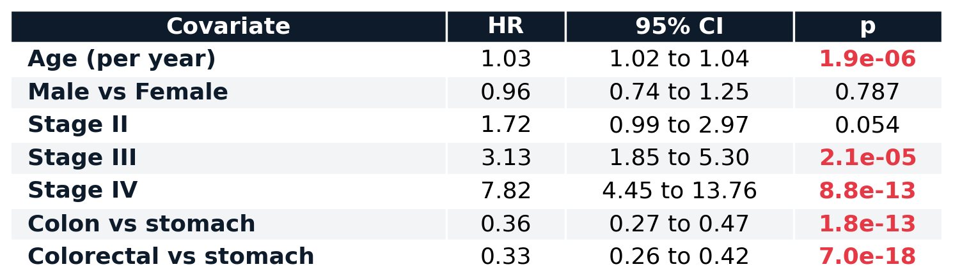
Adjusted Comparison: The Full Model
Pooling the cohorts and adjusting for age, stage and sex. Colon carries a hazard ratio of 0.36 against stomach (colorectal 0.33), so stomach is about three times worse stage-for-stage: the excess is intrinsic, not a consequence of later diagnosis. The stage gradient is steep (Stage IV HR 7.82) and age is significant; sex is not.
20

Slide 21
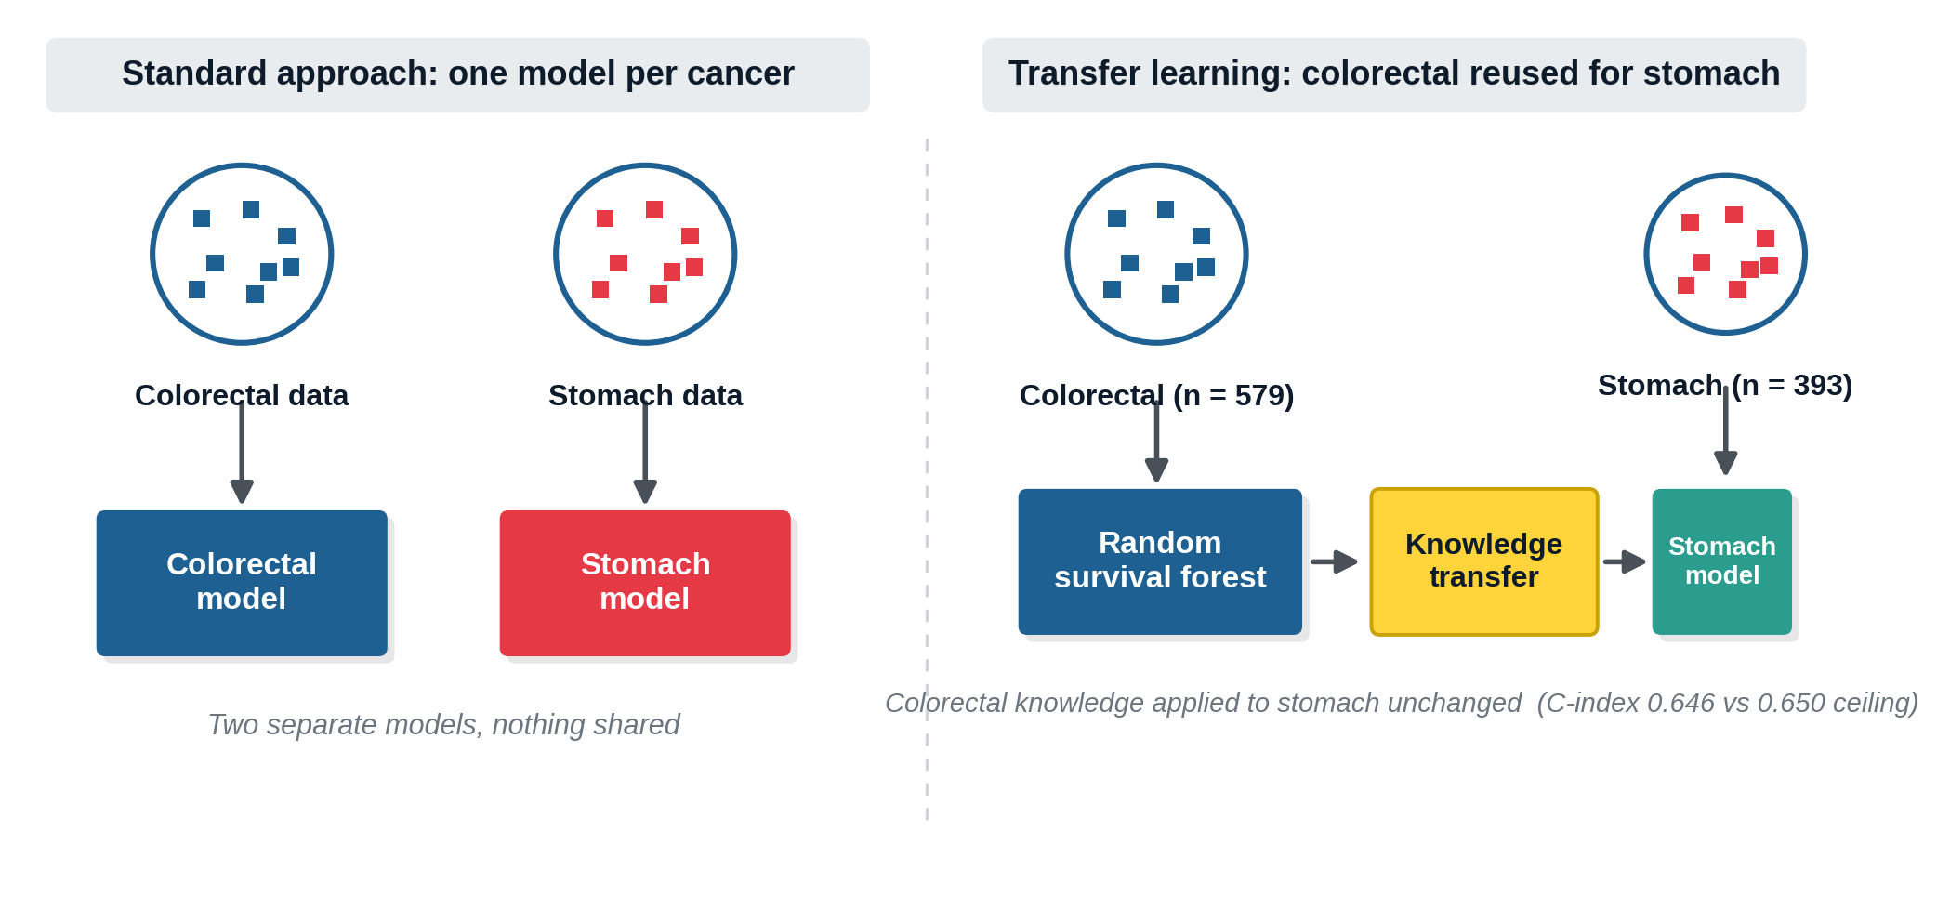
Transfer Learning: Colorectal to Stomach
A random survival forest trained only on colorectal patients is applied to stomach with no refitting. Because the same clinical predictors drive both cancers, colorectal knowledge transfers and the model ranks stomach patients too.
21

Slide 22
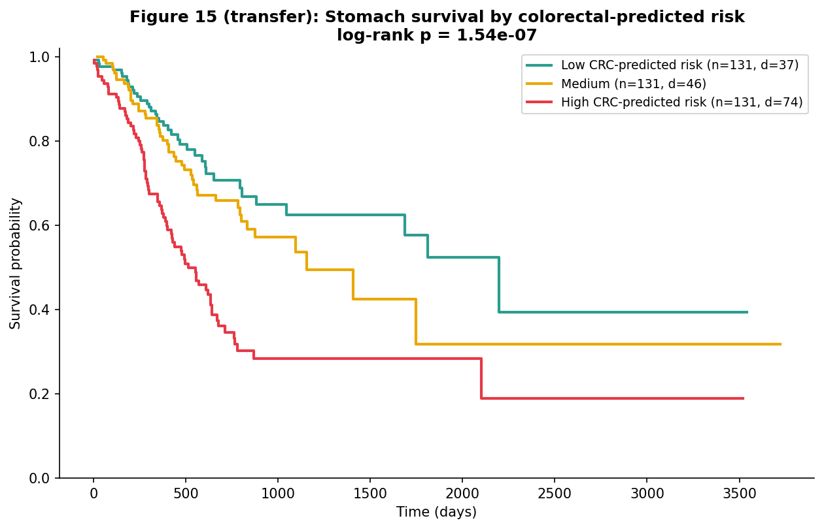
Colorectal Risk Transfers to Stomach
A random survival forest trained only on colorectal patients, never shown a single stomach case, ranks stomach patients almost as well as a stomach-trained model (C-index 0.646 against 0.650). Its predicted risk splits stomach survival cleanly (log-rank p = 1.5e-7): the high-risk third does far worse. Discrimination transfers; calibration is weaker (Brier 0.192), because the two cancers sit at different absolute risk levels.
22

Slide 23
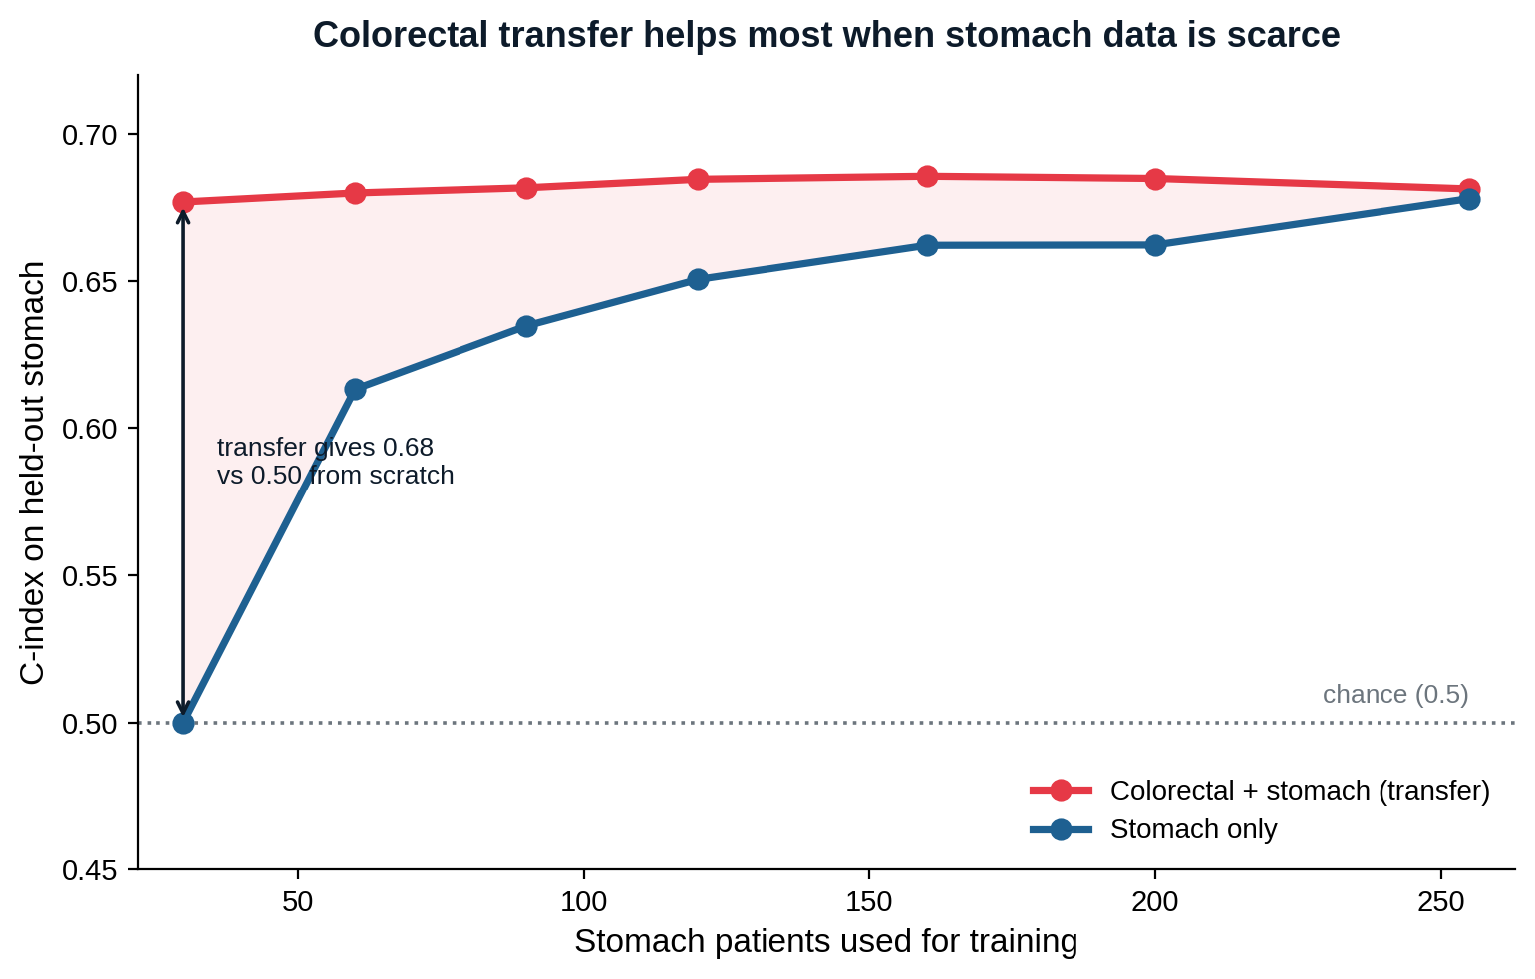
Transfer Helps Most When Stomach Data Is Scarce
A colorectal-trained forest already scores 0.68 on stomach with almost no stomach training data, where a stomach-only model sits at chance. The two converge once stomach data is plentiful, so colorectal transfer matters most when the target cohort is small.
23

Slide 24
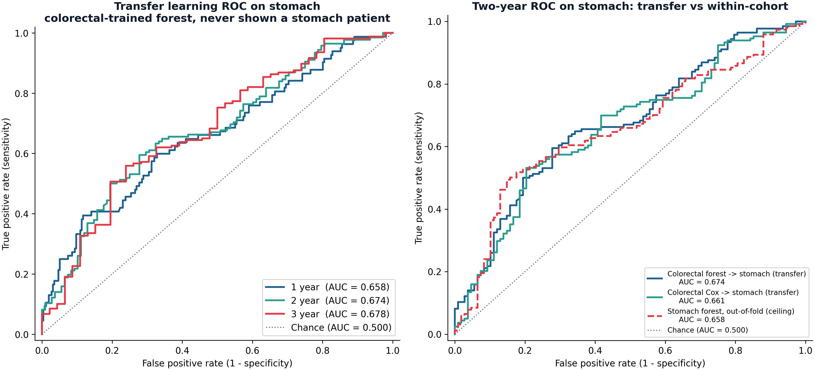
ROC-AUC of the Transferred Model
Time-dependent ROC, inverse-probability-of-censoring weighted: the survival equivalent of a classification ROC, since a plain ROC is invalid under censoring. Left: the colorectal-trained forest on stomach at one, two and three years (AUC 0.658, 0.674, 0.678), consistent with the mean time-dependent AUC of 0.671. Right: at two years a Cox transfer (0.661) and a stomach-trained forest (0.658) land on the same curve.
24

Slide 25
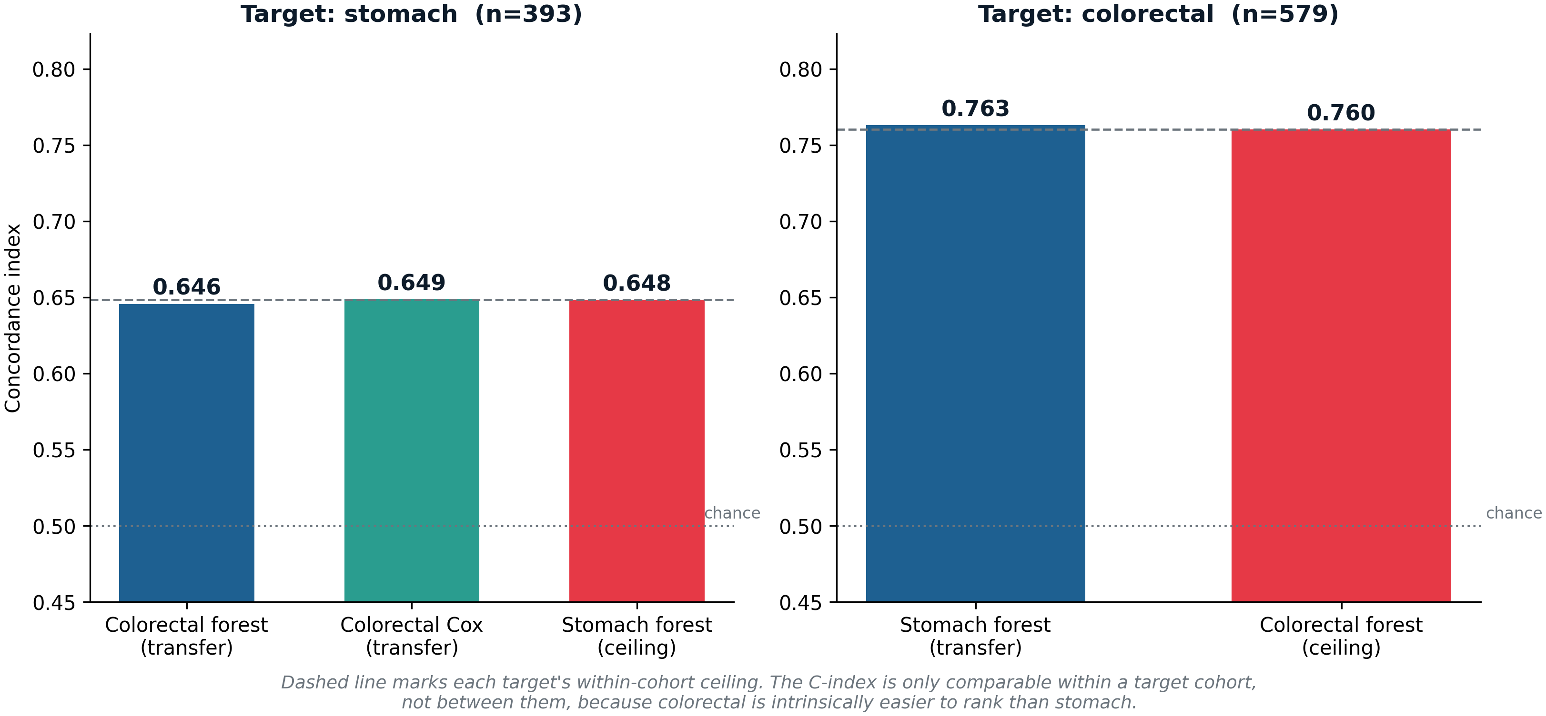
Transfer Reaches the Ceiling in Both Directions
Each transfer is judged against its own target's within-cohort ceiling, because the C-index is not comparable between cohorts. On stomach, the colorectal-trained forest scores 0.646 against a 0.648 ceiling; on colorectal, a stomach-trained forest scores 0.763 against a 0.760 ceiling. Both reach 100%: a model trained on one gastrointestinal cancer ranks patients in the other as well as a model trained on that cancer itself.
25

Slide 26
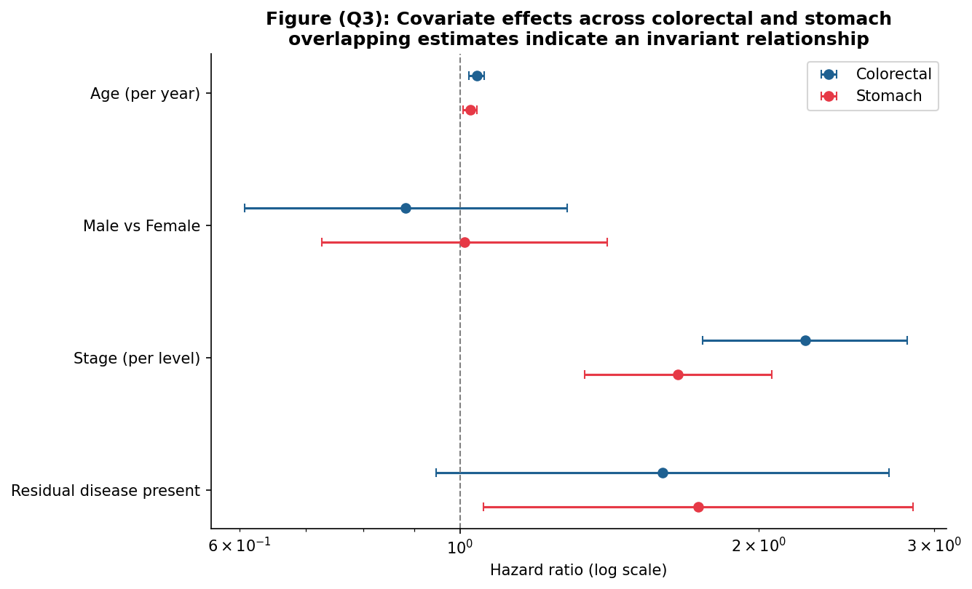
The Same Predictors Drive Both Cancers
Testing each predictor for a different effect in colorectal versus stomach, none differs significantly. Age, stage and residual disease raise risk the same way in both, and sex is null in both. Because the predictors are invariant across the cancers, a model learned on colorectal generalises to stomach, which is exactly why the transfer works. Prior GI studies report the same shared prognostic structure across related cohorts, so this doubles as external validation (Saegusa et al., 2021; Zhou et al., 2023).
26

Slide 27
Conclusions
What predicts survival
How the cancers relate
The one difference
Stage dominates in all three cancers, residual disease comes second, and demographics carry no signal once adjusted. A simple Cox model is as accurate out of sample as the random survival forest.
The same predictors behave the same way across colorectal and stomach, so a colorectal-trained model transfers to stomach and picks out its high-risk patients. This cross-cancer transfer benefit is consistent with Sabbatini et al. (2026).
Ranking is shared, but absolute risk is not. Stomach is about three times worse stage-for-stage, an intrinsic aggressiveness rather than late diagnosis.
27

