Slide 1

Contact Management System
A C# Application for Streamlined Contact Organization

Slide 2

About the Team
Anmol Toor (200578497)
Manyue Javvadi (200575638)
Reference: https://learn.microsoft.com/en-us/aspnet/core/security/authorization/secure-data?view=aspnetcore-6.0

Slide 3
Problem Statement: The Challenges of Contact Management
Difficulty in keeping track of paper contacts
Spreadsheets become cumbersome with large numbers of contacts
Lack of efficient search and organization tools
Potential for data loss or damage with physical methods

Slide 4
Our Solution: Introducing the contact Management System
User-friendly interface for easy navigation
Secure storage of contact information (name, email, phone number, address, etc.)
Admin/Manager Privileges to Approve or Reject Contact
User Specific secure contact Manger space

Slide 5
Demonstrations
Let us walk through the application User Interface and Features

Slide 6

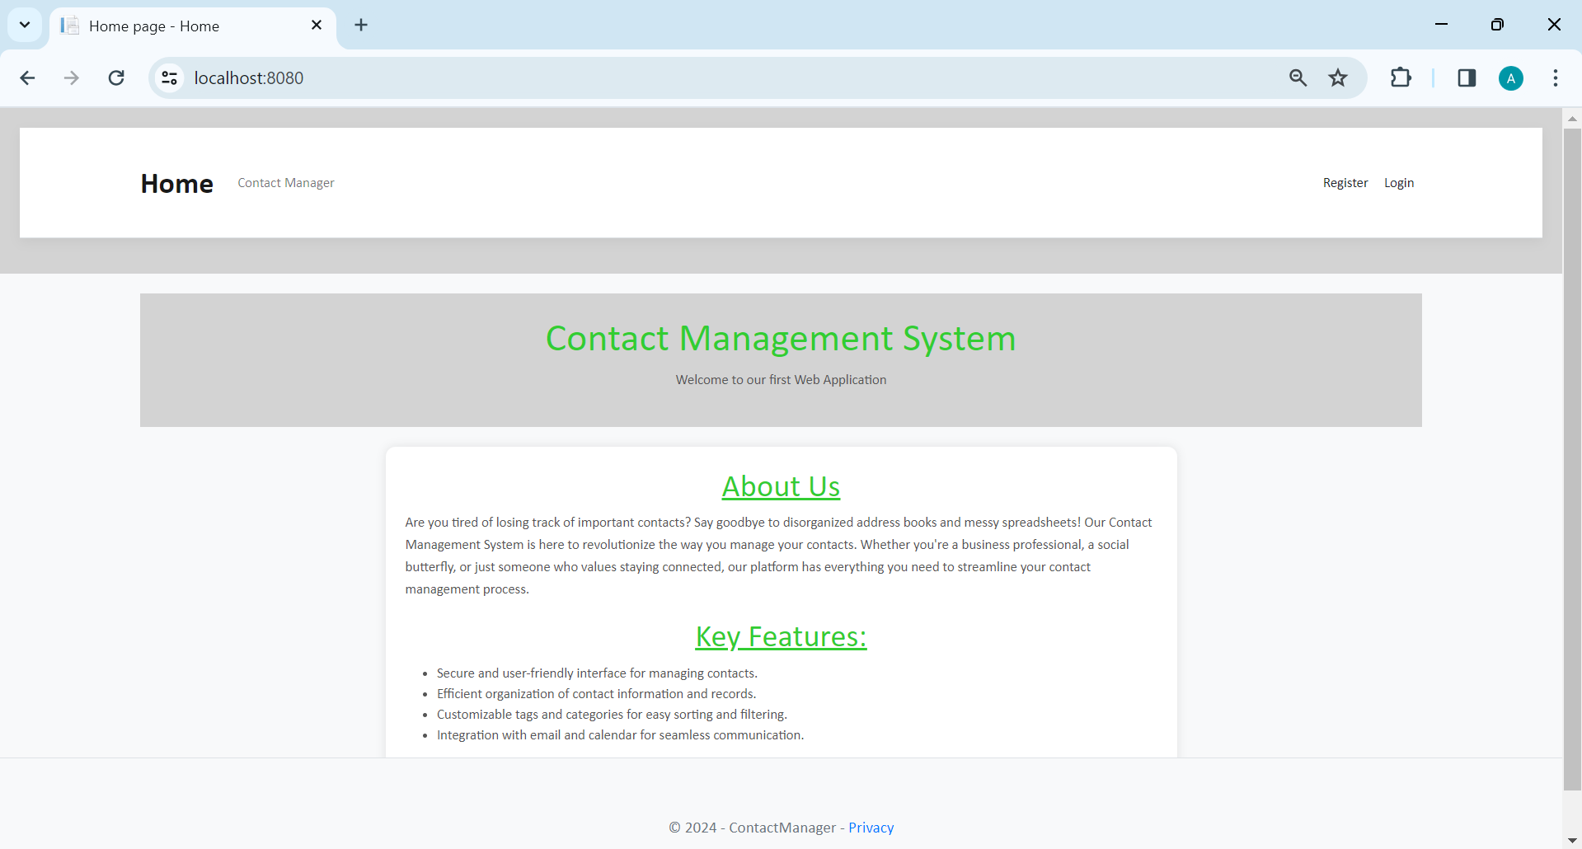
Home Page

Slide 7
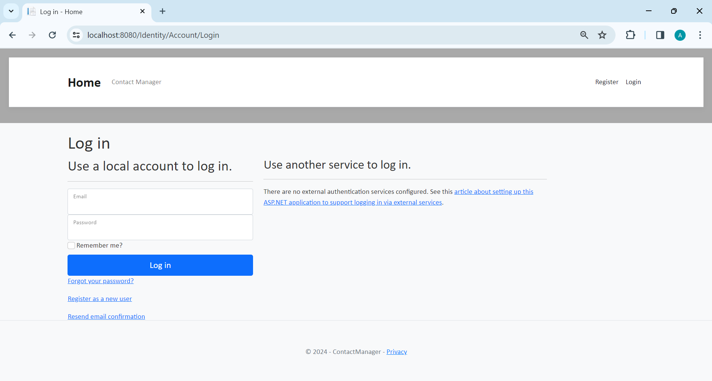
Login Page

Slide 8
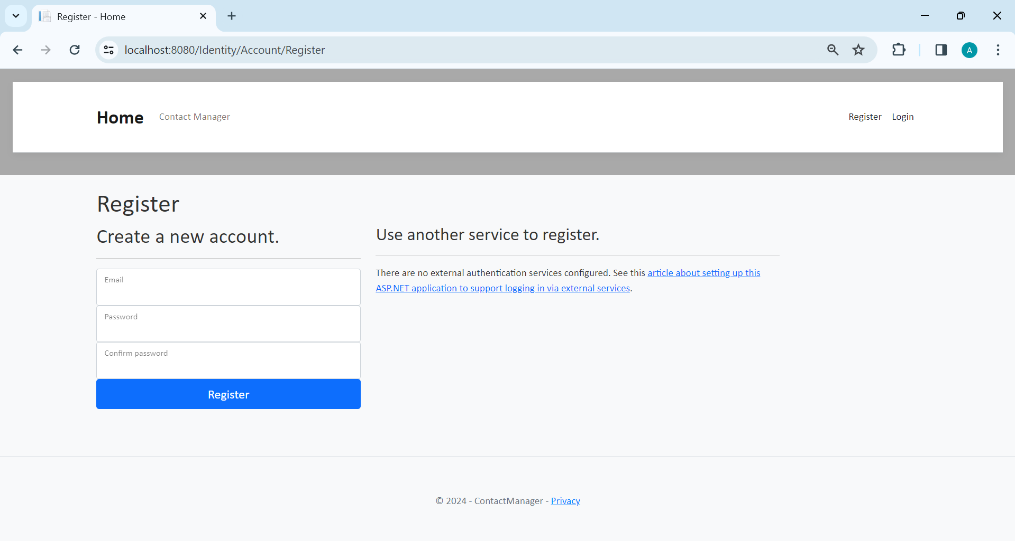
Registration Page

Slide 9
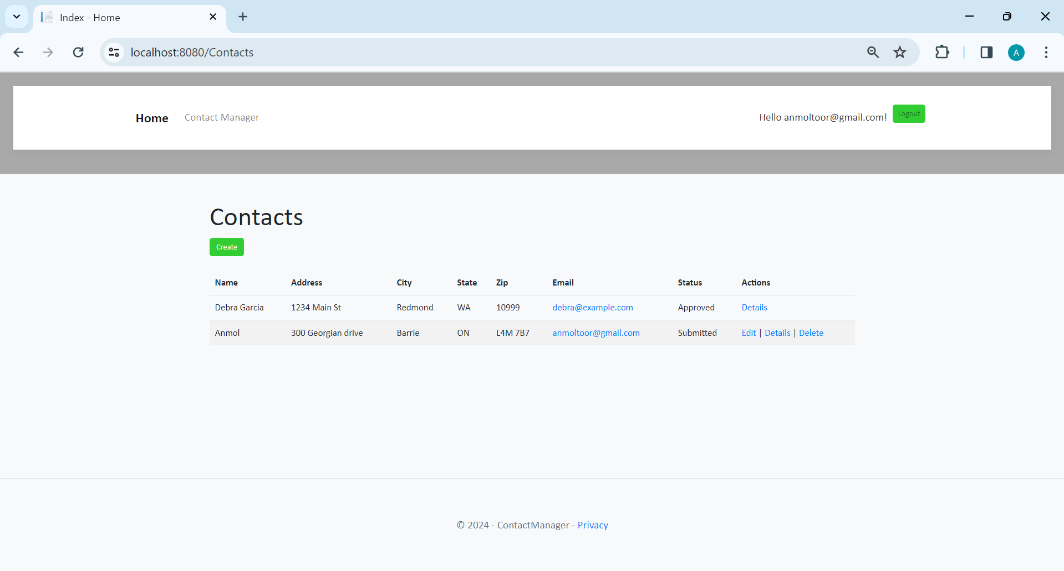
Registered User
Registered users can view all the approved data and can edit/delete their own data.

Slide 10
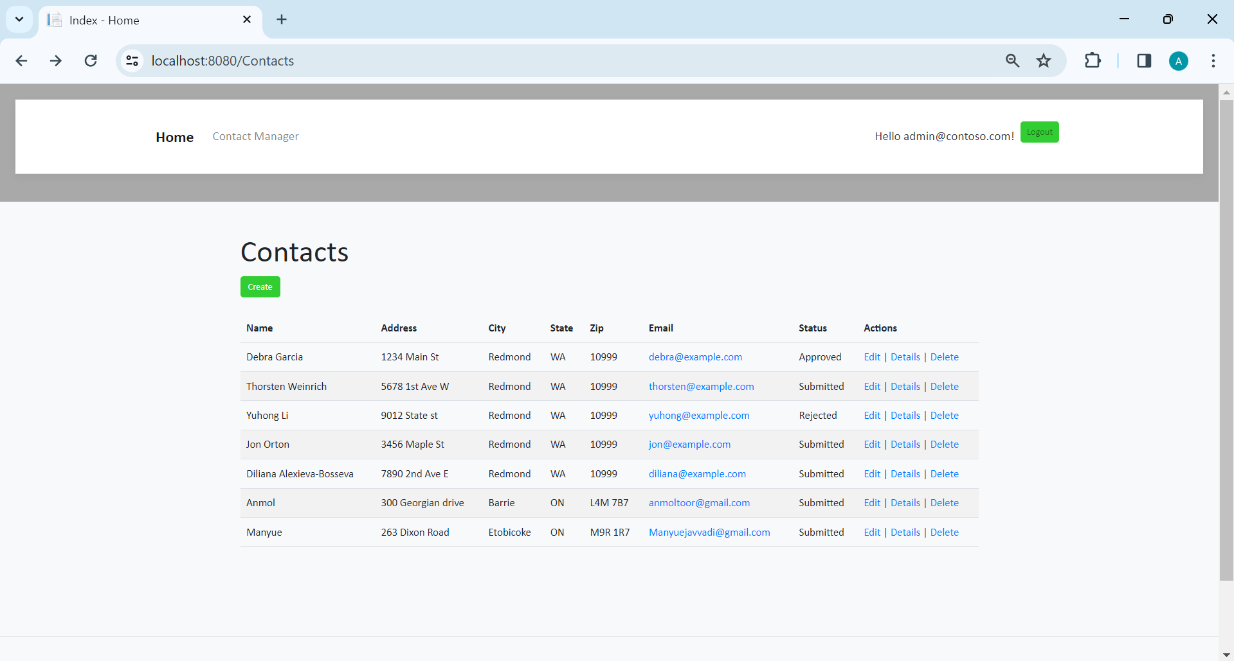
Admin
Administrators can approve/reject and edit/delete any data.

Slide 11
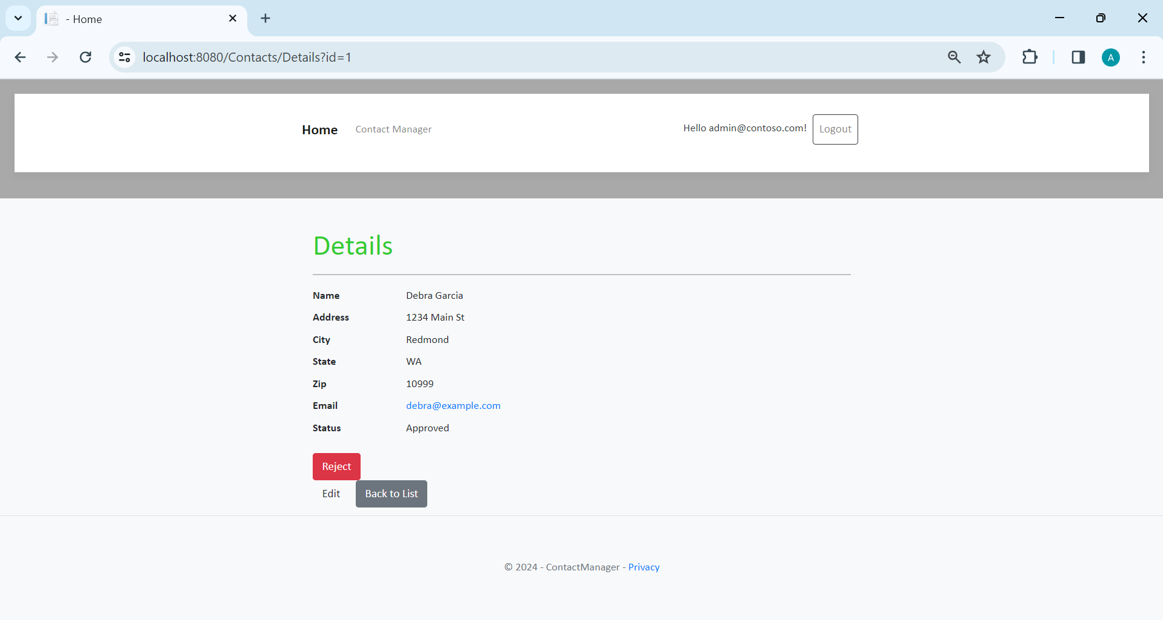
Admin has privilege to Approve or Reject the Contact of the Register Users.

Slide 12
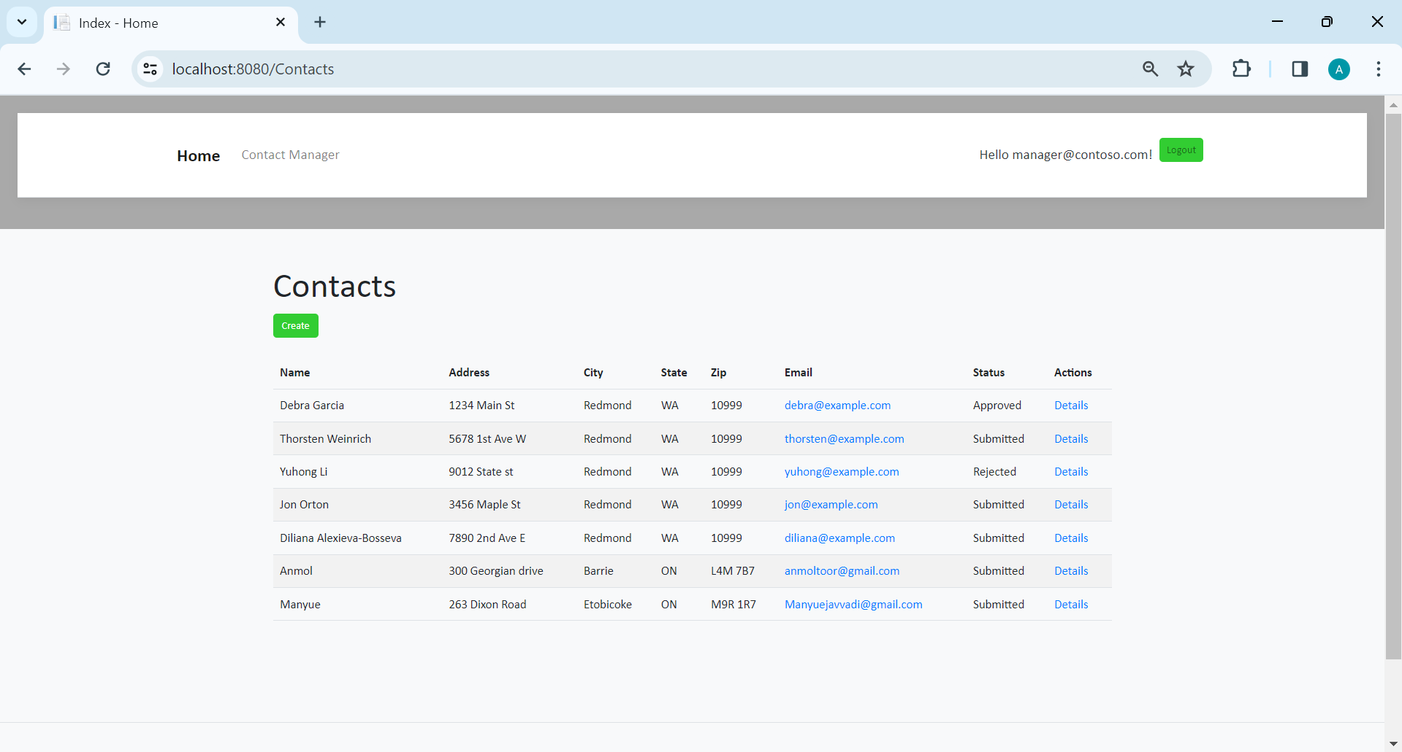
Manager
Managers can approve or reject contact data. Only approved contacts are visible to users.

Slide 13
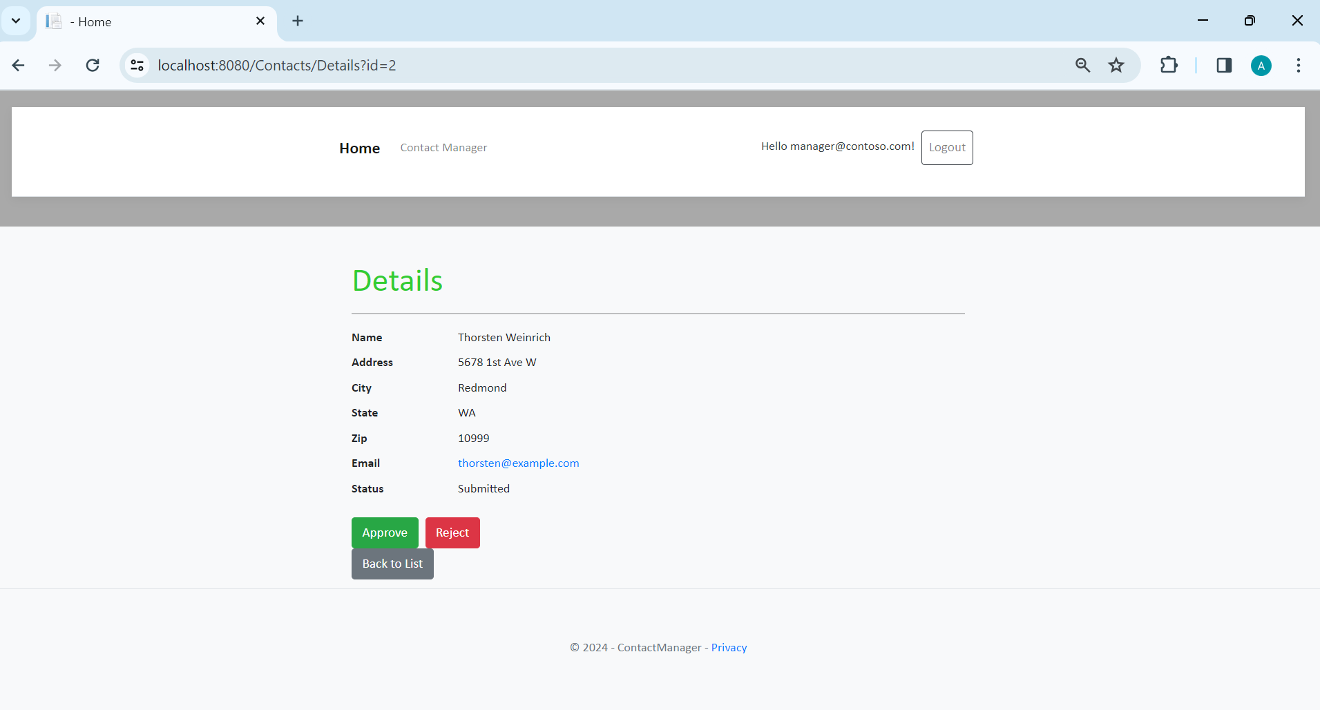
Manager has privilege to Approve or Reject the Contact of the Register Users.

Slide 14

Challenges and Learnings
Complex Data Modeling: Navigating intricate data relationships and ensuring database integrity.
User Experience Design: Balancing functionality and user-friendly interface design for optimal usability.
Team Collaboration: Coordinating tasks and managing project scope for effective teamwork

Slide 15
Conclusion
The successful implementation of the Contact Management System demonstrates our commitment to delivering a high-quality, user-centric solution that addresses the needs and challenges of contact management effectively.
Through collaborative efforts, innovative solutions, and a customer-centric approach, we have achieved our goal of creating a robust and feature-rich CMS that empowers users to manage their contacts efficiently and communicate effectively.

Slide 16
Thank You
Anmol Toor
Manyue Javvadi
https://github.com/Anmol-toor/Contact_Management_System

