Slide 1

Integrated Data Analytics

Slide 2

MongoDb
MongoDB is a database based on a non-relational document model.
The data stored in the MongoDB is in the format of BSON documents. Here, BSON stands for Binary representation of JSON
Customer transaction information is stored to track their credit usage.

Slide 3
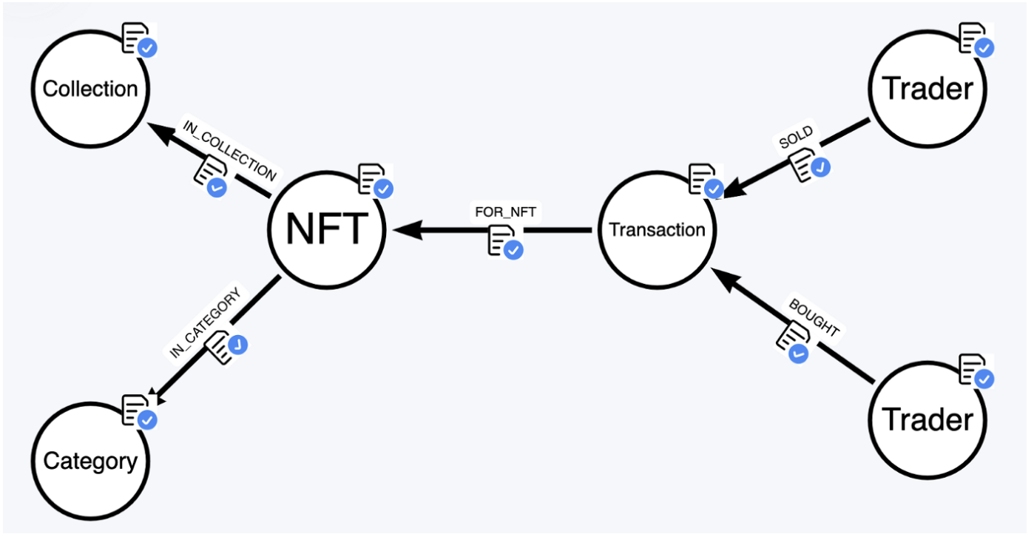
Neo4j – Graph Database
Neo4j is a graph database management system developed by Neo4j, Inc. Described by its developers as an ACID-compliant transactional database with native graph storage and processing
In graph database context, there are two ways to represent data which are Nodes and Edges
Both Nodes and Edges can have its own properties (attributes)

Slide 4

Integration of Neo4j and MongoDb
In this project, we’ve used used python to connect with Neo4j and MongoDb.
After their connection with python, Nodes were made based on the relation given in MongoDb database.
Graph structure made to analyze the parameters of a customer.

Slide 5
Data Analysis
Nodes relationship were made in Neo4j based on data collected from Mongodb.
Credit score of a particular customer was calculated.
Associated credit score was used to measure the loan amount that can be credited to a specific customer.

