Slide 1
AI TRACK · IBM BOBATHON 2026
TrialGuard AI
Clinical Trial Risk Monitor and Protocol Deviation Detector
"Don’t wait for the audit. Detect deviations early, predict site risk, explain the cause, generate the action plan."
Team Bob The Builder
01

Slide 2
THE PROBLEM
Audits Catch It Too Late
WHAT'S HAPPENING
119 deviations
Protocol deviations: missed visits, dosing errors, prohibited medications, eligibility violations, late data entry are mostly caught through periodic audits and manual monitoring visits, well after they’ve already affected multiple patients.
Average per Phase III protocol. Touching ~1/3 of enrolled patients
Deviation records, protocol rules, and site history typically sit in separate systems. There’s no single place that explains which site is quietly becoming a problem before the next inspection.
40%+
WHO FEELS IT
Of patients affected in some oncology trials, the highest of any therapeutic area
Study / clinical trial risk managers overseeing multiple sites
Site coordinators who need visibility into their own compliance
Auditors and regulatory affairs teams
Sponsors and CROs running multi-site trials
30%
Of FDA inspection warning letters cite failure to follow the protocol
Regulators often catch this before sponsors do internally.
02

Slide 3
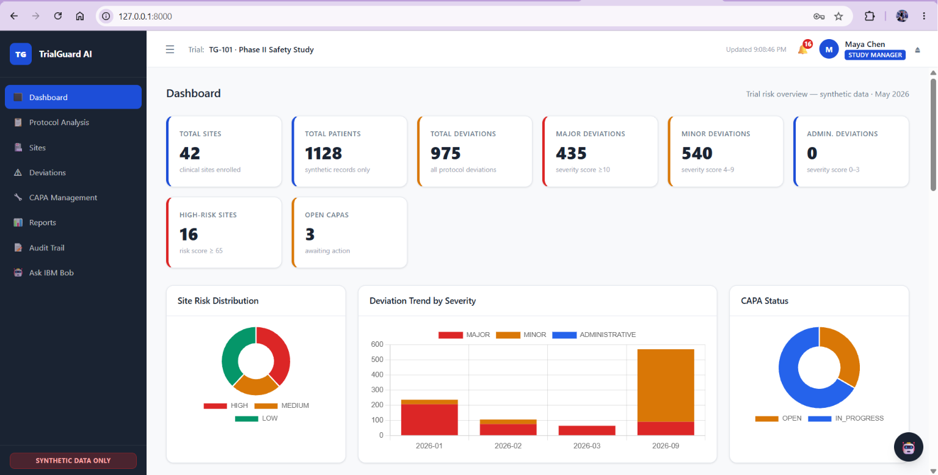
THE SOLUTION
One Pipeline, End to End
TrialGuard AI compares live site data against protocol rules, automatically detects and classifies deviations, scores every site’s current and predicted risk, and lets a risk manager ask IBM Bob “why” and get an evidence-backed answer plus a ready CAPA.
Protocol
→
Patient /
Site Data
→
Protocol
Comparison
→
Deviation
Detection
→
Severity
Classification
Site-Level
Risk Analysis
→
Predictive
Risk
→
IBM Bob
Investigation
→
Recommended
Actions
→
CAPA
Report
03

Slide 4
UNDER THE HOOD
Architecture
Frontend
AI / Agent Boundary
Single-page app in plain HTML, CSS, and vanilla JavaScript (index.html, styles.css, app.js). No framework. Talks to the backend only over REST and JSON.
13 MCP-ready tool contracts sit between the app and IBM Bob. Bob calls a tool (e.g. get_site_risk), the tool calls the service, the service queries MongoDB, and a structured JSON result returns for Bob to explain in plain language.
Backend
Security
Python standard library http.server, split into modular services: engines.py (deviation engine, severity classifier, site risk engine), services.py (CAPA generation), bob_boundary.py (Bob tool contracts), database.py (repository layer).
Server-side role-based access control on every route, PBKDF2 password hashing, session-based authentication, and Bob tool access scoped by the logged-in user’s role.
Database
MongoDB via PyMongo for all persistent collections (users, sites, patients, visits, deviations, risk scores, CAPA records, audit events). Falls back to an in-memory repository automatically if MongoDB is unreachable.
Browser
→
http.server
→
Engines
→
MongoDB
04
MCP tool layer ↔ IBM Bob

Slide 5
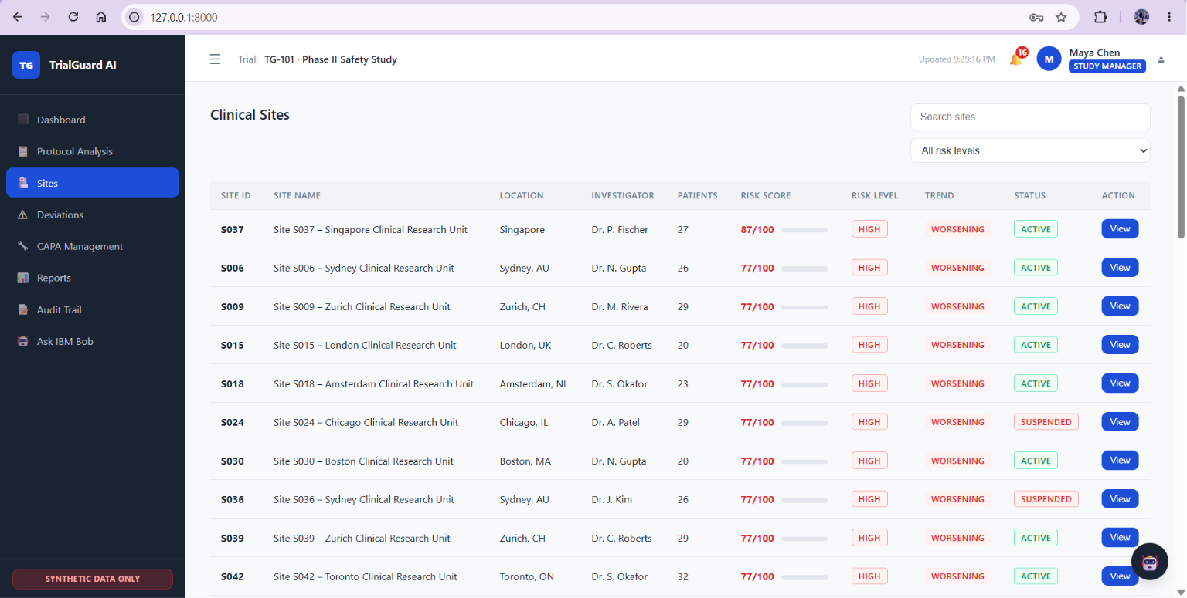
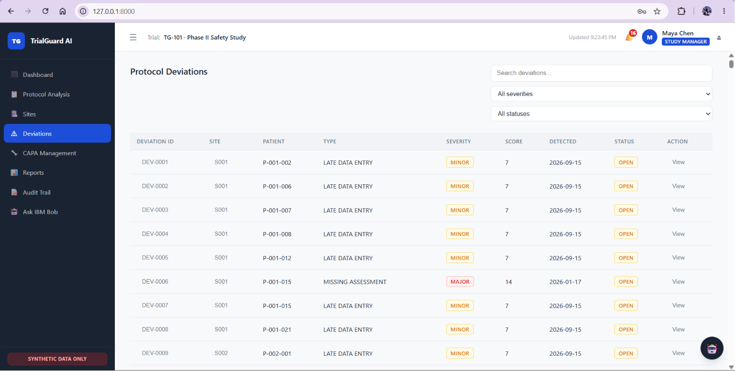
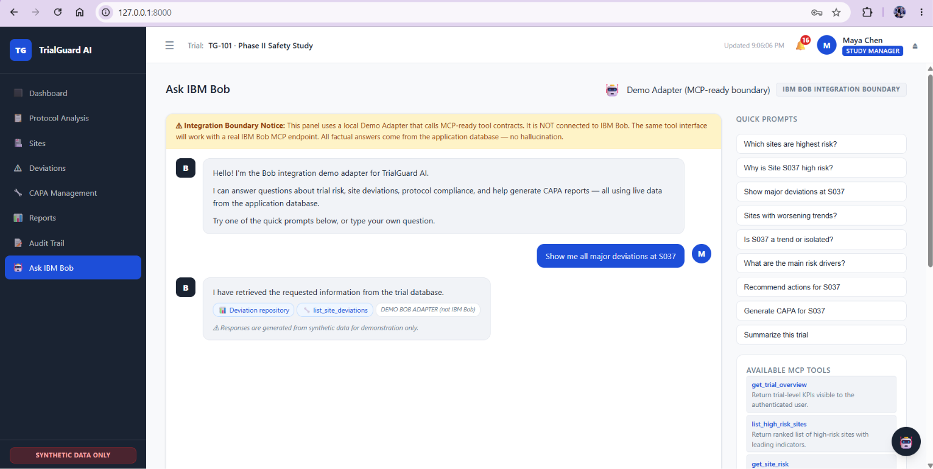
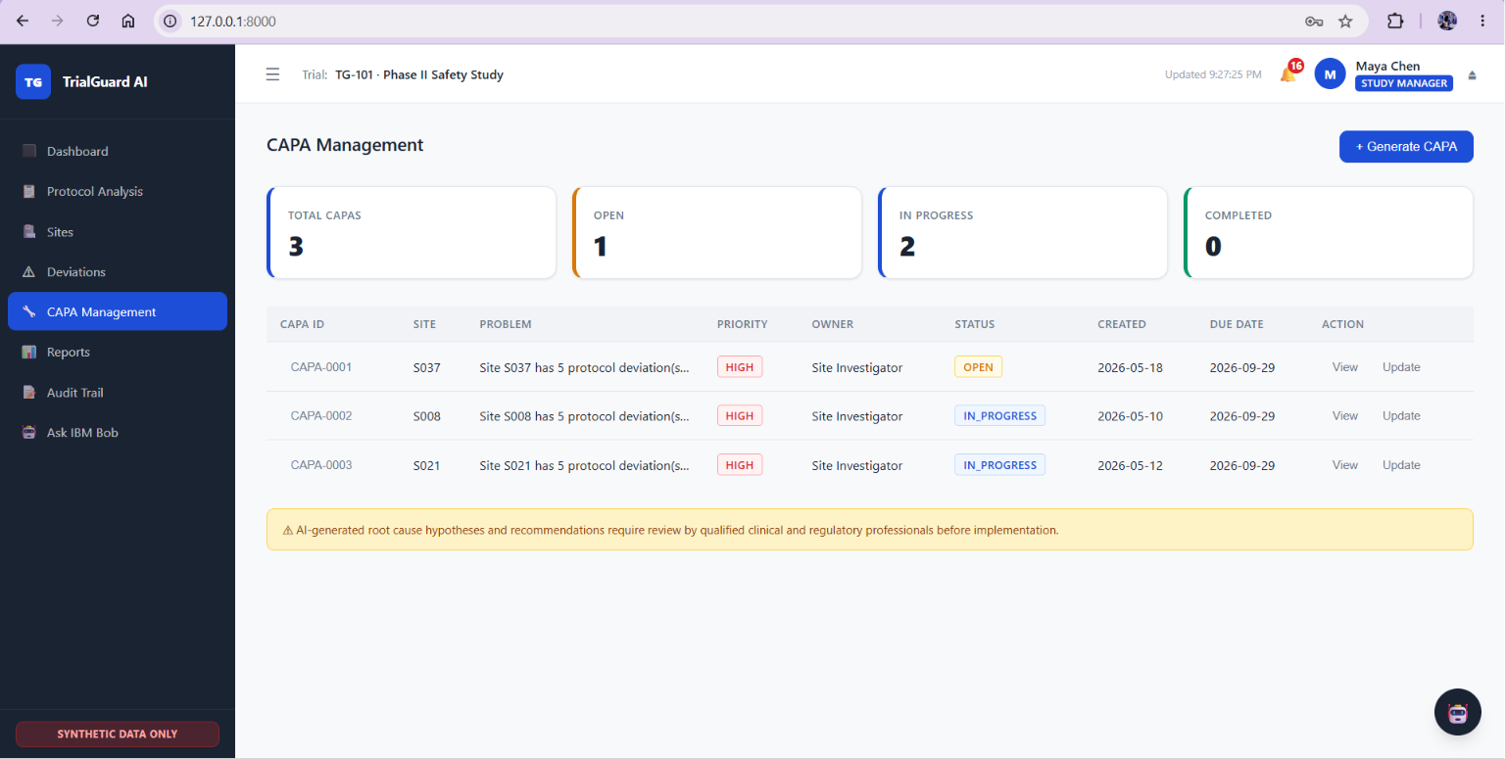
DEMO WALKTHROUGH
Predictive Site Risk + IBM Bob
Demonstration Link: https://drive.google.com/file/d/11EevCuju7d8nsmjDWvEXVL2--p_WmRd4/view?usp=drive_link
1
Site S037 risk detail
Current score 87/100 -> level HIGH -> trend WORSENING
Site risk
detail page
2
Leading indicators
Repeated dosing deviations, increasing missed visits, data-entry delays
3
Drill into a MAJOR deviation
Expected dose 100 mg vs. actual 150 mg
Clinical Sites
Deviations
4
Ask IBM Bob: “Why is Site S037 high risk?”
Answered using actual database tool results, not free-form text
5
Ask Bob: “Generate a CAPA for Site S037”
Problem statement, root-cause hypothesis, corrective & preventive actions
Ask IBM Bob
CAPA Management
05

Slide 6
IBM TECHNOLOGIES
The IBM Bob Integration Boundary
A dedicated module exposes 13 MCP-ready tool contracts: each with a tool name, description, input schema, output schema, and authorization requirement.
get_trial_overview
list_high_risk_sites
get_site_risk
explain_site_risk
list_site_deviations
get_deviation
search_protocol_rules
compare_patient_to_protocol
get_site_trends
recommend_site_actions
generate_capa
get_capa_status
generate_risk_report
Role-based permission inheritance: every Bob tool call runs under the logged-in user’s role; a Site Coordinator asking about a site outside their assignment is refused at the tool layer itself.
Built for a real IBM Bob connection later: the shipped demo adapter is clearly labeled in the UI as not IBM Bob, but calls the exact same tool contracts a live IBM Bob or MCP endpoint would.
No invented trial facts: every factual claim Bob makes comes from these tool results and the underlying MongoDB data.
06

Slide 7
RESULTS & IMPACT
Flagged Before the Audit, Not After
42
1,128+
~975
87/100
13
100
synthetic sites
synthetic patients
deviations detected
across 7 types, vs. 8 rules
Site S037: HIGH risk,
WORSENING, 3 indicators
MCP-ready Bob tools,
all role-gated
automated tests passing
Full demo flow: Login through CAPA generation to audit trail and is reproducible in under 5 minutes, with zero external dependencies since MongoDB is optional.
WHY THIS MATTERS AT SCALE
Onsite monitoring is consistently one of the largest cost lines in a trial’s budget, running into six or seven figures per trial.
Industry guidance (ICH E6(R2)) explicitly pushes trials toward risk-based, proportionate monitoring that concentrates effort on higher-risk sites instead of spreading it evenly. A predictive, explainable site risk score is a direct enabler of that shift.
07

Slide 8
BOB THE BUILDER
The Team
PS
PP
PD
JS
Parita Shah
Pranay Pandey
Priyanshi Dalwadi
Jiya Shah
Team Lead
Lead Engineer
Documentation & Presentation
Demo & QA
Project coordination and overall solution architecture
Built the core application - backend services, deviation and risk engines, and the IBM Bob integration boundary
Built the pitch deck and project documentation
Built and validated the end-to-end demo flow
08

