Slide 1

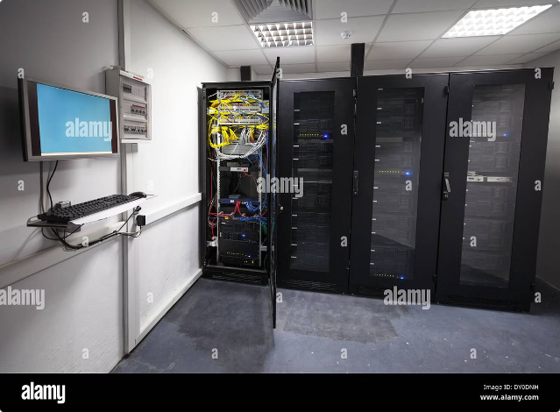


API Endpoints Overview
This presentation outlines the key API endpoints for our e-commerce platform. Each endpoint handles specific operations related to users, products, orders, and more.
by Anmol gupta

Slide 2


homeHandler
The homeHandler endpoint checks if a customer is a Prime member. It requires no authentication and returns information about the customer's Prime membership status.
Endpoint
/customerId={id}
Method
GET
Authentication
Not required
Response
Prime membership status

Slide 3
userHandler
The userHandler manages all user-related operations, including retrieval, creation, update, and deletion. Authentication is required for certain operations.
Endpoints
Other Endpoints
Authentication
/users
/registerCustomer
Required for update and delete operations.
/user/userId={id}
/registerSeller
/addUser
/login
/updateUser/userId={id}
/logout
/deleteUser/userId={id}
/forgotPassword
/changePassword

Slide 4


customerHandler
The customerHandler manages customer details and operations, including retrieval, creation, update, and deletion. Authentication is required for sensitive operations.
1
Retrieval
Retrieves all customers or a single customer by ID.
2
Creation
Adds a new customer.
3
Update
Updates customer information.
4
Deletion
Deletes a customer.

Slide 5


sellerHandler
The sellerHandler manages seller details and operations, including retrieval, creation, update, and deletion. Authentication is required for updating and deleting sellers.
Endpoint
Method
Authentication
/sellers
GET
Not required
/seller/sellerId={id}
GET
Not required
/addSeller
POST
Required
/updateSeller/sellerId={id}
PUT
Required
/deleteSeller/sellerId={id}
DELETE
Required

Slide 6






productHandler
The productHandler manages product-related operations, including retrieval, creation, update, and deletion. Authentication is required for adding, updating, and deleting products.
Retrieval
Retrieves products with pagination or a single product by ID.
Creation
Adds a new product.
Update
Updates product details.
Deletion
Deletes a product.

Slide 7

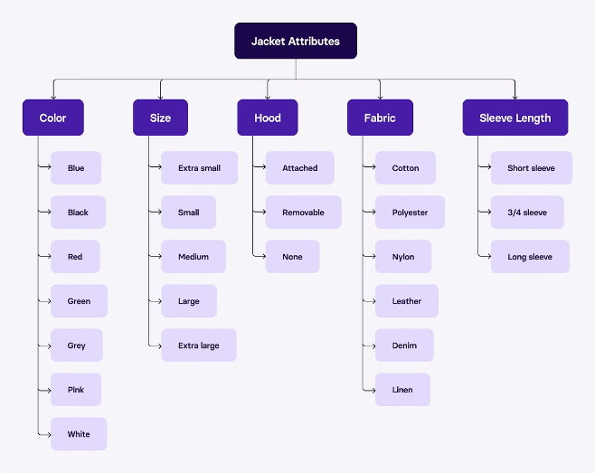



categoryHandler
The categoryHandler manages product categories, including retrieval, creation, and deletion. Authentication is not required for any operations.
Retrieval
Retrieves all categories or a single category by ID.
Creation
Adds a new category.
Deletion
Deletes a category.

Slide 8
cartHandler
The cartHandler manages operations related to shopping carts, including retrieval, adding items, removing items, and toggling buy status. Authentication is required for all operations except getting all carts.
Retrieval
1
Retrieves all carts or a cart by customer ID.
2
Adding Items
Adds items to a customer's cart.
Removing Items
3
Removes all items from a cart or a specific product.
4
Buy Status
Toggles the buy status of a product in the cart.
Quantity
5
Increases or decreases the quantity of a product in the cart.

Slide 9


wishlistHandler
The wishlistHandler manages wishlist-related operations, including retrieval, adding items, removing items, and removing all items. Authentication is required for all operations except getting all wishlists.
1
Retrieval
Retrieves all wishlists or a wishlist by customer ID.
2
Adding Items
Adds an item to a wishlist.
3
Removing Items
Removes all items from a wishlist or a specific product.

Slide 10




addressHandler
The addressHandler manages customer addresses, including retrieval, creation, update, and deletion. Authentication is required for all operations.
Retrieval
Creation
Update
Deletion
Retrieves all addresses.
Adds a new address for a customer.
Updates an existing address.
Deletes an address.

Slide 11

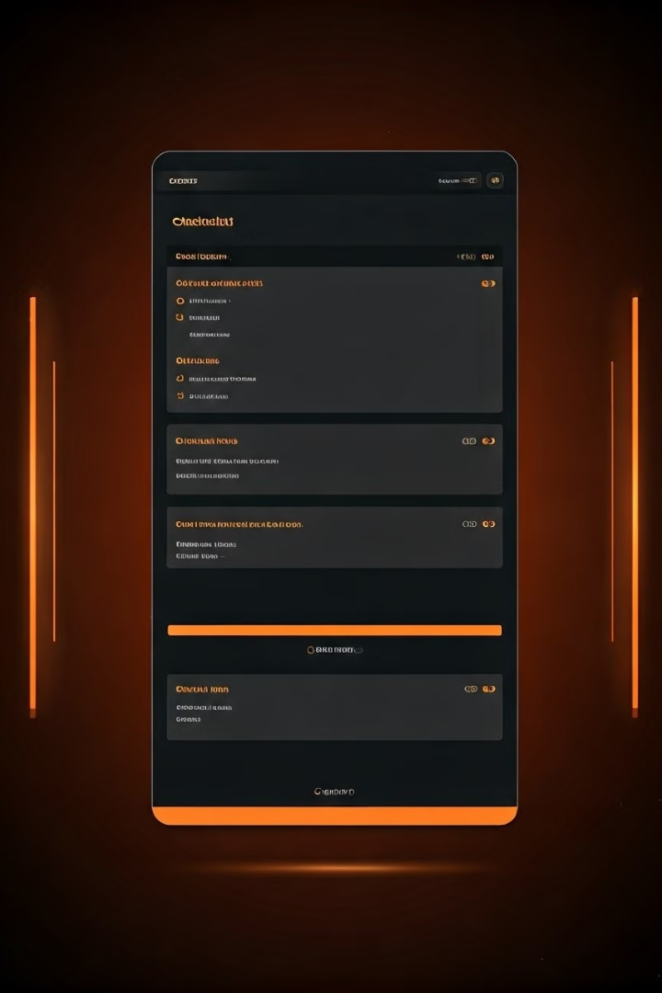
orderHandler
1
Order Management
Manages order operations including purchasing, returning, and canceling orders.
2
Authentication
Authentication is required for most operations.
3
Endpoints
Provides endpoints for retrieving, initiating, and modifying orders.

Slide 12
deliveryPartnerHandler
Delivery Partner Operations
Authentication
Endpoints
Authentication is required for marking orders as delivered, replaced, or returned.
Provides endpoints for retrieving and updating order status for delivery partners.
Manages delivery partner operations for delivering, replacing, and returning orders.

Slide 13

reviewHandler
Review Management
Authentication
Endpoints
Manages reviews for products, including adding and retrieving reviews.
Authentication is required for adding a review.
Provides endpoints for retrieving and adding reviews for products.

Slide 14
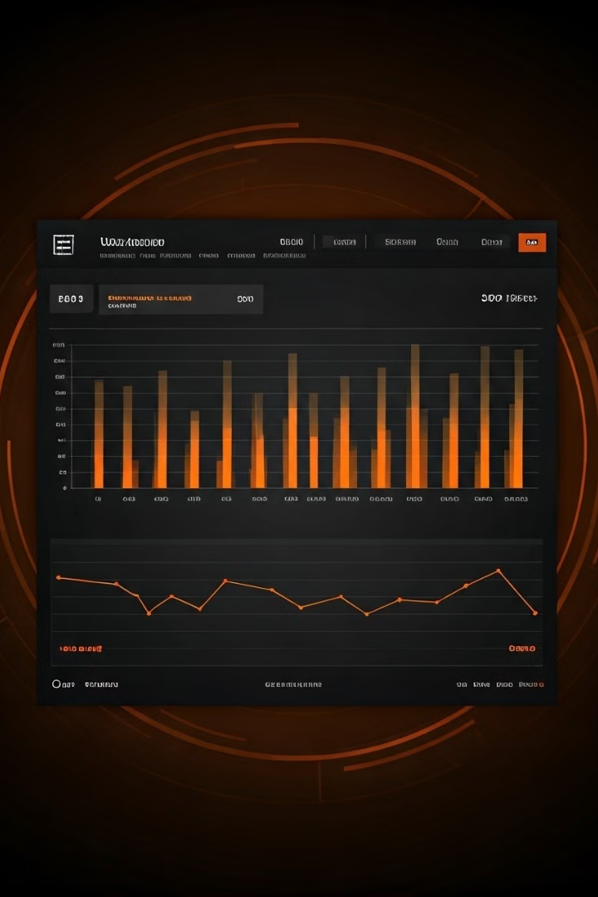
reportHandler
Endpoint
Description
/report/sellerId={id}
Views reports for a seller.
/report/productId={productId}&sellerId={id}
Views reports by product ID for a seller.

Slide 15
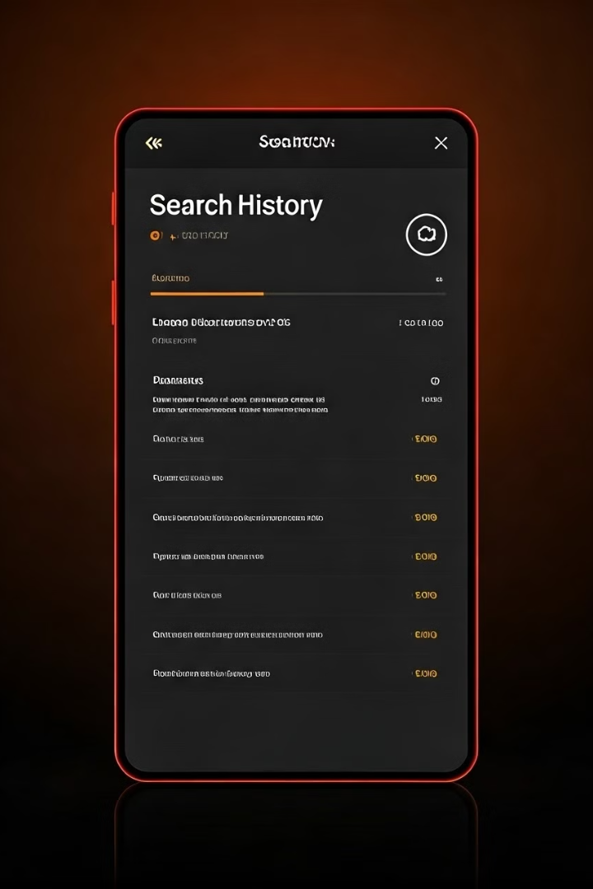
searchHistoryHandler
1
Search History Management
Manages the retrieval of search histories.
2
Authentication
Authentication is required for retrieving search history by customer ID.
3
Endpoints
Provides endpoints for retrieving search histories by customer ID.

Slide 16
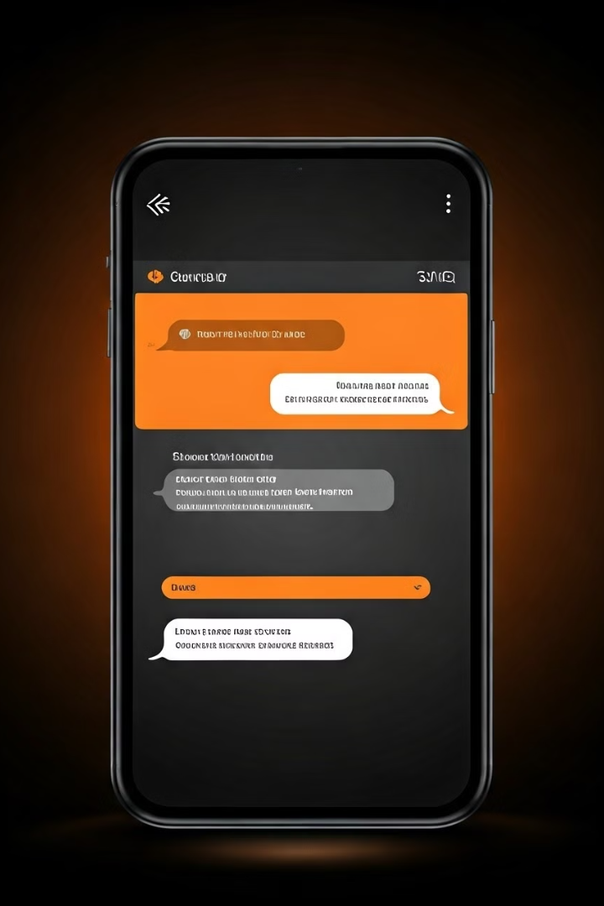



customerCareHandler
Customer Care Interactions
Handles customer care interactions through messaging.
Authentication
Authentication is required for sending messages.
Endpoints
Provides endpoints for sending messages to customer care.

Slide 17
Product Recommendation and Recently Viewed Products
Product RecommendationHandler
Authentication
recentlyViewedProductHandler
Authentication is required for retrieving recommendations.
Provides personalized product recommendations for customers.
Manages the retrieval of recently viewed products.

