Slide 1
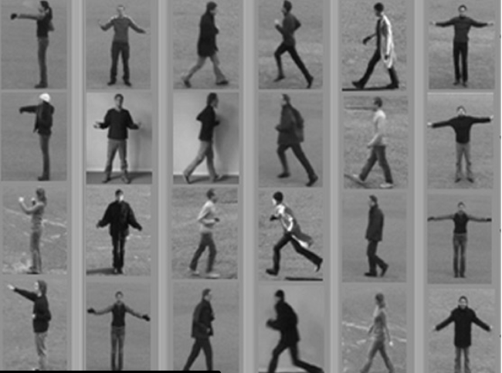
Human Activity Recognition
Using Smartphone data
Team Members:-
Bharath Kumar Reddy
C V Thirumala Kumar
Suchika Sachdeva
Sagnik Sarkar
Anmol
Aparna

Slide 2
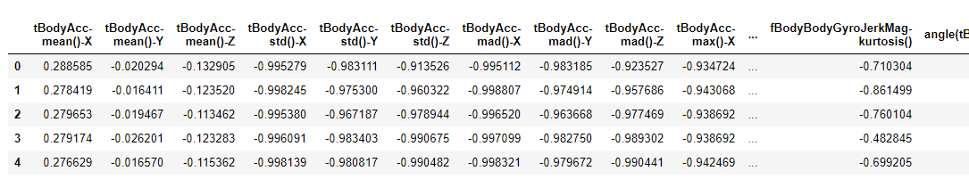
The Human Activity Recognition database was built from the recordings of 30 study participants performing activities of daily living.
The objective is to classify into following activities: WALKING, WALKING_UPSTAIRS, WALKING_DOWNSTAIRS, SITTING, STANDING AND LAYING.
The dataset consists of 7352 rows and 550 columns.
7352 rows and 550 columns
DATASET

Slide 3
STEPS PERFORMED
01
Data Analysis and Visualization
06
Model Selection
02
Data Cleaning
03
Feature Selection
07
Predictions and Conclusions
04
Dimensionality Reduction
05
Preprocessing and Labelling

Slide 4
Data visualization
From visualization part we are able to find out following things:-
The dataset contains zero null values and is free from duplicate data.
The dataset is well balanced among different activities.
The dataset is normalized, that is it contains values between -1 to 1.
There was a presence of dynamic as well as static activities which was based on tBodyAccMean.

Slide 5
Feature Selection
Feature Selection is quite necessary when we are dealing with the large no. of features in our Dataset.
There are total of 550 features available in our Dataset , So in order to reduce computations, we have reduced the features from 550 to 109 features using a correlation filter.
We have drop those features which are highly correlated by taking the threshold value as 0.7.

Slide 6
Support Vector Machine
Support Vector Machine or SVM is one of the most popular Supervised Learning algorithms, which is used for Classification as well as Regression problems.
We have implemented SVM algorithm on our dataset to check how this algorithm is performing on our dataset.
After calculating the accuracy with the help of evaluation metrics we have got a good accuracy in this algorithm.
Accuracy - SVM (94%)

Slide 7
Random Forest Classifier
Random forests or random decision forests are an ensemble learning method for classification, regression and other tasks that operates by constructing a multitude of decision trees at training time.
We have also implemented Random forest Algorithm on our dataset and evaluated the performance of this algorithm on our dataset.
After calculating the accuracy with the help of evaluation metrics we have got quite a good accuracy of 96%.

Slide 8
Extra Trees Classifier
Extra Trees Classifier is an ensemble machine learning algorithm that combines the predictions from many decision trees.It is related to the widely used random forest algorithm.
We have also implemented Extra Trees Classifier on our dataset and evaluated the performance of this algorithm on our dataset.
After calculating the accuracy with the help of evaluation metrics we have got the best accuracy of 97%.

Slide 9
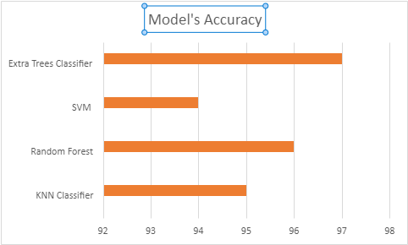
Comparison of Models
We can observe from the below bar chart that Extra Trees Classifier is the model which is giving us the highest accuracy of 97%
M O D E L S ------>
A C C U R A C Y (%) ------->

Slide 10
Conclusion
We have started our project with Data preprocessing which included steps like checking for missing values and reducing the highly correlated features.
Our second step involved Exploratory Data Analysis to get the more understanding of our dataset. This step included visualization of our analysis performed on the features.
Our third step included the implementation part of different machine learning algorithms on the dataset. We trained and tested on different ML models.
At last we got Extra Tree Classifier, which was performing best on the dataset as comparison with other models on the basis of accuracy.

