Slide 1
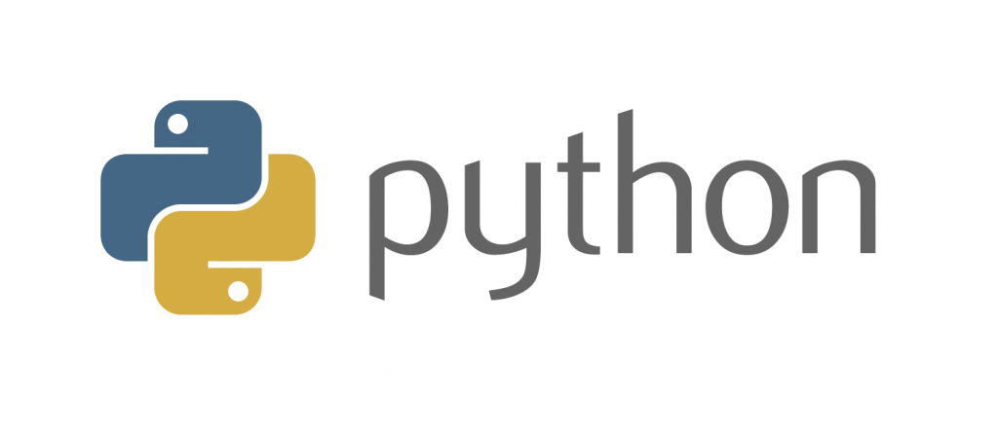
Introduction to
Part 1
Notes:
- Welcome and thank you for coming
- Introduction
- aims:
-- introduce fundamentals
-- build up confidence for self-study!!! Not as scary as the real-world version
- assumptions:
-- basic high-school maths
-- no prior experience in coding

Slide 2
Structure
Divided into two 1h sessions.
45-minute coffee break in between.
Each session has 1h of teaching and half an hour of exercises.
Try to follow within your notebook and run all examples shown on the slides.

Slide 3

Ask!
The art and science of asking questions is the source of all knowledge.
- Thomas Berger
Do not hesitate to ask!
If something is not clear, stop me and ask.
During exercises (you can also ask others).
Image by mohamed Hassan from Pixabay
Notes:
All of us learn through asking and being curious
more of a conversation - don't hesitate to stop me and ask

Slide 4
Now let me ask something..
Why do you want to learn Python/programming?
What would you use Python for?
Notes:
make notes

Slide 5
Failure
Coding is all about trial and error.
Don't be afraid of it.
Error messages aren't scary, they are useful.
Notes:
You might fail 5 times while doing something but in the end you will understand how it works and be able to replicate it

Slide 6

Python natalensis by A. Smith on Wikimedia Commons

Slide 7
Who am I?
Anmol Adhikari
Module Leader
MSc. IT Data Analytics - London Metropolitan University
BSc. (Hons.) IT Computing - London Metropolitan University
Work Related Description:
Lecturer, IIMS College Kathmandu
Python with Data Science Instructor, Techaxis
Project Management Instructor, LeafAcademy
Former Associate Module Leader, Herald College Kathmandu
Former FYP Reader, Herald College Kathmandu
Former Content Writer, Analytics Vidya
Former Head of Information Technology, Surya Print Pvt. Ltd.
Former IT Consultant, Surya Chemicals Pvt. Ltd.
Former Project Manager, BlueBell Software Solution
Practical Research:
Machine learning technique for intrusion detection in the field of the intrusion detection system
Sentiment Analysis in Agile Software Development: Enhancing User-Centric Decision Making
Theoretical Research:
Creating and Managing Project Folder Structure for Final Year Project
Understanding SQL Data Analytics(Part 1)
Hand-written Digit Recognition Using CNN classification
Twitter Sentimental Analysis Using Naive Bayes Classifier
Book
A Comprehensive Guide: Project Management

Slide 8
Team
Lily Tamang
Module Tutor
Bachelor in Information Management - Tribhuvan University

Slide 9
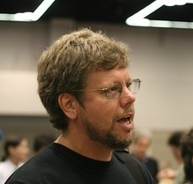
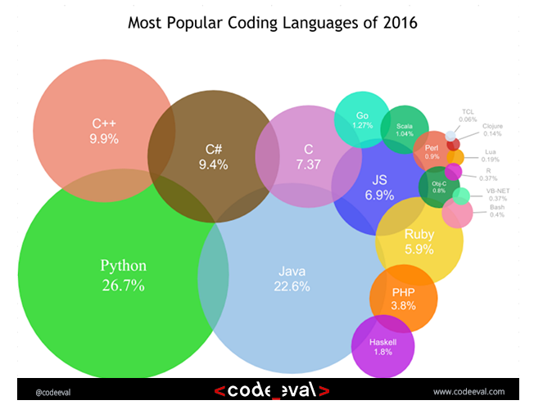
History
Started by Guido Van Rossum as a hobby
Now widely spread
Open Source! Free!
Versatile
Guido Van Rossum by Doc Searls on Flickr CC-BY-SA
Notes:
- Started by Guido Van Rossum as a hobby over the Christmas vacation.
- named after Monty Python's Flying Circus
- First released in 1991, loved by Unix scripters
- Now transformed into the most popular interpreted language. You can build anything with it!
- Facts! Python was the most used language in 2016 and still most likely is!

Slide 10
1. Python today
Developed a large and active scientific computing and data analysis community
Now one of the most important languages for
Data science
Machine learning
General software development
Packages: NumPy, pandas, matplotlib, SciPy, scikit-learn, statsmodels
Notes:
Why choose it instead of MATLAB, R, SAS, Stata and others?
- It is free and open source
- Intuitive and easy to learn
- Extremely versatile – examples – websites, planes, robots, data
- Large and friendly community
- packages
Very important in industry and academia

Slide 11
2. Modes
Python
Python can be run interactively
Used extensively in research
2. Python scripts
What if we want to run more than a few lines of code?
Then we must write text files in .py
Notes:
Python has 2 modes of running
- IPython stands for Interactive Python
Python can be interpreted – good for a calculator
Live demo!

Slide 12
Time for a demo..
https://www.youtube.com/watch?v=BBwEF6WBUQs
Notes:
- showcase power of Python
- you're not expected to understand all of it

Slide 13
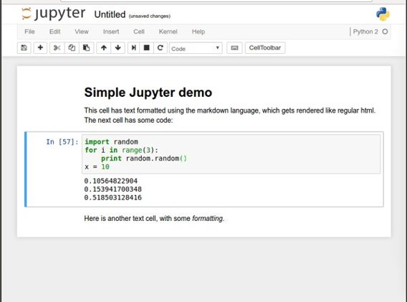
Noteable (Jupyter notebooks)
Easy to use environment
Web-based
Combines both text and code into one
Come with a great number of useful packages
Notes:
We will be using Noteable, just another service Jupyter Notebooks. It is free and open source
Web environment focused at Python
Easy to use – nice gui and no setup required
Block based. Has blocks which execute the code within it. Single type only
Allows to combine text and code into same page. Helps with readability

Slide 14
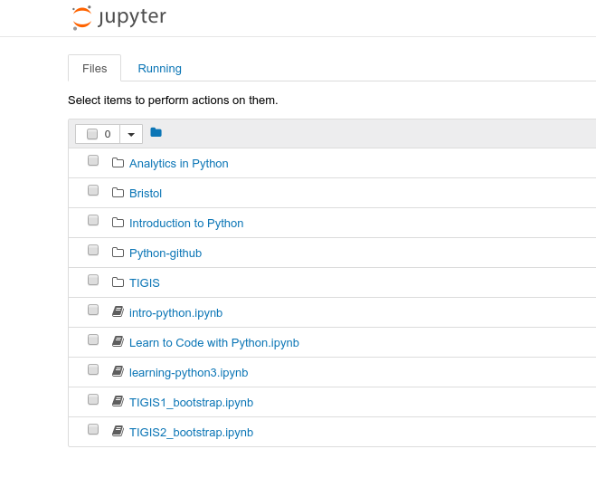
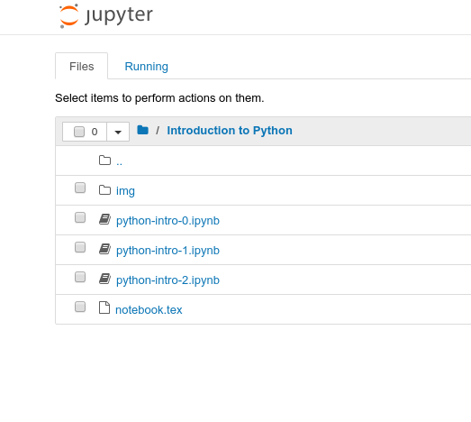
3. Starting a notebook
Notes:
Start a notebook by clicking on it.
Notebook 0 is an environment introduction.
Skip that, open notebook 1
Make sure that everybody is ready

Slide 15

4. Toolbar
Stop execution
Save
Cut, copy
paste
Block type
New block
Move block
Reset block
And clear output
Notes:
Autosave

Slide 16
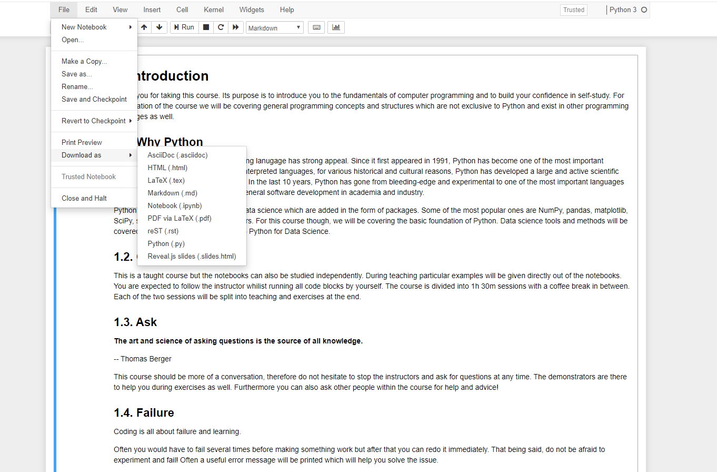
5. Download files

Slide 17
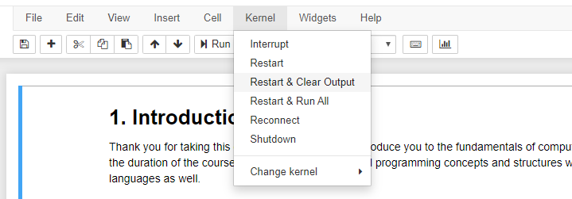
6. Kernel/Restart & Clear output

Slide 18
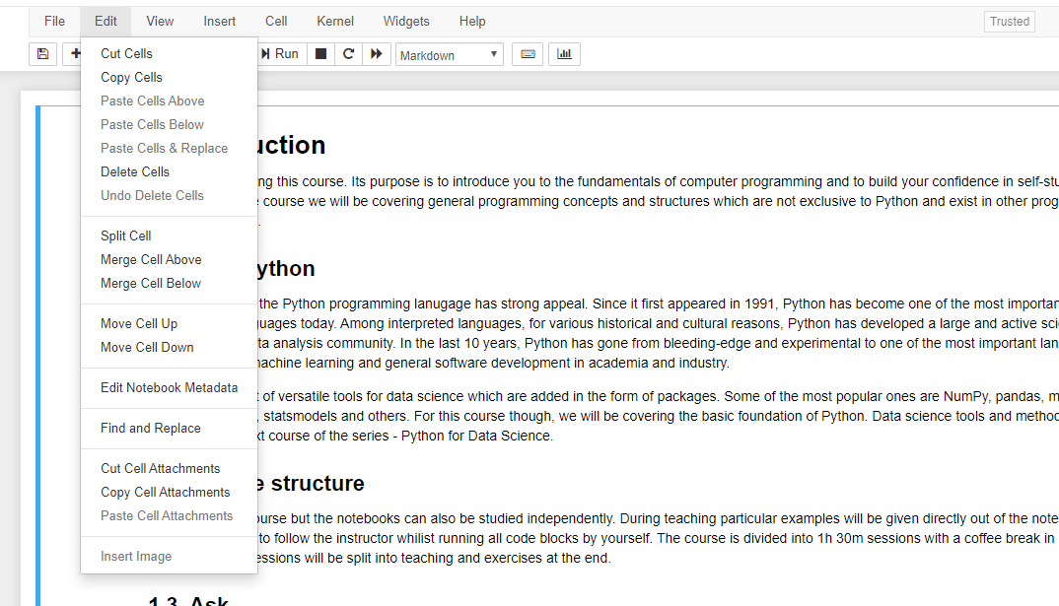
7. Edit/Delete Cell

Slide 19
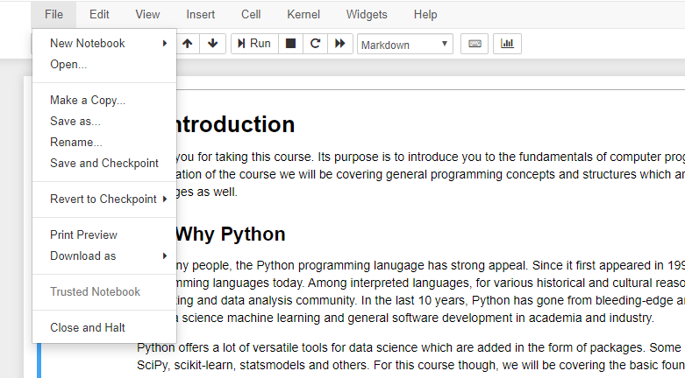
8. File/ Close & Halt

Slide 20
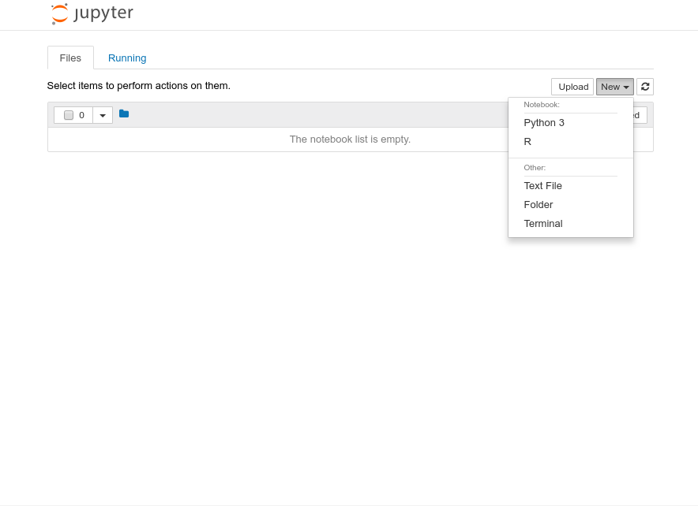
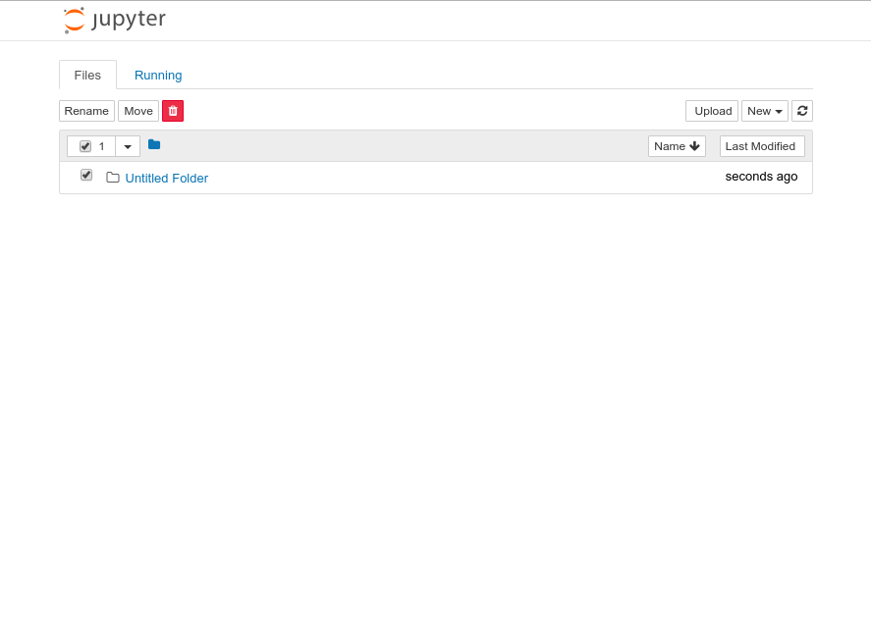
9. Create a folder 10.Rename
Notes:
We need to make a course folder
Then rename it to Introduction to Python or whatever
Then go into that folder

Slide 21
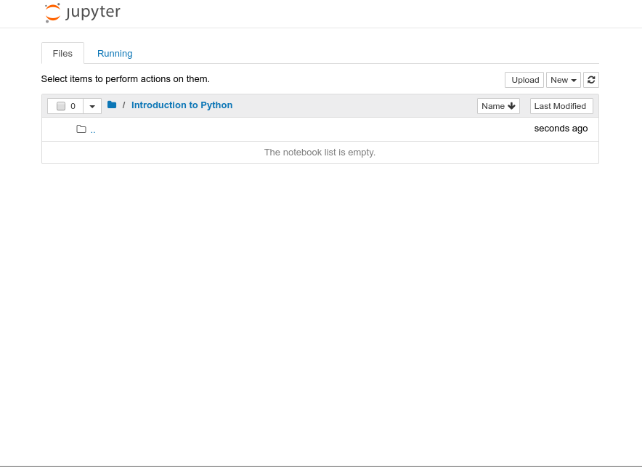
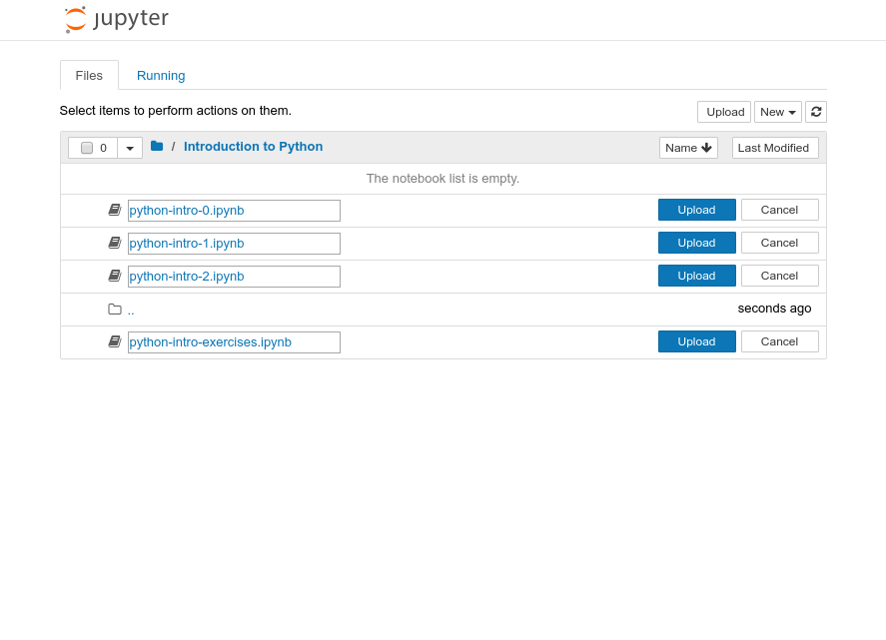
11. Upload files
Notes:
Make sure that you are inside that folder

Slide 22
Running blocks
By pressing the Run button
Shift + Enter – runs block
Alt + Enter – creates a new block
Notes:
Run button but its best with shortcut Shift + Return/Enter
Alt + Return/Enter which creates a new block after the on you are currently on.

Slide 23
Other operations
File/Save and Checkpoint
File/Revert to Checkpoint
Tab completion
Introspection
Notes:
Checkpoints are useful!
You can download it as multiple different things:
Notebook
Python script
pdf

Slide 24
Let us start
If you like to follow along, you can open your own notebook. But please try to keep up with my presentation, as you still have time for exercises after the teaching.

Slide 25
Agenda
Variables
Types
Arithmetic operators
Boolean logic
Strings
Printing
Exercises

Slide 26

Python as a calculator
Let us calculate the distance between Kathmandu and London in km
Notes:
Let's run our first block.
That's great
Writing numbers is very tedious
Run this in your notebooks
How can we improve that?

Slide 27
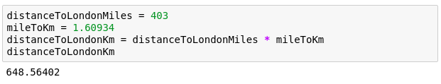
Variables
Great calculator but how can we make it store values?
Do this by defining variables
Can later be called by the variable name
Variable names are case sensitive and unique
Notes:
Can we save values? By defining a variable.
Can have values assigned
Variables must be declared and can then be called by name.
Code example
Check the code yourself

Slide 28

We can now reuse the variable mileToKm in the next block without having to define it again!
Notes:
reuse without having to type in again
Note: mileToKm not defined again

Slide 29
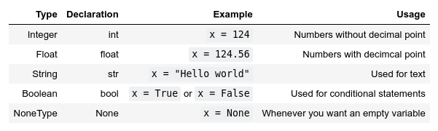
Types
Variables actually have a type, which defines the way it is stored.
The basic types are:
Notes:
So far - storing values in memory; how exactly are they stored?
defined by the type.
Go over all types

Slide 30
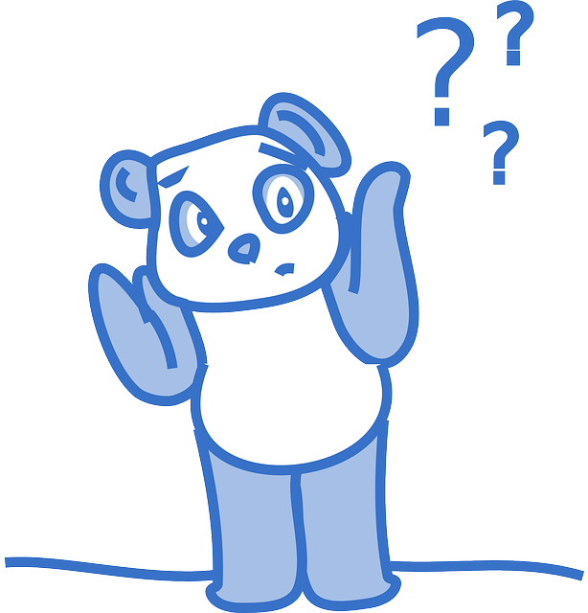
Why should we care?
Image by Clker-Free-Vector-Images on Pixabay
Notes:
Python decides the types, why should we care?
Python uses duck typing
Try running the next block

Slide 31
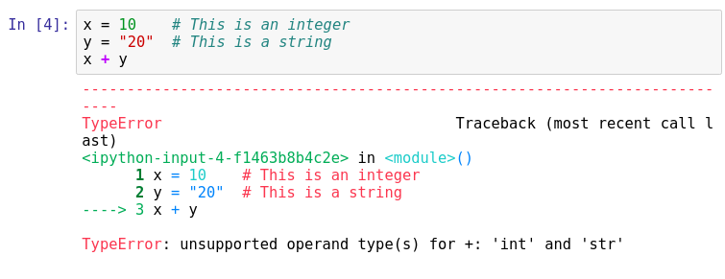
Important lesson to remember!
We can't do arithmetic operations on variables of different types. Therefore make sure that you are always aware of your variables types!
You can find the type of a variable using type(). For example type type(x).
Notes:
Explain code, run it.
we broke python. Any ideas?
Don't be afraid of errors, they are invaluable
we can't add up variables of different types.
important to remember! always take note of what the types of your variables are!
Python is helpful and gives us a hint.
Can you fix this particular block?

Slide 32

Casting types
Luckily Python offers us a way of converting variables to different types!
Casting – the operation of converting a variable to a different type
Similar methods exist for other data types: int(), float(), str()
Notes:
Casting – the operation of converting a variable to a different type
Let's try it on the previous code snippet.
Take note that this works only in a sensible way!

Slide 33

Quick quiz
What will be the result?

Slide 34
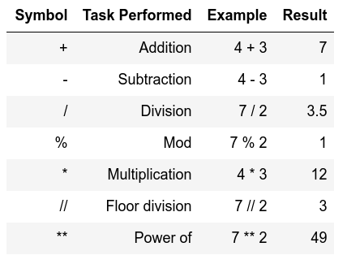
Arithmetic operations
Similar to actual Mathematics.
Order of precedence is the same as in Mathematics.
We can also use parenthesis ()
Notes:
Note of order precedence.
Table doesn't show this
Should be intuitive for all of you.

Slide 35

Order precedence example

Slide 36


Quick quiz
vs
13
49

Slide 37
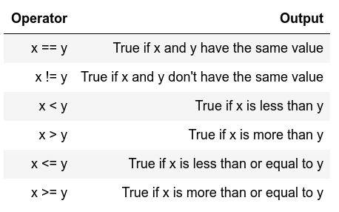
Comparison operators
I.e., comparison operators
Return Boolean values
(i.e. True or False)
Used extensively for conditional statements
Notes:
Similar to mathematics again
Will become important later on.

Slide 38
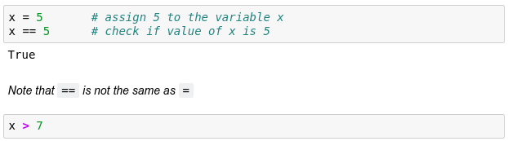
Comparison examples
False
Notes:
Note variable passing down
What will the 2nd block return?

Slide 39
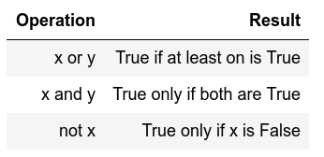
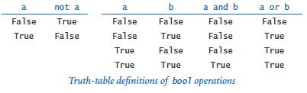
Logical operators
Allows us to extend the conditional logic
Will become essential later on
Notes:
how we can combine comparison operators and logical operators

Slide 40
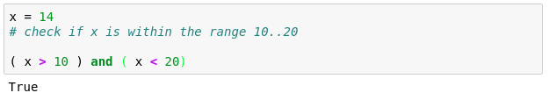
Combining both
True
True

Slide 41
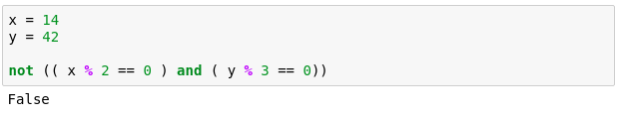
Another example
True
True
True
That wasn't very easy to read was it?
Is there a way we can make it more readable?
Notes:
Another more complex example.
Here we check if x is divisible by 2 and if y is divisible by 3.
Can anybody guess why we are getting False?

Slide 42
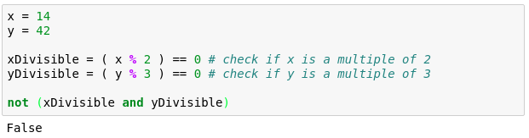
Notes:
Simpler – store intermediate values
Easier to read
Generally advised

Slide 43
Strings
Powerful and flexible in Python
Can be added
Can be multiplied
Can be multiple lines

Slide 44
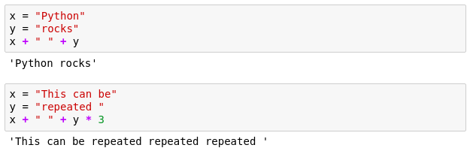
Strings

Slide 45
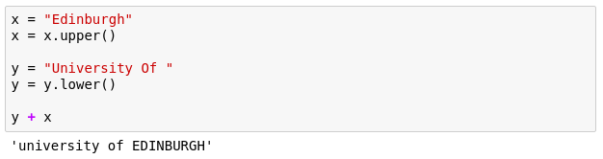
Strings
These are called methods and add extra functionality to the String.
If you want to see more methods that can be applied to a string, simply type in dir('str')
Notes:
Functionality of strings can be extended through methods
should be in your notebooks but the dir() can be used on any Object/variable

Slide 46
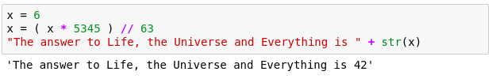
Mixing up strings and numbers
Often we would need to mix up numbers and strings.
It is best to keep numbers as numbers (i.e. int or float)
and cast them to strings whenever we need them as a string.
Notes:
We need to mix numbers and strings often, ie. Whenever printing.
best to keep numbers as numbers
cast them to strings whenever needed.

Slide 47
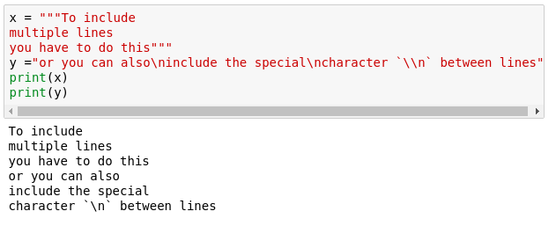
Multiline strings
Notes:
Sometimes we need strings on multiple lines. How? Two ways?
One is using triple quotes """
The other one is using the new line character - \n

Slide 48
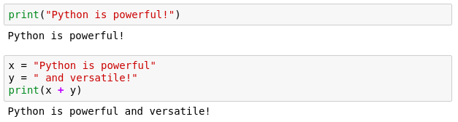
Printing
When writing scripts, your outcomes aren't printed on the terminal.
Thus, you must print them yourself with the print() function.
Beware to not mix up the different type of variables!

Slide 49

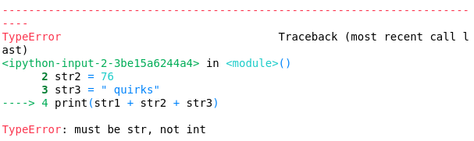
Quick quiz
Do you see anything wrong with this block?
Notes:
Let's see if everybody remembers their types
Is there anything wrong with this block or will it execute nicely?
[issue] Any idea how we can fix it?

Slide 50
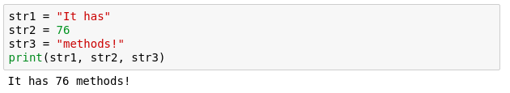
Another more generic way to fix it
If we comma separate statements in a print function, we can have different variables printing!

Slide 51
Commenting
Useful when your code needs further explanation. Either for your future self and anybody else.
Useful when you want to remove the code from execution but not permanently
Comments in Python are done with #
Notes:
You seen the # symbols in the slides.
I forget what I write; need to remind my future self
Programmers though it's better to write explanation in between the code
Show example

Slide 52
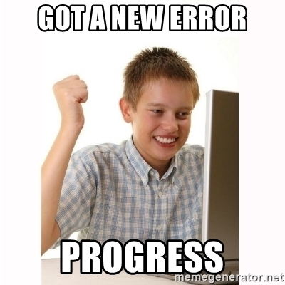
Exercise time
Simple and fun exercises.(notebooks 0 and 1)
20-minute break afterwards.
Failure is progress!
Ask us anything. Ask among yourselves as well.
Notes:
error checking code , don't change it

