Slide 1
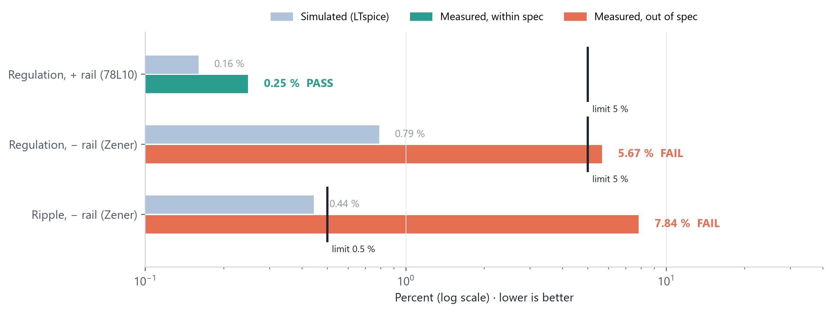
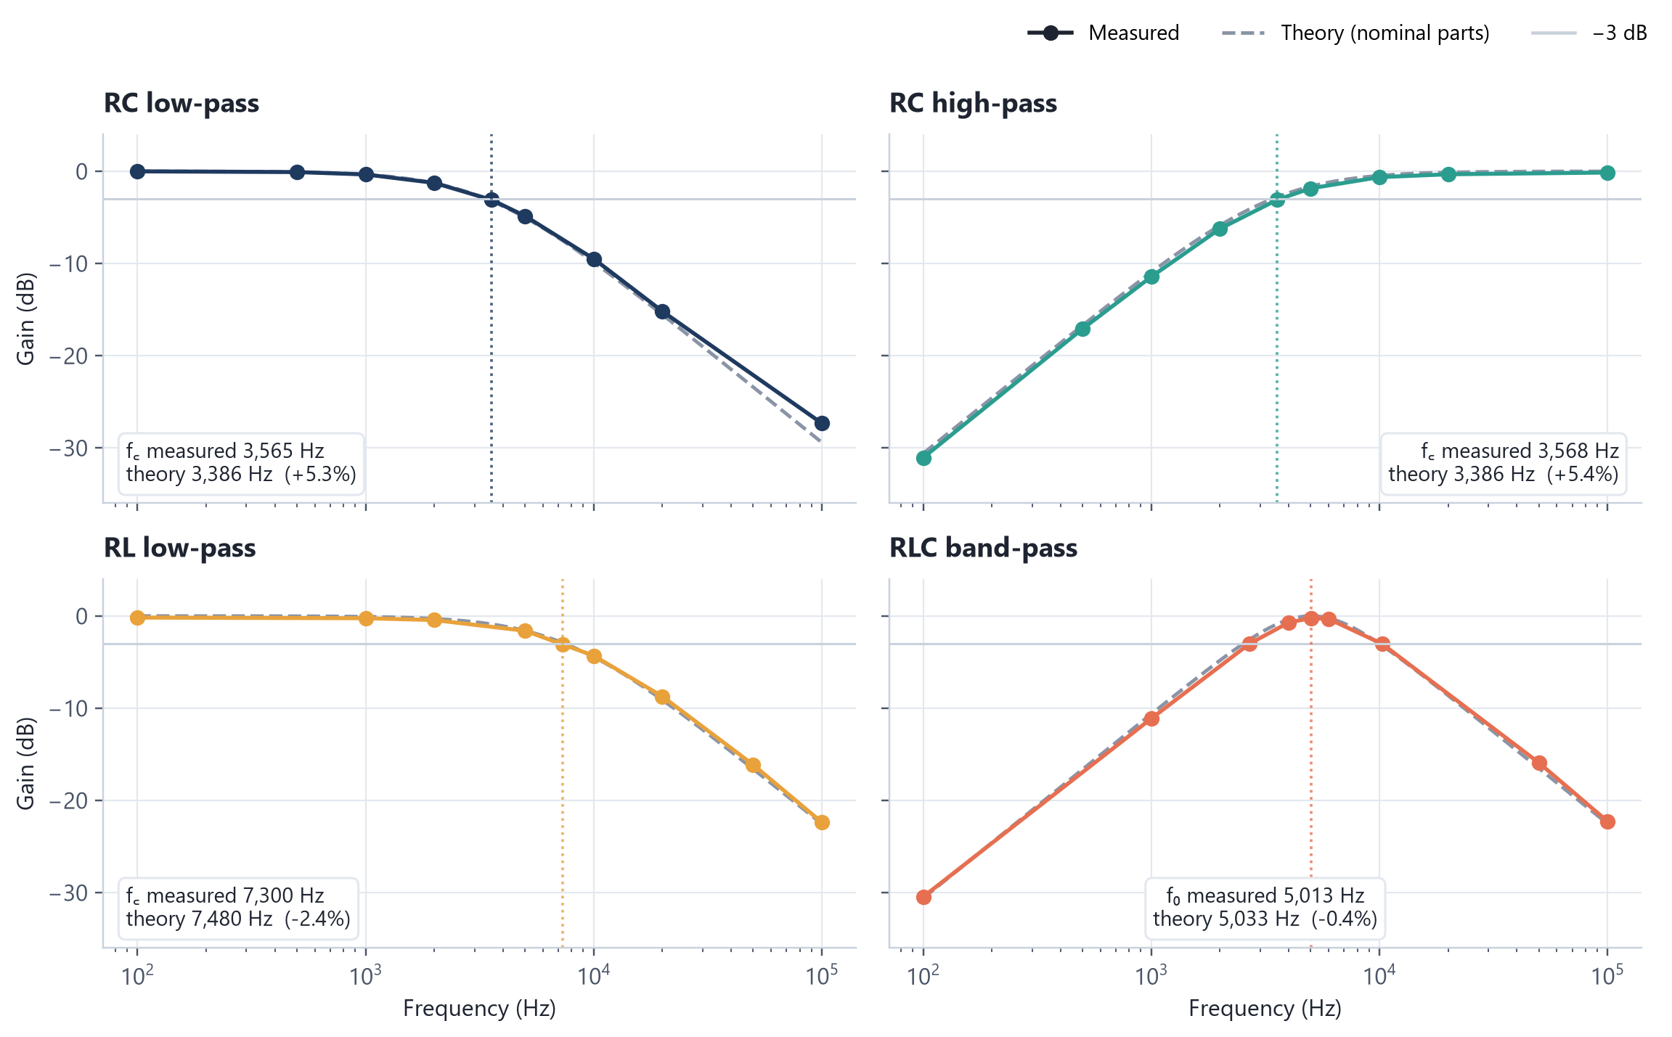
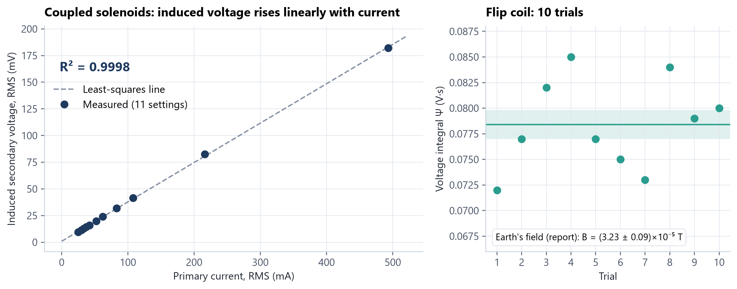
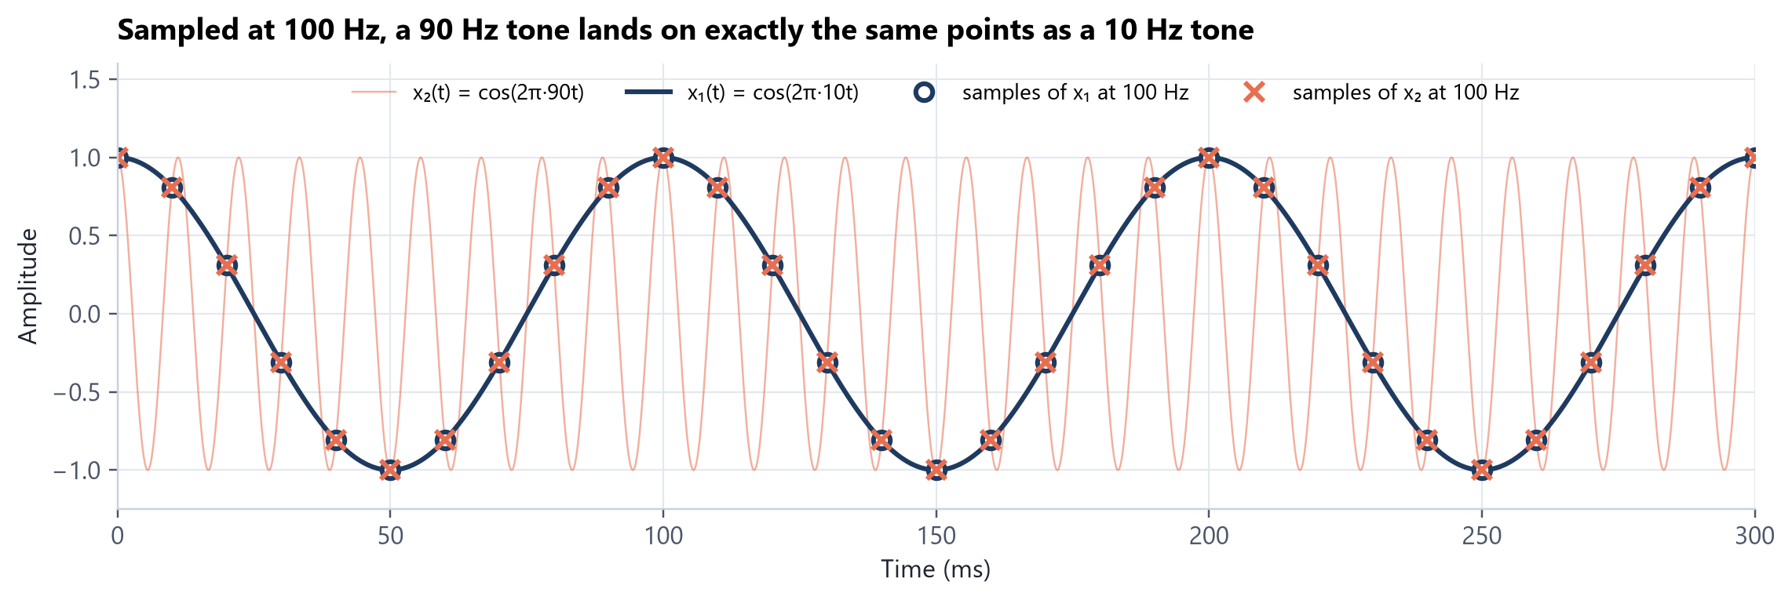
COURSE LABS · 2025–2026
Four labs at a glance
ECE 302
ECE 203
±10 V dual-rail power supply
Filters and resonance
Design, simulate in LTspice, build, measure
Four filters swept 100 Hz to 100 kHz
The question, one graph, the numbers, and what I concluded. Graphs rebuilt from my submitted reports' data; the workbook behind them recalculates every result.
PHYS 230
ECE 340
Faraday's law
Sampling and aliasing
Anmol Bhandohal
BSc Electrical Engineering (Co-op) · University of Alberta
Earth's field from a flip coil, with error propagation
MATLAB: when 90 Hz becomes 10 Hz

Slide 2
ECE 302 · ELECTRONIC DEVICES · LAB 2
A ±10 V supply: one rail passed, one didn't, and why
THE QUESTION
Can a transformer, rectifiers, a 78L10 regulator and a Zener shunt hold ±10 V within 5 % regulation and 0.5 % ripple at full load?
WHAT WE DID
Sized the 220 Ω ballast by hand, simulated both rails in LTspice, built it on a breadboard and measured with a scope and meter.
CONCLUSION
The IC regulator rail met spec. The Zener rail fell out of breakdown under heavy load: not enough ballast current. Fix: more filter capacitance or a smaller ballast.
0.25 %
5.67 %
7.84 %
+ rail regulation, measured (limit 5 %)
− rail regulation, measured: over the limit
− rail ripple, measured (sim 0.44 %, limit 0.5 %)
Group lab with Rohan Singh. Values from our submitted report (Oct 2026); chart rebuilt from them.
2 / 7

Slide 3
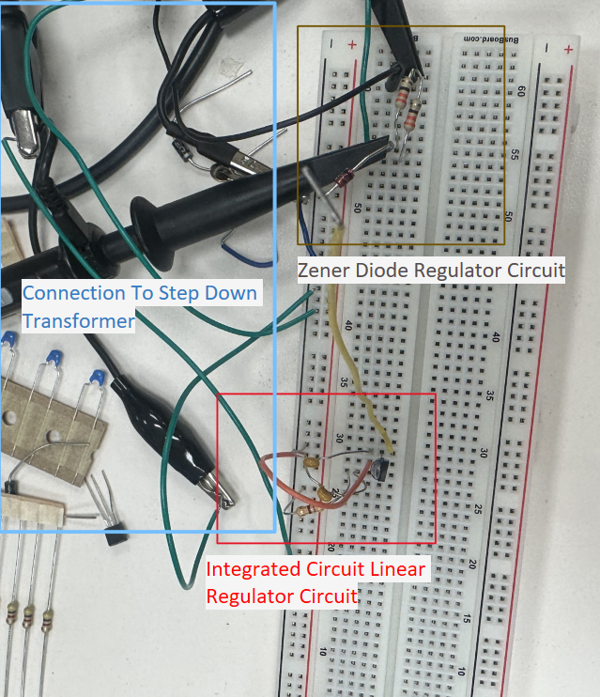
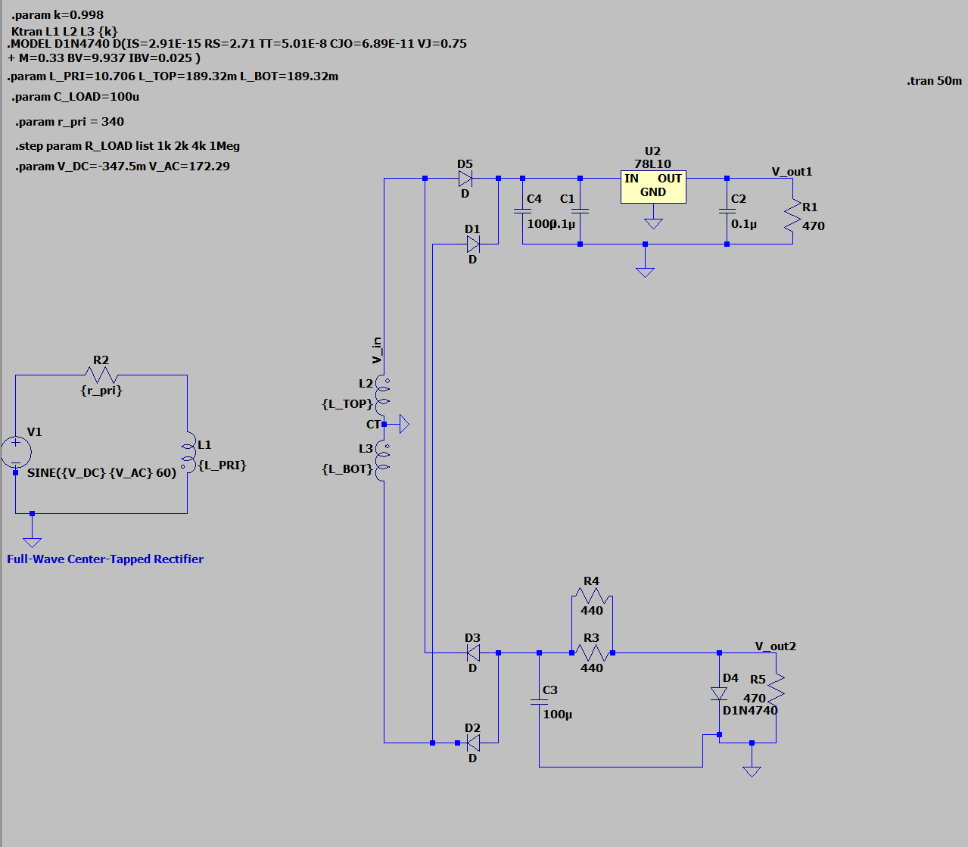
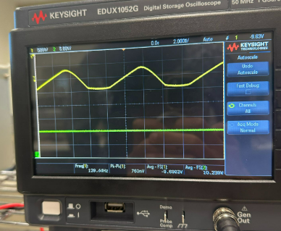
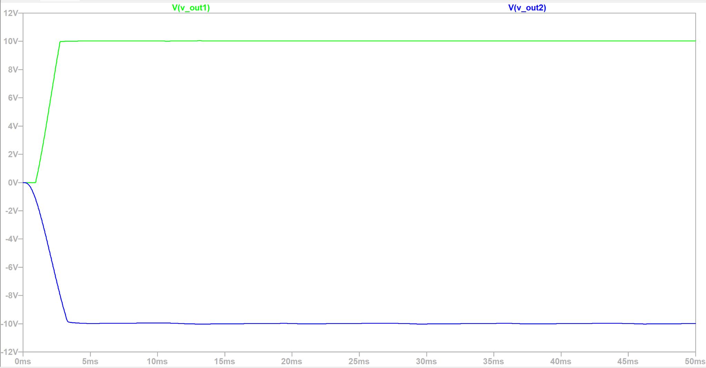
ECE 302 · LAB 2 · HOW IT WAS BUILT
From schematic to scope
›
›
›
1 · Design in LTspice
2 · Simulate
3 · Build
4 · Measure
Transformer, full-wave centre-tapped rectifiers, 78L10 on the + rail, 1N4740 Zener shunt on the − rail.
Transient run: both rails settle to ±10 V within about 3 ms. Load stepped with .step to get full-load and no-load.
On the breadboard: transformer leads in, IC regulator rail and Zener rail side by side.
Scope in AC coupling on the − rail: 760 mV peak-to-peak ripple, the number that failed the spec.
Group lab with Rohan Singh. Figures from our submitted report: LTspice schematic and transient run, the breadboard build, the bench scope.
3 / 7

Slide 4
ECE 203 · ELECTRICAL CIRCUITS II · LAB 6
Four filters, measured against the math
THE QUESTION
Do real RC, RL and RLC filters cut off where 1/(2πRC), R/(2πL) and 1/(2π√LC) say they should?
WHAT I DID
Swept each filter from 100 Hz to 100 kHz on the function generator and scope, and found each −3 dB point.
CONCLUSION
Every corner landed within 5.4 % of theory. Both RC cut-offs ran high by the same 5 %, consistent with the capacitor being about 95 nF (within its tolerance).
−0.4 %
+5.3 %
Q 0.66
RLC centre frequency vs theory (5,013 vs 5,033 Hz)
Both RC cut-offs high: implies C ≈ 95 nF
Band-pass sharpness, theory 0.67
Individual results sheet (Mar 2026). Measured points from my tables; theory uses the nominal 470 Ω, 100 nF, 10 mH.
4 / 7

Slide 5
PHYS 230 · ELECTRICITY AND MAGNETISM · LAB 4
Faraday's law, two ways
THE QUESTION
Is induced EMF proportional to the rate of change of flux, and can a flipped coil measure Earth's magnetic field?
WHAT I DID
Ten 180° flips of a 100-turn coil through a ×200 amplifier; then 11 current settings on coupled solenoids, fit with LINEST in Excel.
CONCLUSION
Induced voltage is linear in current (R² = 0.9998). The flip coil gave B 32 % above the gaussmeter; likely local interference and coil alignment.
R² 0.9998
3.23 ± 0.09
2.45
Linear fit, induced EMF vs primary current
Earth's field, ×10⁻⁵ T (fractional error propagation)
Gaussmeter reference, ×10⁻⁵ T
With lab partners Duong Hung Nguyen and James Pacia. Report written individually (Mar 2026).
5 / 7

Slide 6
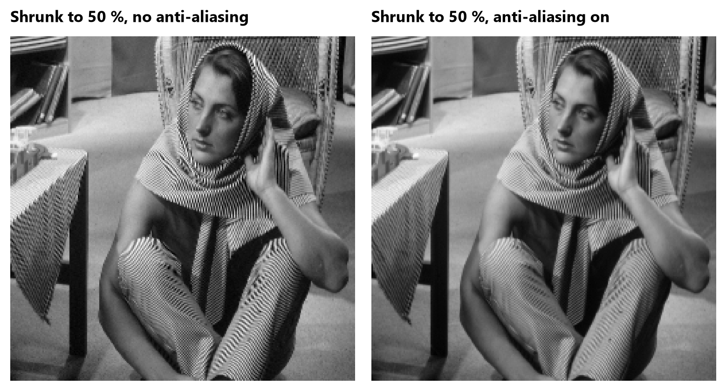
ECE 340 · DISCRETE-TIME SIGNALS AND SYSTEMS · LAB 2
When 90 Hz turns into 10 Hz
THE QUESTION
What happens when a signal is sampled slower than twice its highest frequency, in 1D and in images?
WHAT I DID
Sampled 10 Hz and 90 Hz cosines at 100 Hz and 1 kHz in MATLAB, then shrank a test image with anti-aliasing off and on.
CONCLUSION
Left: stripes on the clothing turn into false wavy bands.
Right: filtered first, they fade to grey instead. Cost: a little blur.
At 100 Hz the two tones give identical samples (max difference 1.7×10⁻¹⁴). Shrinking an image is resampling too: fine stripes alias into moiré unless low-passed first.
Individual report (Oct 2026). Top graph redrawn from the lab's signal definitions; the images are my MATLAB output.
6 / 7

Slide 7
WHAT THESE SHOW
Predict it, measure it, explain the gap.
Bench
Simulation
Oscilloscope (AC/DC coupling), function generator, DMMs, breadboard builds
LTspice: stepped parameters, .meas averages and ripple
Analysis
Reporting
Excel LINEST, error propagation, MATLAB conv, sampling, imresize
Spec checks, honest failures and their causes, Word reports
Data and every calculation: Lab_Highlights_Data.xlsx · anmol-portfolio-omega.vercel.app/docs

