Slide 1
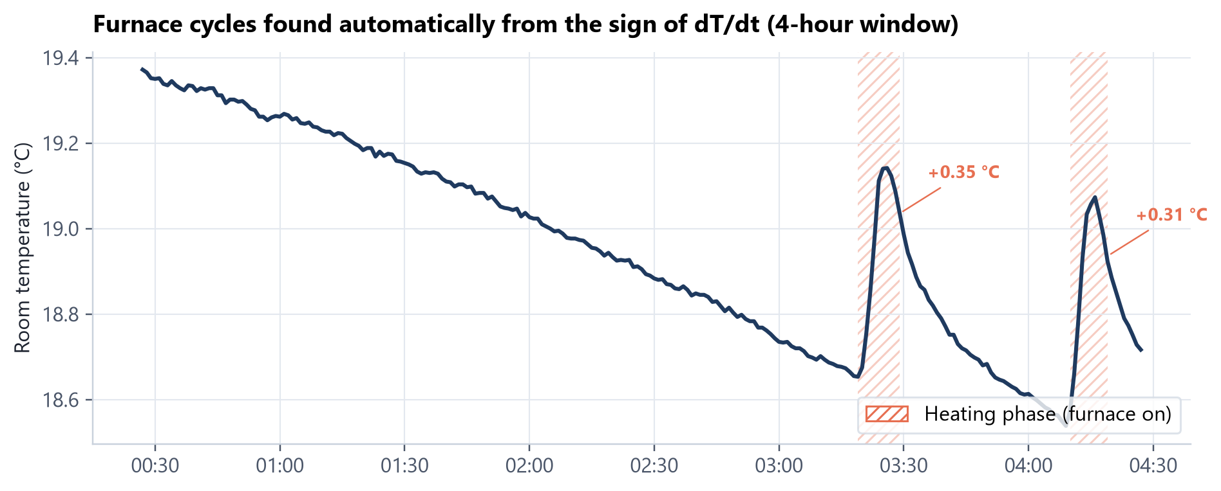
PROJECT PORTFOLIO · 2026
Why is one room colder?
Measuring heat loss with ESP32 sensor nodes, weather data and an RC circuit model. Plus: a closed-loop LED lamp.
Real data: Room A, Oct 3 to 4, 2026. 5,747 sensor readings; the furnace's heating sawtooth, detected automatically.
Anmol Bhandohal
BSc Electrical Engineering (Co-op) · University of Alberta

Slide 2
THE QUESTION
Three explanations, three different fixes
One bedroom is always colder. Before spending money on a fix, find out which of these is actually true.
H1
H2
H3
Less sun
Leaky envelope
Weak heating
Window faces away from the sun
Poor insulation, air leaks (low R)
Damper partly closed, long duct
DATA WOULD SHOW
DATA WOULD SHOW
DATA WOULD SHOW
Gap in daytime only; disappears at night
Room cools faster after every furnace cycle
Room warms less per furnace cycle
FIX
FIX
FIX
Curtains or accept
Weatherstrip, caulk, insulate
Open or balance dampers
Anmol Bhandohal · Electrical Engineering, University of Alberta
2 / 17

Slide 3
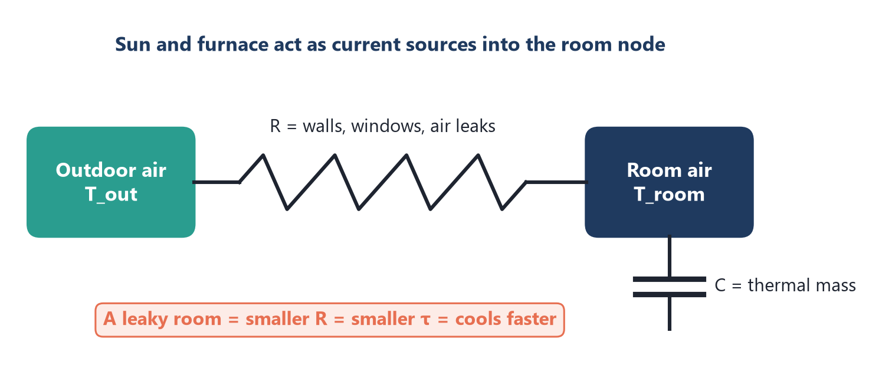
THE IDEA
A room behaves like an RC circuit
C · dT/dt = (Tout − T) / R
+ a·solar + b·furnace
▪ Walls and air leaks = resistor R. Heat flow ∝ temperature difference, like Ohm's law.
▪ Air and furniture = capacitor C: they store heat.
▪ τ = RC is one number per room. A leaky room has smaller R, smaller τ, and cools faster.
▪ Comparing τ between rooms separates H2 from H1 and H3.
Anmol Bhandohal · Electrical Engineering, University of Alberta
3 / 17

Slide 4
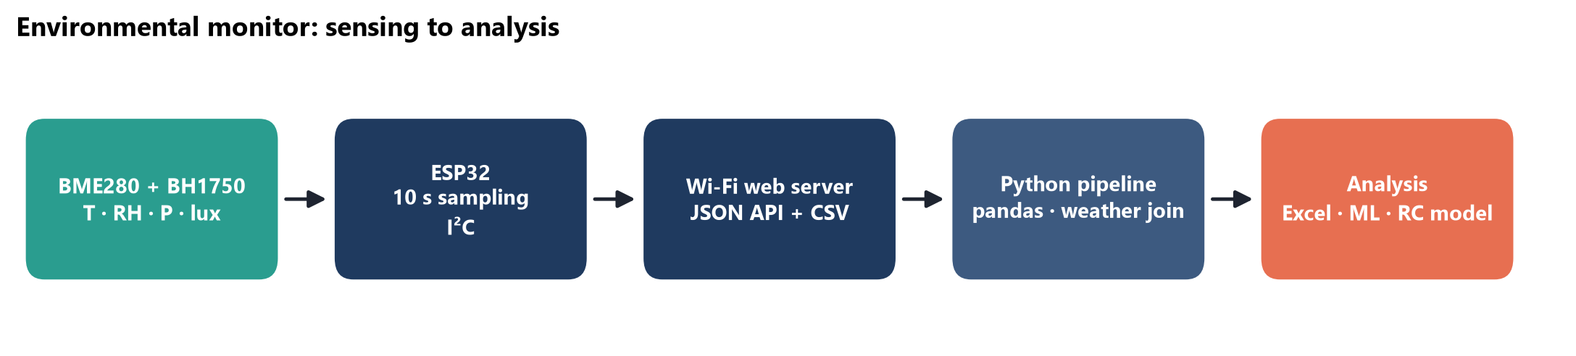
APPARATUS
How it's measured
10 s
±0.2 °C
1 min
100 %
sampling interval, temperature · RH · pressure · light
target agreement between nodes after calibration
resampled grid, joined to hourly Edmonton weather
of derived values reproducible as Excel formulas
ESP32 · Bosch BME280 · ROHM BH1750 · Arduino C++ · Python (pandas, scikit-learn) · Open-Meteo API · Microsoft Excel
Anmol Bhandohal · Electrical Engineering, University of Alberta
4 / 17

Slide 5
METHOD
The experiment, phase by phase
0
1
2
3
Calibrate
Baseline
Two rooms
Analyse
Both nodes side by side for 24 h. Measure the offset, subtract it everywhere.
One node in Room A. Build and test the whole pipeline on real data.
One node per room, 1.2 m high, away from vents. Log events.
τ per room, rise per furnace cycle, day vs night, wind.
Pending
Done
2 to 3 weeks
Pipeline ready
Why calibrate first: each sensor is only ±1 °C accurate out of the box, which is bigger than the effect being measured.
Anmol Bhandohal · Electrical Engineering, University of Alberta
5 / 17

Slide 6
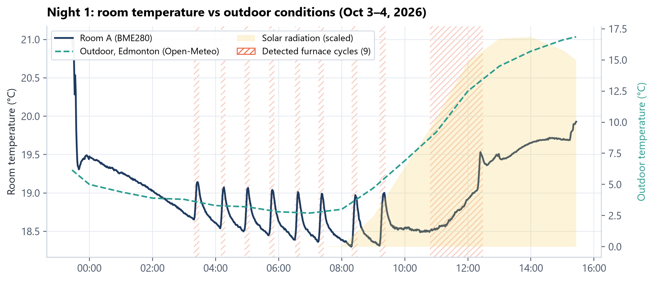
RESULTS · MEASURED
Night 1: the room, the weather and the furnace
18.9 °C
average room temperature
2.7 → 16.9 °C
outdoor range
23.9 h
The thermostat holds about 19 °C while it drops to 2.7 °C outside.
τ ≈ 24 h: with the furnace off, Room A would lose about 0.8 °C in the first hour.
Room A time constant τ (RC fit)
Anmol Bhandohal · Electrical Engineering, University of Alberta
6 / 17

Slide 7
RESULTS · MEASURED
9 furnace cycles, found automatically
0.48 °C
average rise per cycle
56 min
average time between cycles
≈ 20 min
furnace on-time per cycle
Method: smooth over 5 min, find where dT/dt changes sign, keep rises ≥ 0.15 °C (15× the sensor resolution).
Anmol Bhandohal · Electrical Engineering, University of Alberta
7 / 17

Slide 8
EXTENSION · MEASURED
Can ML forecast the room 30 minutes ahead?
HONEST RESULT
▪ Best model beats "no change" by only 4.7 %, and loses on a single hold-out split.
▪ One night holds just 9 furnace cycles. The model needs weeks of data.
▪ Tested so it never trains on the future (time-series folds).
Features: recent temperature changes, indoor–outdoor gap, solar radiation. Python + scikit-learn.
Anmol Bhandohal · Electrical Engineering, University of Alberta
8 / 17

Slide 9
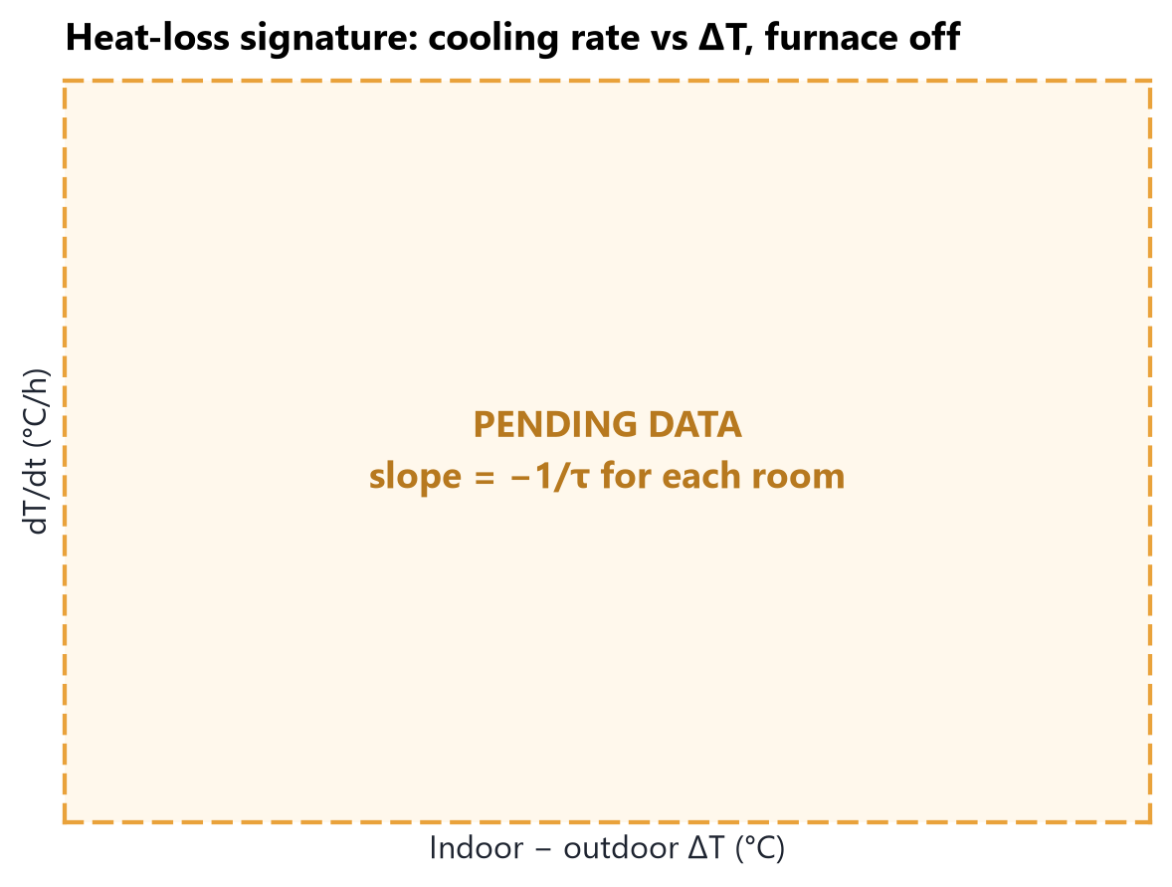
RESULTS · DATA COLLECTION IN PROGRESS
Room A vs Room B: the actual experiment
What gets computed per room
Metric | Room A | Room B
Time constant τ (h) | 23.9 | ?
Rise per furnace cycle (°C) | 0.48 | ?
Cooling rate per °C ΔT (1/h) | 0.063 | ?
Day − night gap (°C) | ? | ?
Every chart, table and formula is already built. Room B's logs get pasted into the workbook and the results fill in.
PENDING DATA
Anmol Bhandohal · Electrical Engineering, University of Alberta
9 / 17

Slide 10
INTERPRETATION
Decision rules, written before the data arrives
τ(B) at least 25 % smaller than τ(A), day and night
H2 · leaky envelope
→
Weatherstrip, seal outlets on exterior walls
Similar τ, but B warms clearly less per cycle
H3 · weak heating
→
Open or balance dampers, check the duct
Gap mostly in daytime; B's light curve peaks late or low
H1 · less sun
→
Accept, or thermal curtains at night
Gap grows with wind speed
Air leaks (part of H2)
→
Air-seal first: the cheapest fix
Fixing the rules first stops me from bending the result toward the answer I expected.
Anmol Bhandohal · Electrical Engineering, University of Alberta
10 / 17

Slide 11
ADAPTIVE LED LAMP · MEASURED
Project 2: is the LED lamp's dimming linear?
0.99991
R², light vs duty
0.51 %
worst deviation from the line (of full scale)
7×
finer sensor resolution after fixing the first failed test
ESP32 · IRLZ44N MOSFET · 12 V strip · BH1750
Anmol Bhandohal · Electrical Engineering, University of Alberta
11 / 17

Slide 12
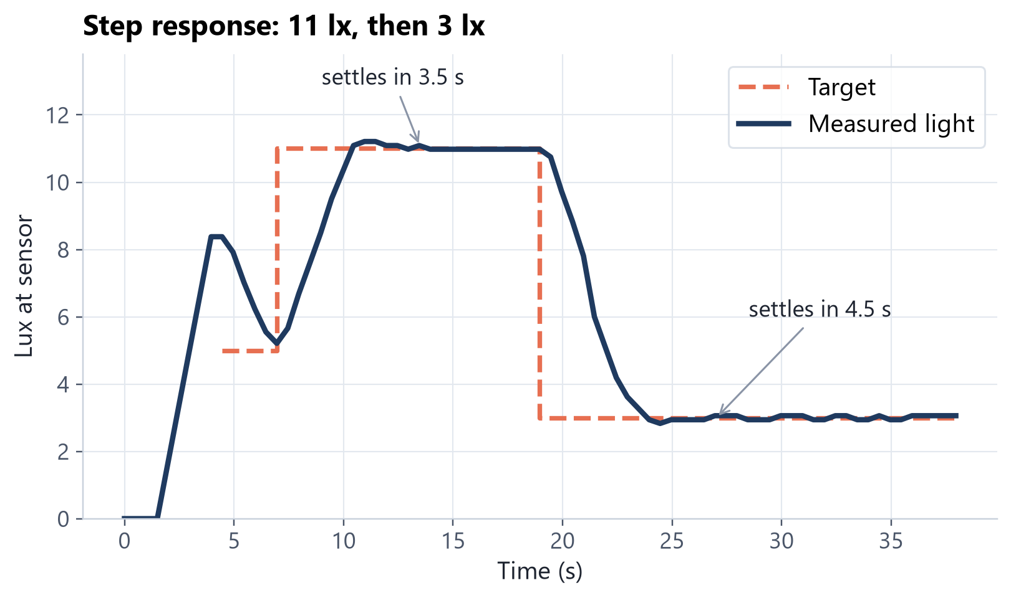
ADAPTIVE LED LAMP · MEASURED
Holding a set brightness with feedback
u ← u + (G/K)·error
▪ Integral controller, gain G = 0.35
▪ Plant gain K measured by the lamp itself, since it changes with sensor position
▪ Simulated first: stable even with K wrong by 2×
▪ 3.5 s to settle at 11 lx, 0.21 lx overshoot, ±0.1 lx ripple
Anmol Bhandohal · Electrical Engineering, University of Alberta
12 / 17

Slide 13
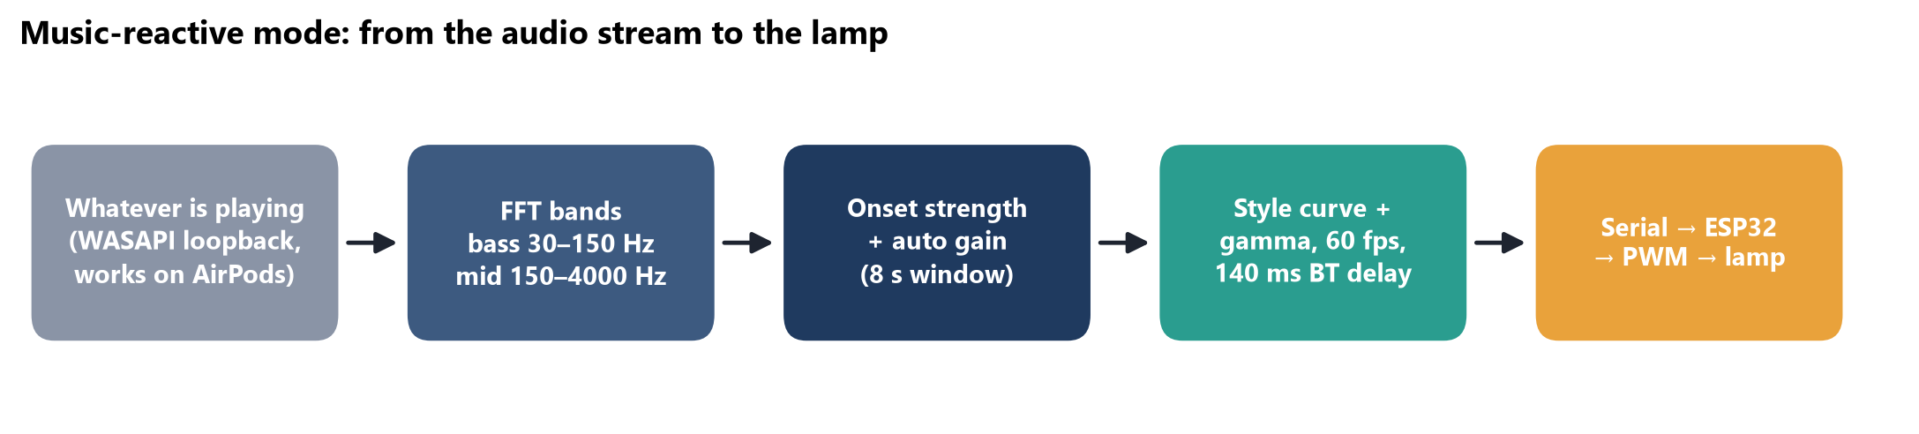
ADAPTIVE LED LAMP · MUSIC-REACTIVE MODE
Then I made it react to music
0 mics
60 fps
140 ms
it listens to the audio stream itself, so headphones work and room noise is ignored
brightness updates, sent over serial to the ESP32's PWM
Bluetooth delay measured and compensated, so flashes land on the beat
Same lamp hardware as before. The music mode is a Python engine on the PC: numpy FFT, auto gain control, onset detection.
Anmol Bhandohal · Electrical Engineering, University of Alberta
13 / 17

Slide 14
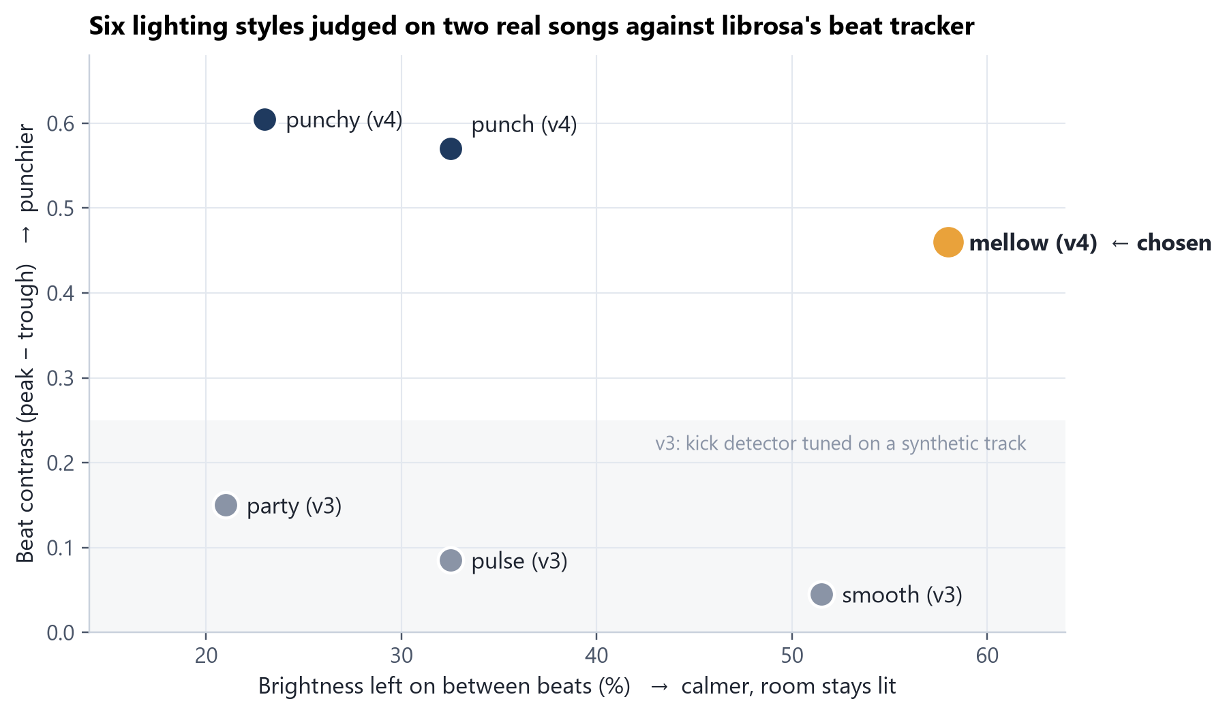
ADAPTIVE LED LAMP · DESIGN DECISIONS
Four versions, judged against an independent beat tracker
v1
Mapped raw volume. Swung only 50–70 % and followed the volume knob, not the music.
v2
Auto gain over an 8 s window, so it works at any volume.
v3
Kick detector tuned on a synthetic track. On real songs it caught only 0.12–0.33 kicks per beat.
v4
Continuous bass/mid onset strength: 5.8× the beat contrast on the same song.
Chosen: mellow. Picked by watching all three v4 styles on the same song. It keeps the room lit (58 %) and still lands the beats.
Anmol Bhandohal · Electrical Engineering, University of Alberta
14 / 17

Slide 15
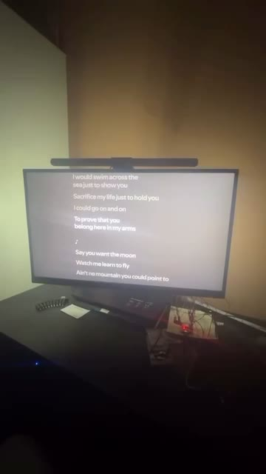
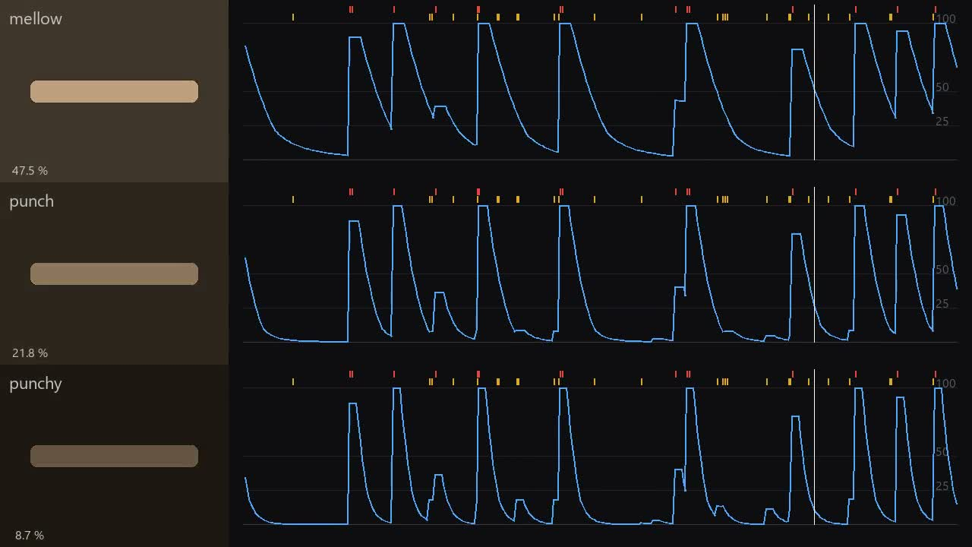
ADAPTIVE LED LAMP · VIDEO
Watch it
Rendered comparison: the three v4 styles run on the same 30 s of music. Left: simulated diffuser at the commanded brightness. Right: brightness trace with detected hits.
Real lamp, behind the monitor (click to play)
Anmol Bhandohal · Electrical Engineering, University of Alberta
15 / 17

Slide 16
CONCLUSIONS
What I built, and what's next
Done
Next
▪ Sensor → ESP32 → Wi-Fi → Python → Excel chain, validated on 16 h of real data
▪ Room A: 9 furnace cycles, ≈ 0.5 °C each, τ ≈ 24 h
▪ LED lamp: linear to R² 0.9999, closed-loop control within 1 sensor count
▪ Music mode: 4 versions, judged against librosa; v4 has 5.8× the beat contrast
▪ Build node 2 and run the 24 h side-by-side calibration
▪ Log both rooms for 2 to 3 weeks
▪ Fill in the comparison and apply the decision rules
The same approach transfers to any building or equipment question: measure, model, then decide.
Anmol Bhandohal · Electrical Engineering, University of Alberta
16 / 17

Slide 17
Thank you
Anmol Bhandohal · bhandoha@ualberta.ca
linkedin.com/in/anmol-bhandohal-904789305
Technical report (Word)
Analysis workbook (Excel)
Firmware + Python code
available on request

