Slide 1




CROP AND FERTILIZER RECOMMENDATION SYSTEM

Slide 2

INTRODUCTION
Agriculture is the backbone of many economies, but farmers often face challenges in choosing the right crop and using fertilizers effectively due to limited scientific knowledge about soil nutrients and environmental conditions.
This lack of data-driven decision-making leads to low crop yield, higher input costs, and soil degradation.
There is a growing need for smart farming solutions that can guide farmers using real data and technology.

Slide 3
OBJECTIVES
Recommend the most suitable crop based on soil nutrients (N, P, K) and environmental factors (temperature, humidity, pH, rainfall).
Provide fertilizer suggestions to balance soil nutrient levels for better yield.
Suggest water requirements to ensure optimal growth and productivity.

Slide 4
WHY THIS PROBLEM MATTERS
Agriculture depends on soil health and environmental conditions.
NPK (Nitrogen, Phosphorus, Potassium):
Soil pH: Controls nutrient availability; most crops grow best at pH 6–7.
Environmental factors (Temperature, Humidity, Rainfall): Affect germination, growth, and yield.
Nitrogen (N): Encourages leaf & stem growth.
Phosphorus (P): Promotes root development & energy transfer.
Potassium (K): Improves disease resistance and crop quality.

Slide 5
KEY PARAMETERS
NPK levels (mg/kg): Each crop needs a different balance.
pH (0–14): Determines crop suitability (e.g., rice prefers 5.5–6.5).
Temperature (°C): Warm-season vs. cool-season crops differ in requirements.
Humidity (%): Affects water retention and plant disease risks.
Rainfall (mm): Water needs vary by crop (e.g., rice ~1200 mm, pulses much less).
These KPIs guide the ML model to provide accurate crop and fertilizer recommendations.

Slide 6
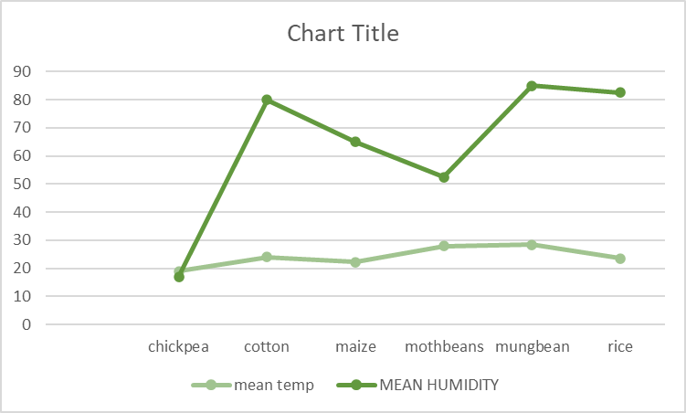
Example
Cotton and mungbean require higher humidity (80–85%) compared to other crops like chickpea (~20%).
Temperature requirements remain moderate (20–28°C) across most crops, with slight variations.
Selecting crops based on these environmental conditions ensures better yield and resource efficiency.

Slide 7
SOLUTION
Developed a data-driven system for crop and fertilizer recommendations.
Inputs: Soil NPK, pH, temperature, humidity, rainfall.
Outputs: Top 3 crop suggestions with fertilizer and water advice.

Slide 8
OUR APPROACH
Data Preprocessing: Cleaned and scaled data from Kaggle Crop Recommendation Dataset.
Model Training: Built an SVM classifier for crop prediction.
Web App: Designed with Streamlit for easy input and real-time results.
Model Deployment: Used Pickle to save the trained model.

Slide 9
TECH STACK
Programming Language: Python
Libraries: Pandas, NumPy, Scikit-learn, Matplotlib, Seaborn
Machine Learning Model: Support Vector Machine (SVM)
Web Framework: Streamlit
Model Deployment: Pickle (for saving the model and scaler)

Slide 10
WORKFLOW
Step 1: Collect soil and weather parameters (N, P, K, pH, temperature, humidity, rainfall).
Step 2: Preprocess and normalize the input data.
Step 3: Predict suitable crops using the trained SVM model.
Step 4: Provide fertilizer and water recommendations based on predicted crops.
Step 5: Display results through a user-friendly Streamlit interface.

Slide 11
DEMO
https://drive.google.com/file/d/12CljWGfsPmIGg4pevr7n1b-dLlBvj9Xv/view?usp=sharing

Slide 12
GROUP TEAM(SC1)_10
Milind Panda (Roll no.:24CSE097)(Reg no.:24UG010163)
Anmol Chandrakar (Roll no.:24CSEAIML239_) (Reg no.:24UG010733)
Blesson Oddu (Roll no.:24CSEAIML234) (reg no.:24UG010729)
Ankit Kumar Nayak (Roll no.:24CSEAIML233) (Reg no:24UG010728)

Slide 13
CONCLUSION
Our Crop & Fertilizer Recommendation System provides data-driven suggestions for crops, fertilizers, and water requirements.
It helps farmers make smarter decisions, leading to better yields, optimized resources, and reduced costs.
The model is simple, fast, and easy to use through a web interface.

Slide 14
FUTURE SCOPE
Integrating real-time weather data via APIs for dynamic recommendations.
Adding pest and disease prediction modules for complete crop advisory.
Expanding the dataset to include regional crops and soil types for better accuracy.
Developing a mobile application for offline use in remote areas.

Slide 15
THANK YOU

