Slide 1
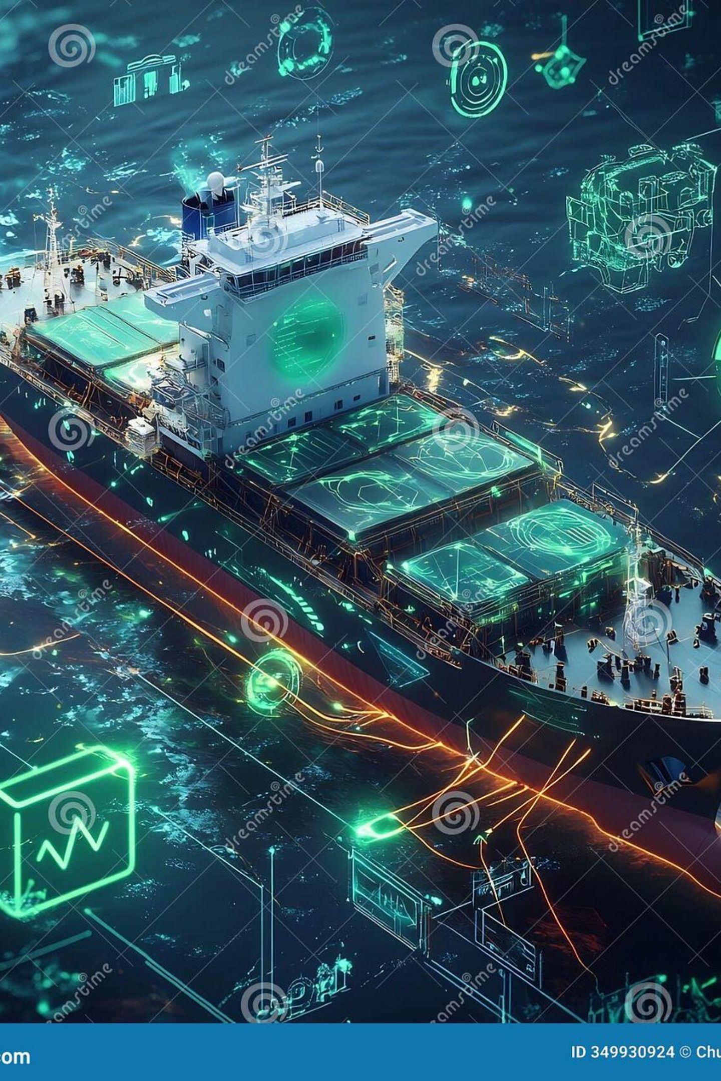
OCEANVANTA
AI-Powered Container Congestion Predictor & Port Operations Optimiser
Team Name – The Titans
Predict congestion. Optimise operations. Act before delays escalate.

Slide 2
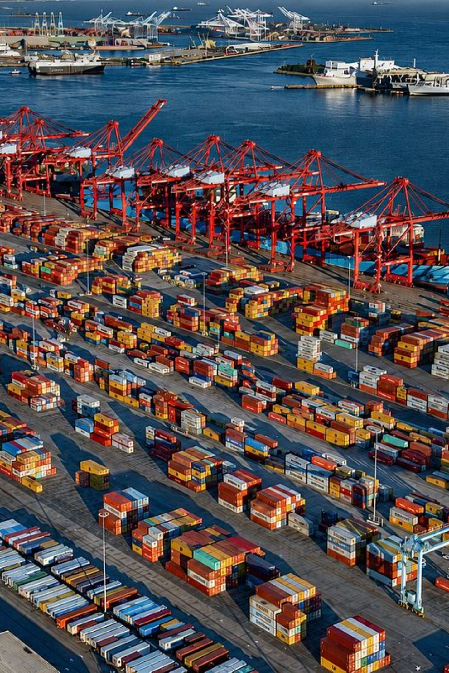
The Port Congestion Problem
01
Unpredictable arrivals
Vessel schedules and ETAs change continuously.
02
Cascading delays
Late vessels increase pressure on berths, cranes and port capacity.
03
Manual decisions
Operators must repeatedly re-plan vessel arrivals and resources.
04
Limited foresight
Existing workflows may identify delays without immediately translating them. into operational actions.
Port operators need an early-warning system that connects congestion prediction directly to operational decisions.

Slide 3
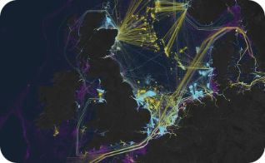
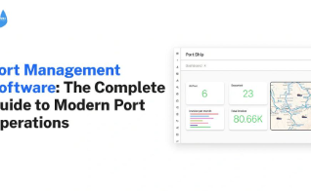
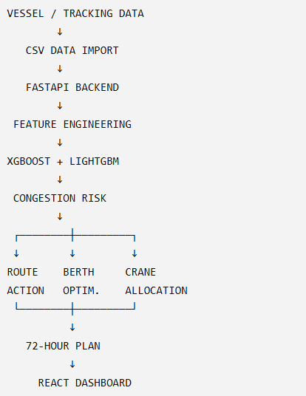
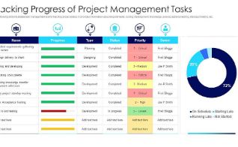
PortMind: From Prediction to Action
1 — Predict
2 — Optimise
Predict vessel congestion/delay risk before arrival using feature-engineered AIS & schedule inputs.
Translate risk into route, berth and crane recommendations for operators.
3 — Plan
Generate an actionable 72-hour operations plan integrating predicted risk and resource constraints.

Slide 4
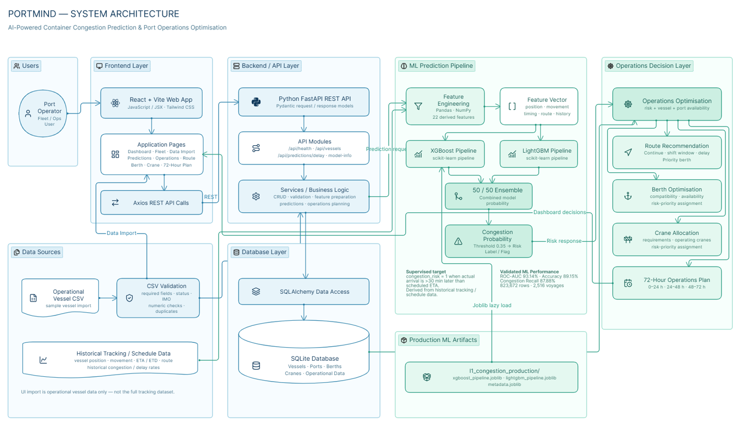

Slide 5
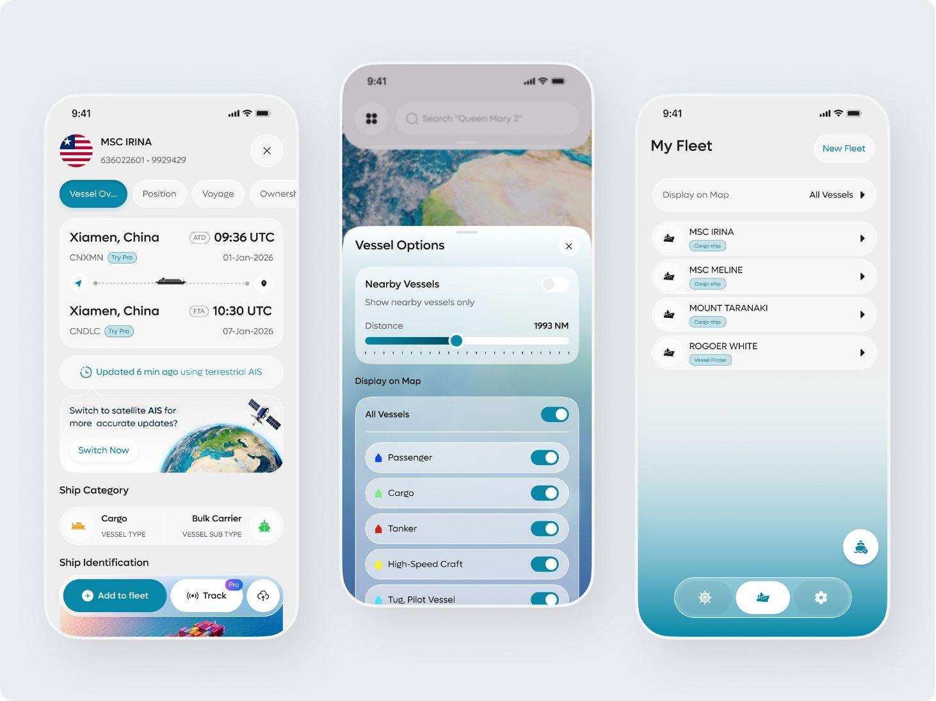
Live Congestion Prediction → Operational Decision
Demo flow
Import vessel schedule / tracking CSV
Select vessel and request prediction (POST /api/predictions/delay)
Backend runs ensemble model → returns probability
Operations module maps probability to actions

Slide 6
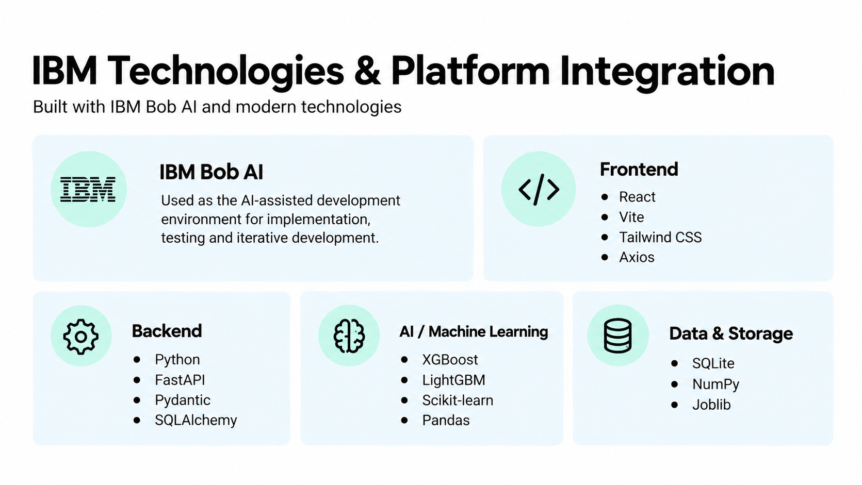

Slide 7
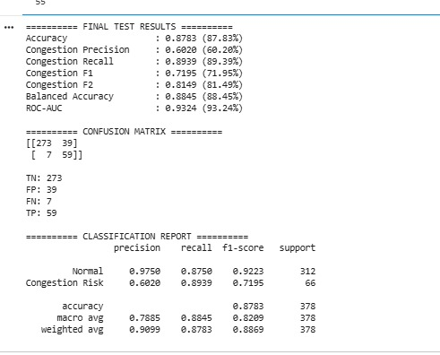
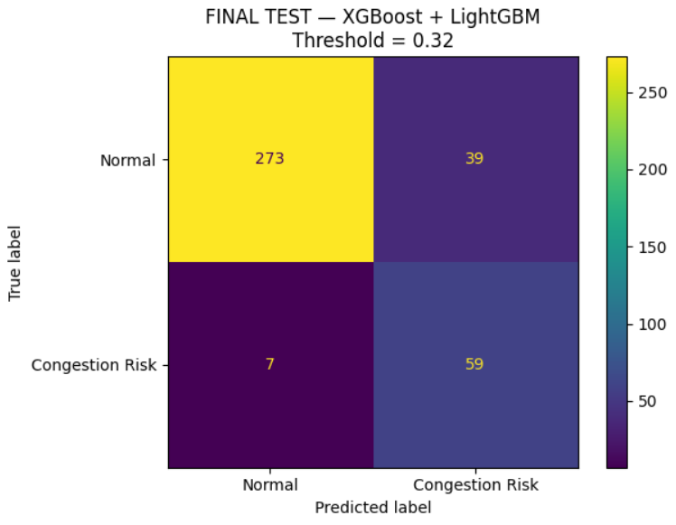
Measured ML Performance & Dataset Scale
Dataset
Model
Test performance
823,672 tracking rows · 2,516 unique voyages · 22 input features
XGBoost + LightGBM ensemble (50/50) · Congestion threshold = 0.35
ROC-AUC: 93.14% · Accuracy: 87.83% · Congestion Recall: 89.39%

Slide 8




Team PortMind
Romit Kakadiya
Anmol Dholiya
Krish Bhingradiya
Avi Patel
ML Engineering
Backend Developer
Frontend Developer
UI/IX + Documentation
PortMind turns vessel data into an actionable congestion & port-operations decision system.
Predict → Prioritise → Optimise → Plan
PortMind | Logistics & Ports — L1 | IBM/Bob AI Hackathon

