Slide 1

GateFlow
Smart traffic congestion alert for campus arrivals, 08:00–10:00
Forecasts Low / Moderate / High one hour ahead · explains why · alerts before the jam
VIT AI Innovate-A-Thon · Question 2 · October 2026
Proof of concept on real public traffic data · no live traffic feed connected
Notes:
Introduce GateFlow: it warns the college one hour before the gate road jams, so students and staff can act early. Be clear from the start that it is a proof of concept trained on real public data, not connected to live traffic.

Slide 2




Students all arrive 08:00–10:00 and the gate road jams
Transport / admin office
2 hours
Decides on extra shuttles, a second gate and marshals. Gets the 07:00 alert with actions.
when most of campus arrives at the same gate
Gate security staff
Needs to know when crowds peak. Gets a simple level plus the reason.
23%
Students and staff
Want to arrive on time. Get a "leave 20 minutes earlier" message via the office.
of weekday 8–10 AM hours reach High congestion in our data
Shuttle operators
Congestion depends on vehicle volume, weather and events. A warning only helps if it comes before the jam.
Plan trips around peaks. Get forecasts for every weekday, as CSV.
Notes:
The problem: arrivals bunch into two hours, and on bad mornings the approach road jams. Intended users are the transport office (main decision-maker), gate security, students and staff, and shuttle operators.

Slide 3




A one-hour-ahead forecast that explains itself
Forecast, not hindsight
Explains every forecast
At 07:00 it predicts 08:00–09:00, using only what is known at 07:00. It never sees the answer.
Shows how much recent traffic, usual traffic, weather and holidays push the chance of High up or down.
AI that runs in the browser
Built for real use
The trained trees are exported to JSON and run in JavaScript, identical to scikit-learn. Free hosting, instant, private.
Replay any day, what-if sliders, type today's numbers, upload a CSV and download forecasts.
Notes:
Four ideas set GateFlow apart: an honest one-hour-ahead forecast, an explanation for each forecast, a model that runs entirely in the browser (so no server), and practical tools for the transport office.

Slide 4
Real data: 6 years of hourly traffic, weather and holidays
Task field | Dataset column
Timestamp | date_time (hourly, Oct 2012 – Sep 2018)
Vehicle count | traffic_volume (vehicles per hour)
Weather | weather_main + temp, rain, snow, clouds
Event indicator | holiday (US holidays, State Fair)
Labels (volume-to-capacity proxy)
Low
< 5,000 veh/h
Moderate
5,000 – 5,800
High
≥ 5,800 (≈85% of capacity)
UCI Machine Learning Repository / Kaggle · 48,204 rows · CC BY 4.0 · highway I-94 used as a stand-in for the campus road
Preprocessing
Chronological split, never shuffled
Dedupe hours (7,629 duplicate rows), spread the holiday flag to the whole day
Fix sensor errors; the 2014–15 outage stays empty, never invented
Weekdays only, target hours 08:00 and 09:00
Train 2012–2017 · 986 days
Test
Validation = 4 expanding-window CV folds inside train, used only to choose the model. Test = last year, 247 days, 494 forecasts, used once.
Notes:
Data: the public Metro Interstate Traffic Volume dataset, with all four required fields. Labels come from volume because there are no speeds. Explain the cleaning, and stress the chronological split: the test year was never seen during training or model selection.

Slide 5
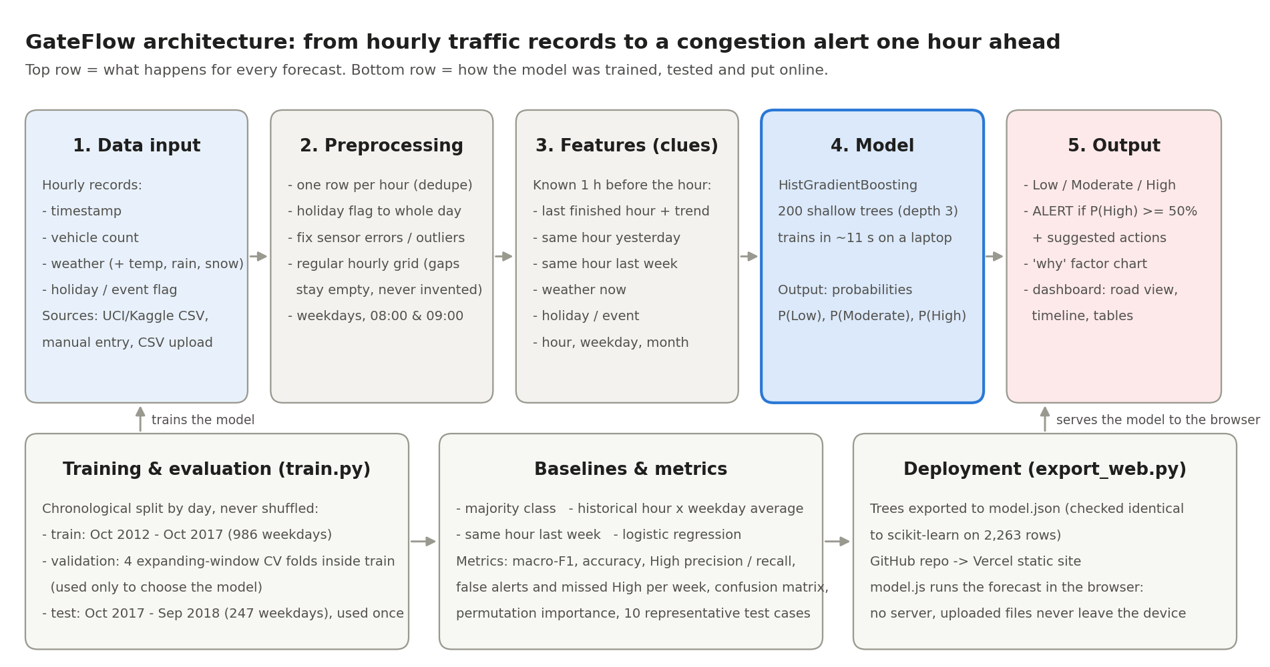
Architecture: data in, forecast and alert out
Notes:
Walk left to right: hourly records are cleaned, turned into clues known one hour ahead, scored by the gradient-boosting model, and shown as a level, an alert and an explanation. Bottom row: training with a held-out test year, baselines and metrics, then export to the browser through GitHub and Vercel.

Slide 6
A lightweight model: 200 small trees, trained in 11 seconds
HistGradientBoosting
Clues known one hour before the arrival hour
200 trees, 3 questions deep, each fixing the last one's mistakes
Traffic in the last finished hour, and its trend
Same hour yesterday and last week
Weather now: type, temperature, rain, snow, cloud
Holiday or event that day
Arrival hour, weekday, month
11 s
training time on a laptop CPU: no GPU, no deep learning
0.705 vs 0.672
validation macro-F1 vs logistic regression, so it was picked before testing
Example on 12 Sep 2018: 5,908 cars at 6–7 AM, up 2,823 on the hour before, rain → 99% chance of High.
3 × 10⁻⁷
largest gap between browser and scikit-learn outputs
Notes:
Explain gradient boosting simply: many small yes/no trees, each fixing the previous ones' mistakes. It suits small tables of numbers, trains in seconds and can be explained. It was chosen by validation on training years only.

Slide 7
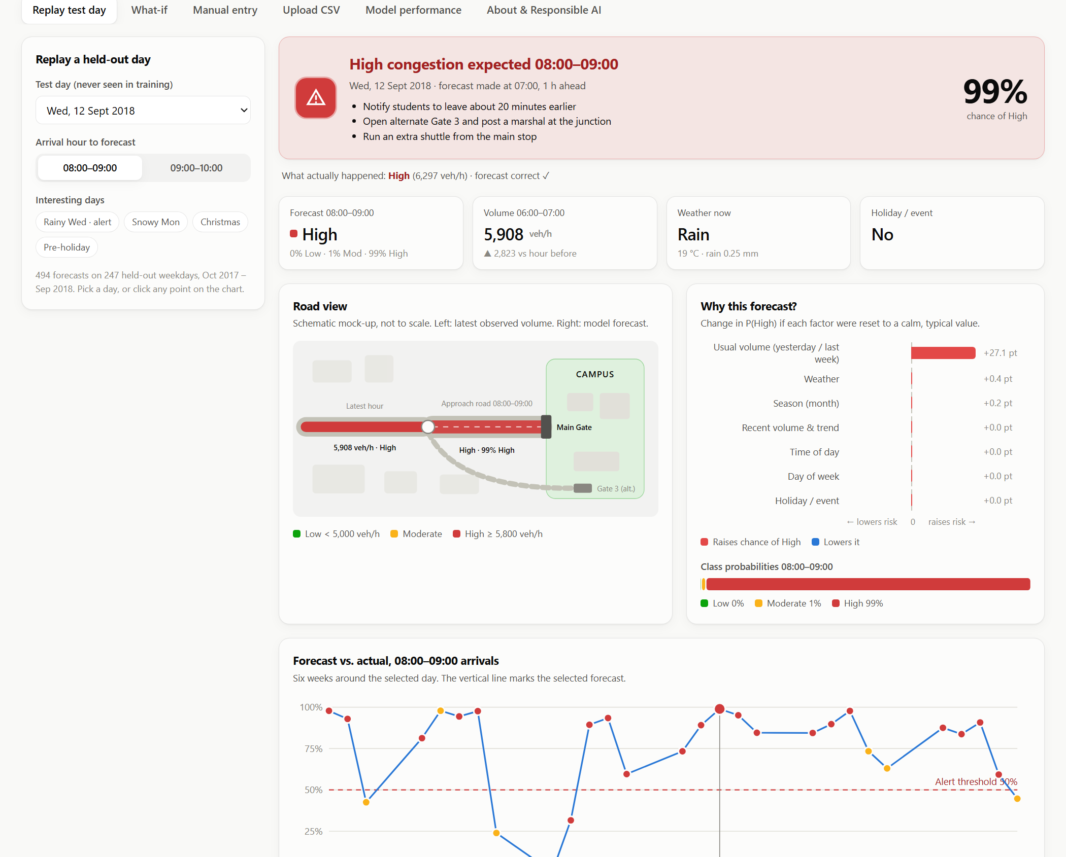
Demo: a day the model never saw, caught one hour early
1
Pick a held-out day
Wed 12 Sep 2018, rainy. Forecast made at 07:00.
2
Red alert + actions
99% chance of High: leave earlier, open Gate 3, extra shuttle.
3
See why
Usual traffic for this slot adds +27 points to the chance of High.
4
Check the truth
Actual: 6,297 veh/h, High. The forecast was correct.
Notes:
Live demo: open the site, Replay tab, 12 Sep 2018 08:00. Show the alert, the why chart, then scroll to the timeline and click another point. The model never saw this day.

Slide 8
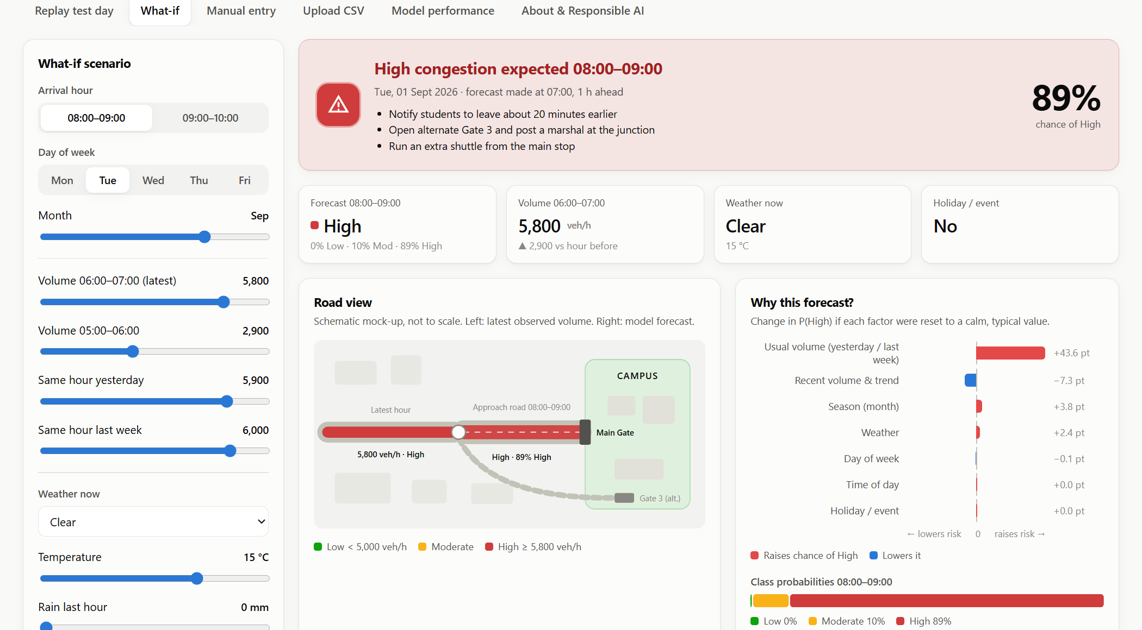
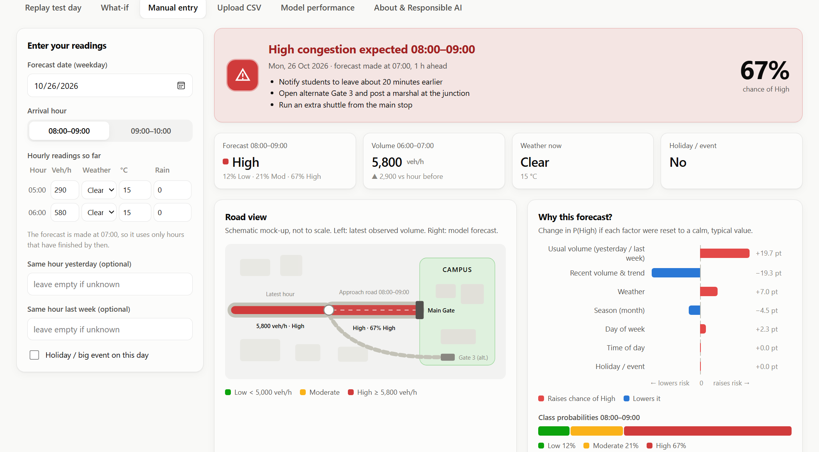
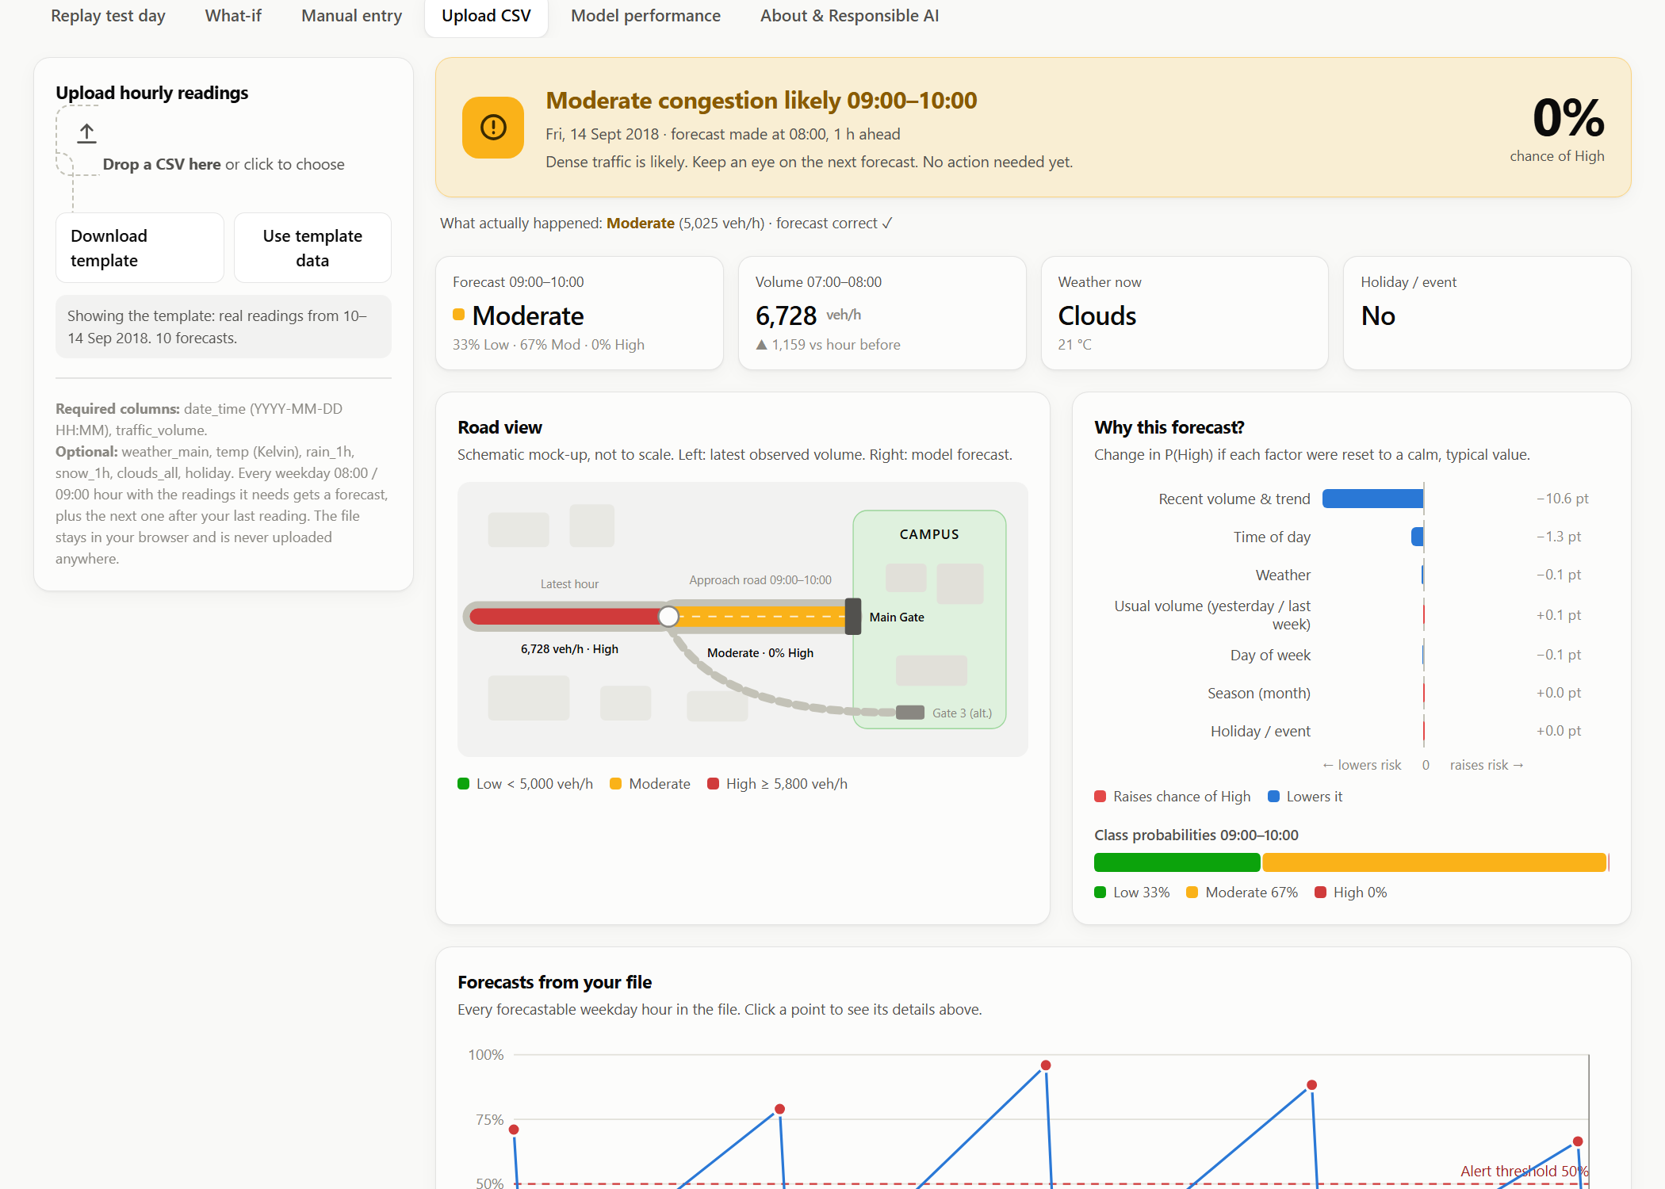
User workflow: three ways to get a forecast
What-if
Manual entry
Upload CSV
Drag sliders for traffic, weather, month or holiday. The alert updates live.
Type today's hourly counts and weather into a table, then get the 08:00 or 09:00 forecast.
Drop a file: every weekday peak in it gets a forecast, with a table and CSV download.
Notes:
Besides replay, the office can test scenarios, type in today's counts, or upload a whole CSV. Uploaded files never leave the browser. The Model performance and About tabs show the evaluation and the responsible-AI notes.

Slide 9




Agentic AI: ML predicts patterns, the agent handles surprises
1. Observe
2. Plan
3. Act
4. Reason
5. Reflect
6. Decide
→
→
→
→
→
Read the ML forecast
Pick which feeds to check
Call the tools
On the route? In the time window?
Do sources agree?
Keep or override the alert
↻ repeats until it can decide
Decision rules
Govt incident feed
Govt roadworks permits
News stations
Road blocked (confirmed) → High, ~97%
Lane closed → risk up by lost capacity
Unverified rumour → keep forecast, ask a human
Off the route or already over → ignore
Crashes, breakdowns and closures from the traffic police / transport department
Construction and lane closures from public-works permits
Local news reports to cross-check. Live mode adds real web search
Two engines, same tools
Built-in agent: runs offline, no key. Claude agent: claude-opus-5-5 drives the tool loop and can search live news. The ML model is not changed.
Notes:
ML learns from history, so it cannot see one-off events like a crash or a closed road. The agent starts from the ML forecast and runs a loop: observe, plan, act by calling tools (government incident feed, roadworks permits, news), reason about route and timing, reflect by cross-checking sources, then decide. If the road is blocked, it overrides the forecast to High. It never alerts on a rumour alone. The ML model itself is unchanged.

Slide 10
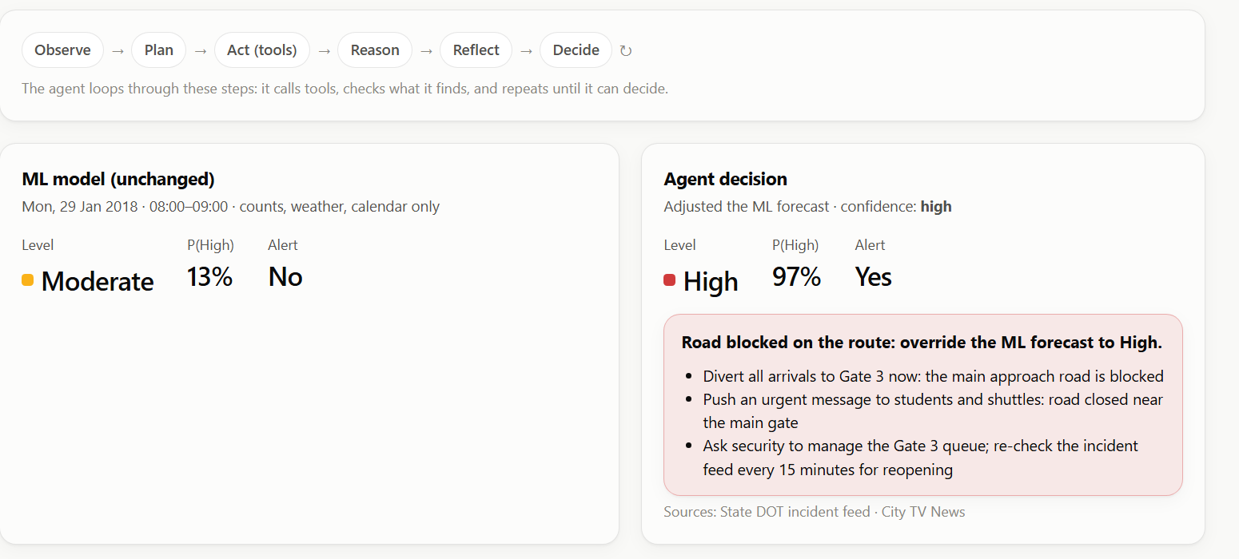
Demo: a blocked road turns Moderate into a High alert
Scenario | ML | Agent decides
Calm morning | Mod 13% | Keeps it
Accident blocks road | Mod 13% | High 97%: divert
Roadworks, 1 lane | Mod 19% | High 80%: leave early
Unverified rumour | Mod 25% | Keeps it, human check
Crash already cleared | Mod 3% | Keeps it (over by 07:30)
The ML model alone said Moderate, 13%. It cannot see the crash.
The agent found an official crash report, confirmed by TV news, so it raised the forecast to High, 97%: divert to Gate 3.
Every step is shown as a trace, so the decision can be checked.
Scenario feeds are simulated examples in a government / news feed format; the ML forecasts under them are real held-out days.
Notes:
Live demo: open the Agentic AI tab, pick Accident blocks the road, press Run agent and let the steps appear. Then show the rumour scenario: the agent refuses to raise an alarm on an unverified post and asks a human to check. That is responsible AI in action.

Slide 11
On a year it never saw, it beats every simple rule
0.73
macro-F1, vs 0.61 for the best simple rule
80%
of High-congestion hours caught
~1
false alert per week (out of 10 forecasts)
0.69
macro-F1 even 2 hours ahead (92% of High caught)
Notes:
Results on the held-out year: macro-F1 0.73 against 0.61 for the best baseline. Explain macro-F1: it checks each level fairly, unlike accuracy. The alert catches 4 of 5 jams with about one false alarm a week.

Slide 12
Test cases: where it works and where it fails
Arrival hour | Result | Situation | P(High) | Predicted → actual
12 Sep 2018 08:00 | Success | Rainy peak: alert raised and correct | 99% | High → High (6,297)
23 Aug 2018 08:00 | Success | Event day (State Fair), heavy traffic | 93% | High → High (6,162)
25 Dec 2017 08:00 | Success | Christmas: no false alarm | 0% | Low → Low (1,260)
05 Feb 2018 08:00 | Failure | Quiet 6 AM, then a sudden surge | 1% | Low → High (6,048)
19 Apr 2018 09:00 | Failure | Barely over the High cut-off | 0% | Moderate → High (5,842)
28 Aug 2018 08:00 | Failure | False alarm: ended just under the cut-off | 98% | High → Moderate (5,692)
Error analysis
79% of false alarms ended within 300 veh/h below the cut-off; all 20 missed High hours were within 300 above it
Weakest in fog and rain (67–68% correct), best in snow (91%); all 20 holiday forecasts were right
Notes:
Show failures honestly. Most mistakes sit right at a level boundary. The worst miss followed a quiet early morning with a sudden surge. Ten cases are in the report and on the website's performance tab.

Slide 13

What drives the forecast, and what it can't do yet
Limitations
Not live
Replays history; no traffic or weather API yet
Stand-in road
Highway I-94, not our gate: retrain on our counts
Volume, not speed
Labels are a proxy; queues and accidents are invisible
Hourly
15-minute data would give earlier, sharper alerts
Weather and holidays matter on the days they occur, but they are rare in the test year. The per-forecast "why" chart shows their effect.
No campus events
Exams and fests are not in the data
Notes:
Recent traffic and usual traffic for the slot dominate. Be upfront about the limits: no live feed, a stand-in road, volume-based labels, hourly resolution, and no campus calendar.

Slide 14





Responsible AI: private, fair about its limits, human in charge
Privacy
Bias & fairness
Security
Vehicle counts only. No cameras, plates or personal data. Uploaded CSVs never leave the browser.
One US highway; weaker in fog and rain (67–68%). Balanced class weights so High isn't ignored.
Static site: no server, database or keys. User text is escaped; files are parsed as plain data.
Accessibility
Limitations
Human oversight
Word + icon for every level, colour-blind-safe colours, keyboard use, screen-reader labels, dark mode, mobile.
Proxy labels, stand-in road, hourly data, no live feed. All stated on the site and in the report.
Advisory only: the transport office decides. Borderline 40–60% shown as a probability. Nothing automated.
Notes:
Cover the six responsible-AI areas: privacy, bias, security, accessibility, limitations and human oversight. The key point is that GateFlow advises and a person decides.

Slide 15
Aligned with the UN Sustainable Development Goals
11
SDG 11: Sustainable cities & communities
Target 11.2: safer, more accessible transport at a shared choke point; pushes shuttles and alternate gates.
3
SDG 3: Good health & well-being
3.6 road injuries and 3.9 air pollution: calmer gate queues, less stop-start exhaust.
13
SDG 13: Climate action
Smoother flow and more shuttle use mean less idling and lower emissions.
9
SDG 9: Industry, innovation & infrastructure
9.1: more out of existing roads through data, not new construction.
4
SDG 4: Quality education
4.a: students reach class on time and safely.
Notes:
The main goal is SDG 11.2, safe and sustainable transport, supported by health (SDG 3), climate (SDG 13), infrastructure (SDG 9) and education (SDG 4).

Slide 16
Implemented today, and what comes next
Implemented and working
Planned next
Real-data model, beats all baselines on a held-out year
1-hour-ahead forecast, alert at P(High) ≥ 50%, explanations
Web dashboard: replay, what-if, manual entry, CSV upload, performance, responsible AI
Agentic AI layer: tool loop that overrides the alert for crashes and closures
Model runs in the browser; deployed from GitHub to Vercel
Metrics, confusion matrix, test cases with failures, parity tests
Count vehicles at our own gate for a few weeks and retrain (same code)
Speed or queue labels from a camera or GPS
Live traffic counter and weather-forecast APIs
Real government incident and roadworks APIs for the agent
SMS or app notifications run by the transport office
15-minute data and the campus event calendar
Notes:
Close by separating what works today from what is planned. The most important next step is our own gate counts, which need no code changes.

Slide 17
Catches 4 of 5 jams, one hour early
About one false alarm a week · explainable · private · runs free in any browser
Code: github.com/AnmolDiwan/gateflow-congestion-alert
Data: Hogue (2019), Metro Interstate Traffic Volume, UCI ML Repository, CC BY 4.0
Notes:
Thank the judges and invite questions. Have the website open for the live demo.

