Slide 1


DELTALIGHT GAMES

Slide 2
Problem Statement : Develop a web application that can help manage a Gaming Parlor.
Problem Statement Number:PS16 Team Name : HS321_PS16 Team Number: 39
College Name: JSPM’s Rajarishi Shahu College of Engineering, Tathavade,Pune

Slide 3




OUR TEAM
SANKET KANEGAOKAR
Team Leader
ANMOL GATHE
MEMBER 1
SHRUTI YENKAR
MEMBER 2
GAYATRI JOSHI
MEMBER 3

Slide 4
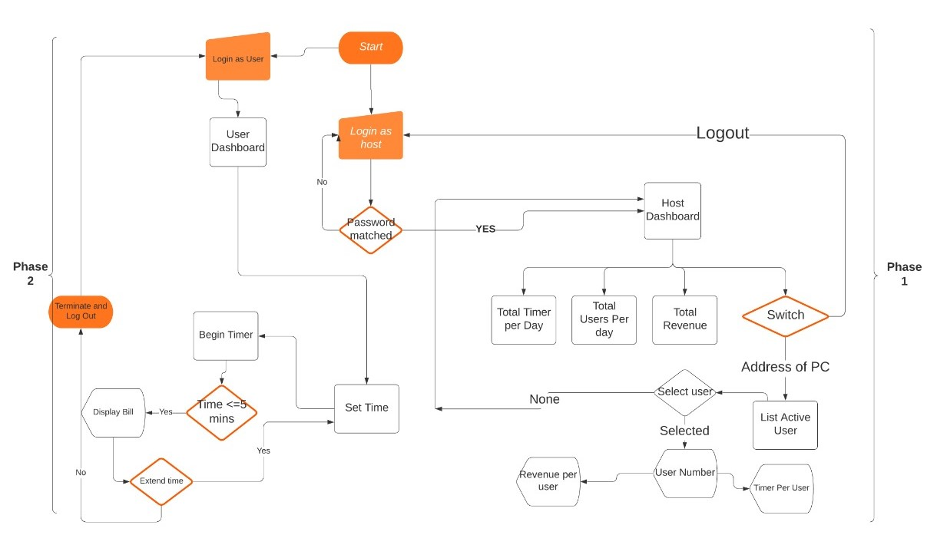
APPROACH DETAILS

Slide 5

HOST DASHBOARD
USER TIMER
TIMER FOR EACH USER WILL BE DISPLAYED SIMULTANEOUSLY.
TOTAL TIME
TOTAL TIME USED PER CUSTOMER.
TOTAL REVENUE
TOTAL REVENUE GENERATED IN A DAY.

Slide 6

DESCRIPTION OF THE PROJECT
SCOPE
IMPLEMENTATION
METHODOLOGY
EXECUTION
WE HAVE USED HTML,CSS FOR FRONTEND AND PYTHON FOR BACKEND.
CREATION OF USER DASHBOARD WHICH CONTAINS THE RULES OF PARTICULAR GAME AND THE TIMER FOR TRACKING.
HOST WILL HAVE THE TRACK OF ALL THE PC’S AND AT THE END OF EACH DAY HE CAN GET THE STATISTICS OF THE DAY WHICH INCLUDES TOTAL TIME BY EACH AND THE FINAL REVENUE GENERATED.
USER WILL BE PROVIDED WITH A PASSWORD OF THE PC AND THEN ACCORDING CHOSEN SLOT THE TIMER WILL START AND THE USER WILL BE NOTIFIED 5 MIN BEFORE THE GAME ENDS

Slide 7

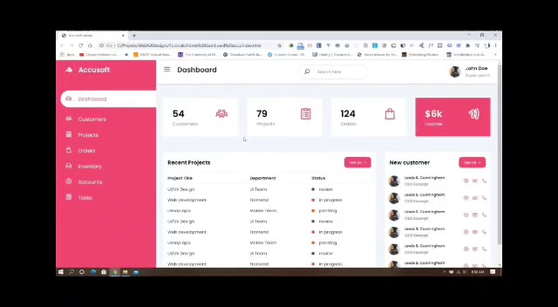
OVERVIEW

Slide 8
Day 1 mentor suggestions
1.Create different folders for each type of file like
html, css ,images and javascript files to be saved in
different folders to assure ease of access for all the
files.
2. Use MongoDB for database management.

Slide 9
DAY 2 MENTOR SUGGESTIONS
1)Bootstrap can be used for emphasizing the html page.
2)Can use container to make the login pages easier to access as well as improvise the
visibility of the input fields.
3)Give different id’s for different PC data in the host dashboard. Can create cards like
elements for each active device.
4) Can include bootstrap links in the html files.
5) For background can use gradients instead of images as images may take some
reload time or sometimes may also be not displayed.
6)Home page may not have a login button can be replaced by some welcome message or may also be eliminated.

Slide 10
THANK YOU !

