Slide 1
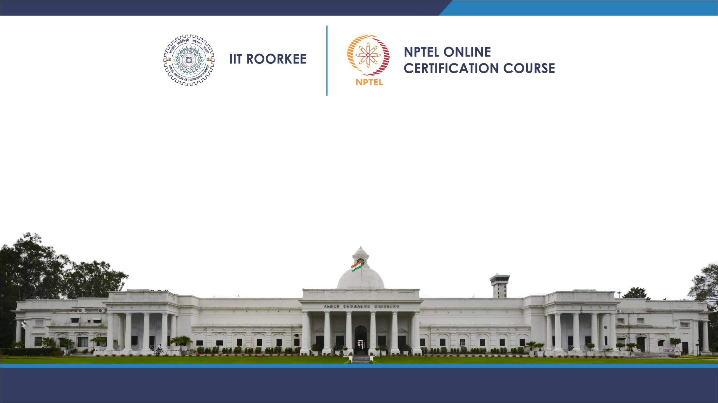
Lecture 2
Sociology: Anthony Giddens Part 2
Dr. Anindya Jayanta Mishra Professor of Sociology Department of Humanities and Social Sciences IIT Roorkee

Slide 2
A sociologist is someone – who is able to break free from the immediacy of personal circumstances and put things in a wider context
Sociological Imagination – requires us to “ think ourselves away from the familiar routines of our daily lives in order to look at them anew” C Wright Mills
Sociological Imagination- It’s an interplay of Biography and History
Biography – Individual Circumstance, Personal Experiences
History – Broader Social, Economic, Political, Economic, Religious context
Private Trouble Versus Public Issue

Slide 3
Sociological imagination – allows us to see that many events that seem to concern only the individual actually reflect larger issues
Example – Divorce, Unemployment (both personal & public concern)
Example: Drinking coffee
1. Symbolic value – act of drinking – a ritual – individual & group interaction more important
2. Use as drug – not considered a drug in most societies but is considered so in some societies and banned

Slide 4
3. Social and economic relationship – An individual who drinks coffee is caught up in complex set of socio eco rel. stretching across the world
Production, distribution, transportation require continuous transaction between people 1000 miles from consumer
Many aspects of our lives now affected by broader worldwide social influences
4. Past socio-economic development – act of drinking coffee presumes past socio economic development
Like banana, tea, white sugar it is a new entrant to western & Indian diet
After 1800 – coffee has a colonial past

Slide 5
5. Coffee reflects globalisation, international trade, human rights and environmental destruction – coffee globalised and politicised
Individuals may choose decaffeinated coffee or organic coffee or fairly traded coffee or reject coffee from countries with human rights violation – corporate coffee Vs independent coffee houses
Globalisation heightens our awareness of issues happening across the world

Slide 6
Our activities both structure – give shape to – the soc world we live in & at the same time are structured by that soc world
Soc structure – soc context of our lives do not consist just of random collection of events & actions – its structured, patterned – regularities in the way we behave and in rel. we have with one another
Soc structure – being reconstructed at every moment by the very building block that compose it – human beings like you and me

Slide 7
Intended and Unintended Consequences
Purposes/intentions of our behaviour and resulting unexpected unintended outcome
Example: Parents’ strictness and children’s deviance in protest against orthodoxy
New York building owners – told to renovate to accommodate more people
They abandoned the old buildings causing scarcity in accommodation space
Reservation policy in India

Slide 8
Its sociologists task to understand the resulting balance between social reproduction and social transformation
Social reproduction – how societies keep going over time
Social transformation – changes societies undergo
Social reproduction – occurs bcoz there is continuity in what people do, how they behave, the practices they follow day to day, year to year
Sociology is a science that involves systematic methods of investigation and evaluation of theories in the light of evidence and logical argument
But cant be directly modelled on natural science

Slide 9
General Subject Matter of Sociology (Alex Inkles 1964)
1.Sociological analysis – Human Culture & Society, Sociological Perspective, Scientific Method In Social Science
2.Primary units of social life – Soc. Acts & Soc Rel., Groups, Communities etc.
3.Basic social institutions – Family, Religious, Economic, Political, Educational etc.
4.Fundamental social processes – Social Stratification, Socialisation, Cooperation, Assimilation, Accommodation, Social Control, Social Conflict, Social Change

Slide 10
Sociology in 2024!
Contents in the Text books of Anthony Giddens and David Newman Individual and Society, Social Construction of Knowledge and Reality, Identity Building: Socialisation, Social Relationships: Family, Crime and Social Deviance, Organisations, Institutions, Social Stratification: Gender, Class, Caste, Race, Ethnicity and Inequality, Religion and Modern Society, Ageing and Old age, Media, Work and Economic Life, Cities and Urban Spaces, Politics, Government and Terrorism, Science, Technology and Society, Globalisation and Social Change

Slide 11
Thank You

