Slide 1
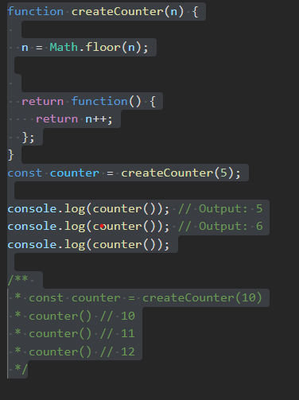
day 1 of leetcode on javascript
problem -: Given an integer n, return a counter function. This counter function initially returns n and then returns 1 more than the previous value every subsequent time it is called (n, n + 1, n + 2, etc).
solution for the problem

