Slide 1

MLSA Full Stack Development Internship

Slide 2
Internship Overview
Objective
Skills
Projects
Gain hands-on full-stack development experience
Strengthen HTML, CSS, and JavaScript foundations
Personal Webpage and Calculator Application

Slide 3
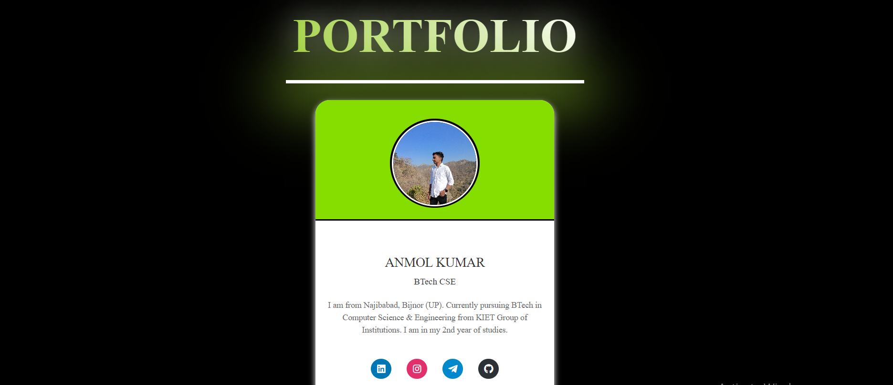
Project 1: Personal Webpage
1
Objective
2
Components
Design simple yet effective personal webpage
Introduction, Bio, and Contact Links

Slide 4
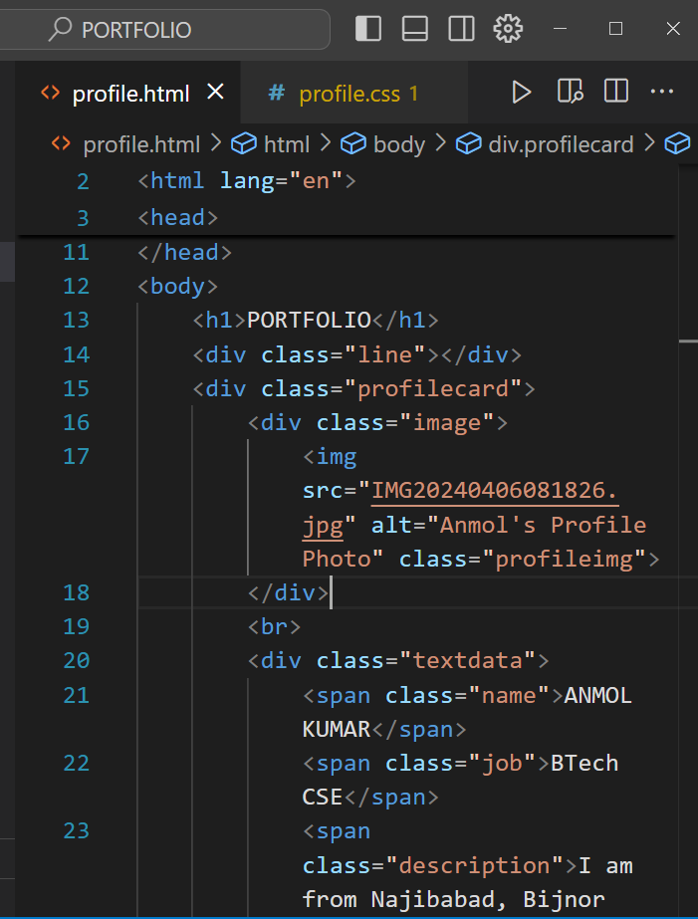
Project 1: Implementation
1
HTML
Create structured page content
2
CSS
Apply styling

Slide 5



Project 1: Key Learnings
HTML Structuring
Semantic elements for better organization
CSS Styling
Enhanced layout techniques and responsive design

Slide 6
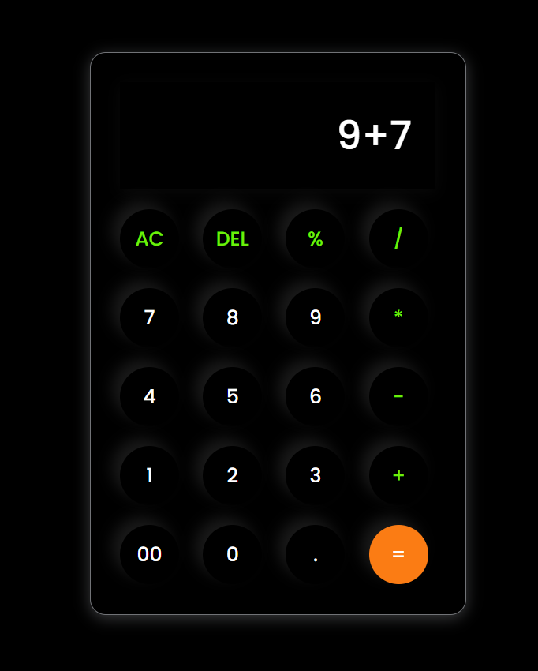
Project 2: Calculator Application
Objective
Build calculator for basic arithmetic operations
Functions
Addition, subtraction, multiplication, and division
Focus
User-friendly interface with real-time calculations

Slide 7
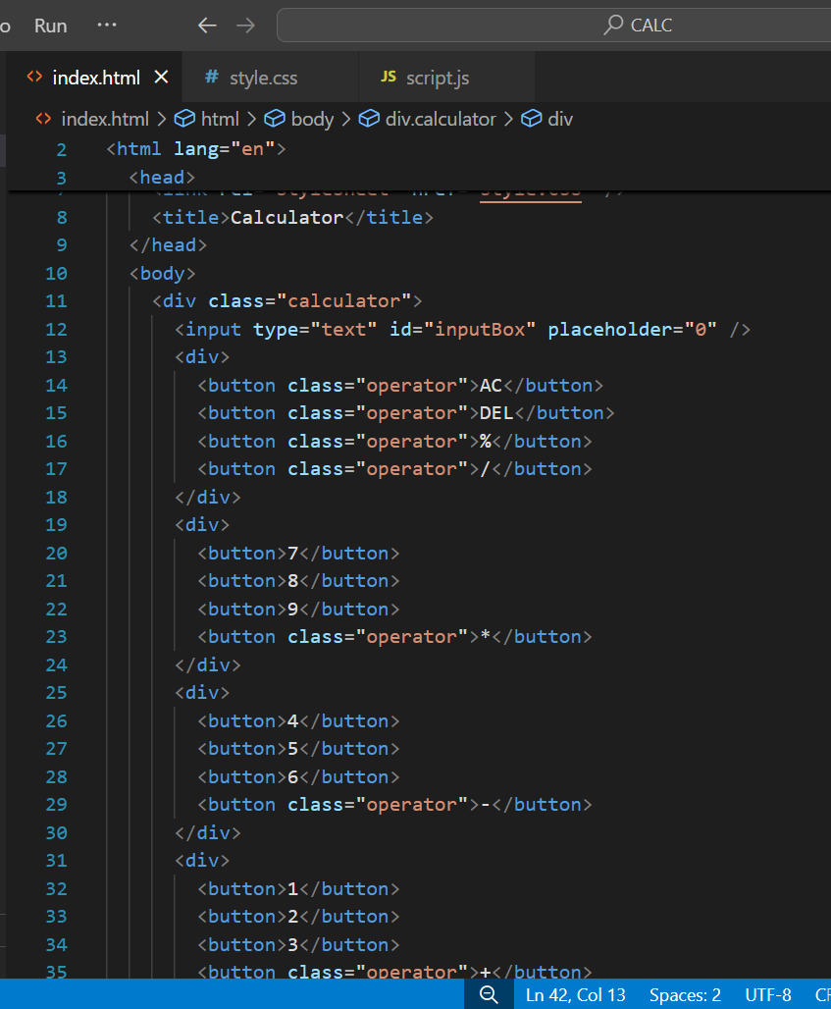



Project 2: Implementation
HTML
Design intuitive calculator interface
CSS
Style for visual appeal and usability
JavaScript
Implement calculations and interactive functionality

Slide 8
Project 2: Key Learnings
JavaScript Functions
DOM Manipulation
Problem-Solving
Efficient handling of arithmetic operations
Dynamic input capture and result display
Debugging and handling edge cases effectively

Slide 9

Overall Internship Experience
1
Skills
Strengthened HTML, CSS, and JavaScript foundations
2
Confidence
Enhanced ability to create interactive web applications
3
Insights
Gained valuable full-stack development workflow experience

