Slide 1
CREDIT CARD FRAUD DETECTION
LUV GAMBHIR(11021210059)
ANMOL NAGPAL(11021210085)

Slide 2
CONTENTS
1.INRODUCTION
2.LITRATURE REVIEW
3.EARLIER STUDIES
4.OBJECTIVE
5.PROBLEM IDENTIFICATION
6.METHODOLOGY
7.IMPLEMENTATION
8.REFERENCES

Slide 3
INTROUCTION
Credit card generally refers to a card that is assigned to the customer (cardholder), usually allowing them to purchase goods and services within credit limit or withdraw cash in advance. Credit card provides the cardholder an advantage of the time, i.e., it provides time for their customers to repay later in a prescribed time, by carrying it to the next billing cycle.
Credit card frauds are easy targets. Without any risks, a significant amount can be withdrawn without the owner’s knowledge, in a short period. Fraudsters always try to make every fraudulent transaction legitimate, which makes fraud detection very challenging and difficult task to detect.

Slide 4
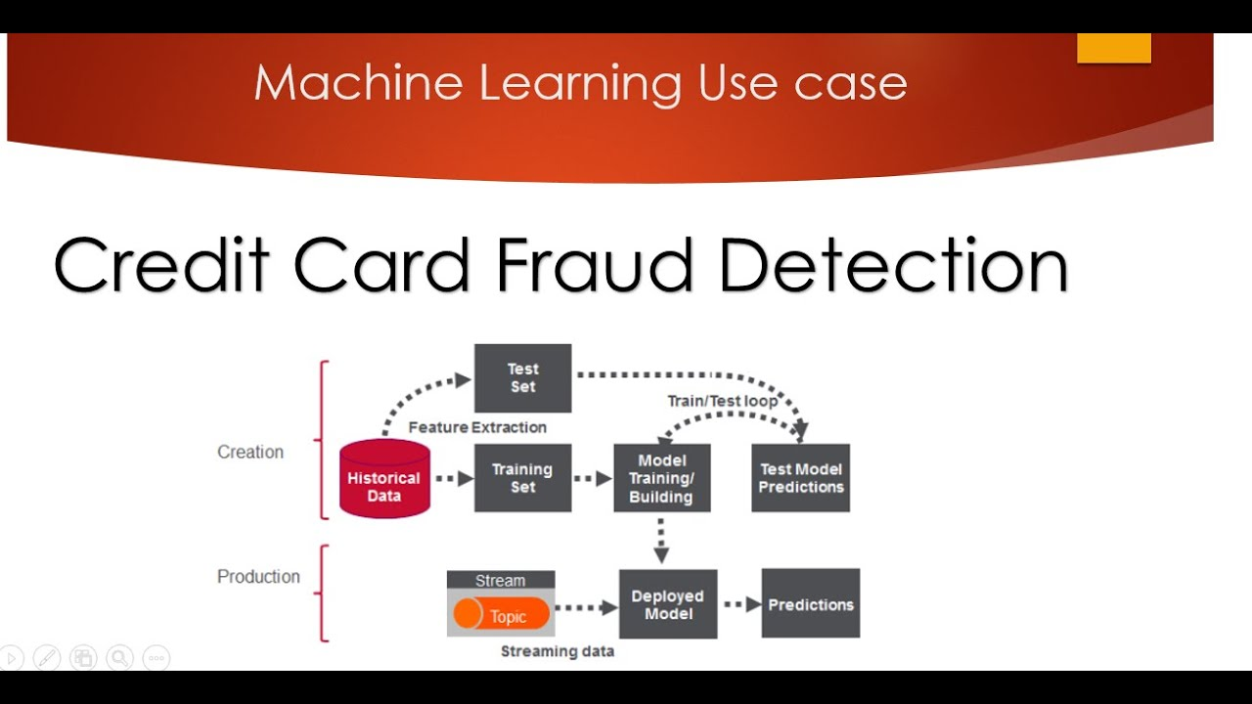

Slide 5
LITRATURE REVIEW
Credit Card Fraud Detection using Machine Learning and Data Science By S P Maniraj Assistant Professor (O.G.) Department of Computer Science and Engineering SRM Institute of Science and Technology . https://www.researchgate.net/publication/336800562_Credit_Card_Fraud_Detection_using_Machine_Learning_and_Data_Science
Mr. Thirunavukkarasu.M1 ; Achutha Nimisha2 ; Adusumilli Jyothsna3 1Assistant Professor, Dept. of CSE, SCSVMV (Deemed to be University), Kanchipuram, TamilNadu, India (mthiru@kanchiuniv.ac.in) 2 Student, Dept. of CSE, SCSVMV (Deemed to be University), Kanchipuram, TamilNadu, India (11179A002@kanchiuniv.ac.in) 3 Student, Dept. of CSE, SCSVMV (Deemed to be University), Kanchipuram, TamilNadu, India. https://ijcsmc.com/docs/papers/April2021/V10I4202112.pdf
Shalini Avinashbhai Naik and Dr. Nitin Pise Department of Computer Science & Technology, MIT-Wpu, Survey No,124, Paud o Road, Kothrud, Pune, Maharashtra 411038 shailynaik24@gmail.com, nitin.pise@mitwpu.edu.in https://ieomsociety.org/proceedings/2022india/170.pdf
Vaishnavi Nath Dornadula , Geeta S , Vellore Institute of Technology ,Chennai

Slide 6
1. SP Maniraj Assistant Professor (O.G.) Department of Computer Science and Engineering SRM Institute of Science and Technology .
Theme and methodology
Result and conclusion
Theme: In this paper they focus on the fraud detection for the credit card where they use the different machine learning algorithm to solve this problem.
Methodology : The approach that this paper proposes, uses the latest machine learning algorithms to detect anomalous activities, called outliers.
Result : The code prints out the number of false positives it detected and compares it with the actual values. This is used to calculate the accuracy score and precision of the algorithms. The fraction of data we used for faster testing is 10% of the entire dataset. The complete dataset is also used at the end and both the results are printed. This result matched against the class values to check for false positives . Results when 10% of the dataset is used.
Conclusion : Credit card fraud is without a doubt an act of criminal dishonesty. This ar has listed out the most common methods of fraud along with their detection methods and reviewed recent findings in this field

Slide 7
2. Mr. Thirunavukkarasu.M1 ; Achutha Nimisha2 ; Adusumilli Jyothsna3 1Assistant Professor, Dept. of CSE, SCSVMV (Deemed to be University), Kanchipuram, TamilNadu, India c. 2 Student, Dept. of CSE, SCSVMV (Deemed to be Unive, Kanchipuram, TamilNadu, India (11179 3 Student, Dept. of CSE, SCSVMV (Deemed to be University), Kanchipuram, TamilNadu, India
Theme and methodology
Result and conclusion
Theme: - This Project is focused on credit card fraud detection in real world scenarios. Nowadays credit card frauds are drastically increasing in number as compared to earlier times. Criminals are using fake identity and various technologies to trap the users and get the money out of them. Therefore, it is very essential to find a solution to these types of frauds. In this proposed project we designed a model to detect the fraud activity in credit card transactions. This system can provide most of the important features required to detect illegal and illicit transactions.
Methodology :
Data collection
• Data pre-processing
• Feature extraction
• Evaluation model
Hence, we have acquired the result of an accurate value of credit card fraud detection i.e. 0.9994802867383512 (99.93%) using a random forest algorithm with new enhancements. In comparison to existing modules, this proposed module is applicable for the larger dataset and provides more accurate results. The Random forest algorithm will provide better performance with many training data, but speed during testing and application will still suffer.

Slide 8
Shalini Avinashbhai Naik and Dr. Nitin Pise Department of Computer Science & Technology, MIT-Wpu, Survey No,124, Paud o Road, Kothrud, Pune, Maharashtra 411038 ,nitin.pisemitwpu.edu.in
Theme and methodology
Result and conclusion
Theme:This project compares supervised algorithms like Logistic regression, Support vector machine, KNN, Decision Tree, Xgboost, etc., and finds the best model through hyper parameter tuning, Grid search and applies resampling techniques.
Methodology :Here, we are going to use 3 resampling techniques for balancing the dataset. The techniques are
1. Random Forest
2. SMOTE
3. ADASYN
From the literature, they used an imbalanced dataset to check the accuracy, precision and recall of different machine learning algorithms to predict the fraudulent transaction. But we will use sampling techniques to the balanced dataset. For an imbalanced dataset we can’t rely on the accuracy, we have to see precision, recall, F1-score, and roc-AUC curve, etc. From this evaluation, we can easily see which model works best on the imbalanced dataset as well as a balanced dataset.

Slide 9
Vaishnavi Nath Dornadula , Geeta S , Vellore Institute of Technology ,Chennai
Theme and methodology
Result and conclusion
Theme : Multiple Supervised and Semi-Supervised machine learning techniques are used for fraud detection , but we aim is to overcome three main challenges with card frauds related dataset i.e., strong class imbalance, the inclusion of labelled and unlabelled samples, and to increase the ability to process a large number of transactions.
Methodology : Firstly, we use clustering method to divide the cardholders into different clusters/groups based on their transaction amount, i.e., high, medium and low using range partitioning.
• Using Sliding-Window method, we aggregate the transactions into respective groups, i.e., extract some features from window to find cardholder's behavioural patterns. Features like maximum amount, minimum amount of transaction, followed by the average amount in the window and even the time elapsed
In this paper we developed a novel method for fraud detection, where customers are grouped based on their transactions and extract behavioural patterns to develop a profile for every cardholder. Then different classifiers are applied on three different groups later rating scores are generated for every type of classifier. This . Followed by a feedback mechanism to solve the problem of concept drift. We observed that the Matthews Correlation Coefficient was the better parameter to deal with imbalance dataset. MCC was not the only solution. By applying the SMOTE, we tried balancing the dataset, where we found that the classifiers were performing better than before. The other way of handling imbalance dataset is to use one-class classifiers like one-class SVM. We finally observed that Logistic regression, decision tree and random forest are the algorithms that gave better results.

Slide 10
OBJECTIVE
The primary objective of credit card fraud detection is to identify and prevent fraudulent transactions in real-time or near real-time, ensuring the security and integrity of financial transactions while minimizing financial losses for both the cardholder and the financial institution. Below are some key objectives:
1. Minimize Financial Losses
2. Enhance Detection Accuracy
3. Real-Time Detection
4. Improve User Experience
5. Enhance Detection Flexibility
6. Comply with Regulatory Standards
7. Increase Detection Efficiency
8. Protect Cardholder Information
9. Enhance Fraud Prevention Strategies
10. Reduce Operational Costs

Slide 11
PROBLEM IDENTIFICATION
The problem of credit card fraud detection involves identifying and preventing unauthorized or fraudulent transactions from occurring on a user's credit card account. Here are some key aspects to consider when identifying the problem:
1. Fraudulent Transactions : Fraudulent transactions refer to any transaction made using a stolen, cloned, or compromised credit card. These transactions are unauthorized and typically result in financial losses for both the cardholder and the financial institution.
2. Types of Fraud
Card-not-present fraud: Occurs in online or phone transactions where the physical card
is not used, making it more difficult to authenticate.
Card-present fraud: Occurs when the card is physically swiped or inserted, but the
transaction is fraudulent due to a stolen or cloned card.
Account takeover: Fraudsters gain control of an account and make unauthorized
purchases, often by changing login credentials or contacting the bank to modify account
details.
Identity theft: Fraudsters impersonate the cardholder using stolen personal
information to commit fraud.
Application fraud: When criminals apply for new credit cards using stolen or
fabricated information.

Slide 12
4. Identification Methods
Rule-Based Detection: Uses predefined rules to flag suspicious activity
(e.g., large transactions, high frequency, or transactions in unusual
locations). This method can be rigid and ineffective against new fraud
patterns.
Machine Learning Models: Algorithms like decision trees, random
forests, support vector machines, and neural networks can be trained to
detect fraud patterns based on historical data. They can adapt to new
fraud patterns over time.
Anomaly Detection: Identifying transactions that deviate significantly
from the cardholder's normal spending behavior.
Behavioral Biometrics: Analyzing user behavior patterns such as typing
speed, mouse movements, and mobile interactions to detect unusual
activities.

Slide 13
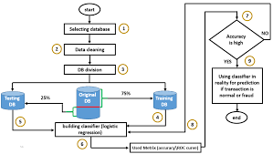
METHODOLOGY
LOGISTIC REGRESSION : logistic regression is a supervised machine learning algorithm used for classification tasks where the goal is to predict the probability that an instance belongs to a given class or not. Logistic regression is a statistical algorithm which analyze the relationship between two data factors. The article explores the fundamentals of logistic regression, it’s types and implementations.

Slide 14
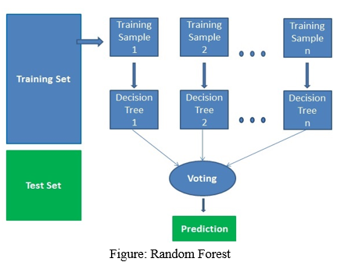
RANDOM FOREST:Random Forest algorithm is a powerful tree learning technique in machine learning. It works by creating a number of Decision Trees during the training phase. Each tree is constructed using a random subset of the data set to measure a random subset of features in each partition. This randomness introduces variability among individual trees, reducing the risk of overfitting and improving overall prediction performance.

Slide 15
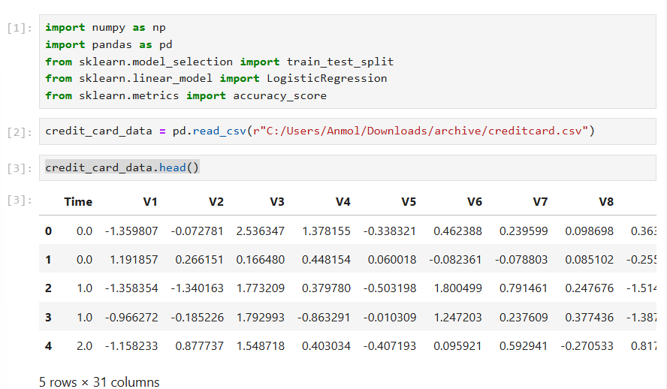
IMPLEMENTATION

Slide 16
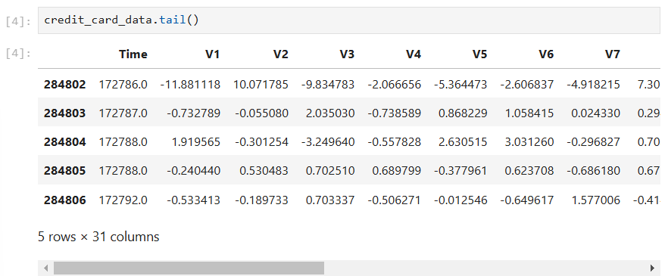
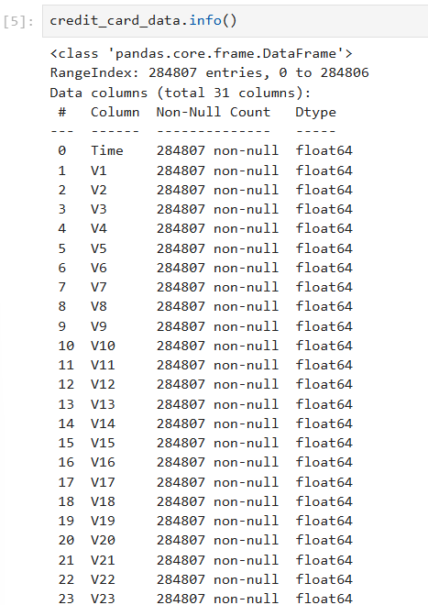

Slide 17
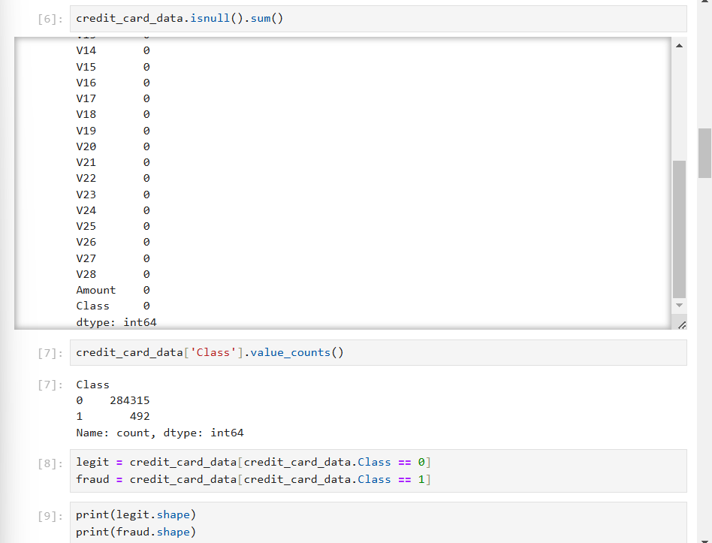

Slide 18
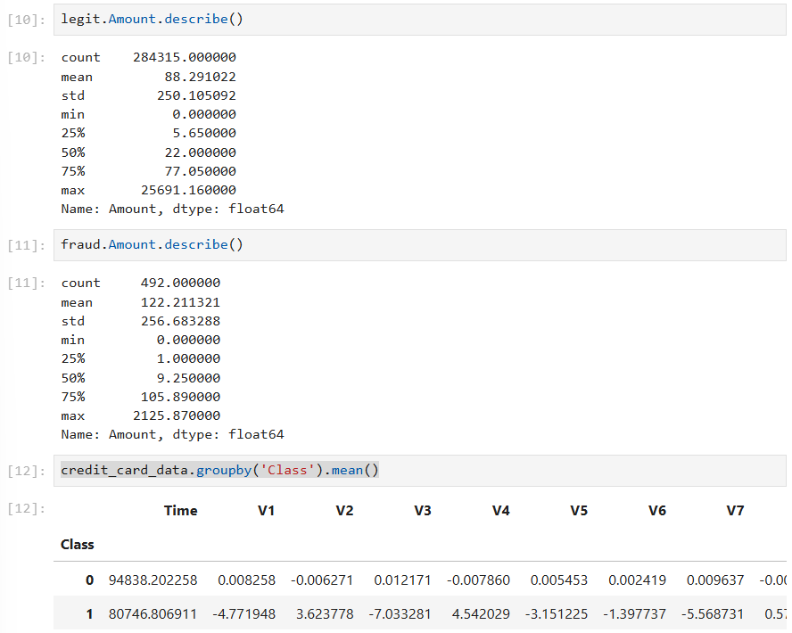

Slide 19
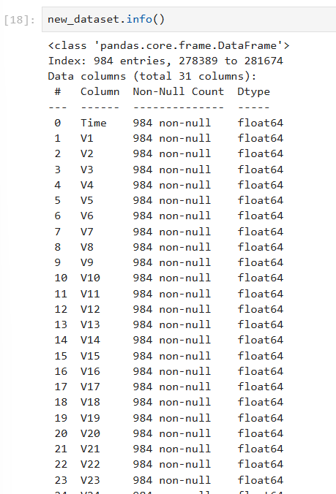

Slide 20
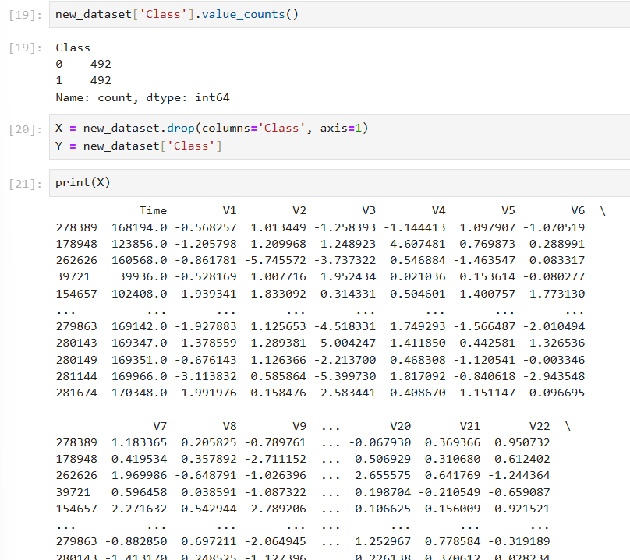

Slide 21
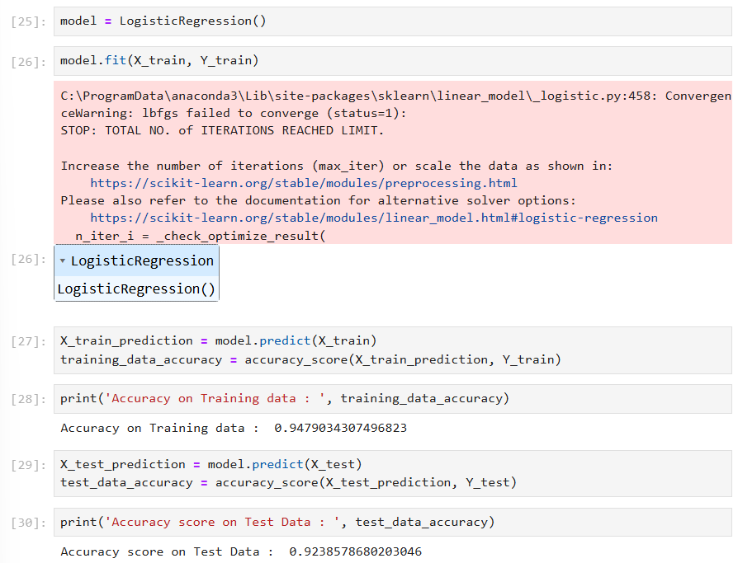
LOGISTIC REGRESSION

Slide 22
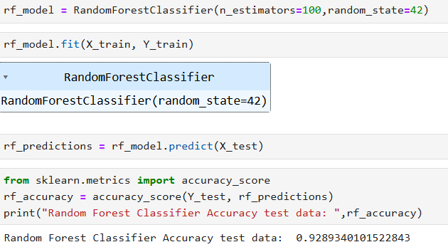
RANDOM FOREST

Slide 23
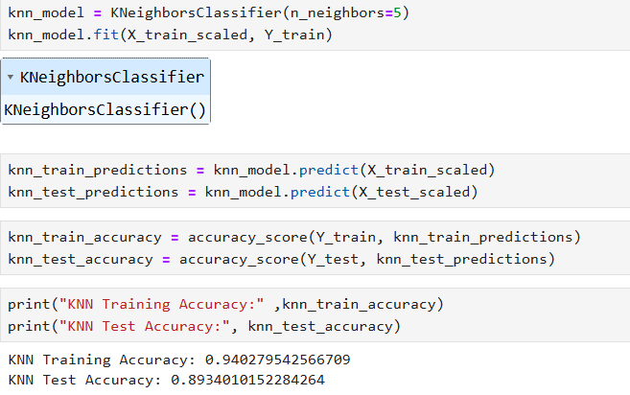
K-NEAREST NEIGHBOUR

Slide 24
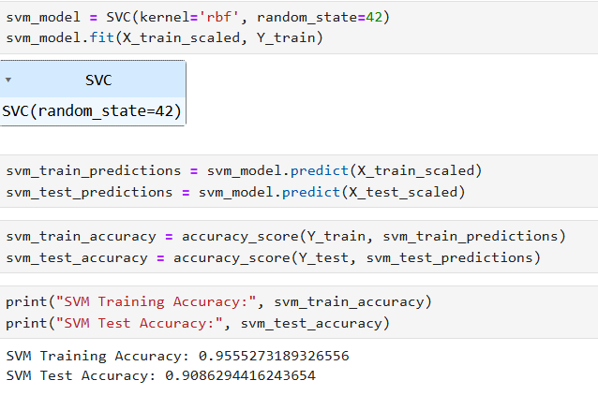
SUPPORT VECTOR MACHINE

Slide 25
REFERENCES
https://www.kaggle.com/datasets/mlg-ulb/creditcardfraud
Credit Card Fraud Detection using Machine Learning and Data Science By S P Maniraj Assistant Professor (O.G.) Department of Computer Science and Engineering SRM Institute of Science and Technology . https://www.researchgate.net/publication/336800562_Credit_Card_Fraud_Detection_using_Machine_Learning_and_Data_Science
Mr. Thirunavukkarasu.M1 ; Achutha Nimisha2 ; Adusumilli Jyothsna3 1Assistant Professor, Dept. of CSE, SCSVMV (Deemed to be University), Kanchipuram, TamilNadu, India (mthiru@kanchiuniv.ac.in) 2 Student, Dept. of CSE, SCSVMV (Deemed to be University), Kanchipuram, TamilNadu, India (11179A002@kanchiuniv.ac.in) 3 Student, Dept. of CSE, SCSVMV (Deemed to be University), Kanchipuram, TamilNadu, India. https://ijcsmc.com/docs/papers/April2021/V10I4202112.pdf
Shalini Avinashbhai Naik and Dr. Nitin Pise Department of Computer Science & Technology, MIT-Wpu, Survey No,124, Paud o Road, Kothrud, Pune, Maharashtra 411038 shailynaik24@gmail.com, nitin.pise@mitwpu.edu.in https://ieomsociety.org/proceedings/2022india/170.pdf
Vaishnavi Nath Dornadula , Geeta S , Vellore Institute of Technology ,Chennai

