Slide 1
PRIVACY PROTECTION FOR USERS OF LOCATION-BASED SERVICES
Prepared & Presented By:
Anmol Sureshkumar Panchal( UID-4446829)

Slide 2
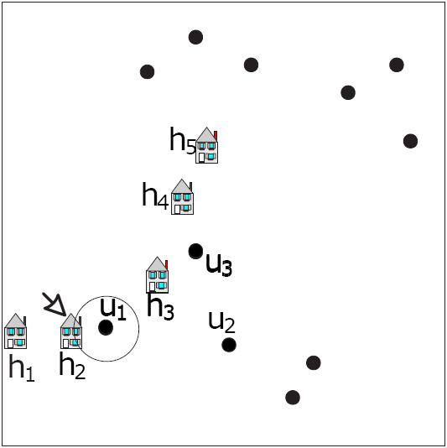
Location BASED services
LBS users
Mobile devices with GPS capabilities
NN and Range Queries
Location server is NOT trusted
Privacy of users Location?
“Find nearby hotels”
Safe
&
Secure?

Slide 3
Research problem
Rise of Location Based Services Applications.
Untrusted Third party Location Based Server Providers.
Privacy concerns for the users.
LBSs poses a serious threat to users’ privacy and access to their sensitive information.
1- Location Privacy and 2- Query Privacy.

Slide 4
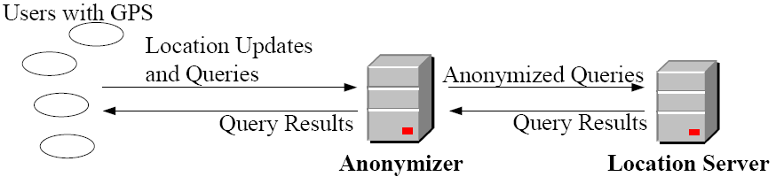
Challenges
Intermediate tier between users and LBS
Bottleneck and single point of attack/failure

Slide 5
solution
Method:1- Time Obfuscation-Based Privacy-Preserving Scheme. [1]
Method:2- A Personalized Two-Tier Cloaking Scheme for Privacy-Aware Location-Based Services. [2]
Method:3- Dynamic Grid System for Mobile based Location Based Services. [3]

Slide 6
Method 1
TOP-Privacy
Generates Dummy queries.
Uses two algorithms: 1. Dummy location selection module 2. Classiﬁed POI pool construction module.
The former module aims to generate solid dummy locations, which cannot be easily ﬁltered out by the adversaries with some side information
The latter module guarantees the effectiveness of the generated dummy point of interests to user’s query privacy.

Slide 7
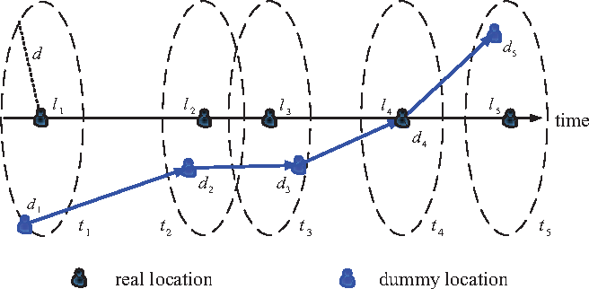
METHOD 1
Dummy location should be determined for each dummy query based on the user’s current location li and the deﬁned location offset d, the mobile user constructs a virtual circle with the center li of the radius d.
Divide local map into M cells, termed as MAP= {loc1,loc2,···,loc i,···,locM}.
Define total (POIs) of map N, POI= {poi1,poi2,···,poi j,···,poiN}.
For a mobile user u, he submits a query alone or with some dummy queries, when LBS is needed.
real query = rquery(loci,poi j), and dummy query = be r’query(loc’ i,poi ‘j).
[1]

Slide 8
Method 1
To construct the classiﬁed POI pool
sorts all the query distributions of the queried poi’s in history
deﬁnes several levels based on the different query distributions and assigns each poi a suitable weight.
computes the query probability of this poi on each location in the obtained set of candidate locations C .
minimum query probability poi is generally selected
The time interval between any two continuous queries can be randomly deﬁned, as a result, adversaries have less useful information to predict or infer the real location and real poi of a user

Slide 9
Method 2
Personalized spatial cloaking scheme, called TTcloak.
By performing our proposed Dummy Query Determining (DQD) and Dummy Location Determining (DLD) algorithms.
Uses (k,l,Adesired)-indistinguishability: aims to provide k anonymity on user’s location privacy and l-diversity on user’s query privacy, and meanwhile guarantee the desired size of cloaking region, Adesired.

Slide 10
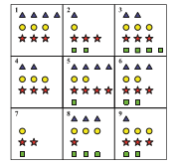
Method 2
Divide the local map into several cells (c1,c2,···,cn)
m queries issued in the whole system, (q1,q2,···,qm).
jth query qj & ith cell ci, query probability is pij.
In this case, we deﬁne a query puv, which means that Alice issues the vth query from the uth cell.
In user’s current cell cu, search all query probabilities of other m−1 queries except her real query and computes the query difference set D.
DQD algorithm aims to ﬁnd a set of dummy queries which have the similar probabilities to be issued as the user’s real query in cu.
Reset the order of elements in D to D_ from small to large.
chooses elements from D’ and adds related s queries into candidate query set Q - ‘q1,q2,···,qs’.
[2]
Notes:
In this ﬁgure, the local map is divided into 9 cells, marked from 1 to 9, respectively. Different shapes represent different queries sent from that particular cell. Totally, we get 4 types of query in the whole map, the number of each type of query means the query probability. Suppose the real user Alice is at the 1st cell and query for the red star (i.e., nearest hospital), the parameters k and l are set as k =3and l =2. As the ﬁrst step, she counts the number of red star in current cell, and it is 3. To achieve 2-diversity on her query privacy, she needs to ﬁnd another query, such as the yellow circle in this case whose number is 3 as well. Note that, green rectangle and blue triangle cannot be chosen since they can be easily ﬁltered out. In the second step, she aims to get 3-anonymity on her location privacy by searching all the cells and ﬁltering out part of them based on the query probability of the red star in her current cell. Speciﬁcally, since the determined two queries are red star and yellow circle, she ﬁrst computes the number of red star in all the other cells, then ﬁlters out the cells with different query probability. Here, cells 5, 7 and 8 are gone and the remaining are cells 1, 2, 3, 4, 6 and 9. By this way for yellow circle, cells 2 and 6 are removed, the cells 1, 3, 4 and 9 are left. Besides her current cell, she then can assign other two dummy locations into cells 3, 4 and 9 freely, which can guarantee 3-anonymity on her location privacy and 2-diversity on her query privacy,simultaneously. To ensure all the 3 locations are assigned within the user-deﬁned CR Adesired, we also develop a CR-reﬁnement module which will be presented later.

Slide 11
Method 2
DLD algorithm can be executed through the following steps:
At the initialization phase, the set |C| = n contains all the divided cells within the map. Obviously, the computation complexity is huge when assigning dummy locations and we need to further reduce the size of C.
For each chosen query in Q, Alice searches all the candidate cells in C and ﬁlters out some cells based on their query probabilities and her real query probability. Any cell should be ﬁltered out if the difference is bigger than a user-deﬁned threshold (e.g., τ =0 .1). Then, the size of the candidate cell set C can be reduced to an acceptable complexity after s rounds of reﬁnement.

Slide 12
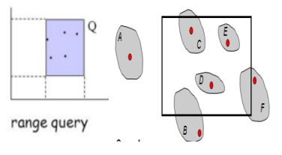
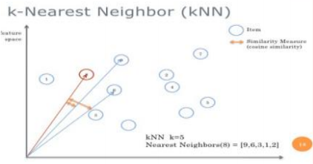
Method 3
This system consists of three main entities:
service providers
query servers and
mobile users.
This system supports two spatial queries:
range queries and
The mobile user registers a continuous range query with our system to keep track of the POI Range, of the user’s current location for a certain time period.
k-nearest-neighbor (NN) queries.
A continuous k-NN query is defined as keeping track of the k-nearest POIs to a user's location (xu, yu) for a certain time period.

Slide 13
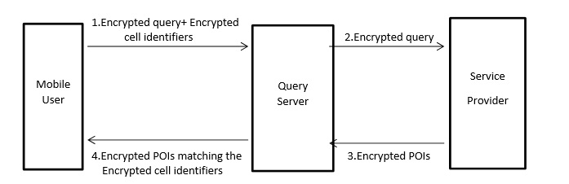
Method 3
[3]
Notes:
Service providers (SP): Each SP is a spatial database association framework that stores the domain data of a specific kind of static POIs to store run data of a specific affiliation. The spatial database utilizes a current spatial summary to record POIs and answer grow ask for (i.e., recover the POIs organized in a specific zone).
Mobile users: Every mobile user is furnished with a GPS-empowered gadget that decides the client's area in the frame. The client can get preview or consistent LBS from our framework by issuing a spatial inquiry to a specific SP through QS.
Query servers (QS): Query Server acts an intermediate between the mobile user and Service Provider. Query Server just passes the encrypted query which is sent by the user. The user shares his current location to other user which is transmitted through query server. Here, Query server does not store any user’s location information because everything is encrypted and sent to query server. Query server then sends this request to service provider which in turn service provider responds to query and sent to user through query server. Query Server does not store any information and it is a semi-trusted third party. This enriches user security.

Slide 14
Method 3
For each selected POI sent from QS, the SP encrypts its information, using the dynamic grid structure stated by the user.
QS Stores the obtained set of encrypted POIs and only returns to the user a subset of POIs whose corresponding identifiers match any one of the encrypted identifiers originally sent by the user.
After the user obtains the encrypted POIs, they decrypt them to get their definite locations and figures out the query answer

Slide 15
Pro’s & con’s
Time obfuscation - better privacy degree and ensures full time requirement of quality of service with less System overhead.
Time obfuscation generates too much dummy queries resulting in high communication cost.
Spatial Cloaking is resistant to colluding attacks and Inference attacks.
Spatial Cloaking performs worst in terms of system overhead.
DGS provides with low computation and communication cost.
DGS unlike two works even without GPS connectivity.
DGS is slightly more expensive than other when applied to range queries.

Slide 16
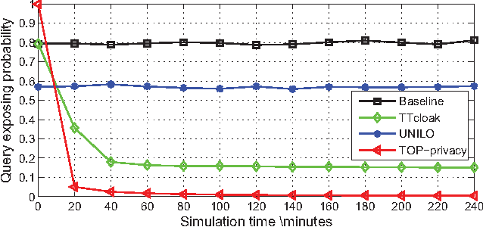
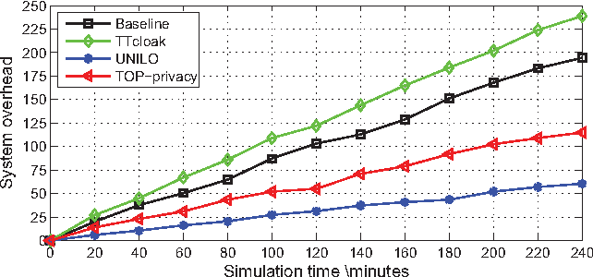
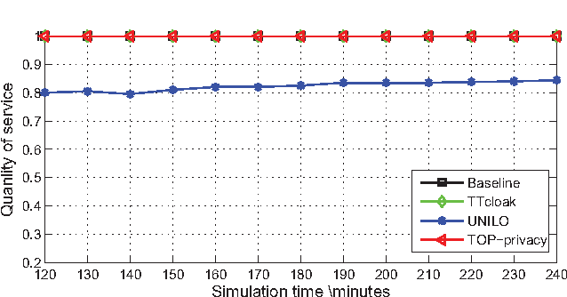
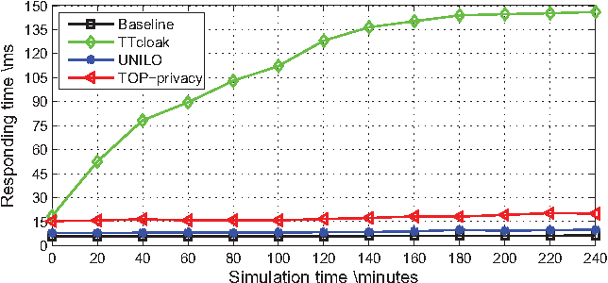
[1]
[1]

Slide 17
Summary
The introduced randomization in both dummy location selection and classiﬁed POI pool construction modules in Time obfuscation guarantees their scheme to be resistant from colluding and inference attacks.
We saw a two-tier cloaking scheme for personalized users in privacy-aware LBSs, termed TTcloak. With carefully generated dummy users, TTcloak guaranteed user’s location privacy and query privacy simultaneously within a user-deﬁned CR against adversaries with side information but at large system overhead.
Then we saw DGS which can resolve the problems of other methods associated with computation and communication cost with high privacy levels and low computation and communication cost.

Slide 18
MY method: 128 bit key encryption using AES in real time.
Working:
The time required to crack an encryption algorithm is directly related to the length of the key used to secure the communication.
It stores location in encrypted form in real time.
Uses 128 bit key to encrypt first and then store the GPS coordinates to the server.
Advantages of these systems over Other Techniques:
More Mathematically efficient
Elegant Cryptographic Algorithm
Symmetric Key cipher.
High Computation complexity for ANY BRUTE FORCE ATTACKS.
Fast processing.
Cracking a 128 bit AES key with a state-of-the-art supercomputer would take longer than the presumed age of the universe. And AES even uses 256 bit keys.
As of today, no practicable attack against AES exists. Therefore, AES remains the preferred encryption standard for governments, banks and high security systems around the world.

Slide 19
Final thoughts
While most existing work focuses on how to minimize the sizes of cloaking boxes, the relation between the box sizes and the quality of LBSs remains unclear. The practicality of integrating the proposed approaches into existing popular LBS use cases should thus be studied in the future.
While the protection schemes discussed in this article can effectively serve as the first line of defense, achieving balance among the interests of mobile users, LBS providers and Ads firms is vital to the prosperity of LBS eco-system.
In my opinion, the AES encryption in real time processing of GPS coordinates will result in robust and tolerant privacy protection technique by providing less system overheads with dynamic processing capabilities.

Slide 20
references
[1] Li, F., Wan, S., Niu, B., Li, H., & He, Y. (2016). Time obfuscation-based privacy-preserving scheme for Location-Based Services. 2016 IEEE Wireless Communications and Networking Conference Workshops(WCNCW).
[2] B. Niu, X. Zhu, W. Li, H. Li, Y. Wang, and Z. Lu, “A personalized two-tier cloaking scheme for privacy-aware location-based services,” in Proc. of IEEE ICNC 2015.
[3] Saravanan, G., Sundaramurthy, G., Sanjay, R., & Geetha, R. (2017). Providing location privacy protection using dynamic grid system for mobile location based services. 2017 International Conference on Information Communication and Embedded Systems (ICICES). doi:10.1109/icices.2017.8070791

Slide 21
THANK YOU
?

