Slide 1

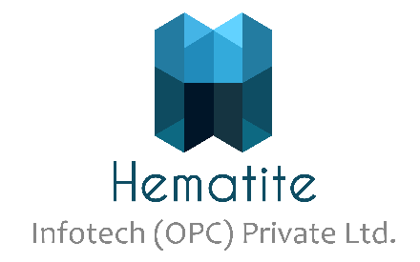
Cloud Computing - Basics
CDAC
1

Slide 2
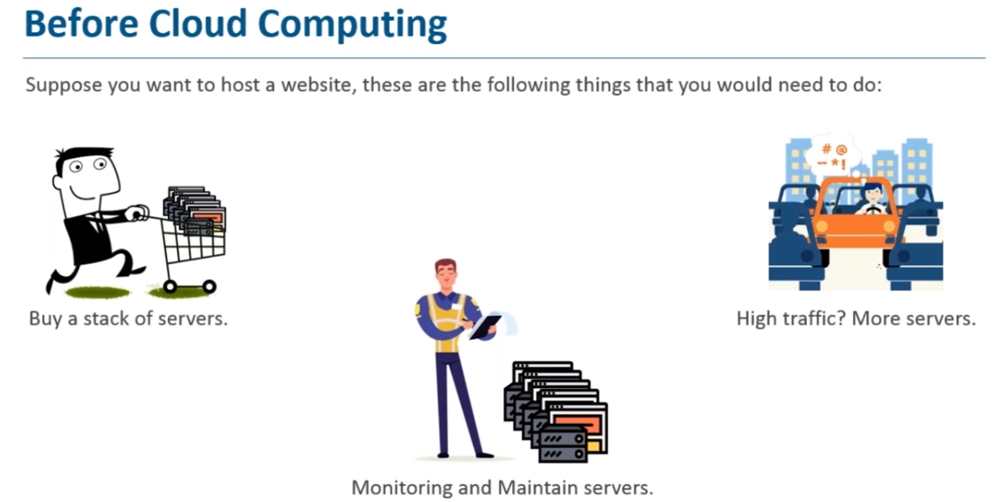

Slide 3
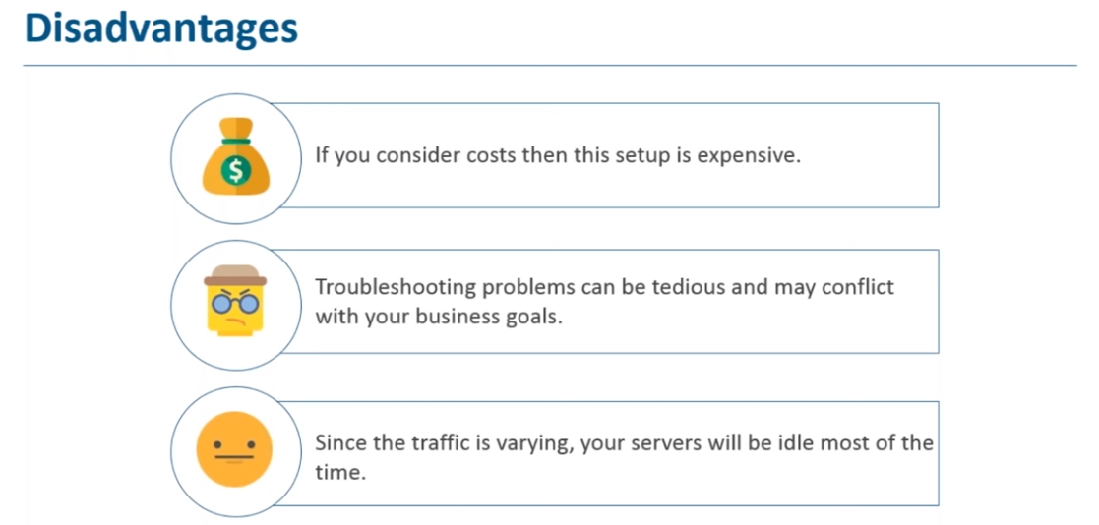

Slide 4
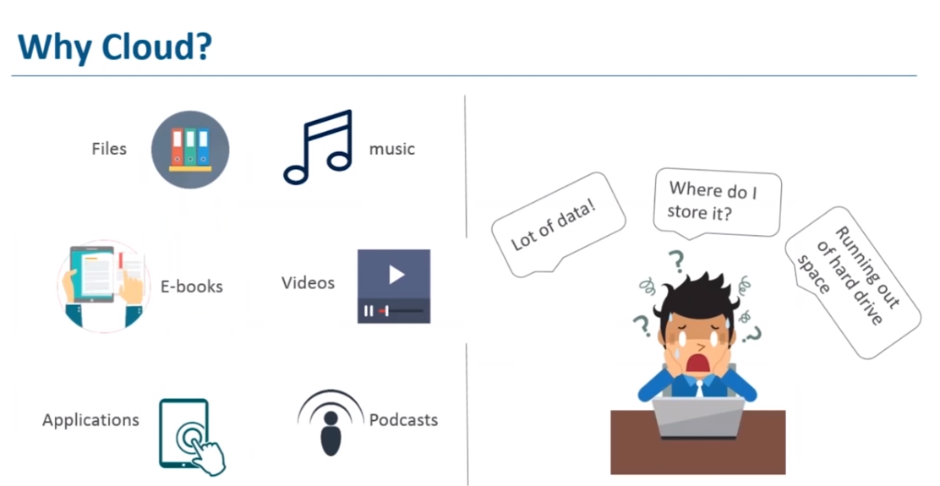

Slide 5
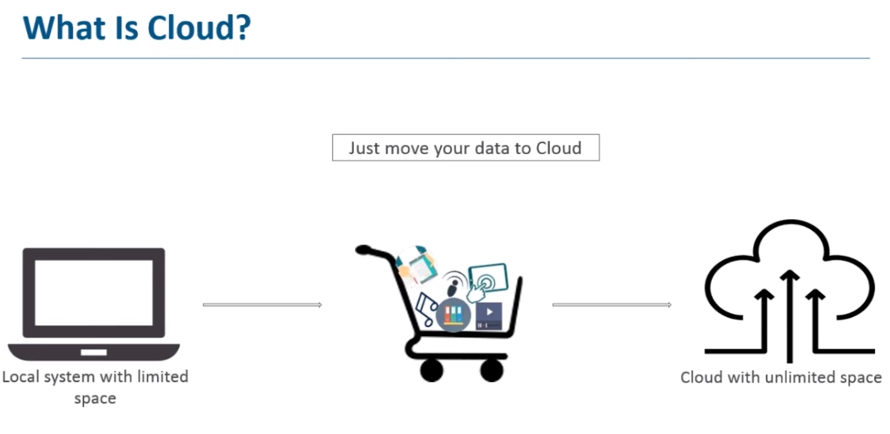

Slide 6
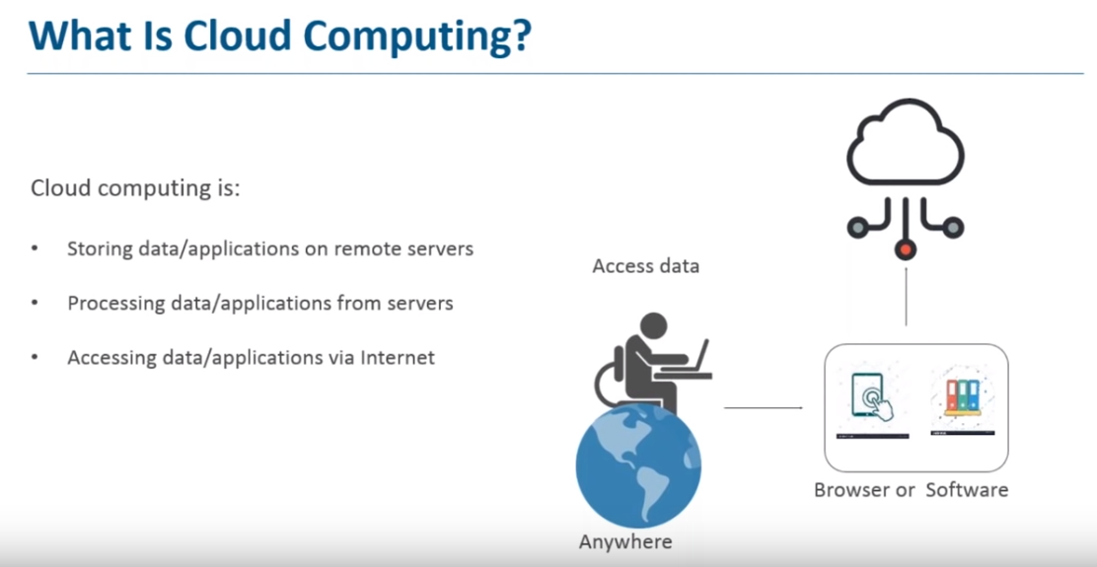

Slide 7
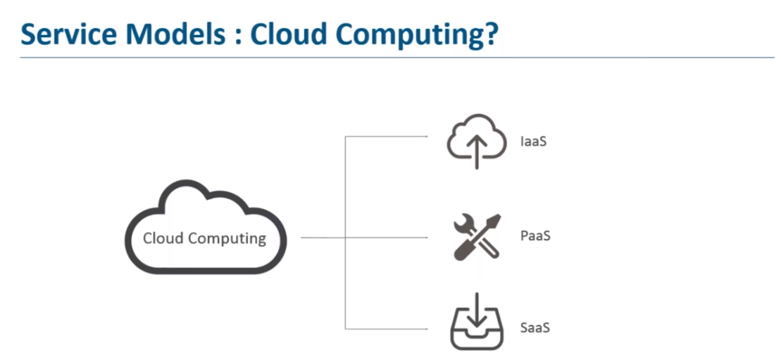

Slide 8
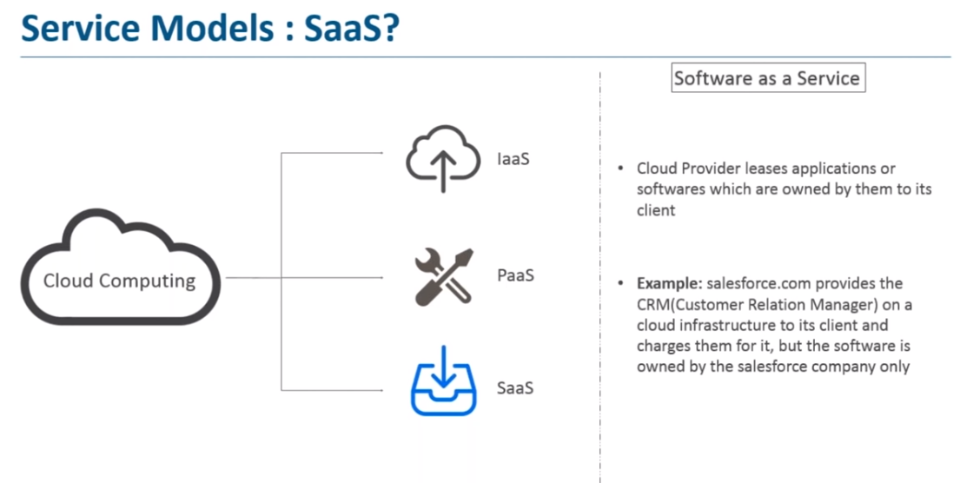

Slide 9
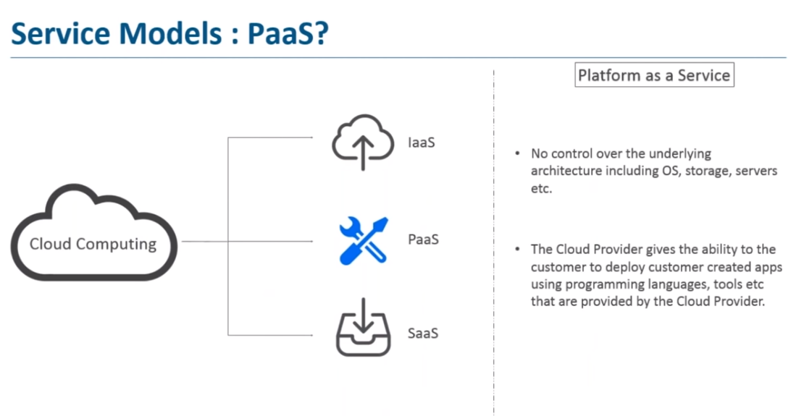

Slide 10
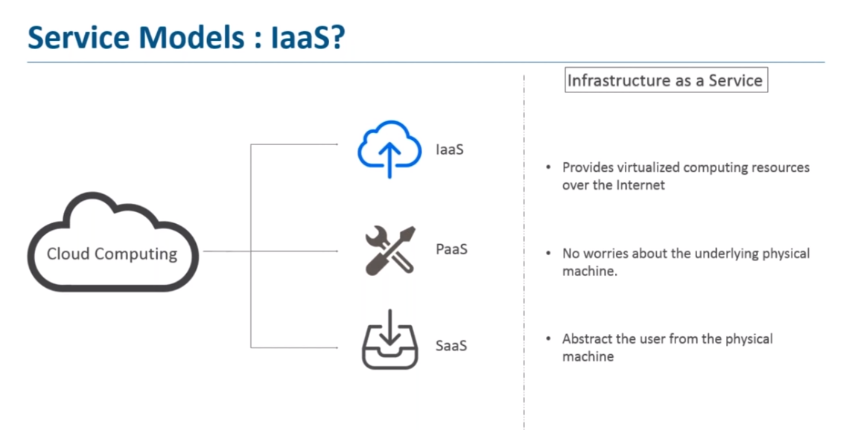

Slide 11
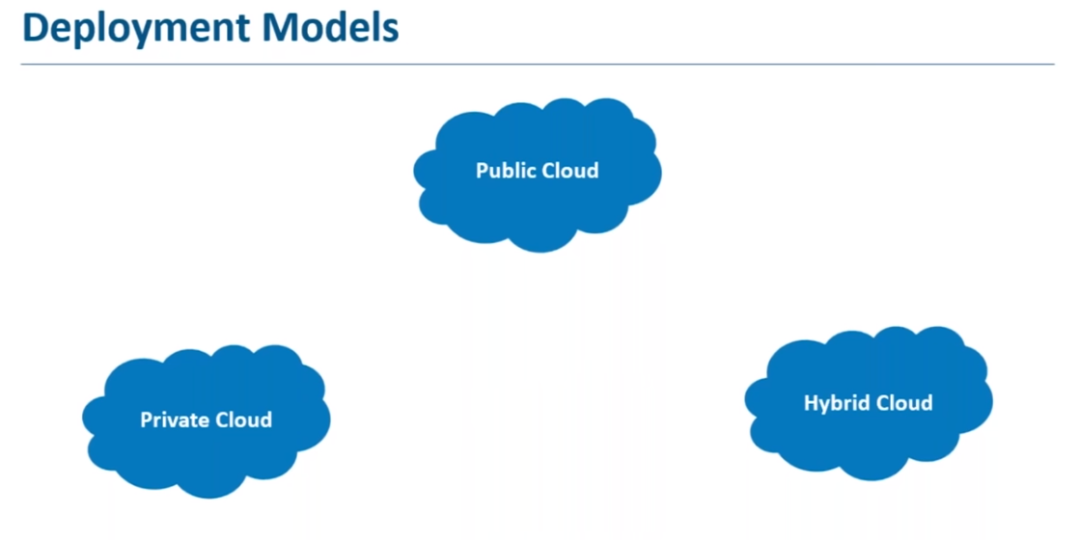

Slide 12
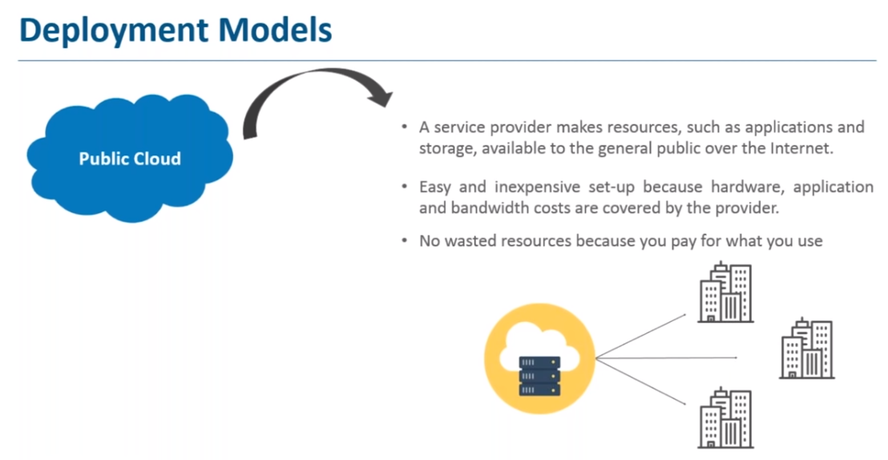

Slide 13
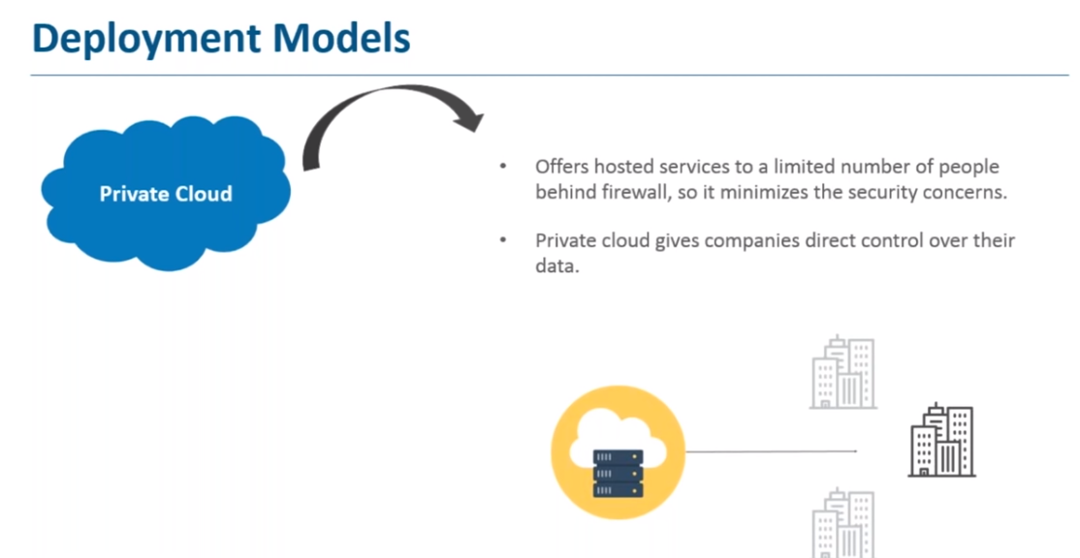

Slide 14
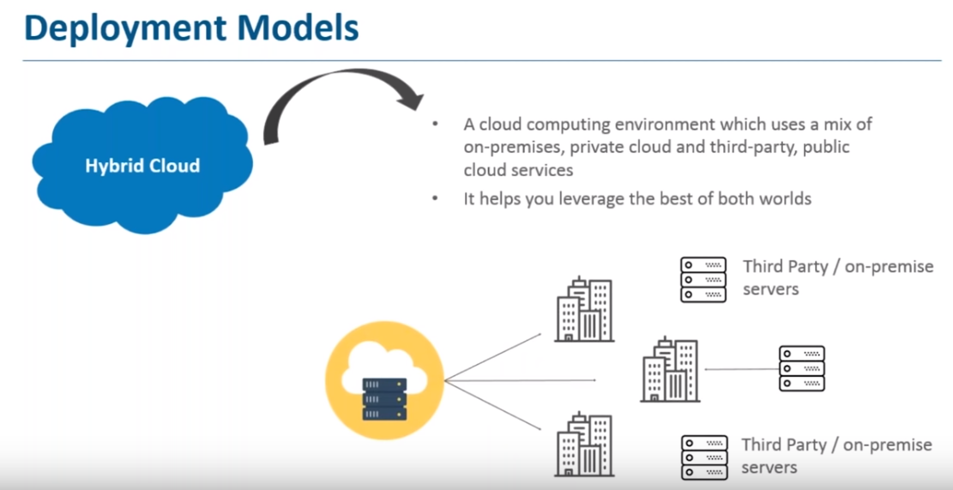

Slide 15
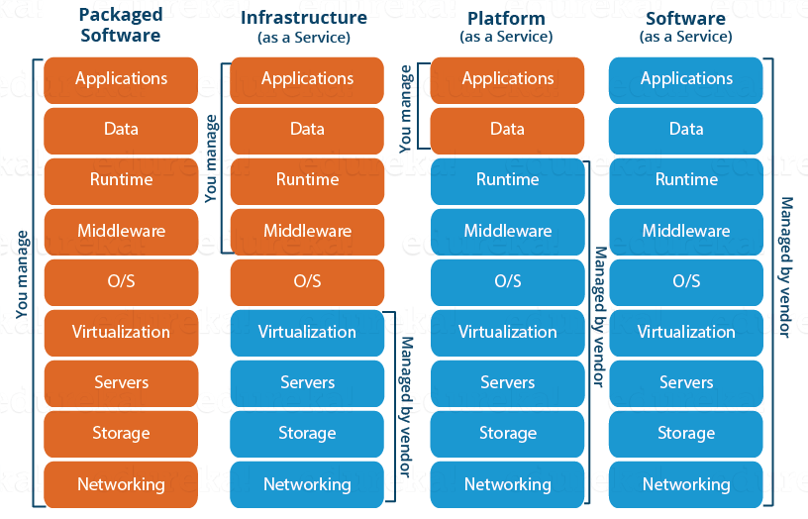
Cloud Offerings

Slide 16
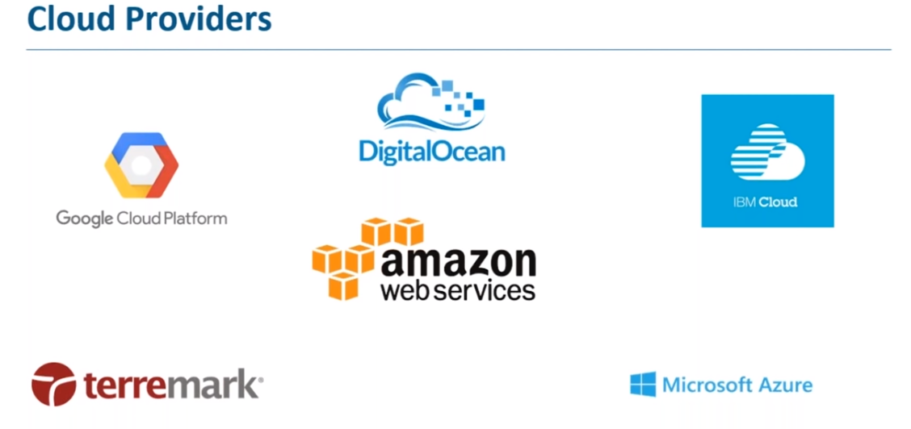

Slide 17
Cloud Notes

Slide 18
What is Cloud Computing?
What is Cloud Computing? Cloud Computing often referred to as “the cloud”, in simple terms means storing or accessing your data and programs over the internet rather than your own hard drive.
You do not have to maintain or administer any infrastructure for the same.
It will never run out of capacity, since it is virtually infinite.
You can access your cloud based applications from anywhere, you just need a device which can connect to the internet.

Slide 19
Cloud Computing – Daily Use
Now that you have a fair idea, what cloud is, just think about all your daily activities online, and you will realize that a lot of your work that you do online is based on cloud. Like your social media interactions are all on the cloud, anything that you store online, is again cloud, you paying your electricity bills online, online shopping, everything!
Now how does it all work, let’s understand it through an example:
So, there is this application called the Customer Relation Manager (CRM) which is based on the cloud. This software is highly used in all the Sales organisations for better agility, enhanced productivity and low costs.
The way it is used is like this; a field sales representative would need an access to a mobile device which is connected to the internet and then he can retrieve the customer information irrespective of his location. Also, he can update the information on the go therefore no need of going back to the office to update the deal information.
The sales managers can also monitor everything on their internet enabled devices, and will know which deals to close or not. It all happens on the go!
The best part? You don’t have to buy any machines or administer any kind of software, it all will be handled by the cloud company which is running this application. Cool right?

Slide 20
Cloud Categories
Public Cloud
Private Cloud
Hybrid Cloud
Public Cloud
In a public cloud deployment mode, the services which are deployed are open for public use and generally public cloud services are free. Technically there maybe no difference between a public cloud and a private cloud, but the security parameters are very different, since the public cloud is accessible by anyone there is a more risk factor involved with the same.
Private Cloud
A private cloud is operated solely for a single organization, it can be done by the same organization or a third-party organization. But usually the costs are high when you are using your own cloud since the hardware would be updated periodically, security also has to be kept in check since new threats come up every day.
Hybrid Cloud
A hybrid cloud consists the functionalities of both private and public cloud. How?

Slide 21
Advantages of Cloud
Fast Implementation If you’ve been there for a development or implementation of an application, it takes sometimes months or even years to make the application up and running, with cloud you can cut through the time and make things faster.
Instant Scalability With cloud resources you can always scale up or scale down the no. of resources and users according to your need, the cloud capacity never runs out! Access Anywhere Applications built on cloud are designed to be accessed from anywhere, you just need an internet connection on a mobile device.
No Upfront Costs & Maintenance Free Traditionally you would have to patch your software with the latest releases, upgrade your hardware and also troubleshoot faults in your system at the hardware level, but with cloud you don’t have to worry about the maintenance of your hardware, it will all be managed by your cloud provider.
Better Security An Independent study found that yearly a medium scale company loses around 260 laptops, this is a loss to the company not in monetary terms, but the data that was there on the laptop is valuable, with Cloud you don’t have to worry about that, all your data is stored in a centralized secure location.

Slide 22
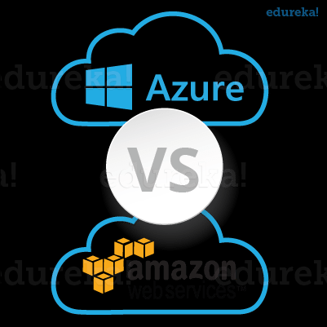
There are tons of cloud providers out there to choose from. Let us take the most prominent ones.
Azure: It’s a cloud computing platform by Microsoft founded in 2010.
AWS: Amazon Web Services is a cloud computing platform by Amazon in 2006.
Which one will you choose?
A question which would have crossed your mind, the moment you saw the two names.

Slide 23





Thank You
Parag Joshi
+91 98233 17863
Parag.joshi@hematitecorp.com
www.hematitecorp.com
23

