Slide 1
StackBits
By →Team Ctrl Alt Defeat

Slide 2
Analysis Of Problem
Lack of awareness about environment in general, and lack of initiatives among communities.
Lack of awareness as well as decline in community participation in various events and in times of disaster.
There comes a time when community leaders struggle to make their community more efficient and smarter and many a times they have the will and dedication to do so but lack the right platform.

Slide 3
Possible Solutions
Collection of real time pollution data and its analysis leading to research for controlling pollution and creating awareness.
Providing alerts to residents of the community on time so that there is more of the public participation in social causes and issues.
Creation of an effective smart community that applies a forum/community approach in connecting people through a platform where they can discuss and communicate in a constructive manner.

Slide 4
Vision
We at StackBits are driven by creation of an active community . Our website aims to bring together the residents of Chennai to form a full-fledged, modern, closely knitted, connected and aware society of citizens.
Every user of our platform has access to a plethora of opportunities that are vital to the community and we allow multiple activities such as availing services, participating on a local forum, getting information regarding the city, and a lot more to be performed from a single easily-accessible location, there by making our site simple to use first of its kind place for everyone.

Slide 5
Layout Of Implementation
User Profile
Alerts
Warnings
Polling
Forum
Real Time Temperature and Pollution Monitoring through OpenWeather and Breezometer API

Slide 6
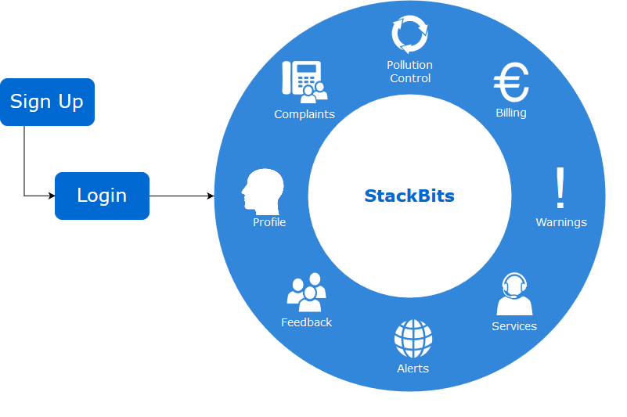
Topics Covered :
1. Sustainable Technology, Sustainable Environment
2.Modern Society
3. Smart Community

Slide 7
Application
More awareness about community, increased public interaction.
It is a non profit platform for a non profit organisation.

Slide 8
Preface Of Code
MySQL for database
PHP and JS for backend logic implementation.
Use of OpenWeather and Breezometer APIs to display real time temperature and various air pollution parameters.
HTML, CSS and JS for Frontend.
Xampp for locally hosting the website and beta version deployed on DigitalOcean droplet running on Ubuntu 16.04 LTS.

Slide 9
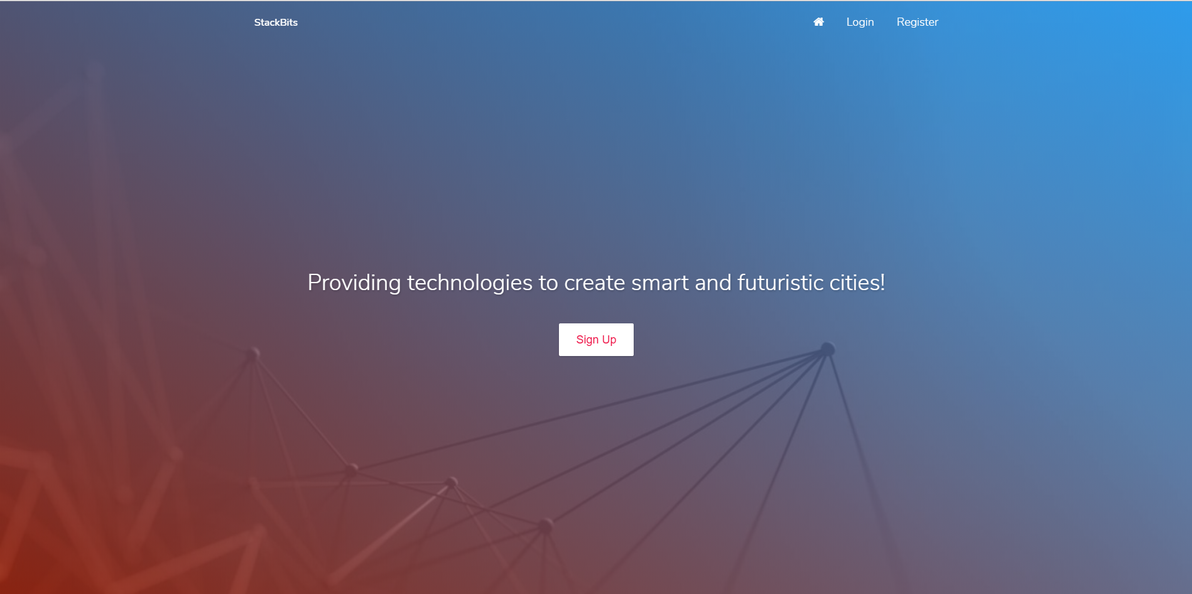

Slide 10
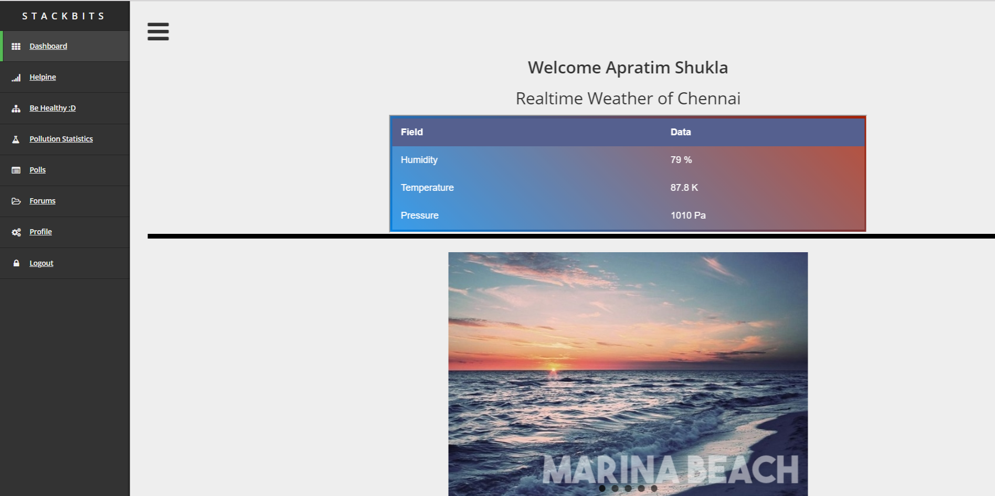

Slide 11
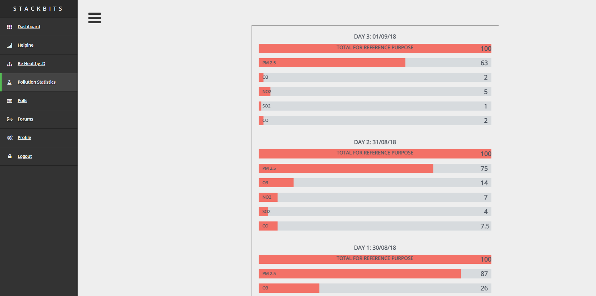

Slide 12
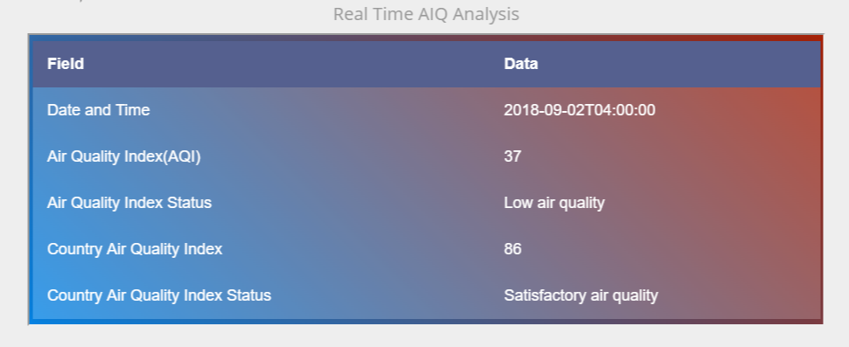
REAL TIME AIR QUALITY MONITORING USING BREEZOMETER API

Slide 13
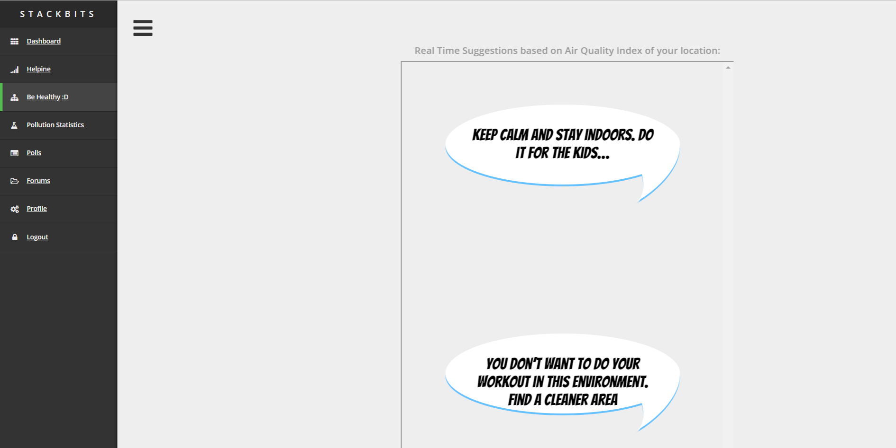
Real Time Suggestions based on Air Quality Index of user’s location

Slide 14
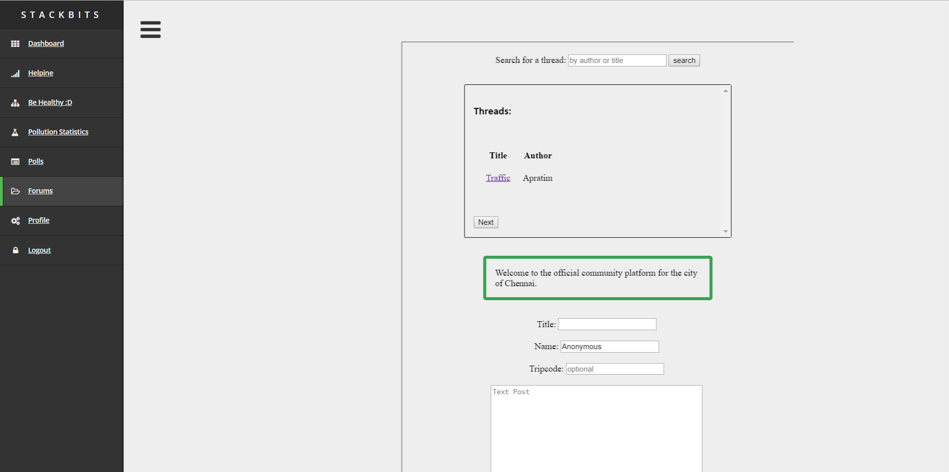
PHP+SQLite Based Forum (Anonymous feature available)

Slide 15
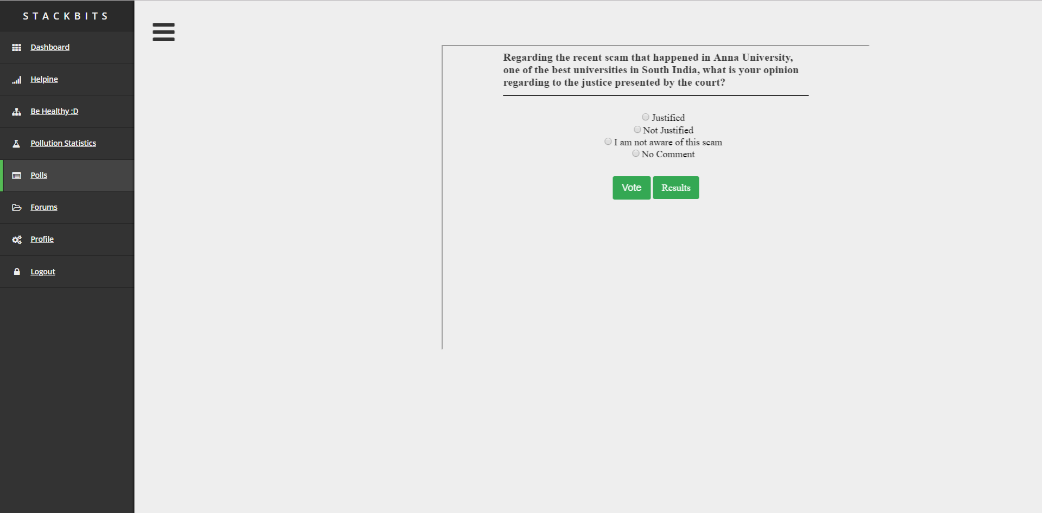
Admin Controlled PHP+MySQL based Polling System

Slide 16
Thank you
Team → Ctrl Alt Defeat
--- Anmol Tomer 18BLC1040
--- Apratim Shukla 18BLC1085
--- Rishikesh Sriram 18BCE1049
--- Ankit Gundewar 18BCE1247

