Slide 1
Departmental Vision & Mission
Department of Computer Engineering
Vision
Achieve academic excellence by imparting education in computing and providing exposure to research to create intellectual professionals and explore global opportunities.
Mission
To impart learning by educating students with conceptual knowledge, hands-on practices using Free and Open-Source Software and tools, competency skills, social awareness, thereby igniting young minds for innovative thinking, professional expertise, and multidisciplinary research.
1

Slide 2
Syllabus

Slide 3
Unit 1
Fundamentals of Programming
Prepared By
Prof. Rutuja A Kulkarni
PICT, Pune

Slide 4
Introduction
Any notation for the description of algorithms and data structures may be termed a programming language.
Why study Programming Languages(PL)?
Hundreds of different programming languages have been designed and implemented.
In 1969, SAMMET listed 120 programming languages.
In fact, practicing programmers often work at computer installations where use of particular language such as Java, C is required.

Slide 5
Why study PL?
Six primary reasons to study:
To improve your ability to develop effective algorithms.
To improve your use of your existing programming language.
To increase your vocabulary of useful programming constructs.
To allow a better choice of programming languages.
To make it easier to learn a new language.
To make it easier to design a new language.

Slide 6
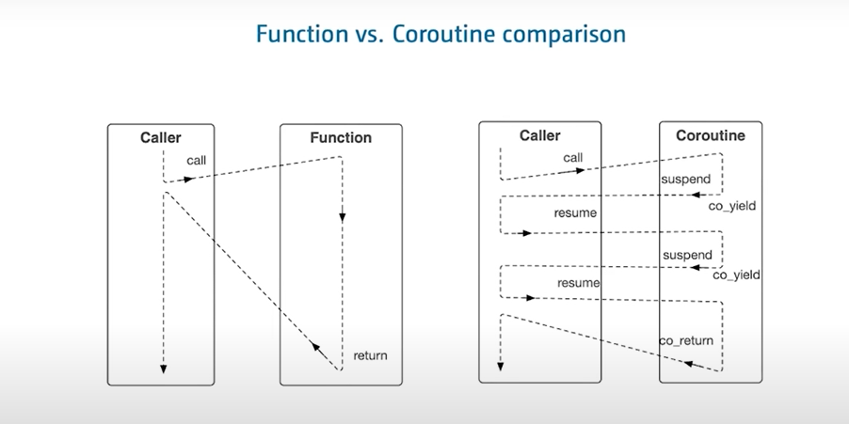
3. To increase your vocabulary of useful programming constructs

Slide 7
Short History of PL
Earliest high language appeared in 1950.
First versions of FORTRAN and LISP were designed during the 1950s.
Ada, C, Pascal, Prolog and Smalltalk date from 1970s.
C++, ML, Perl, and Postscript date from 1980s.
Java dates from 1990s.

Slide 8
Short History of PL
Development of Early Languages:
Numerically based Languages:
Computer technology dates from the era just before World War-II through the early 1940’s.
In early 1950s, Symbolic notation started to appear.
Grace Hopper developed A-0 language.
The real breakthrough occurred in 1957 when Backus managed a team to develop FORTRAN or FORmula TRANslator.

Slide 9
Short History of PL
FORTRAN was extremely successful and was dominant language through the 1970s.
Business Language:
The goal was to develop business applications using a form of English like text.
In 1960’s COBOL was designed.
AI languages:
Information Processing Language : LISP (LISt Processing functional language)

Slide 10
Short History of PL
System Languages:
C language come into the picture as high level language during the early 1970s.
UNIX mostly written in C.

Slide 11
Short History of PL
Evolution of Software Architectures:
The external environment supporting the execution of the program is termed its operating/ target environment.
This is 3rd major era in development of computer programs.
Mainframe Era:
Batch Environment:
Simplest operating environment consists only of external files of data.
Input: set of data files Output: set of data files
Processes data

Slide 12
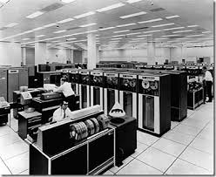
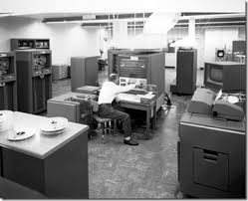
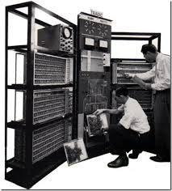
Mainframe era:

Slide 13
Short History of PL
Interactive Environment :
Rather than developing a program on a deck of cards, CRT terminals were directly connected to the computer.
Time share for each user.
A program interact directly with a user at a display console during its execution.
Eg: word-processing system, dbms, spread sheets, video games.

Slide 14
Short History of PL
Effects on Language Design:
In interactive I/O, special need of I/O are not addressed. for eg: program would need to read each character from file as it is entered on the keyboard.
In batch processing environment facility for correcting the errors is not there so the program get terminated when exception occurs during execution.
No facility for monitoring the execution speed/time for program.

Slide 15
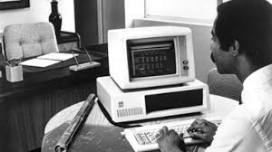
Short History of PL
Personal Computer Era:
Personal computers (PC):
The 1970s could be called the era of minicomputers.
These were smaller and cheaper machines than a standard mainframe era.
The standard mainframe of 1970s shrunk from room full of cabinets and tape drives to 3-5 feet long and 3-4 feet high

Slide 16
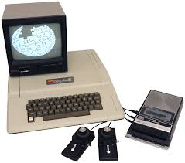
Short History of PL
In 1978, Apple released the Apple II computer, the first true commercial PC.
It was a small desktop machine that ran BASIC.
In 1981, all of this changed.
The PC was released by IBM, this was overnight success.
In January 1984 Apple announced Macintosh computer, it contained windows-based GUI with a mouse for point and click data entry.
https://www.youtube.com/watch?v=8bepzUM1x3w

Slide 17
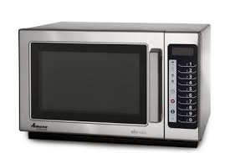
Short History of PL
Embedded-system environments:
A computer system that is used to control part of the larger system such as an industrial plant, an aircraft, or even your toaster is termed as embedded computer system.
Failure of embedded application can often be life-threatening.
Ada, C and C++ are used extensively to
meet some of the special requirements
of embedded-system environments.

Slide 18
Short History of PL
Effects on language design:
PC users are quite familiar with the tools of the windows interface.
Programs written for embedded systems often operate without underlying OS , usual environment of files and I/O devices.
Error handling in embedded systems is of particularly importance.
Embedded systems almost always operate in real time.
Finally it’s a distributed system.

Slide 19
Short History of PL
Networking Era:
Distributed Computing:
As machines become faster, cheaper, and smaller they started to populate the business environment.
E.g.: College Payroll System.
E.g.: An airline reservation system [Client-Server Application].
Internet:
The mid-1990s saw the emergence of the distribute LAN into an international global network, the internet.
Accessing the internet in its early days required 2 classes of computer.

Slide 20
Short History of PL
FTP
SMTP
HTML
HTTP
Effects on language design:
The use of WWW has again changed role of PL.
Large repository servers are being created worldwide.
The initial web pages were static.
Performance is again critical problem.
https://www.youtube.com/watch?v=-DmzUlLqIfc
https://www.youtube.com/watch?v=ctkAiIXyBmA

Slide 21
Short History of PL
Languages for various application domains

Slide 22
Role of Programming Language
Initially, languages were designed to execute program efficiently.
By middle 1960s, programs were developed to solve problems for some given domain- specific problem.
The older languages have undergone periodic revisions to reflect changing influences from other areas of computing.
Some of these influences include:

Slide 23
Computer capabilities
Applications
Programming methods
Implementation methods
Theoretical studies
Standardization

Slide 24
What makes a good language?
Attributes of a good language:
Clarity, Simplicity, and Unity
Orthogonality: able to combine various features
Naturalness for the application: sequential, concurrent, logic algo.
Support for abstraction
Ease of program verification
Programming environment
Portability of a program

Slide 25
Cost of use
Cost of program execution
Cost of program creation, testing
And use
Cost of program maintenance
Cost of program translation

Slide 26
Syntax and Semantics:
Syntax of a programming language is what the program looks like.
Semantics of a programming language is the meaning given to the various syntactic constructs.
E.g.: In C++ for loop can be written as:
for(int i=0;i<10;i++)
cout<<i
Similarly in python: m=[]
for i in range(10):
m.append(i)
print(i)

Slide 27
Language Paradigm
There are 4 basic computational models that describe most programming today
Imperative/ Procedural Language
Applicative/ Functional Language
Rule based Language
Object Oriented Language
It works by changing the program state through assignment statements. It performs step by step task by changing state.
C
The key principal of this paradigms is the execution of series of mathematical functions.
LISP
Executes by checking certain condition
Prolog

Slide 28
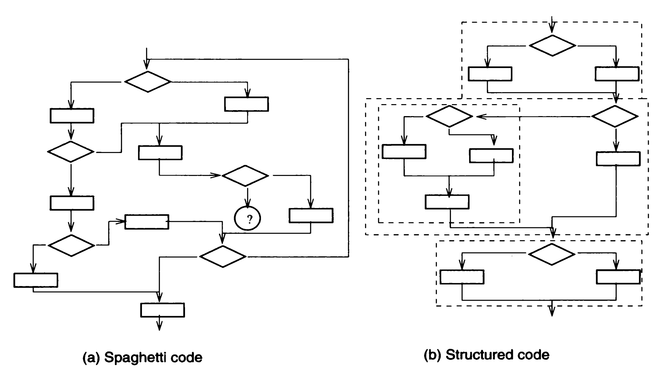
Generality of Computational Model

Slide 29
Language standardization
What describes a PL?
Consider following C code:
int i;
i=(1&&2)+3;
Is this valid C? what is the value of i?
If you extend C to add a new dynamic array declaration can you still call the language C?
To address this concern, most languages have standard definitions.

Slide 30
Conti..
Standard comes in 2 flavours
To use standards effectively, we need to address 3 issues:
Timeliness: When do we standardize a language?
Conformance: What does it mean for a program to adhere to a standard and for a compiler to compile standard?
Obsolescence : when and how does a standard age get modified?
Proprietary Standards
Consensus
Standards

Slide 31
Internationalization
With the globalization of commerce and emergence of the WWW, programming is increasingly a global activity, and it is important for language to be readily usable in multiple countries.
Often local conventions affect the way data are stored and processed.
1. collating sequence 2. country specific date format. 3. country specific time format 4. currency etc.

Slide 32
Programming Environment
It is environment in which programs are created and tested, and it tends to have less influence on language design than the operating environment in which program are expected to be executed.
Effects on language design:
Programming Environment have affected language design primarily in 2 major areas
1. Separate compilation
2. Testing and Debugging

Slide 33
Separate compilation
In the construction of any large program, it is desirable to have different programmers for design, code and test part.
Individual subprograms are compiled and executed and finally merged into the final program.
Separate compilation is difficult for shared data objects.
1. check whether call to external subprogram is valid?
2. The declaration of data type for any variable referenced is needed?

Slide 34
A common problem is to find, during assembly of final complete program , that several subprograms have the same names. To avoid this problem
1. each shared name must be unique, Naming conventions must be adopted.
2. Language often use scoping rules to hide names.
3. Use of inheritance in OOP.

Slide 35
Testing and Debugging
Most languages contain some features to aid program testing and debugging. Few examples are as follows:
Execution trace feature
Breakpoints
Assertions : Assertions are statements used to test assumptions made by programmers.
E.g. : assert(x>0 or a=1) or (x=0 and a>b+10)
Example in C++

Slide 36
Machine Architectures
In developing a programming language, the architecture of the software influences the design of a language in 2 ways
The underlying computer on which programs written in the language will execute
The execution model, or virtual computer that supports language on the actual hardware.

Slide 37
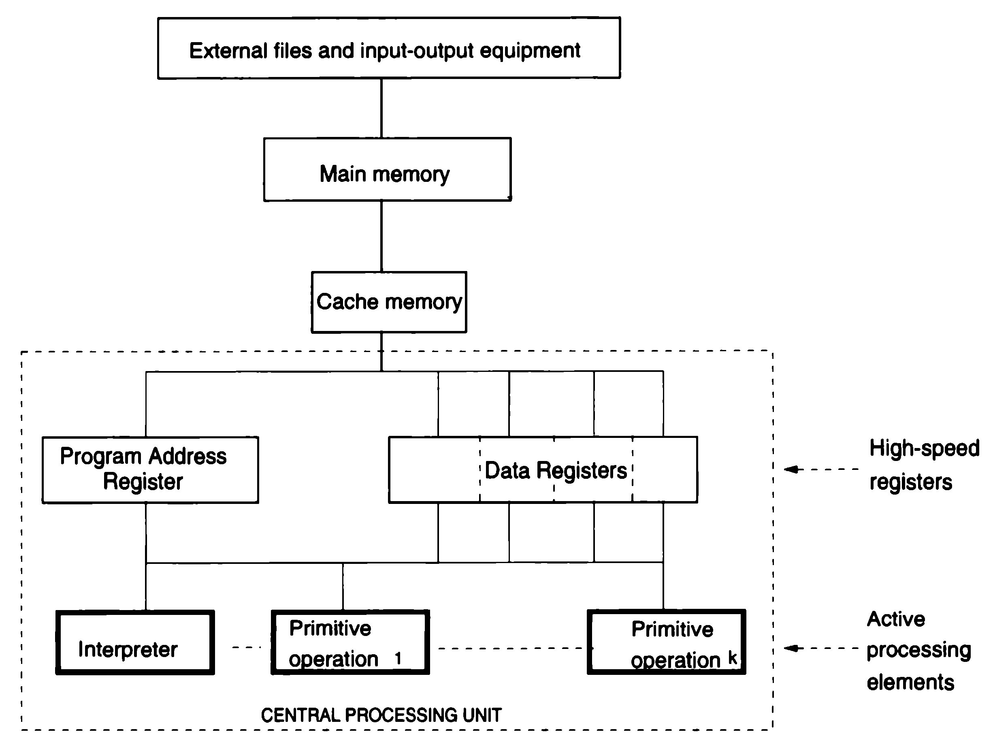
The operation of a computer:

Slide 38
A computer consists of six major components:
Data
Primitive operations
Sequence control
Data access
Storage management
Operating environment

Slide 39
Computer Hardware:
A main memory contains programs and data to be processed.
Processing is performed by an interpreter, which takes each machine language instruction in turn, decode it, and execute it.
1. Data
3 major data components are
Main Memory
High speed Registers
External Files

Slide 40
2. Primitive operations
A typical set of operation include primitive for arithmetic on each built-in numeric data type,
primitive for test for zero, positive, and negative numbers,
primitive for accessing and modifying various data items,
primitive for controlling I/O devices
primitive for sequence control.
CISC and RISC

Slide 41
3. Sequence control and 4. Data access:
The next instruction to be executed at any point during execution of a machine language program is usually determined by the contents of a special program address register, which always contain memory address of the next instruction.

Slide 42
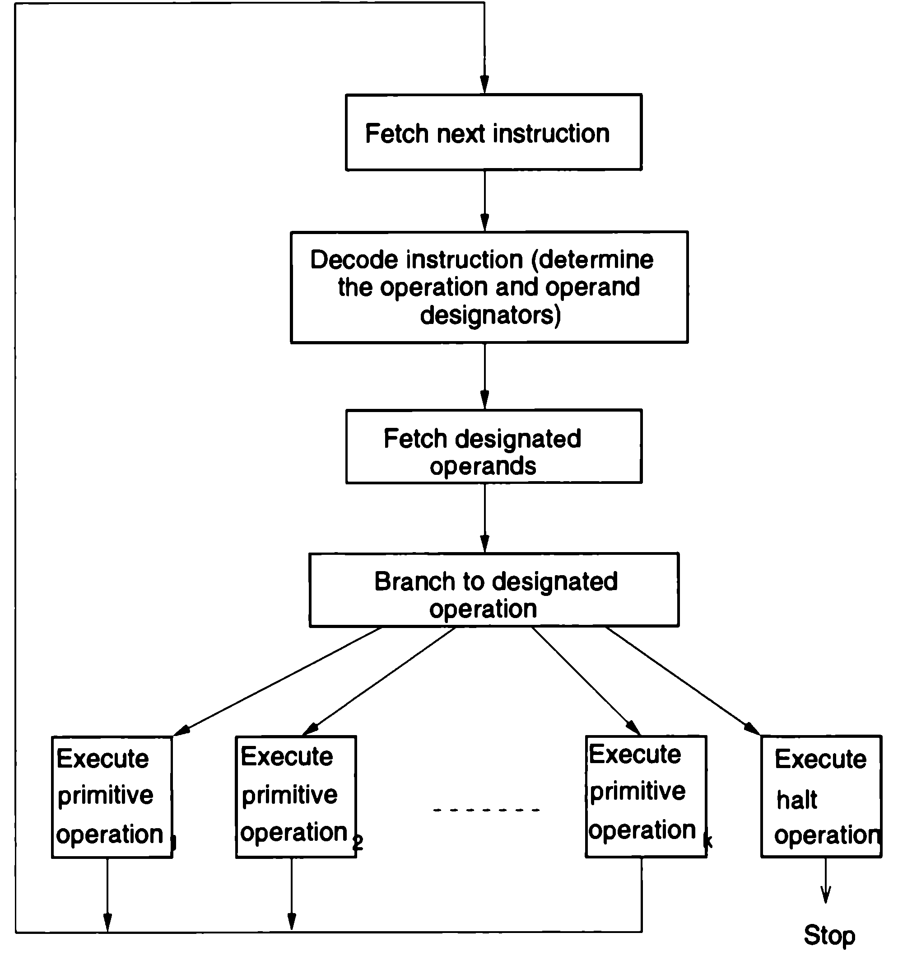

Slide 43
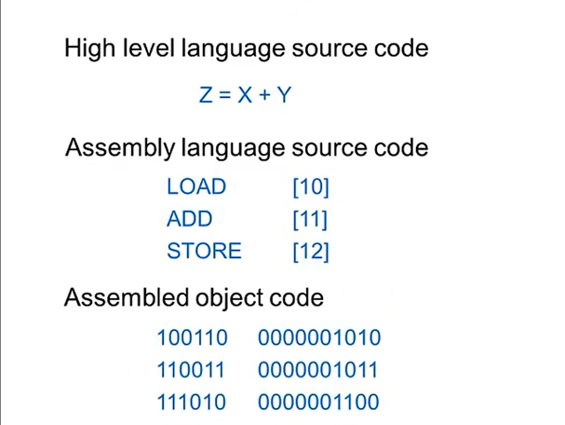

Slide 44
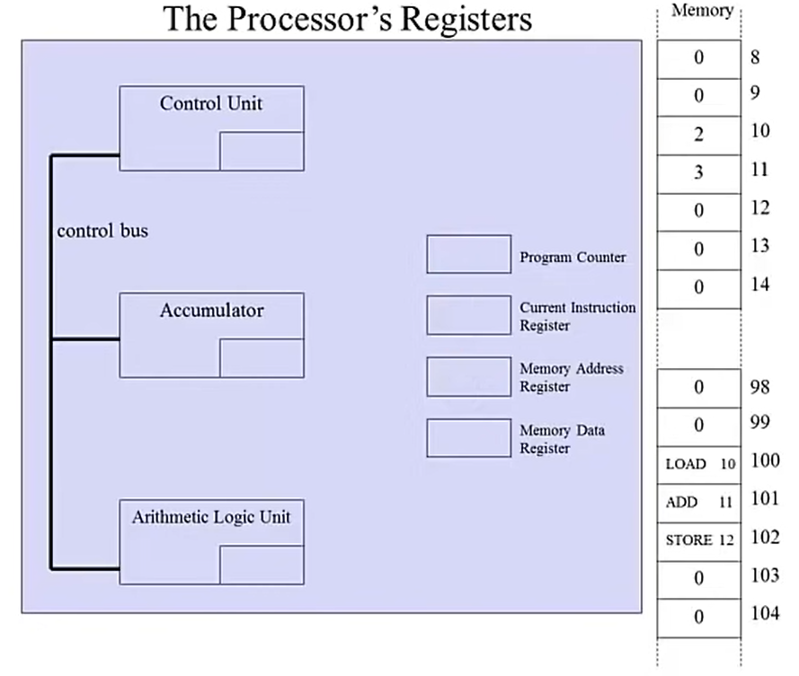

Slide 45
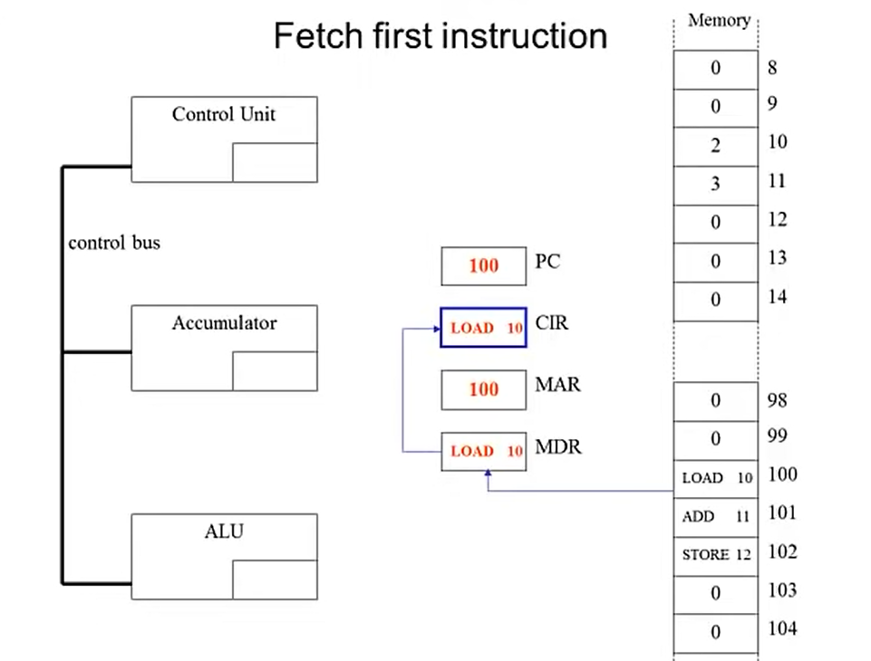
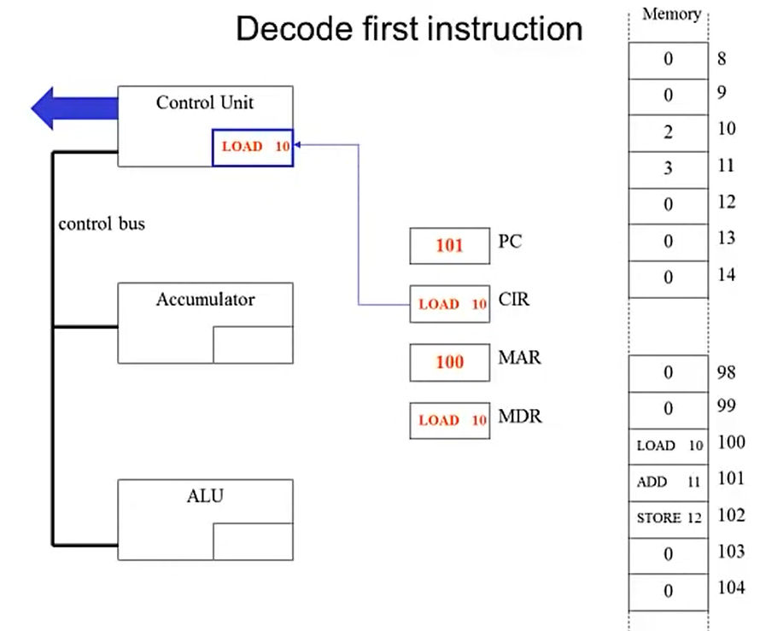
What happens when a program run

Slide 46
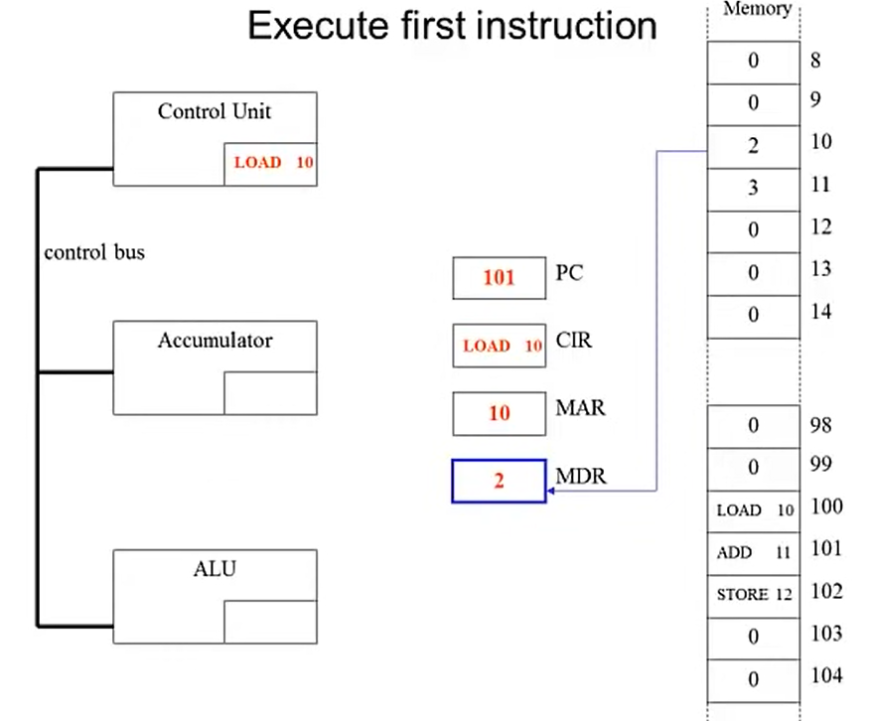
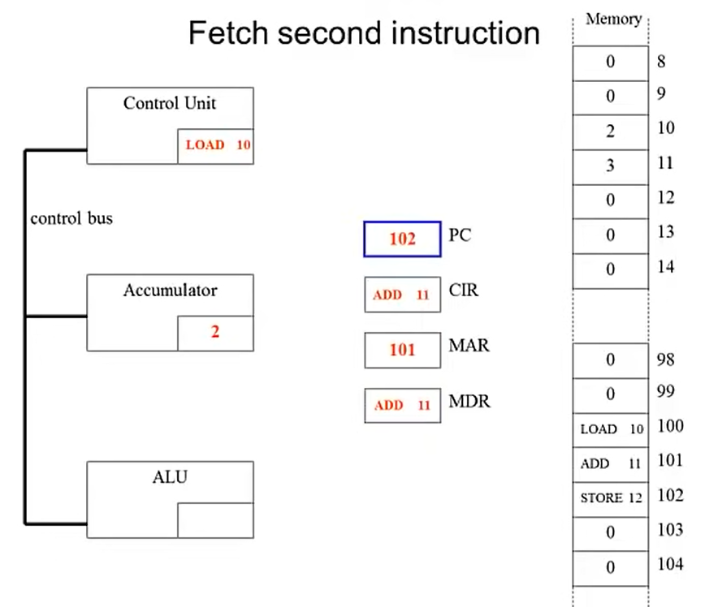

Slide 47
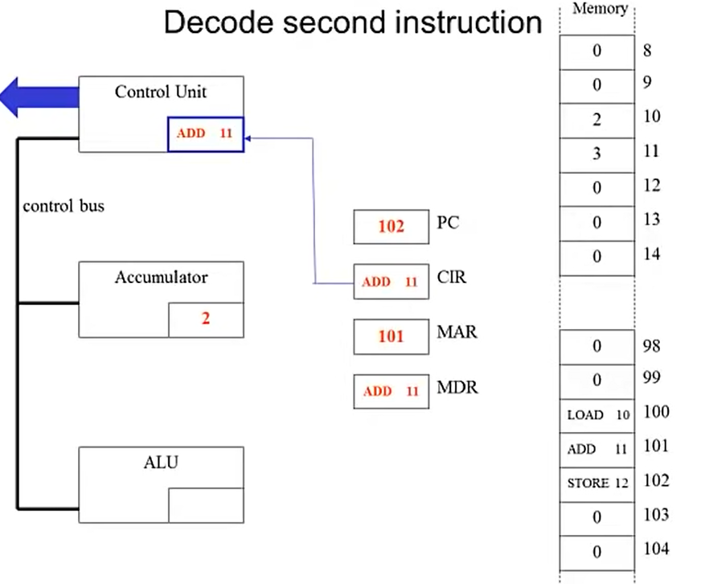
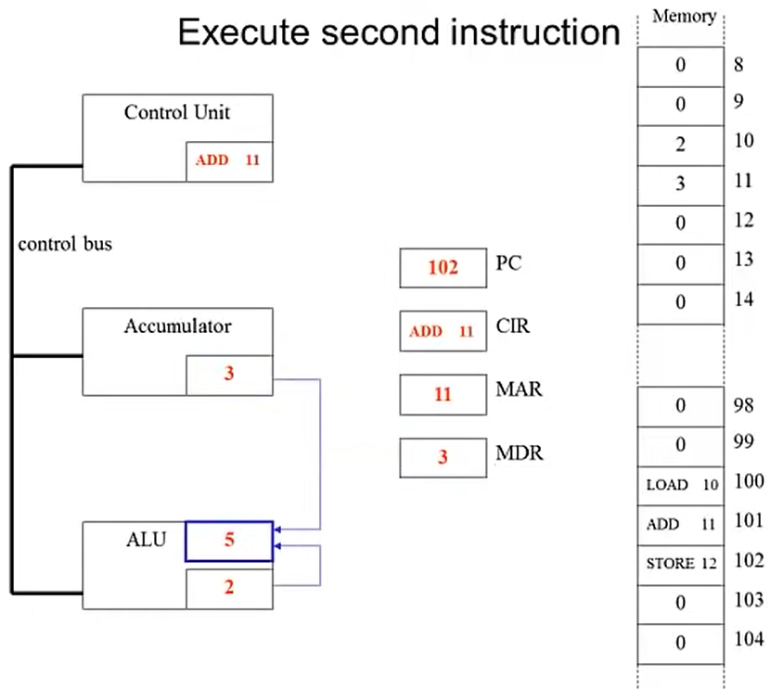

Slide 48
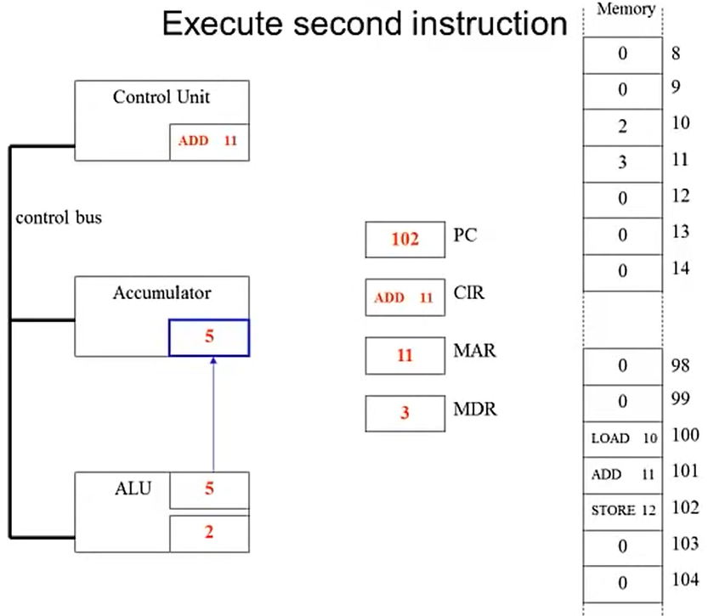

Slide 49
5. Storage management
One principle in machine design is to keep all resources of computer operating as much as possible.
In the simplest design at a time one program will be running in memory.
For speeding up the imbalance between CPU and main memory, a multiprogramming is used by OS.
Concept of multiprogramming (to achieve this paging or dynamic program relocation) facilities are directly included in hardware.

Slide 50
For speeding up the imbalance between main memory and the central processor, a cache memory is used.
6. Operating environment:
It consists of a set of peripheral storage and I/O devices.
These devices communicate with computer by operating environment.

Slide 51
Firmware computers:
Earlier we have defined a computer as an integrated set of algorithms and data structures capable of storing and executing programs.
Programs executed by computer are, written in low-level machine language.
However machine languages are not restricted to low-level.
Any precisely defined algorithm or data structure may be realized in hardware.
Note: hardware realization means construct a hardware device whose machine language is precisely that of the defined computer)

Slide 52
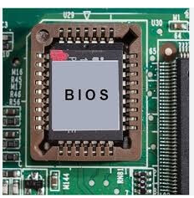
An alternative to hardware realization of a computer is the firmware computer simulated by microprogram running on special microprogrammable hardware computer.

Slide 53
Translators and virtual Architectures:
Programming, of course is most often done in a high level language far removed from hardware machine language.
How to do it?
Translation (or Compilation): several specified type of the translator are:
An assembler
A compiler : C usually converted to assembly then to machine language by an assembler. g++ -s add.cpp
Linker or loader.

Slide 54
A preprocessor or a Macroprocessor :
Is a translator whose source language is an extended form of some high-level language such as C++ or Java and whose object language is the standard form of the same language.
Software simulation (software interpretation):
Rather than translating the high-level language programs into equivalent machine-language programs, we might instead simulate, through programs running on another host computer, a computer whose machine language is the high-level language.

Slide 55
To do this, we construct a set of programs in the machine language of the host computer that represent the algorithms (and data structures) necessary for the execution of programs in the high-level language.
we construct with software running on the host computer the high-level language computer that we might otherwise have constructed in hardware. This is termed a software simulation.

Slide 56
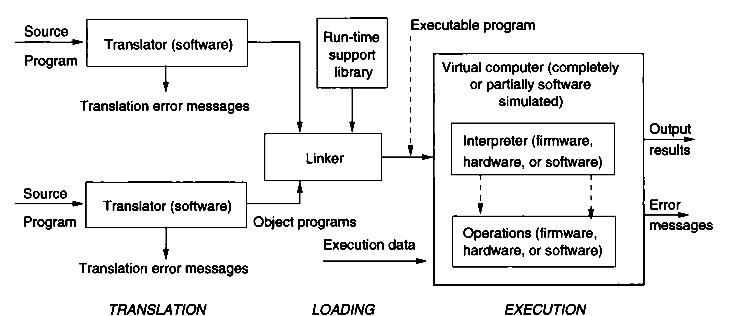

Slide 57
The key question in a language implementation tends to be whether the base representation of the program during execution is that of the machine language of the actual computer being used.
Compiled languages:
C, C++, FORTRAN, Pascal, and Ada are commonly thought of as languages that are compiled.
Interpreted languages.
LISP, ML, Perl, Postscript, Prolog, and Smalltalk are often implemented by use of a software interpreter.

Slide 58
Interpreter translates just one statement of the program at a time into machine code. | Compiler scans the entire program and translates the whole of it into machine code at once.
An interpreter takes very less time to analyse the source code. However, the overall time to execute the process is much slower. | A compiler takes a lot of time to analyze the source code. However, the overall time taken to execute the process is much faster.
An interpreter does not generate an intermediary code. Hence, an interpreter is highly efficient in terms of its memory. | A compiler always generates an intermediary object code. It will need further linking. Hence more memory is needed.

Slide 59
Keeps translating the program continuously till the first error is confronted. If any error is spotted, it stops working and hence debugging becomes easy. | A compiler generates the error message only after it scans the complete program and hence debugging is relatively harder while working with a compiler.
Interpreters are used by programming languages like Ruby and Python for example. | Compliers are used by programming languages like C and C++ for example.

Slide 60
VIRTUAL COMPUTERS AND BINDING TIMES
A computer was defined as an integrated set of algorithms and data structures capable of storing and executing programs.
We considered ways in which a given computer might actually be constructed:
1. Through a hardware realization, representing the data structures and algorithms directly with physical devices.
2. Through a firmware realization, representing the data structures and algorithms by microprogramming a suitable hardware computer. (BIOS)

Slide 61
3. Through a virtual machine, representing the data structures and algorithms by programs and data structures in some other programming language.
https://www.youtube.com/watch?v=yIVXjl4SwVo
4. Through some combination of these techniques, representing various parts of the computer directly in hardware, in microprograms, or by software simulation as appropriate.

Slide 62
Virtual Computers and Language Implementations
Each time the language is implemented on a different computer, the implementer tends to see a slightly (or very) different virtual computer in the language definition.

Slide 63
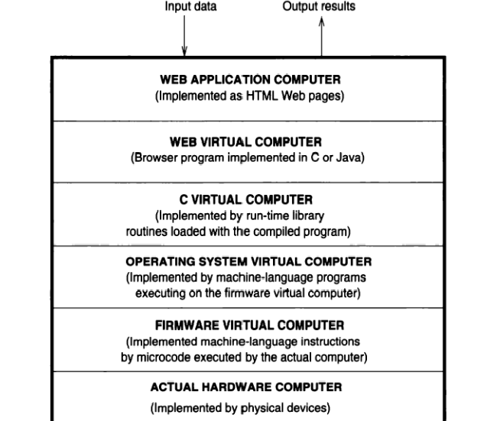
Layers of virtual computers for a Web application.

Slide 64
Classes of Binding Times
1. Execution time (run time).
a. On entry to a subprogram or block.
b. At arbitrary points during execution.
2. Translation time (compile time).
a. Bindings chosen by the programmer.
b. Bindings chosen by the translator: How arrays are stored?
c. Bindings chosen by the loader:
3. Language implementation time.
4. Language definition time.

Slide 65
Classes of Binding Times
To illustrate the variety of bindings and binding times, consider the simple assignment statement written in a language L.
X = X + 10
1. Set of types for Variable X.
2. Type of variable X.
3. Set of possible values for variable X.
4. Value of Variable X.
5. Representation of the constant 10.
6. Properties of the operator +.

Slide 66
Importance of Binding Times
For example, although both ML and FORTRAN allow one to set up and manipulate arrays of numbers, solving a problem requiring large arrays and large amounts of arithmetic in ML would probably be most inappropriate if it could also be done in FORTRAN.
Nevertheless, we might turn around and ask a related question: Why is FORTRAN so inflexible in its handling of strings as compared with ML?

Slide 67
Importance of Binding Times
Concept of late binding and early binding.
A language like FORTRAN, in which most bindings are made during translation, early in the processing of a program, is said to have early binding; languages with late binding, such as ML or HTML, delay most bindings until execution time.

