Slide 1
Earthquake Aftershock Prediction Model for Nepal
Team: QuakePredict Nepal
(Anmol Baruwal, Supriya Aryal)

Slide 2
Table of contents
01
02
03
04
05
06
Research Problem & Goals
Key Findings and Results
Validation of Hypothesis
Reflection & Learning
Contributions, Implications
Future Directions

Slide 3
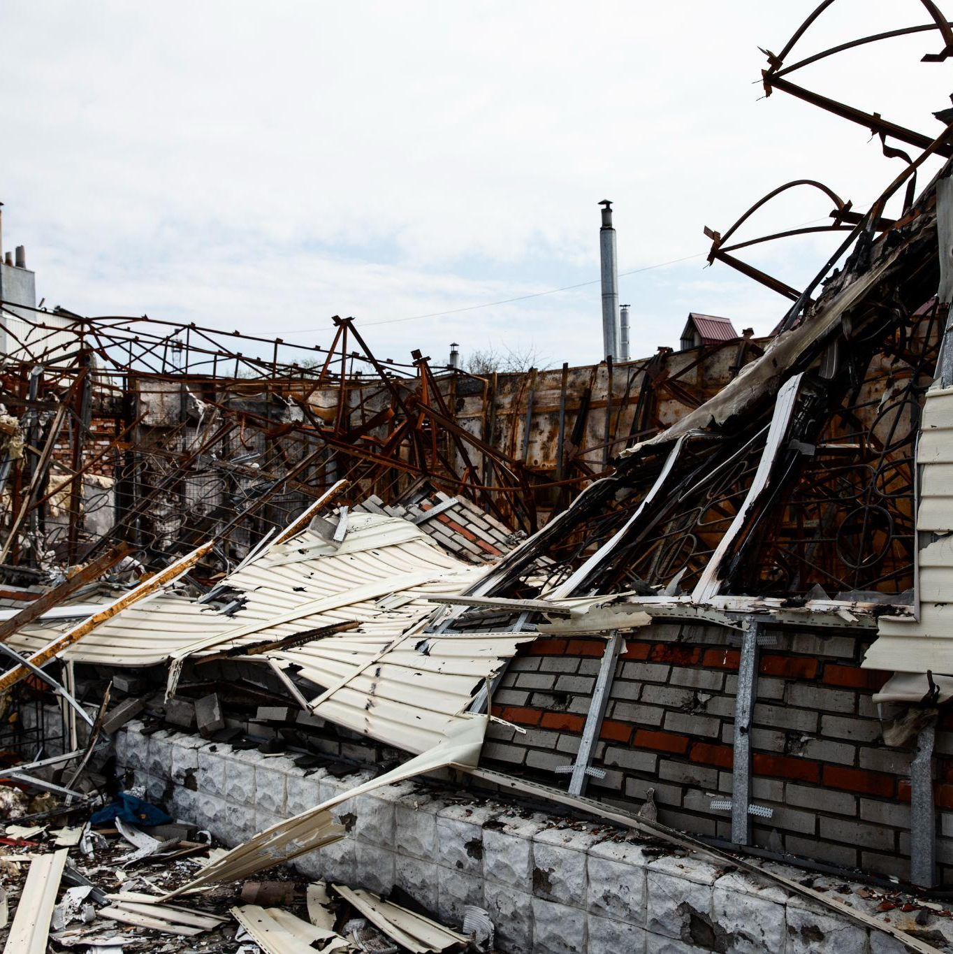
01
Research Problem &
Goals

Slide 4
Research Problem
The problem we intend to solve is the lack of accurate and up-to-date earthquake aftershock prediction tools.
Research Question: Will we be able to predict aftershocks based on the mainshocks that occurred in Nepal using a machine learning model?
Notes:
“Nepal’s seismic activity is high, yet there’s no rapid, accurate tool to forecast aftershocks—those secondary quakes that often cause more damage than the mainshock itself.”
Research Question:
“Can we predict whether a mainshock will produce an aftershock using machine‑learning on USGS data?”

Slide 5
Key Objectives
Develop a labeling method that distinguishes mainshocks from aftershocks based on time and distance thresholds.
Develop and test on multiple machine-learning models to predict whether a mainshock result in aftershock or not.
Notes:
• Objectives:
1. “First, we wanted to build a spatiotemporal labeling method—classifying events as mainshock or aftershock based on a 30‑day, 50 km rule.
2. Then, we wanted train and tune multiple models—from SVMs to ensemble methods to neural networks—to forecast aftershock occurrence (will_have_an_aftershock).”

Slide 6
02
02. Key Findings and Results

Slide 7
DataSet Overview
Dataset Selection: Earthquake data from the past 35 years in Nepal, extracting key features like magnitude, depth, latitude, longitude, and time. (Source:USGS)
Earthquake greater than 3.5 Richter scale.
Rows: 17,356 and Columns: 30 (After EDA)
Notes:
for our dataset we grabbed all Nepal earthquakes from the USGS going back 35 years.
We only kept quakes above magnitude 3.5, since smaller ones aren’t usually damaging. After cleaning and filling missing values, we ended up with 17,356 events described by 30 columns—things like magnitude, depth, latitude/longitude, time, intensity reports, station counts, and signal strength.
That’s the data we fed into our aftershock‑prediction models

Slide 8
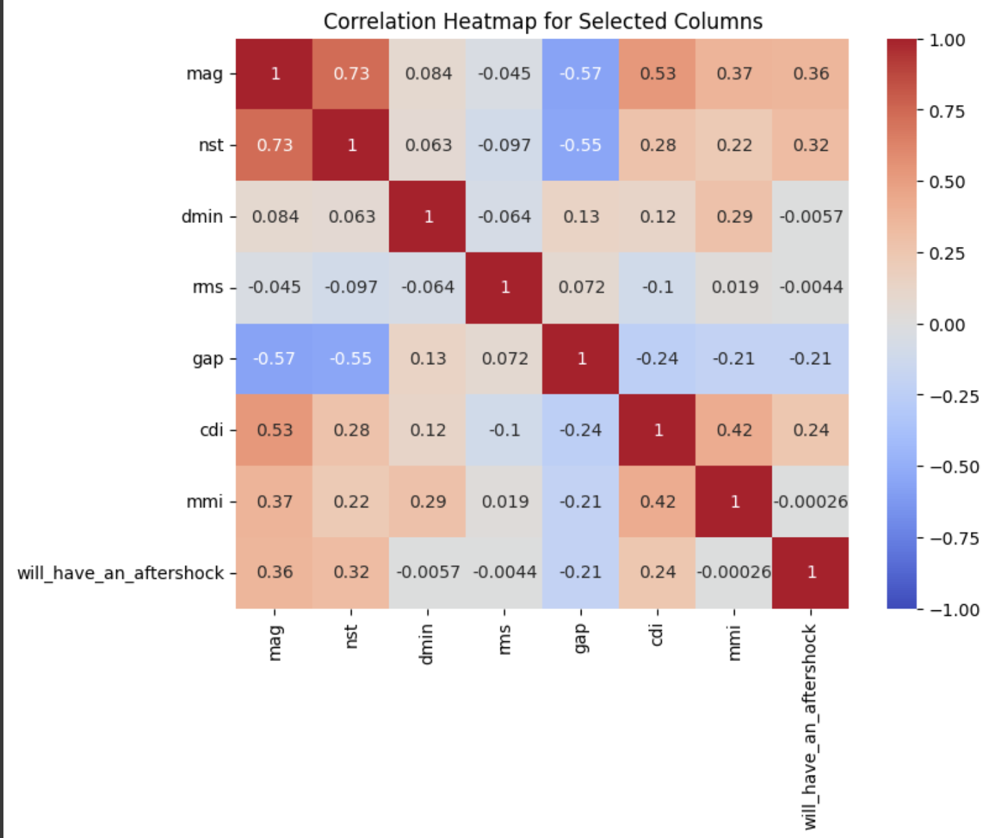
Feature Engineering & Correlation
Converted the earthquake epicenters (latitude, longitude, and depth) into ECEF coordinates (EPSG:4978) using a GeoPandas to obtain Earth-Centered, Earth-Fixed Cartesian coordinates.
Create a new column to classify earthquakes as mainshocks (0) or aftershocks (1).
Identified our target variables as “will_have_an_aftershock”.
Positive Correlations: mag, nst, cdi
Notes:
We turned each quake’s latitude, longitude, and depth into neat XYZ coordinates (ECEF) so we could easily measure distances in 3D.
We added a column to tag every event as a mainshock (0) or an aftershock (1).
Our prediction target became the new “will_have_an_aftershock” flag.
When we checked which features matter most, we found that magnitude, number of stations (nst), and community intensity (cdi) show the strongest links to aftershock occurrence.

Slide 9
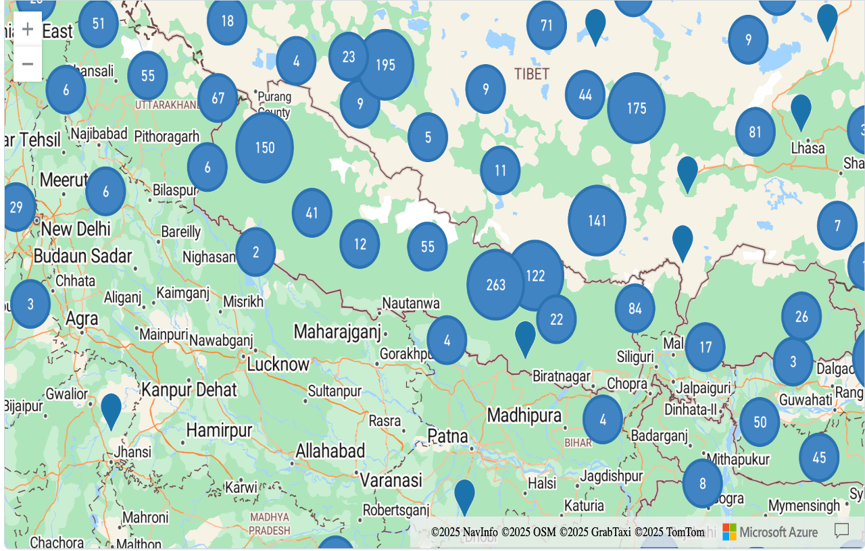
EpiCenter Mapping
Earthquake Epicenter Map reveals clusters near known fault lines.
Notes:
Plotted all earthquake epicenters on a map of Nepal.
Noticeable clusters align with major fault zones (e.g., the Main Himalayan Thrust).
Highlights high‑risk areas to prioritize when issuing aftershock alerts

Slide 10
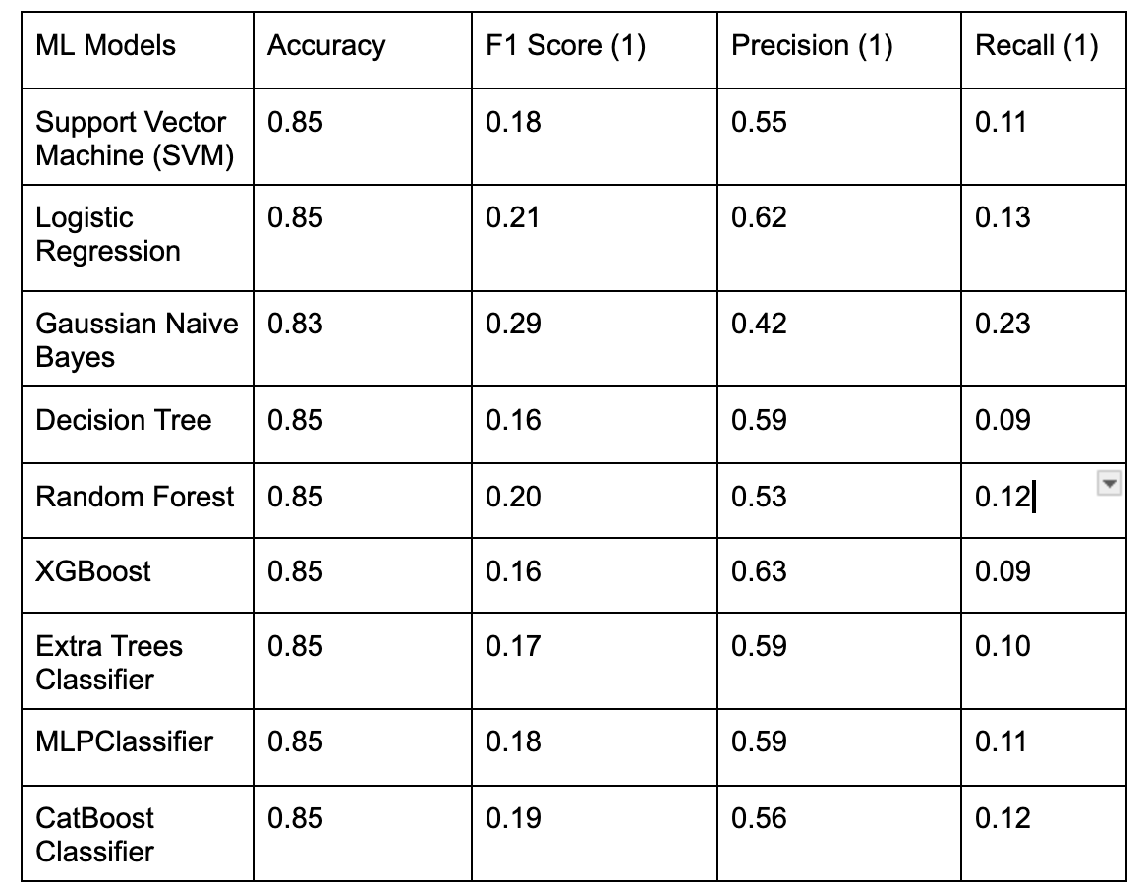
Model Outcomes
Aftershock Detection Varies Widely
Gaussian Naïve Bayes leads with the highest F1‐score (0.29) and recall (0.23), making it best at capturing true aftershocks.
XGBoost offers the highest precision (0.63), minimizing false alarms when an alert is issued.
Logistic Regression strikes a middle ground (F1 = 0.21, precision = 0.62, recall = 0.13), balancing detection with false alerts.
Notes:
“Here, we see that not all models are the same when it comes to catching aftershocks, even though they all have about 85 % overall accuracy.
Gaussian Naïve Bayes finds the most aftershocks, with a recall of 23 % and an F1‑score of 0.29. That means it flags nearly one in four real aftershocks which is best if you really don’t want to miss any.
XGBoost has the highest precision at 63 %, so when it does predict an aftershock, it’s right almost two‑thirds of the time. Use this if you want to avoid false alarms.
Logistic Regression sits in the middle: precision 62 %, recall 13 %, F1 = 0.21. It’s a balanced option if you care about both catching aftershocks and keeping false alerts low.

Slide 11
Interpretation & Trade‑Offs:
High recall (Naïve Bayes) is critical when missing an aftershock carries severe risk.
High precision (XGBoost) reduces unnecessary community alerts and resource deployment.
Choice of model depends on operational priorities: safety‑first vs. alert‑quality.
In the context of earthquake prediction, missing an aftershock (a false negative) can have serious consequences for public safety and emergency preparedness.
High recall ensures that most, if not all, aftershock events are flagged, which is crucial when the cost of missing an event is very high.
Gaussian Naïve Bayes had the highest recall for predicting ‘1’ which is aftershocks.
Notes:
Lets look at the trade‑offs between catching aftershocks and avoiding false alarms:
• High recall (Gaussian NB) is key when missing an aftershock is too risky. It flags almost every real aftershock, even if it throws more false alerts.
• High precision (XGBoost) is best when you need to avoid unnecessary warnings.
Our choice depends on what matters more:
In cases like eaqrthquakes with high casualties and destruvtions, we think we should prioritiese safety. So, we picked Gaussian NB as the best model to catch nearly all aftershocks.

Slide 12
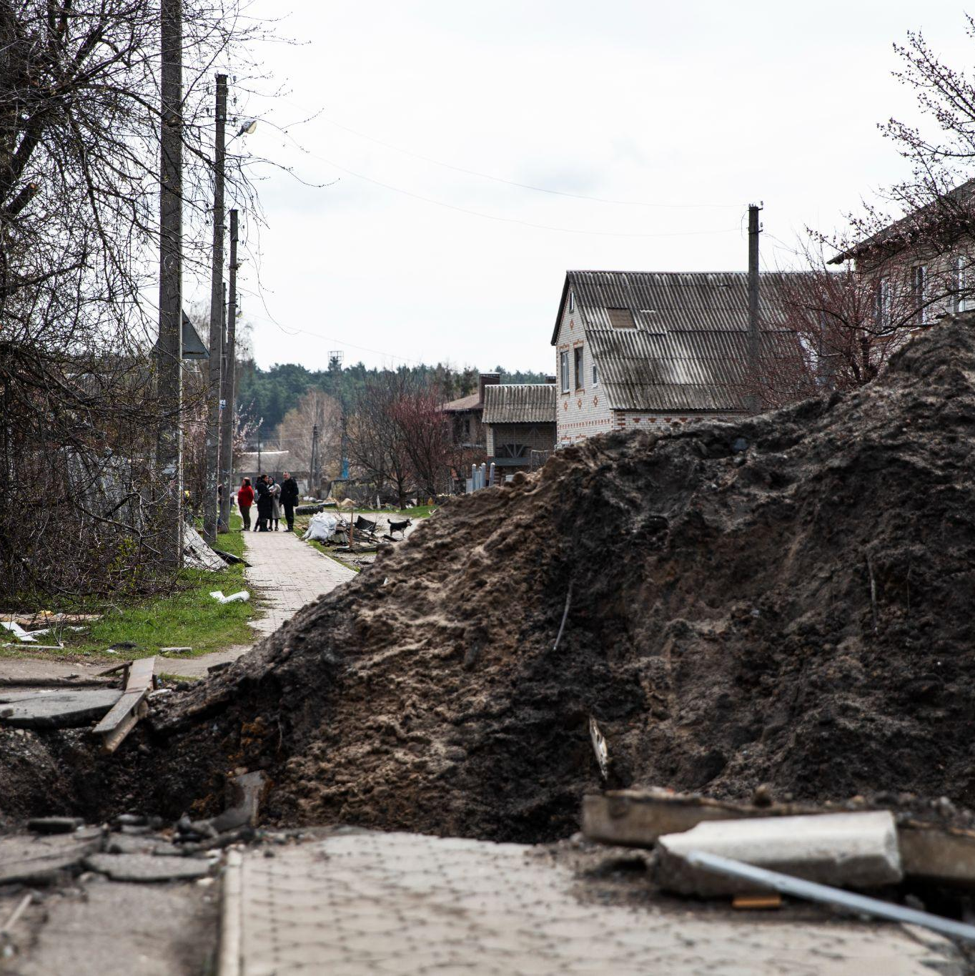
03
Validation of Hypothesis

Slide 13
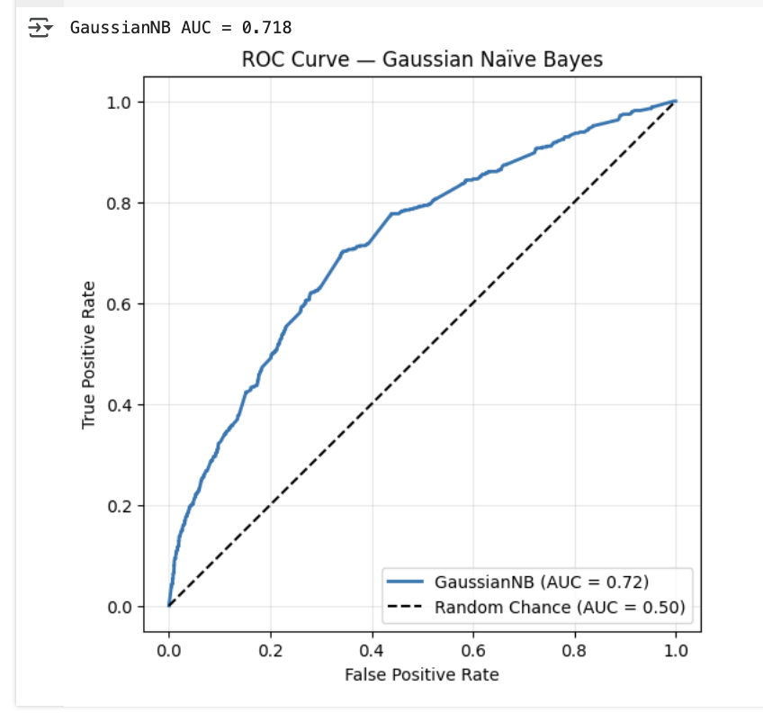
What the Area Under ROC Tell Us?
Better than random: AUC > 0.50 confirms our model is learning real signals.
Still room to grow: At AUC = 0.718, the model misranks roughly 28 % of event pairs.
If you pick one event that did have an aftershock and one that didn’t, our model spots the true aftershock about 72 times out of 100.
ROC Curve
Notes:
Here, we see the ROC curve for our Gaussian Naïve Bayes model.
The curve shows how often we correctly catch aftershocks (true positive rate) versus how often we raise false alerts (false positive rate) as we change our probability threshold.
The area under this curve, or AUC, is 0.718, which is well above the 0.5 you’d get by random guessing.
If you pick one quake that had an aftershock and one that didn’t, our model will rank the real aftershock higher about 72 % of the time.
So this AUC tells us our model is learning real patterns—much better than chance—though there’s still room to improve

Slide 14
Hypotheses Validation
H₀ (Null Hypothesis): Aftershocks in Nepal occur randomly and cannot be predicted accurately using mainshock features.
H₁ (Alternative Hypothesis): Aftershocks in Nepal exhibit patterns that can be modeled and predicted using machine learning.
Since every model’s recall and F1 for aftershocks is far better than random, we can confidently reject H₀ and accept H₁: aftershocks in Nepal follow patterns we can learn with machine learning.
Notes:
• H₀ (Random): Aftershocks happen by chance.
• H₁ (Predictable): Aftershocks follow patterns in the quake data.
All our models beat random guessing by a big margin, so we reject H₀ and accept that aftershocks in Nepal do follow learnable pattern

Slide 15
04. Reflection & Learning
Building a custom spatiotemporal classifier (distance + 30‑day window) was essential—without it, our ML models learned on noisy “aftershock” labels.
Inconsistent ‘cdi’ and ‘nst’ entries required careful median‑imputation to avoid biasing model training.
Although it is possible to predict aftershocks using machine learning, pre-existing features are not enough to predict if the mainshock will induce an aftershock.
Notes:
First, we built a custom spatiotemporal classifier—using a 30‑day, 50 km rule—to get clean mainshock vs. aftershock labels. This was key, because noisy labels wreck models.
• We saw a lot of missing ‘cdi’ and ‘nst’ values, so we filled them in with medians. That kept our training stable and fair.
• we realized our four features can beat random guessing, but they’re not enough to catch every aftershock. From here, we know we need extra inputs—like depth or fault‑line distance—to improve our forecasts.

Slide 16
05. Contributions & Implications
While progress has been made in projects like the Collaboratory for the Study of Earthquake Predictability (CSEP), earthquakes being unpredictable has made this research more challenging.
Demonstrates that a small, publicly available feature set (mag, cdi, nst, sig) can yield good recall in aftershock prediction which opens avenues for research in data‑limited regions.
By reducing uncertainty in the critical hours after a major quake, our model helps protect lives and streamline disaster‑response resource allocation.
Notes:
• We showed that just four common features—magnitude, intensity, station count, and signal strength—can predict aftershocks, even in data‑limited regions.
Our model can plug into existing seismic monitoring systems to send aftershock alerts within 24 hours of a main quake.
• Those faster, more reliable warnings help rescue teams and communities plan evacuations and target resources where they’re needed most.”

Slide 17
06. Future Directions
After being able to predict more accurately, we will work on the prediction of the magnitude of aftershocks.
Add geophysical inputs like hypocenter depth, fault‑line proximity, soil composition to sharpen model precision and recall.
Use other machine learning algorithms to analyze large earthquake datasets and identify patterns that are associated with aftershock occurrence.
Create a full pipeline to enable live integration with USGS feeds and create mobile alert apps.
Notes:
We’ll want to go beyond yes/no aftershock predictions and train models to estimate how strong the aftershock will be.
We plan to bring in depth, distance to fault lines, and soil type so our models can learn more and improve both precision and recall.
We’ll test additional machine‑learning methods on larger quake datasets to uncover patterns we haven’t tapped yet.
Finally, we also want to be able to build a live system that pulls in USGS data as it’s published and pushes alerts to a mobile app, so communities get timely warnings.

Slide 18
References
USGS Earthquake Hazards Program, “USGS Catalog of Nepal Earthquakes.” (Data obtained via USGS API; includes worldwide station network description).
H. Ebrahimian and F. Jalayer, “Improvements to seismicity forecasting based on a Bayesian spatio-temporal model,” Scientific Reports, vol. 12, art. 20970, Dec. 2022.
P. M. DeVries et al., “Deep learning of aftershock patterns following large earthquakes,” Nature, vol. 560, no. 7720, pp. 632–634, 2018.
“Nepal earthquake of 2015,” Encyclopædia Britannica. (describing the April 25, 2015, mainshock and May 12 aftershock impacts) .
P. Reuell, “Examining aftershocks with AI,” Harvard Gazette, Sep. 2018. (Discusses Harvard/Google research using AI for aftershock location prediction) .

Slide 19
Thanks!

