Slide 1
Analysis of Chapter 6
Student Name
Student ID
Module
Day & Date

Slide 2
Differences between Groups (Part D)

Slide 3
Normally distributed vs. Non-normally distributed data
Normally distributed data:
Information distribution looks like a bell curve with equal heights.The data is evenly distributed around the mean if the following three conditions hold: -Mean, median, and mode are all the same
Non-normally distributed data:
Mean, median, and mode are not always the same value; they can take on a wide range of numbers; and the data does not follow a symmetrical pattern.Variation in the data around the mean is not uniform.

Slide 4
Types of variables
Numerical Variables:
- Quantitative data that can be measured and expressed as a number
- Can be further broken down into Discrete and Continuous
Ordinal Variables:
- Variables with ordered categories that can be ranked
Nominal Variables:
- Variables with unordered categories that cannot be ranked

Slide 5
“One-way (between groups) ANOVA & robust Welch ANOVA”
• Objective: The one-way (between groups) ANOVA (ANalysis Of VAriance) determines “whether there are statistically significant differences among the means of three or more independent samples (groups)”.
• Assumptions:
We have one continuous (numerical) dependent variable
We have one categorical independent variable with three groups or more (each group represents a sample)
We have independent observations – no relationship between the observations in each group (sample)
No significant outliers for the numerical dependent variable associated with each group separately
• Method for testing assumption #4: Boxplots

Slide 6
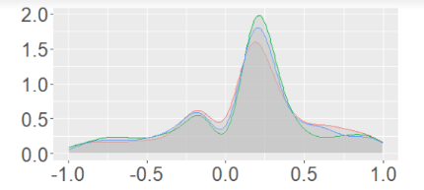
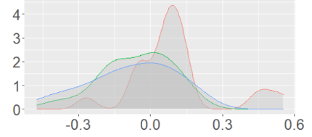
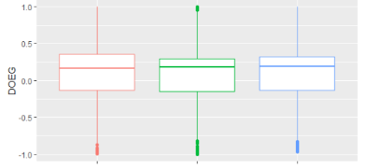
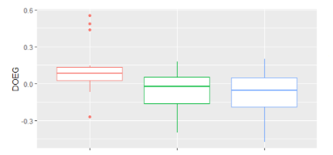
“Kruskal-Wallis one-way ANOVA test (non-parametric)”
The Kruskal-Wallis test is a non-parametric one-way analysis of variance (ANOVA) that goes by a few other names: Kruskal-Wallis H test; one-way ANOVA on ranks; and Kruskal-Wallis F test. It is used to compare three or more groups and find out if there are statistically significant variations between their medians or distributions of the dependent variable, which can be either continuous or ordinal.
• The assumptions for this test are:
1. We have one continuous or ordinal dependent variable.
2. We have one categorical independent variable that consists of three or more groups.
3. The observations should be independent.
4. We should determine whether the distributions of scores (dependent variable) for each group (independent variable) have the same or different shape.
• If the assumptions are not met, then the Friedman ANOVA test should be used instead.

Slide 7
“Homogeneity of Variance”
• Homogeneity of variance refers to the equality of variance (or dispersion) of a variable across different groups.
• When the variance is not equal (or not homogeneous) across groups, it is referred to as heteroscedasticity.
• Homogeneity of variance is important in statistics, as it affects the validity of the results of statistical tests.
• It is also important to check for outliers, as these can affect the homogeneity of variance.

Slide 8
Differences between Groups (Part E)

Slide 9
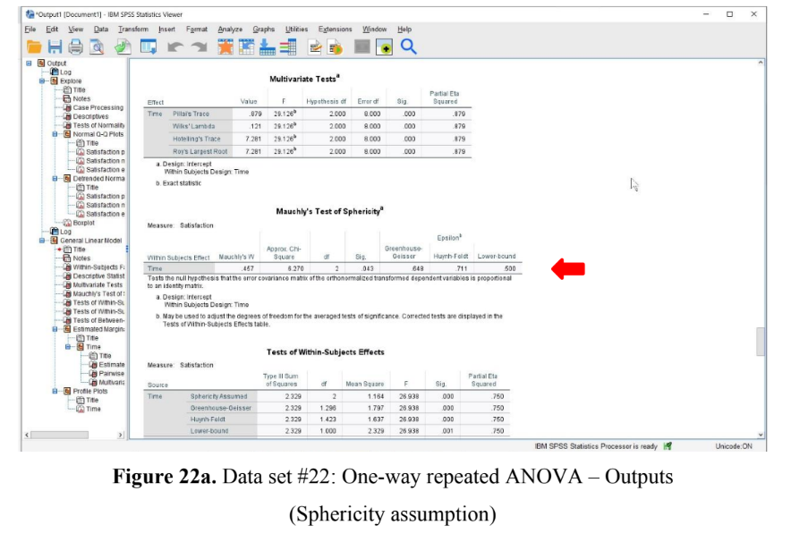
“Sphericity assumption – Greenhouse-Geisser test”
Sphericity assumption is the assumption that the differences between the groups (e.g., satisfaction pre-semester; satisfaction mid-semester; satisfaction post-semester) have equal variances.
In order to verify this presumption, the Mauchly sphericity test was applied.
2 (2) = 6.27, p 0.05 indicates that the sphericity assumption is not met.

Slide 10
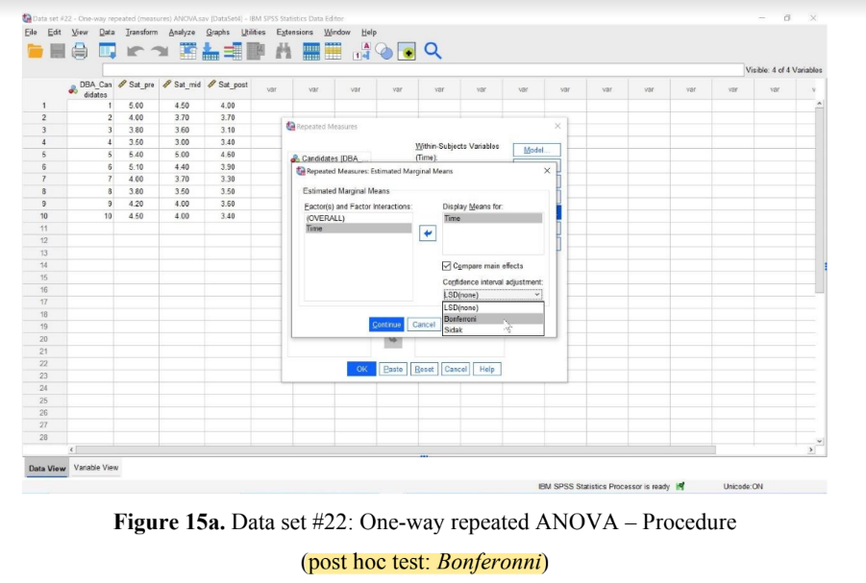
“Post Hoc Analysis”
• Post hoc analysis is a tool to identify & analyze relationships between variables after an experiment has been conducted
• It is used to identify factors which may have had an effect on the outcome of the experiment
• It helps researchers understand which variables had the biggest impact on the outcome
• Post hoc analysis can be used to identify potential confounding variables which may have been overlooked during the experiment
• It can also help identify areas of further exploration which could be beneficial to future experiments

Slide 11
“Cochran’s Q test”
Cochran's Q test compares the proportions of two or more unrelated groups and is a non-parametric statistical test.
In order to test if two or more categorical variables have statistically significant differences in their respective percentages, this test is employed.
This chi-square variation is helpful when working with small sample sizes or non-normally distributed data.
The test is used to compare proportions in the same sample at different points in time or across different groups.
The test is used to compare the proportions of two or more categorical variables that have three or more levels.
The test is based on the assumption that the variables are independent and that the observations are independent and identically distributed.

Slide 12
“Friedman’s ANOVA (non-parametric)”
When comparing the distributions of three or more closely related groups, Friedman's test is employed to identify statistically significant differences.
Unlike the one-way repeated-measures ANOVA, this test does not rely on parametric assumptions to draw conclusions.
• Assumptions:
One numerical or ordinal independent variable,
2. One categorical independent variable consisting of three or more groups.
• Hypothesis testing: Ho: All group distributions of scores are the same, Ha: At least one group distribution of scores is different from the other group distributions of scores.
• Friedman’s test only identifies an overall effect and does not provide any information about differences between groups. A post hoc test (i.e., pairwise comparisons) should be used to identify any differences between groups.

