Slide 1
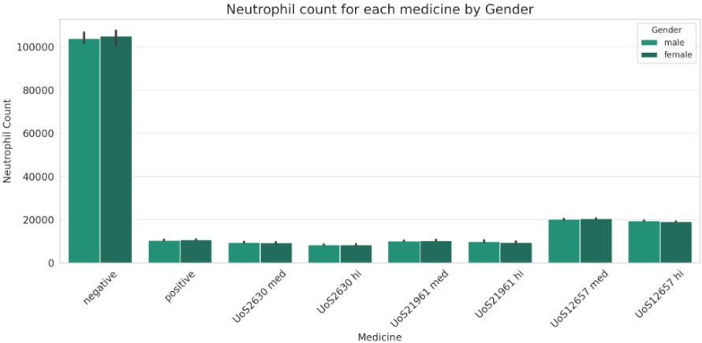
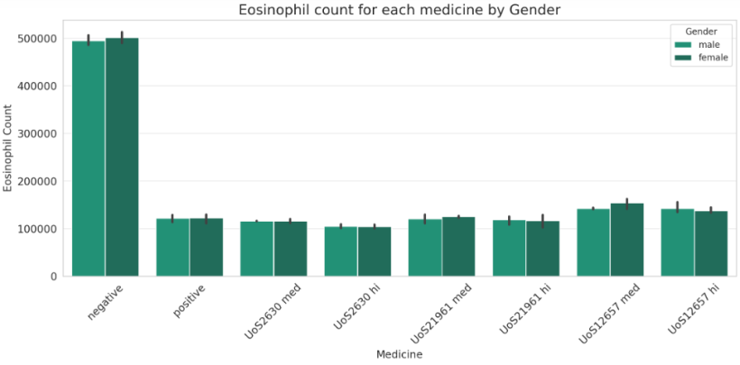
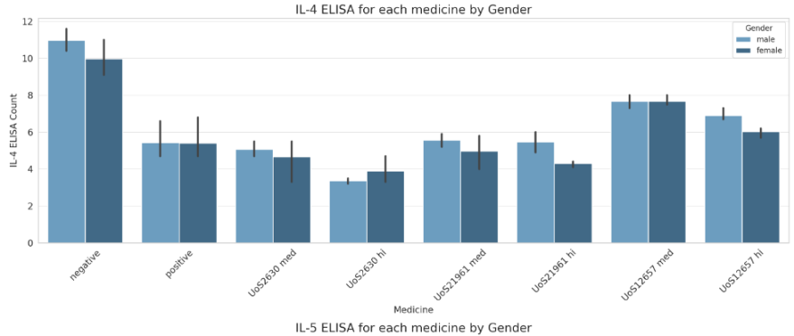
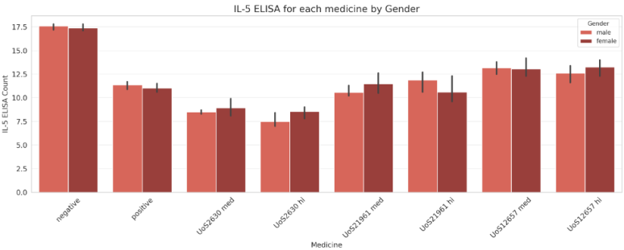
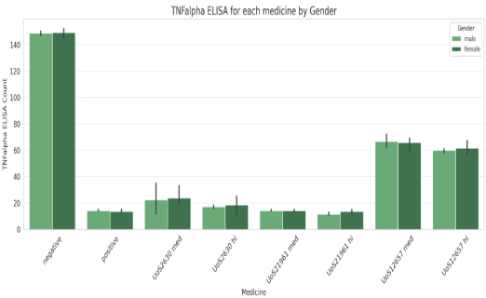
Pollution Findings
Here, we find that, compared to the negative controls, the positive control drugs result in a significant reduction in neutrophil counts for both male and female mice. This suggests that these medications may have an anti-inflammatory or immunosuppressive effect.
When compared to negative controls, it appears that positive control medications significantly lower the eosinophil counts in both male and female mice. The impact of these medications on eosinophil levels can be a crucial component of their therapeutic impact because the eosinophil count can be a sign of allergic reactions or other illnesses.
These counts may represent different immune reactions, and tracking their progression can reveal information about the effectiveness and side effects of a drug. According to the data, there are variations between male and female mice in the ELISA levels produced by positive control drugs compared to negative controls.

Slide 2
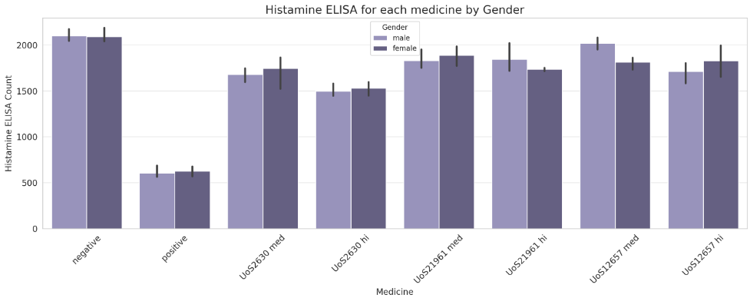
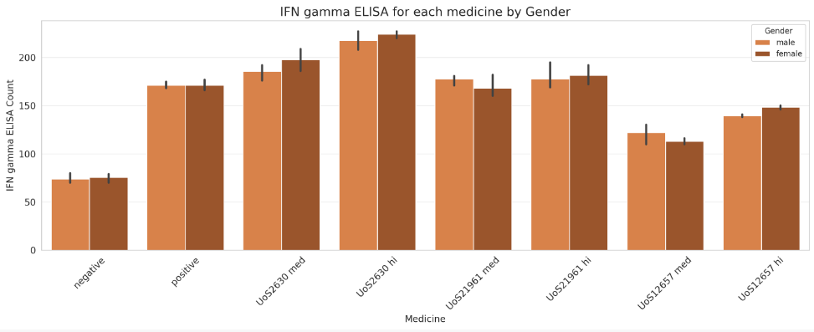
The two bar graphs display the gender-separated counts for Histamine ELISA and IFN gamma ELISA across various medications. While IFN gamma is important in immune responses, particularly those against viral infections and tumors, histamines play a role in allergic reactions. According to the data, different medications affect these ELISA levels differently, with distinct patterns seen in male and female mice.

Slide 3
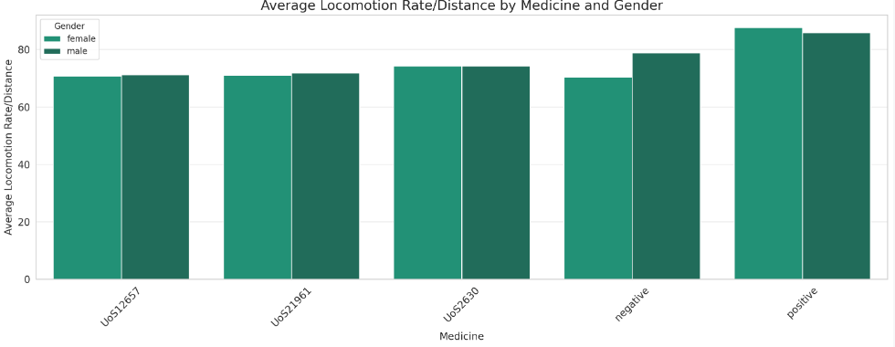
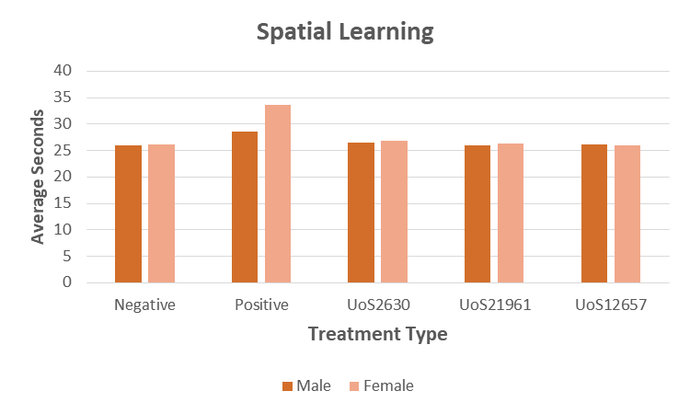
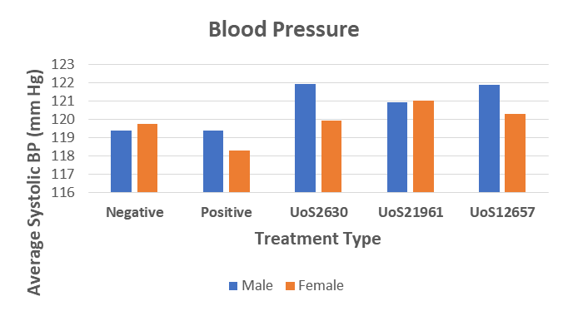
Side effects
The average distance travelled by mice while taking various medications is shown in this bar plot, segmented by gender. Higher rate-inducing drugs may encourage more physical activity, whereas lower rate-inducing drugs may have sedative effects. Male and female mouse differences can also shed light on gender-specific reactions.
To determine how drugs affect the brain's cognitive and motor functions, the spatial learning method is used. As a result of the drugs' results being less severe than the positive control, graph shows less spatial learning impairment. On the ability of mice in both sexes to learn spatial relationships, all three drug candidates exhibit comparable lower effects.
All three drug treatments resulted in an increase in blood pressure. Systolic blood pressure in females was discovered to be higher than normal. Compared to other drugs, UoS2630 showed relatively lower Bp in females.

Slide 4
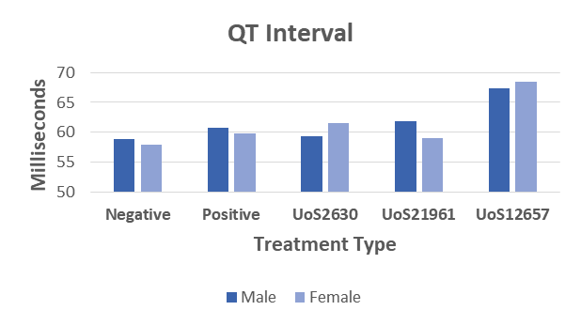
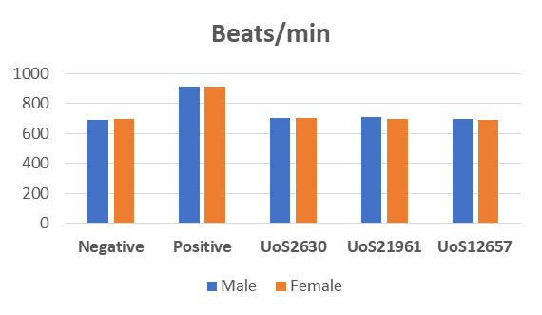
UoS2630 | Decreased (in males), Increased (in females) | Probable side effects
UoS21961 | Slightly Increased in males | Probable side effects
UoS12657 | Very High | More probable CVS problems
Conclusion
Based on the findings discussed above, Drug UoS21961 should proceed to Human Clinical Trials because it has been found to be more effective at causing the desired effects and to have the fewest side effects in animal testing. Comparing UoS21961's side effects to those of other drugs tested in relation to BP, spatial testing, locomotion, etc., they were comparatively mild. Human Clinical Trials are successful when there are fewer side effects and greater efficacy, so the development of Drug UoS21961 should continue.

