Slide 1

What if AI could understand ‘WHEN’ as well as ‘what’?

Slide 2
Improving Temporal Awareness in LLM-Based IR systems
By Anmol Arora
Under the supervision of Prof. Guido Zuccon
Notes:
Greetings, my name is Anmol Arora and today I will be presenting my proposed project: Improving Temporal Awareness in LLM-based IR systems.

Slide 3
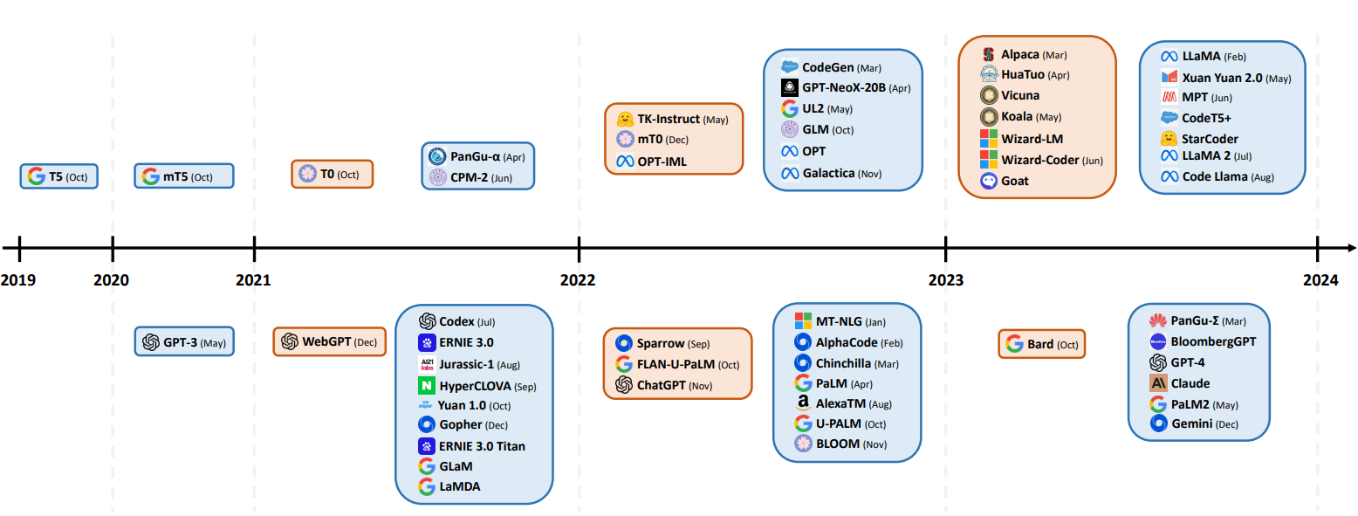
INTRODUCTION
A Large Language Model (LLM) is an advanced artificial intelligence system that can comprehend and generate human-like text by learning from extensive datasets.
There has been a rapid advancement in LLMs and their applications in the last 5 years.
Fig. 1: Chronological display of LLM releases (Naveed et al., 2023)
Notes:
And this fig. does not even account for the development that has been done in the first 5 months of 2024.

Slide 4




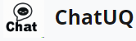
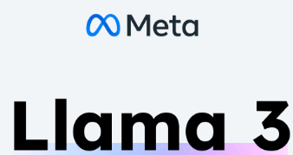
Introduction
One notable application of LLMs has been their integration into Information Retrieval (IR) systems, including chatbots.
Information retrieval is the process of obtaining relevant information from a large collection of data, typically structured as documents, in response to a specific query or search.
LLMs
IR
Chatbots

Slide 5
Motivation behind the project
ChatUQ is a chatbot currently under development by researchers of the IELab at UQ.
The motivation for this research stems from the observed deficiencies in temporal awareness in LLMs used within the ChatUQ framework. The table below illustrates that:
Query | Generated Answer
When is my next DATA7901 assignment due? | Your next assignment due date is not available in the provided context.
When will the Exams for Semester 1, 2024 be held at the University of Queensland? | The Exams for Semester 1, 2024 at the University of Queensland have not been announced yet.
When will the election for the next Academic Board be held at UQ? | The next Academic Board election at UQ will not be held in April or July 2019, as previously stated. Instead, the election will be held in October 2019.
Table 1: Examples of ChatUQ Failing to Capture Temporal Context in Queries
Note: Although the research will be conducted on open-source data and not on ChatUQ data directly, the findings and methodologies are expected to be fully transferable to the ChatUQ environment.

Slide 6
CURRENT Literature
Stateful LLMs & Temporal Attention: Enhancements in LLMs have introduced stateful interactions and temporal attention mechanisms to improve continuity and relevancy in continuous interaction environments such as digital assistants (Z. Chen et al., 2023; Mann et al., 2020; Zhang et al., 2024).
Encoding and Retrieval Optimization: Advances in encoding techniques have reduced computational demands and improved model adaptability across diverse temporal contexts. IR systems have incorporated temporal tagging to refine retrieval processes, enabling more precise data access based on time-specific criteria (Dhingra et al., 2022; Kynoch & Latapie, 2023; Moulahi et al., 2016).
Benchmarking & Predictive Challenges: Despite these advancements, challenges persist. The Time-Sensitive QA dataset has revealed significant accuracy gaps in current QA systems, and predictive models require extensive training to dynamically adjust to the temporal relevance of queries (W. Chen et al., 2021; Whiting, 2016).
Notes:
There has been a significant research in this area. Here, I will go through some research papers that are relevant to our project.

Slide 7
Challenges in present literature
Stateful Limitations
Computationally Intensive Training
Diverse Data Demands
Temporal Tagging Accuracy
Predictive Model Constraints
Notes:
Stateful Limitations: Despite advancements, stateful LLMs struggle to maintain accuracy as temporal distance increases, impacting their utility in real-world applications.
Computational Efficiency: Integrating temporal attention mechanisms remains computationally intensive, complicating training and scalability of LLMs.
Data Demands: Temporal encoding techniques require robust, varied datasets for effective training, limiting rapid deployment and adaptability across diverse contexts.
Temporal Tagging Accuracy: IR systems with temporal tagging capabilities face challenges in maintaining accuracy in noisy environments, affecting the reliability of time-sensitive IR.
Predictive Model Constraints: Machine learning models that predict temporal relevance need extensive training data, which hampers their effectiveness in smaller or unstructured datasets

Slide 8
Objectives & Proposed Methodology
The overarching goal of this research is to address the pervasive issue of temporal awareness in Large Language Model (LLM)-based information retrieval systems, specifically within the context of ChatUQ. The lack of temporal awareness in such systems manifests as a deficiency in processing and responding accurately to time-sensitive queries, crucial for effective user interaction.
Quantifying Temporal Comprehension
Dataset Creation & Refinement
Literature Review
Evaluation
Refining Methodologies
Flowchart: Illustrating Flow of Steps for Proposed Methodology
Notes:
The overarching goal of this research is to address the pervasive issue of temporal awareness in Large Language Model (LLM)-based information retrieval systems, specifically within the context of ChatUQ. The lack of temporal awareness in such systems manifests as a deficiency in processing and responding accurately to time-sensitive queries.

Slide 9
Proposed Methodology (1)
Quantifying Temporal Comprehension
• Incidence Tracking: Establish a systematic approach to track and analyze incidents of temporal misunderstandings within LLM interactions.
• Experimental Validation: Conduct controlled experiments to validate the findings from the incidence tracking.

Slide 10
Proposed Methodology (2)
Dataset Creation
• Query Generation: Utilize both manual creation and LLM-generated prompts to compile a comprehensive dataset of temporal queries.
• Evaluation Criteria Establishment: Implement human annotation to determine the presence of temporal comprehension issues within responses

Slide 11
Proposed Methodology (3)
Literature Review
• Source Identification: Conduct a thorough search on databases like Google Scholar using keywords related to temporal awareness in LLMs, IR, NLP & RAG.
• Paper Categorization: Manually categorize identified papers based on their methodology’s relevance and applicability to the project’s goals. Methods will be classified as directly applicable, adaptable, inspirational, or not useful.
• Analyze the Papers: Identify baselines that could be implemented and existing methods that could be adapted. Further, report shortcomings of current methods.

Slide 12
Proposed Methodology (4)
Refining Methodologies
• Improvement and Adaptation: Based on insights gained from the literature review, improve on existing methods by creating new methods or adapt existing ones to improve temporal accuracy in ChatUQ.
• Prototyping: Implement these methods within a controlled environment to test their initial effectiveness and integration with existing systems.

Slide 13
Proposed Methodology (5)
Evaluation
• Performance Analysis: Compare and contrast the enhanced system using the specially created dataset with the existing system to evaluate improvements in temporal awareness.
• Gap Identification and Planning: Identify any remaining gaps in temporal comprehension and outline future research directions and enhancements.

Slide 14
CONCLUSION
In conclusion, this project proposal aims to address the critical gap in temporal awareness within LLM-based IR systems, such as ChatUQ. By quantifying deficiencies, refining a targeted dataset, and exploring methodologies, the proposed research is set to significantly enhance the accuracy and relevance of time-sensitive responses in these systems.

Slide 15
Thank
You
Notes:
Thank You.

Slide 16
Reference LIST
Brown, A. (2023, March 14). OpenAI introduces the next evolution of ChatGPT: GPT-4. Android Headlines. https://www.androidheadlines.com/2023/03/openai-chatgpt-gpt-4.html
Chen, W., Wang, X., & Wang, W. Y. (2021). A dataset for answering time-sensitive questions. arXiv preprint arXiv:2108.06314. https://doi.org/10.48550/arXiv.2108.06314
Chen, Z., Li, D., Zhao, X., Hu, B., & Zhang, M. (2023). Temporal knowledge question answering via abstract reasoning induction. arXiv preprint arXiv:2311.09149. https://doi.org/10. 48550/arXiv.2311.09149
Dhingra, B., Cole, J. R., Eisenschlos, J. M., Gillick, D., Eisenstein, J., & Cohen, W. W. (2022). Time-aware language models as temporal knowledge bases. Transactions of the Association for Computational Linguistics, 10, 257–273. https://doi.org/10.1162/tacl_a_00459

Slide 17
Reference LIST
Kynoch, B., & Latapie, H. (2023). RecallM: An architecture for temporal context understanding and question answering. arXiv preprint arXiv:2307.02738. https://doi.org/10.48550/ arXiv.2307.02738
Mann, B., Ryder, N., Subbiah, M., Kaplan, J., Dhariwal, P., Neelakantan, A., Shyam, P., Sastry, G., Askell, A., Agarwal, S., et al. (2020). Language models are few-shot learners. arXiv preprint arXiv:2005.14165. https://proceedings.neurips.cc/paper/2020/hash/ 1457c0d6bfcb4967418bfb8ac142f64a-Abstract.html
ML Wires. (2024, April 23). Meta unveils Llama 3, the most capable open-source LLM yet. https://www.mlwires.com/meta-unveils-llama-3-the-most-capable-open-source-llm-yet/
Moulahi, B., Tamine, L., & Yahia, S. B. (2016). When time meets information retrieval: Past proposals, current plans and future trends. Journal of Information Science, 42 (6), 725– 747. https://doi.org/10.1177/0165551515607277

Slide 18
Reference LIST
Naveed, H., Khan, A. U., Qiu, S., Saqib, M., Anwar, S., Usman, M., Barnes, N., & Mian, A. (2023). A comprehensive overview of large language models. arXiv preprint arXiv:2307.06435. https://doi.org/10.48550/arXiv.2307.06435
Shaparenko, A. (n.d.). Information retrieval icon [Image]. Dreamstime. https://www.dreamstime.com/information-retrieval-icon-simple-element-business-intelligence-collection-filled-templates-infographics-more-image177237150
Whiting, S. (2016). Temporal dynamics in information retrieval. ACM SIGIR Forum, 50 (1), 97–98. https://doi.org/10.1145/2964797.2964818
Zhang, X., Zang, L., Liu, Q., Wei, S., & Hu, S. (2024). Event temporal relation extraction based on retrieval-augmented on LLMs. arXiv preprint arXiv:2403.15273. https://doi.org/10. 48550/arXiv.2403.15273
Zuccon, G., Wang, S., & Leelanupab, T. (n.d.). [ChatUQ website logo] [Image]. IELab, University of Queensland. https://chatuq.ielab.io/

