Slide 1
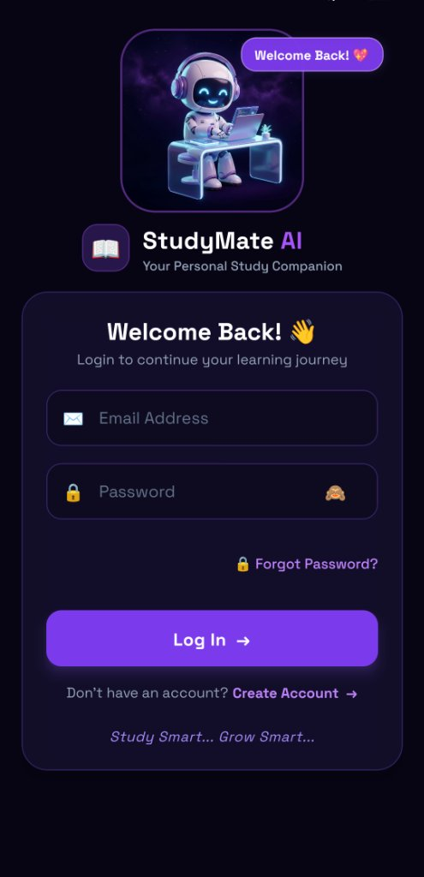
OFFICIAL PROJECT PRESENTATION
StudyMate AI
The Premium AI-Powered Academic Companion & Student Productivity Suite for Android
Seamlessly uniting Google Gemini LLM with Cornell Note taking, Pomodoro binaural soundscapes, Spaced Repetition Flashcards, and Timetable/Attendance safeguards.
Project Overview & Identity
Built with ❤️ for University Students Worldwide
• Creator & Lead Developer: Anmol Singh
• Target Platform: Android (React Native 0.88 + Expo SDK 58)
• Backend Architecture: FastAPI + PostgreSQL 16 + Google Gemini AI
• Release Status: Build 3 Standalone APK Ready | Google Play Store Ready

Slide 2
PROBLEM STATEMENT
The Real-World Academic Crisis Faced by College Students
1. Severe Information Overload
Cognitive Overwhelm
• Students attend 5-7 college courses simultaneously with hundreds of pages of PDFs and lecture slides.
• Traditional study methods lead to low retention; students cram before finals and forget concepts quickly.
• Generic search engines give bloated, non-curated, or confusing explanations.
2. Fragmented App Fatigue
Disjointed Workflow
• Students are forced to switch constantly between 5 different disconnected applications:
• Separate timer app for Pomodoro
• Generic note-taking app
• Separate calendar / timetable
• ChatGPT / external AI tabs
• Constant app-switching breaks deep focus and causes study procrastination.
3. Attendance & Schedule Pitfalls
Institutional Constraints
• Strict university regulations mandate 75% minimum attendance to sit for final semester examinations.
• Missing classes due to forgotten timings or room changes causes severe academic penalties.
• No single app connects syllabus exams, upcoming lectures, and attendance calculations together.

Slide 3
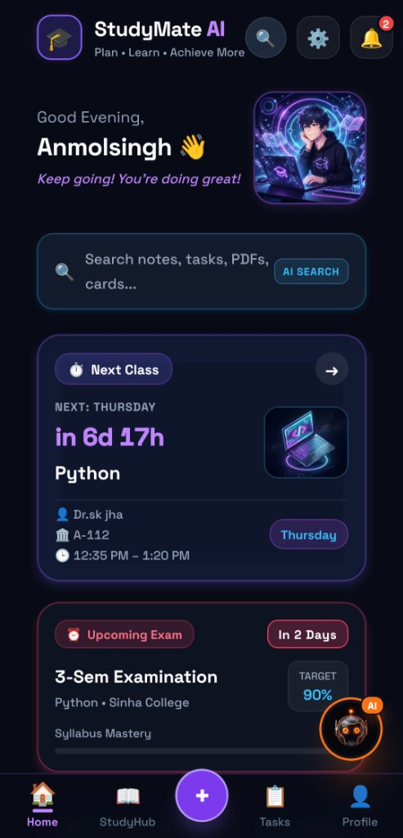
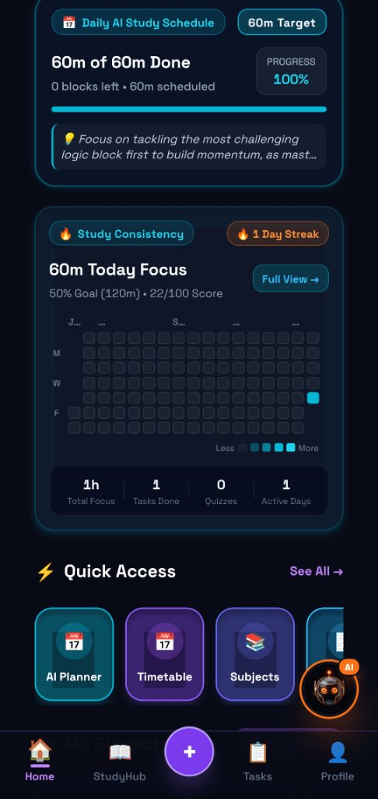
THE SOLUTION
StudyMate AI: The All-in-One Intelligent Study Ecosystem
Unified Academic Architecture
Smart, Fast, Focused
• Single Integrated Mobile Client: Consolidates AI tutoring, focus timers, note taking, flashcards, and timetable tracking in one place.
• Google Gemini Multimodal AI: Context-aware explanations, step-by-step math breakdowns, and Cornell note summarization.
• Cognitive Science Foundations: Integrates the Leitner spaced repetition method and the 25/5 Pomodoro rhythm.
• Attendance Safeguard Engine: Tracks real-time subject attendance percentages with proactive alerts before dropping below 75%.
• Battery-Optimized Dark UI: Built with high-contrast cyberpunk/dark aesthetics to reduce OLED battery consumption during long night study sessions.

Slide 4
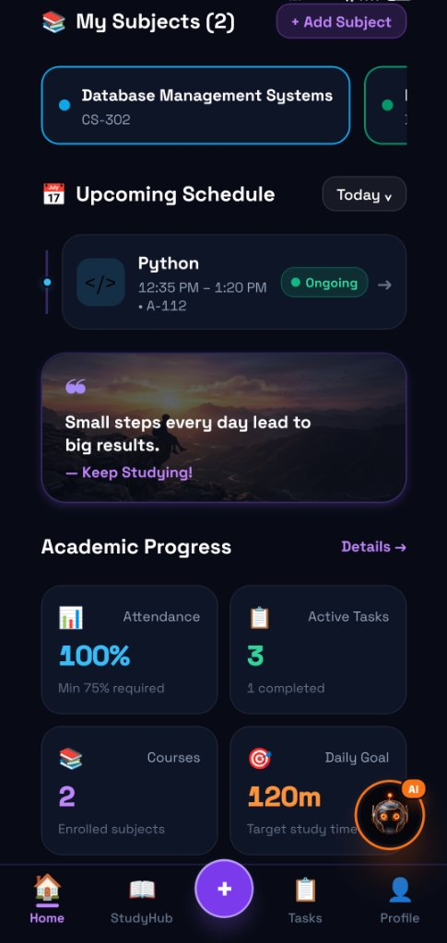
FEATURE DEEP-DIVE: HOME
Smart Student Dashboard & Daily Academic Flow
Dashboard Capabilities
Instant Clarity on Daily Goals
• Personalized Greeting & Status: Real-time dynamic greeting with student name, semester streak, and daily quote.
• Universal AI Search: Instantly query across notes, tasks, PDFs, timetable schedules, and flashcard decks.
• Countdown to Next Lecture: Real-time countdown (e.g. 'in 6d 17h Python in Room A-112 with Dr. sk jha').
• Upcoming Exam Milestone: Tracks days left until semester exams with target percentage goals (e.g. 90%).
• Daily AI Study Schedule: Tracks minutes studied vs daily target with visual progress bar (e.g. 60m of 60m Done).
• Study Consistency Heatmap: GitHub-style contribution grid displaying focus consistency over days and weeks.

Slide 5
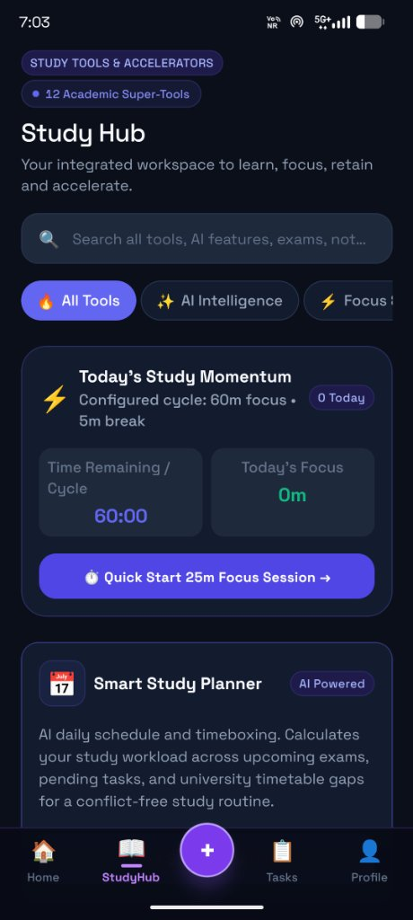
FEATURE DEEP-DIVE: STUDY HUB
Study Hub: 12 Academic Super-Tools in One Command Center
Integrated Learning Accelerators
High-Retention Learning Studio
• Today's Study Momentum Tracker: Real-time visual cycle timer (configured 60m focus + 5m break) showing elapsed vs remaining study blocks.
• Quick-Start 25m Focus Session: 1-click launch for rapid revision blocks with ambient background noise isolation.
• Smart AI Study Planner: Timeboxes daily study workload across upcoming exams, pending assignment checklists, and timetable gaps.
• Cornell Note Synthesizer: Converts lecture recordings or PDF chapters into structured Cues, Notes, and Exam Summaries.
• Interactive Quizzes: Auto-generates multiple-choice and conceptual quizzes from notes with detailed reasoning for each answer.
• Formula & Flashcard Decks: Spaced repetition algorithm automatically reschedules difficult cards for frequent review.

Slide 6
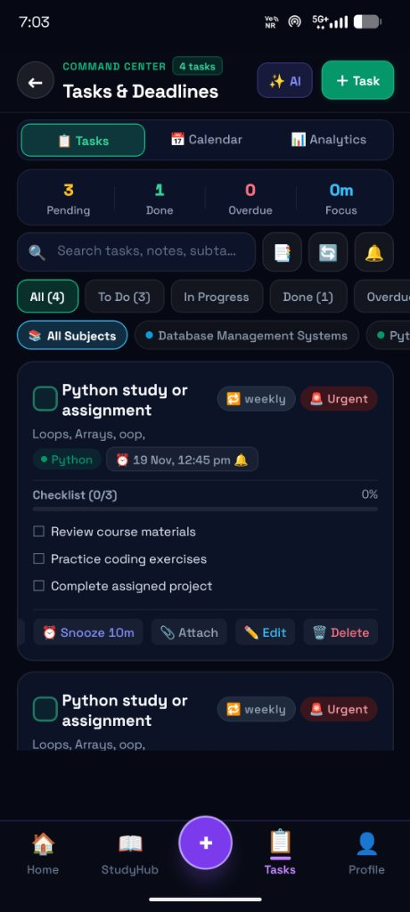
FEATURE DEEP-DIVE: TASKS
Tasks & Deadlines: Proactive Assignment & Exam Execution
Command Center Task Engine
Zero Missed Deadlines
• Granular Multi-Step Checklists: Break down large assignments into actionable micro-steps (e.g. 'Review course materials', 'Practice coding exercises', 'Complete assigned project').
• Urgency & Priority Visual Matrix: Color-coded tags (Urgent, Weekly, Low, Medium) so students tackle critical deliverables first.
• Subject-Specific Tagging: Filter tasks by semester course (Database Management Systems, Python, Math, etc.).
• Snooze & Reminder Alarms: 10-minute snooze capability and exact Android notifications before due dates.
• Integrated Calendar & Analytics: View pending vs completed task velocity to monitor study momentum.

Slide 7
FEATURE DEEP-DIVE: ATTENDANCE
Timetable Matrix, Pre-Class Alarms & Attendance Safeguard
Institutional Compliance & Scheduling
Never Miss a Lecture or Fall Below 75%
• Dynamic Weekly Class Schedule: Maps out daily lectures with subject code, room location (e.g. A-112), and professor details (Dr. sk jha).
• Ongoing Lecture Detection: Live status badge indicating ongoing vs upcoming classes.
• Pre-Class Notification Alarms: Exact Android system notifications sent 10 minutes prior to lectures.
• 100% Attendance Safeguard: Tracks attended vs total classes per course. Proactively warns students when attendance drops close to 75% minimum threshold.
• Academic Progress Metrics: Displays active courses enrolled, active tasks pending, and daily goal completion in high-visibility stats.

Slide 8
SYSTEM ARCHITECTURE
Modular Monolith Backend & Native Android Architecture
Mobile Client (Android)
High Performance & Smooth 60 FPS
• Framework: React Native 0.88 + Expo SDK 58
• Navigation: Expo Router (file-based routing)
• Language: TypeScript (100% strict mode)
• Server State: TanStack Query v5
• Client State: Zustand
• Secure Storage: Expo SecureStore (Android Keystore)
• Animations: React Native Reanimated 4.7
Backend API (FastAPI)
Rock-Solid & Scalable
• Runtime: Python 3.12+ (Modular Monolith)
• Framework: FastAPI with Pydantic v2
• ORM: SQLAlchemy 2.0 Async (asyncpg driver)
• Migrations: Alembic (Revisions 001 -> 017)
• Security: Argon2id password encryption
• Email Relay: Google Apps Script Webhook on HTTPS Port 443 (Zero SMTP block)
Cloud & Database
High Availability & Modern Cloud
• Database: Cloud PostgreSQL 16 (Render)
• AI Gateway: Google Gemini API (gemini-3.1-flash-lite / 3.8-flash)
• Admin Console: React 19 + Vite 6 (Hosted on Vercel)
• Mobile Deployment: Expo Application Services (EAS Build - Build 3 Standalone APK)
• Infrastructure: Render Web Service + Vercel SPA

Slide 9
SECURITY ARCHITECTURE
Defense-in-Depth Security & Student Privacy Guarantee
Data Protection Standards
Enterprise Security on Student Hardware
• Zero Client API Keys: The Android mobile app contains NO Gemini API keys, NO database credentials, and NO secret signing tokens. All AI traffic is mediated through backend /api/v1/ai/* routes.
• Argon2id Password Hashing: State-of-the-art password security resistant to GPU cracking.
• Hardware Android Keystore: JWT access tokens (15m expiry) and refresh tokens (30d) are stored exclusively in hardware-backed Expo SecureStore, never in plaintext AsyncStorage.
• Application-Level Tenant Isolation: Every query enforces user ownership (WHERE user_id = :current_user_id), preventing IDOR cross-tenant data leaks.
• Secure Password Recovery: 6-digit verification code delivered via HTTPS webhook relay directly to Gmail; no auto-filling or response leaking.
• Privacy Policy Compliant: Fully verified for Google Play Store safety standards (No selling of student data).

Slide 10
BUSINESS & MONETIZATION
Student Adoption Strategy & Future Monetization Model
Phase 1: 100% Free Adoption
High Growth & Viral Onboarding
• App is currently running in 100% Free Mode for all university students.
• Zero paywalls or friction during student beta testing and campus rollout.
• Objective: Rapid organic student onboarding, word-of-mouth growth, and student retention.
• Monetization Gate is switchable in 1-click via the Admin Panel.
Tier 1: Student Standard (₹0)
Essential Academic Baseline
• Monthly Price: ₹0 / month (Free forever)
• Included Features:
• 100 Notes creation limit
• 5 University Subjects
• 50 Daily AI Queries (Gemini Flash-Lite)
• Basic Pomodoro Focus Timer
• Timetable & Attendance tracking
Tier 2: StudyMate Pro (₹199)
Power Learning & Exam Prep
• Monthly Price: ₹199 / month (Configured in DB)
• Included Features:
• Unlimited Notes & Document Uploads
• Unlimited University Subjects
• 500 Daily AI Queries
• Priority High-Intelligence AI (Gemini 3.8 Flash)
• Exam Predictor & Advanced Quizzes
• Promotional Campus Coupons (CAMPUS50, EXAMPREP100)

Slide 11
PRODUCT ROADMAP
Strategic Roadmap: From Beta Launch to Campus Ecosystem
Completed Milestones
Production Ready
• Phase 1: Core Academic Engine (Subjects, Notes, Tasks, Flashcards, Timetable, Exams).
• Phase 2: Super Admin Web Console (AI Governance, Remote Config, Telemetry, Subscriptions).
• Phase 3: Production Standalone APK (Build 3 with 45s cold-start timeout & secure Gmail OTP relay).
Upcoming Milestones (Q1 2027)
Market Launch
• Google Play Store Release: Production Android App Bundle (.aab) submission.
• Offline Sync & SQLite Caching: Review flashcards and Cornell notes during campus commute without active internet.
• Biometric Authentication: Fingerprint & Face Unlock via Expo LocalAuthentication.
Long-Term Vision (Q2-Q3 2027)
The Future of Learning
• Campus Study Rooms: Real-time peer focus rooms with shared Pomodoro timers.
• University LMS Integration: 2-way sync with Canvas, Moodle, and Google Classroom.
• Voice AI Study Buddy: Real-time audio study dialogue using Gemini Live Multimodal API.

Slide 12
LIVE DEMO & LINKS
Summary, Download Links & Contact Information
Key Presentation Takeaways
Study Smart... Grow Smart.
• Production-Grade Architecture: Built from scratch with zero legacy debt, following modern layered design patterns.
• Live Android APK: Verified on real Android hardware with ultra-fast responsiveness.
• Google Gemini Integration: Real, working LLM responses tailored for college syllabi.
• Institutional Alignment: Real timetable and attendance tracking solving direct student pain points.
• Direct Download Link: https://study-mate-ai-android-apk.vercel.app/download
• GitHub Repository: https://github.com/Anmolkumar108/StudyMate-AI-Android-APK
• Public Privacy Policy: https://study-mate-ai-android-apk.vercel.app/privacy.html
Presenter & Developer Profile
Crafted with Passion for Higher Education
• Lead Developer & Founder: Anmol Singh
• Role: Full-Stack Mobile & AI Systems Architect
• Core Stack: React Native, Expo, Python, FastAPI, PostgreSQL, Gemini AI
• Email Support: Contact via Admin Desk / Akanmolbhumihar09@gmail.com
• Project Repository: Anmolkumar108 / StudyMate-AI-Android-APK
•
• Thank you for attending the presentation!
• Questions & Live Demonstration Welcomed.

