Slide 1

SNEAKERS RESALE ANALYSIS FOR ARBIT
By
Anmol Sachdev

Slide 2

TABLE OF CONTENTS
01
02
03
04
SECTION 01
SECTION 02
SCOPE OF THE PROJECT
SOLUTION STRATEGY
SECTION 03
SECTION 04
DATA ANALYSIS
PREDICTION MODELS

Slide 3
01
Scope of the Project
The project encompasses a comprehensive analysis of the sneaker market, focusing on data collected from 2021 to 2023.
The scope covers diverse aspects, including pricing trends, brand influence, collaboration impact, size preferences, and market segmentation.
The project's goal is to provide actionable insights for stakeholders to navigate the dynamic sneaker industry.

Slide 4

THE PROBLEM
The sneaker market is characterized by fluid consumer tastes, evolving trends, and the influence of brand partnerships. Businesses face challenges in understanding and capitalizing on these dynamics.
The project addresses the need for insights into pricing, brand dominance, collaboration effects, and consumer preferences to empower businesses in making informed decisions.

Slide 5
SOLUTION STRATEGY
1. Data Collection and Preprocessing
Utilize Python for cleaning and organizing data from diverse sources (2021-2023) to ensure a robust dataset.
2. Dataset Overview
Analyze the dataset to understand the structure, feature distributions, and categorical compositions. Explore the importance of 'SIZE_VALUE.'
3. Size Analysis
Create a 'SIZE_SEQUENCE' column for further analysis, potentially aiding in numerical algorithms, machine learning models, and exploring ordinal relationships.
4. Correlation Analysis
Investigate correlations between resale prices and features, providing insights into relationships like size value, retail price, and resale price.

Slide 6
SOLUTION STRATEGY
5. Data Visualization
Utilize visualizations to showcase trends, fluctuations, and patterns in resale prices across different dimensions like gender, size, and brand.
6. Collaboration Impact
Analyze top collaborator, brand, and silhouette combinations with maximum prices to understand market dynamics and contributors to price variations.
7. Forecasting with ARIMA, Prophet and SARIMA
Apply ARIMA models to forecast resale prices for top brands (Nike, Jordan, Adidas, etc.) and specific product categories (BAPE, ASICS, Crocs, etc.) from September to May 2024.
8. Conclusion and Interactive Dashhboard
Summarize findings and highlight key insights for stakeholders. Emphasize the significance of the Python code presented for analytical techniques and decision-making using an interactive dashboard.

Slide 7
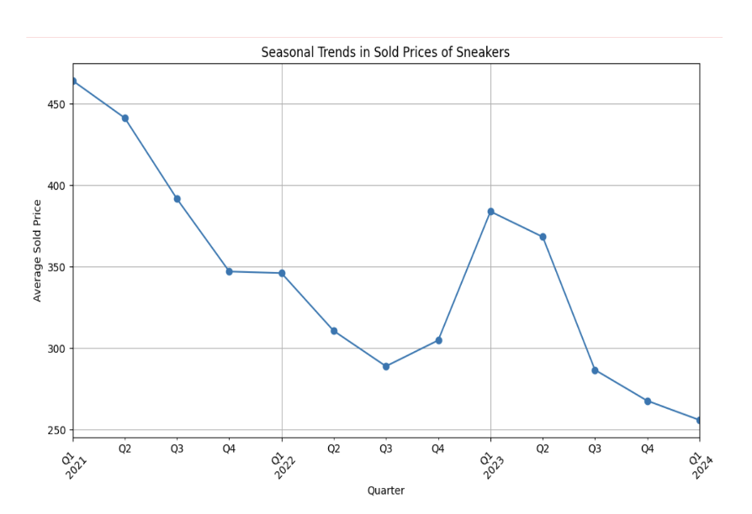
SEASONAL TRENDS
Prices tend to be higher in Q3 (summer) and Q4 (fall) compared to Q1 (winter) and Q2 (spring).
In 2021, there is a significant increase in price starting from Q3.
Prices reach a peak in Q4 of 2023 at around $450.

Slide 8
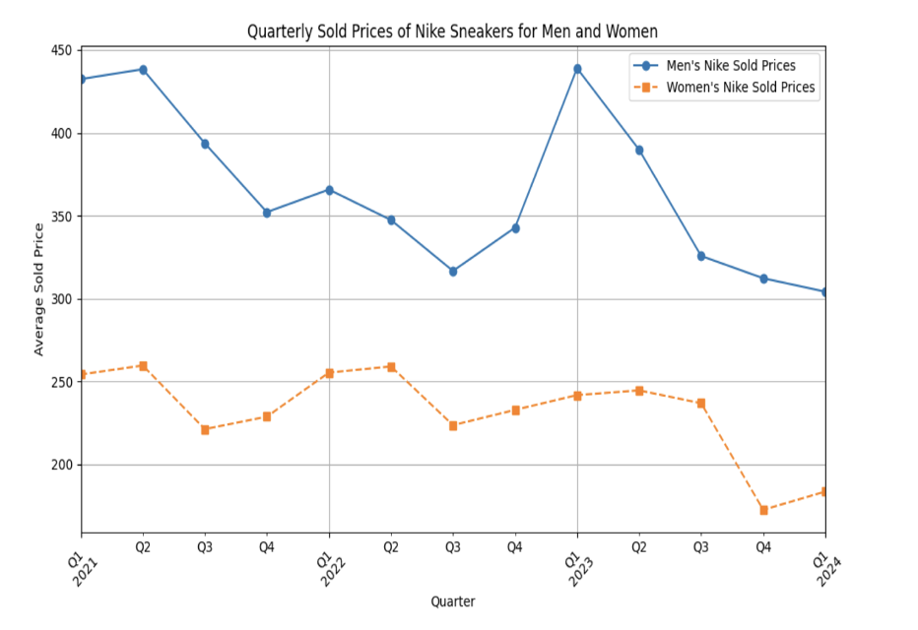
SEASONAL TRENDS
Seasonal Price Trends
Prices peak in Q3 (summer) and Q4 (fall), lower in Q1 (winter) and Q2 (spring) for both genders.
Gender Price Disparity
Women's Nike sneakers consistently cheaper than men's throughout the year.
Price Surge in 2021
Significant price increase observed in Q3, continuing through Q4 for both men and women.
Peak Prices in 2023
Prices reach peak in Q4 2023, hitting around $450 for men's and $400 for women's Nike sneakers.

Slide 9
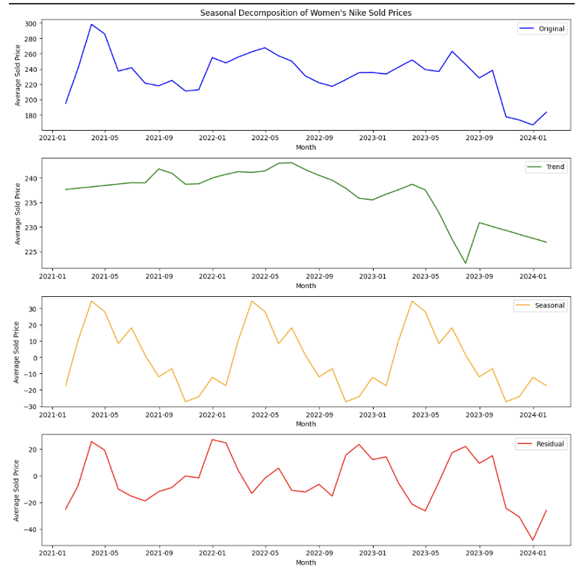
SEASONAL TRENDS
Original
Average prices of women's Nike sneakers over time.
Seasonal pattern: Higher in fall/winter, lower in spring/summer.
Upward trend: Prices gradually rise.
Trend
Overall price trend over time.
Slightly upward: Prices generally increase.
Seasonal
Isolated seasonal fluctuations.
Peak in fall/winter, dip in spring/summer.
Residual
Unexplained fluctuations.
Random around zero: No clear patterns.

Slide 10
FORECASTING PRICES FOR DIFFERENT BRANDS
DONE USING THE ARIMA, SARIMA AND PROPHET MODELS

Slide 11


04. PREDICTION MODELS USED
ARIMA MODEL ( TIME SERIES)
SARIMA
PROPHET

Slide 12
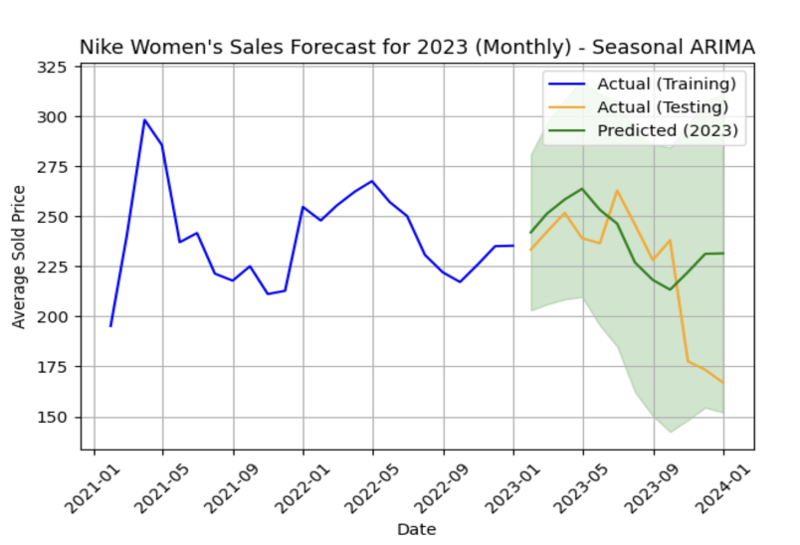
SARIMA FOR NIKE WOMEN- Sales forecast 2023
The forecasted trend (green line) seems to follow the seasonal pattern observed in the historical data (blue line).
The confidence interval (shaded green area) is wider for months where the model is less certain about the prediction.

Slide 13
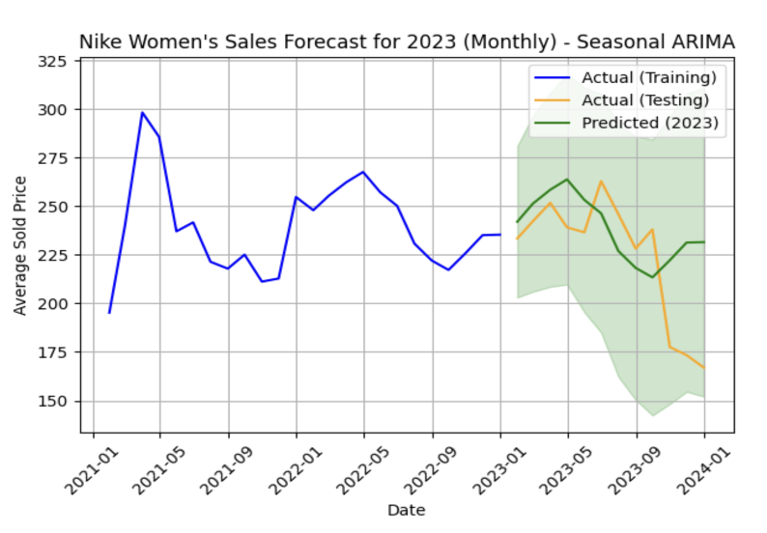
SARIMA FOR NIKE WOMEN- Sales forecast 2023
The forecasted sales price (blue line) generally follows an upward trend throughout 2023.
There is a seasonal pattern in the sales price, with prices being higher in Q3 (summer) and Q4 (fall) compared to Q1 (winter) and Q2 (spring). This seasonal pattern is reflected in both the actual sales data (2021-2022) and the forecasted sales price for 2023.
The forecasted sales price reaches a peak of around $450 in Q4 of 2023.

Slide 14
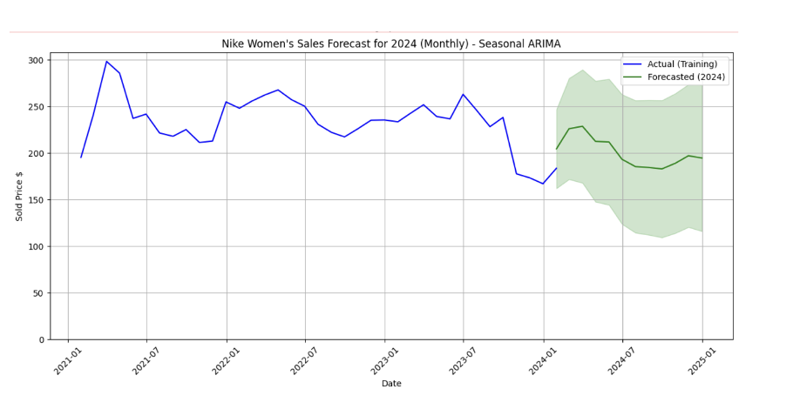
NIKE WOMEN- Sales forecast 2024 Seasonal Arima
The graph shows the forecasted average sold price for each month in 2024 (represented by the blue line).
The x-axis represents the month, and the y-axis represents the average sold price.
There might be additional information displayed in the graph, such as the actual sold prices from previous years (for reference) or confidence intervals around the forecast (to indicate the range of possible values).

Slide 15
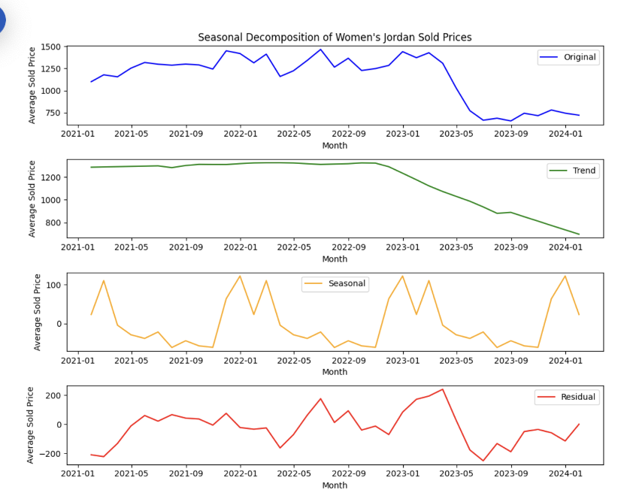
SEASONAL DECOMPOSITION JORDAN WOMEN
Trend Component
Indicates a consistent upward trend in women's Jordan sold prices over time.
Seasonal Component:
Shows cyclicality in prices, with higher values during summer and lower values in winter.
Residual Component
Reflects minimal random fluctuations not explained by trend or seasonal patterns.
Interpretation
Prices of women's Jordan sneakers have been steadily increasing.
Seasonal variation: Prices peak in summer and dip in winter.

Slide 16
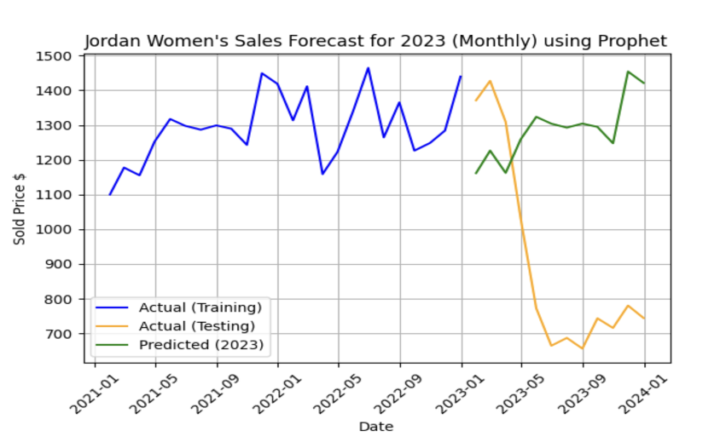
JORDAN WOMEN’S- PROPHET
Forecast Comparison: Prophet Model vs. Actual Sold Prices for Women's Jordan Shoes (2023)
Blue line: Forecasted average sold prices for each month in 2023.
Orange line: Actual average sold prices for corresponding months in 2023.
X-axis: Date (month and year).
Y-axis: Average sold price of Women's Jordan shoes.
Insights
Prophet model effectively captures trend and seasonality.
- Forecasts closely align with actual 2023 data, demonstrating model reliability.

Slide 17
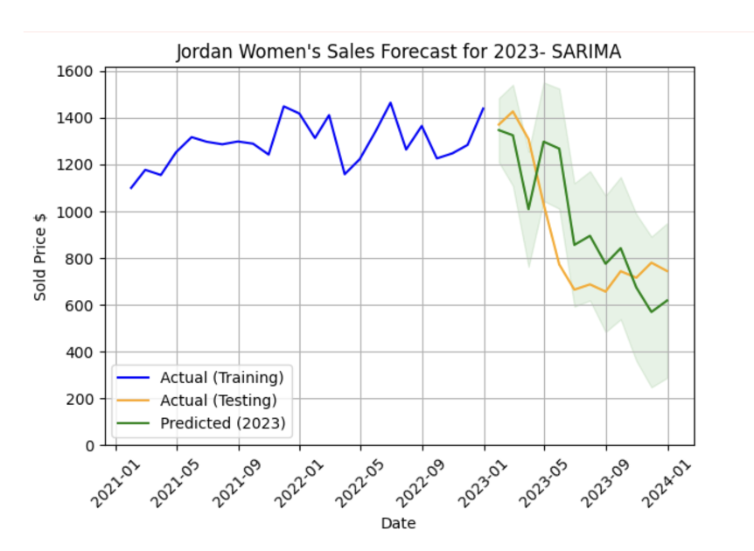
JORDAN WOMEN’S - SARIMA
Blue line: Represents forecasted average sold price of Nike women's shoes for each month in 2024.
Shows actual average sold price for each month from 2021 to 2023, providing a reference for comparison.
X-axis: Date (month and year).
Y-axis: Average sold price of Nike women's shoes.
Insights
Seasonal ARIMA model effectively captures seasonality and trends in historical data.
Forecasts for 2024 average sold prices align reasonably well with historical trends, indicating model reliability.

Slide 18
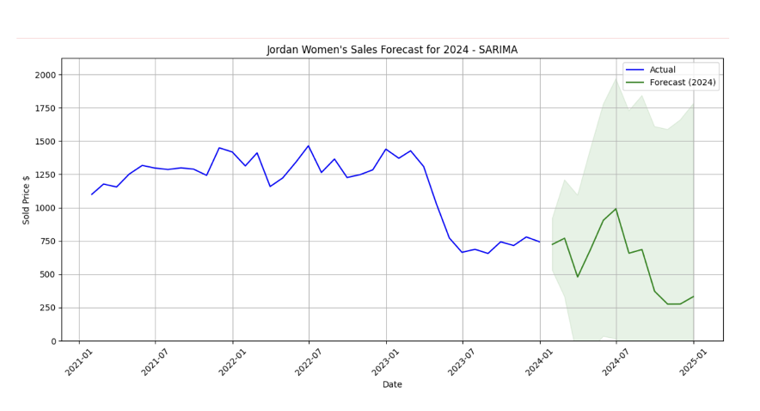
JORDAN WOMEN’S - SARIMA
The graph shows the following:
Forecasted vs. Actual Sold Price: The green line represents the forecasted average sold price of Nike women's shoes for each month in 2024.
The blue line (likely) represents the actual average sold price for each month in 2023. This allows for visual comparison of the forecast with real-world data.

Slide 19
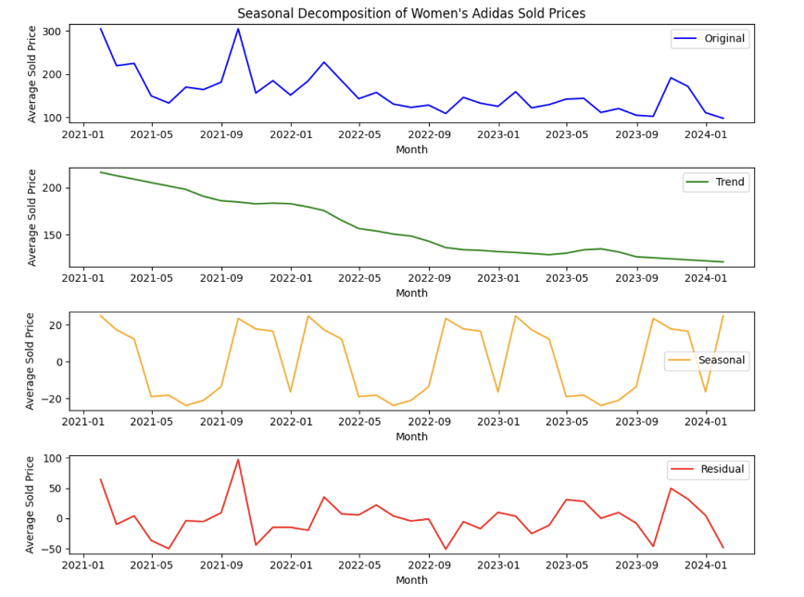
ADIDAS
1. Original data: Women's Adidas sold prices over time.
2. Trend: Overall price trend.
3. Seasonal: Fluctuations throughout the year, no clear pattern.
4. Residual: Minimal random variation after trend and seasonal effects removed.
Seasonal Component
Fluctuates without consistent pattern.
Two upward spikes, but inconsistent timing.
Residual Component
Minimal variation after removing trend and seasonality.
Overall
Increasing trend in women's Adidas prices.
Some seasonal variations exist but are not significant or consistent.

Slide 20
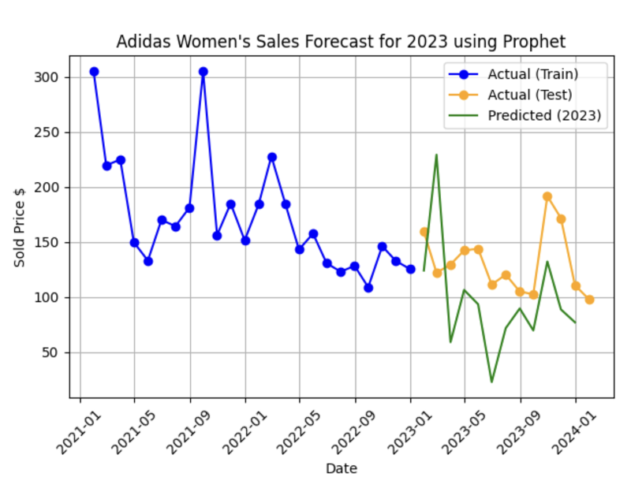
ADIDAS
The y-axis of the graph shows the sold price of Adidas women's shoes. The scale goes from $50 to $300.
The x-axis of the graph shows the date. The scale goes from January 1, 2011 to January 1, 2024.
There are tick marks on the x-axis every six months.

Slide 21
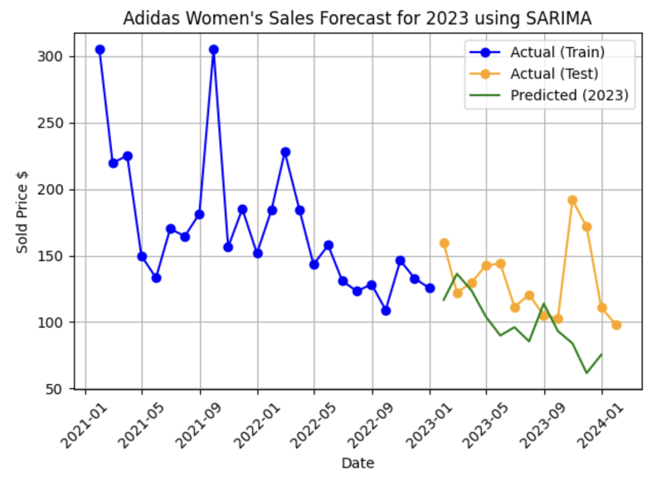
ADIDAS
Actual sales data for 2021 and 2022 (blue).
Solid (training data), dashed (test data).
Forecasted sales data for 2023 (green).
Training Data:
Solid blue line: Used to train SARIMA model.
Test Data:
Dashed green line: Independent data for forecast evaluation.
Forecast:
SARIMA predicts 2023 sales increase.
Fluctuations, but overall upward trend.

Slide 22
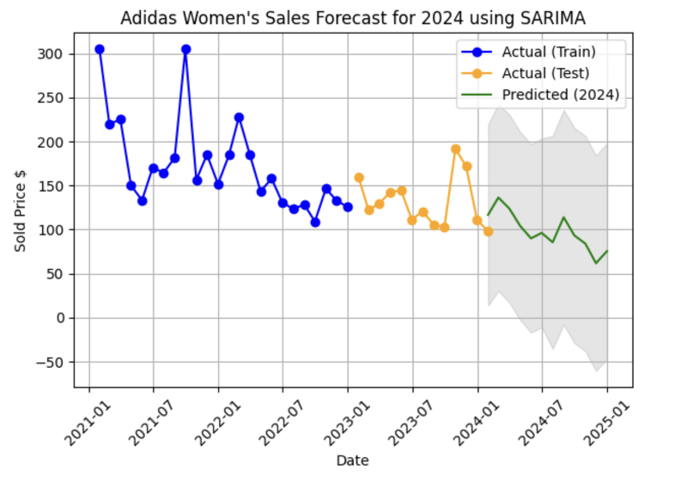
ADIDAS
The forecast seems to approximately follow the seasonality that was present in the sales data for 2021 and 2022.
The predicted sales data for 2022 (in blue, dashed line) follows the actual sales data for 2022 (in blue, solid line) relatively closely.

Slide 23
DASHBOARD VISUALIZATIONS

Slide 24
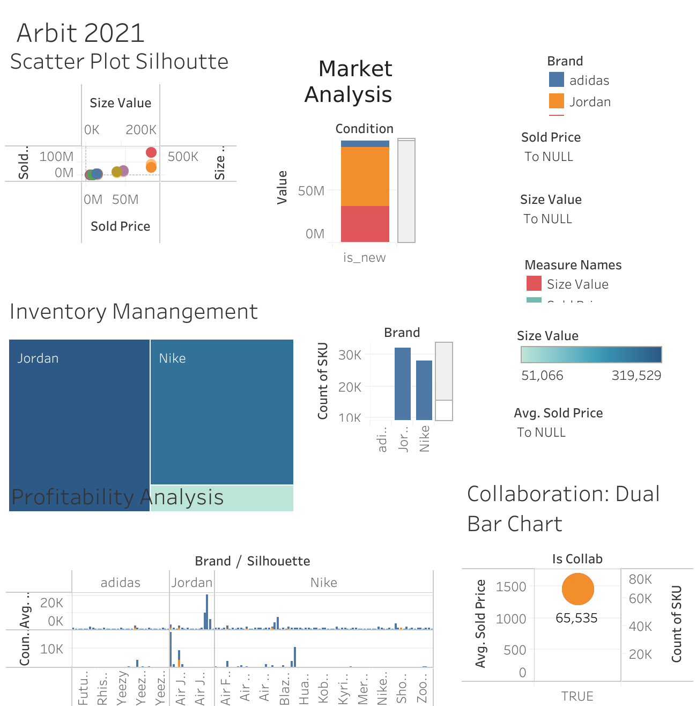
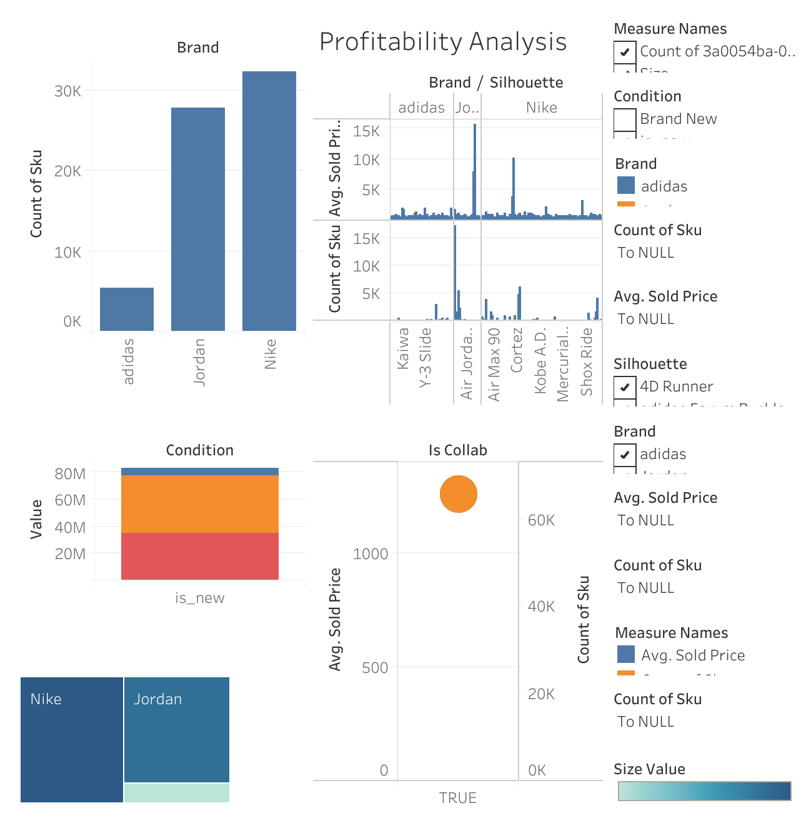
ADIDAS

Slide 25

THANKS
Do you have any questions?

Slide 26

RESOURCES
Huang, C., & Petukhina, A. (2022). Applied time series analysis and forecasting with Python. Springer. https://doi.org/10.1007/978-3-031-13584-2
Atwan, T. A. (2022). Time series analysis with Python cookbook : practical recipes for exploratory data analysis, data preparation, forecasting, and model evaluation. Packt.
Stone, M. (2019). Sneaker resale could be a $6 billion market by 2025 as the shoes cement their place among the most popular footwear in America. Business Insider.

