Slide 1
Analysing Trading Behaviour

Slide 2
Objective
Analyze how trading behavior (profitability, risk, volume, leverage) aligns or diverges from overall market sentiment (fear vs greed). Identify hidden trends or signals that could influence smarter trading strategies.

Slide 3

Understanding the Data

Slide 4
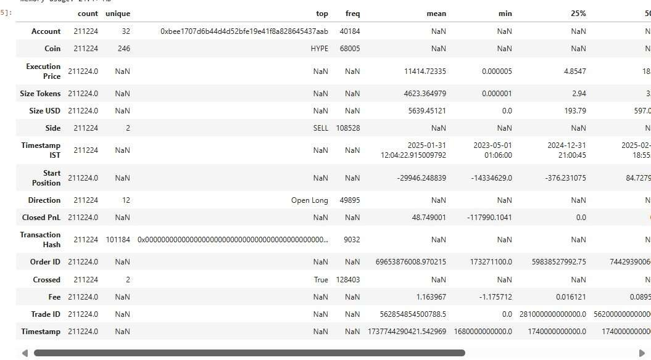
Bitcoin Market Sentiment DatasetColumns: Date, Classification (e.g., Fear / Greed)Coverage: 2,446 rows, 4 columns (sentiment metrics with timestamped history)

Slide 5
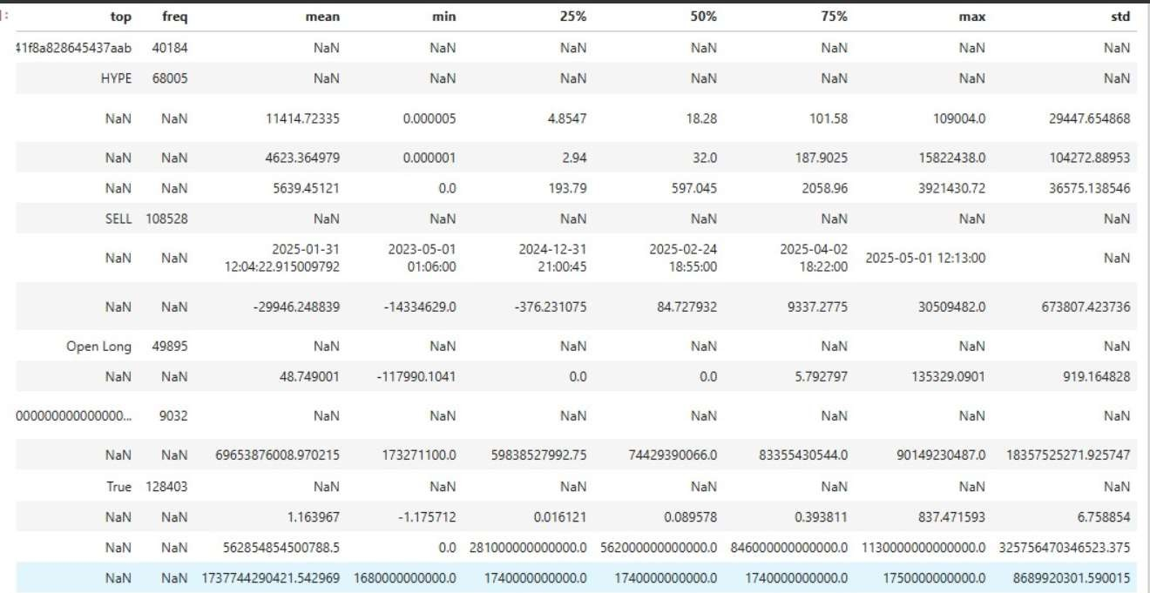
Historical Trader Data from HyperliquidColumns: account, symbol, execution price, size, side, time, start position, event, closedPnL, leverage, etc.Coverage: 21,147 rows, 12 columns (comprehensive trade logs with profitability and risk features)

Slide 6
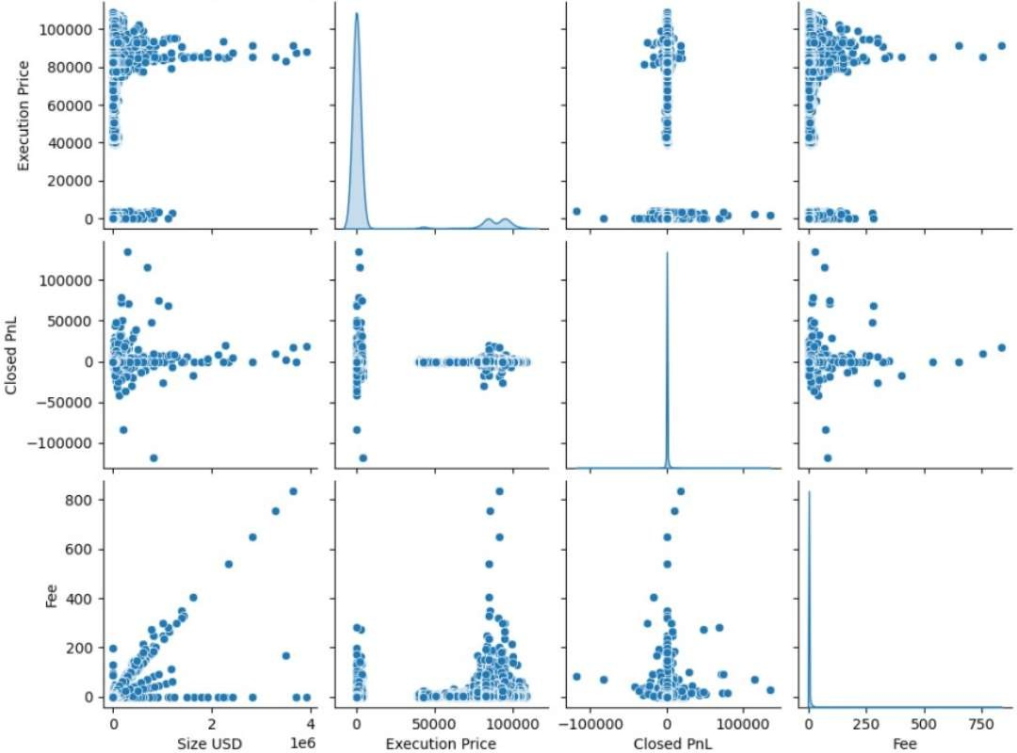
Positive Correlation Between Size USD and Fee
→ As the trade size increases, transaction fees also increase proportionally, indicating that fees are likely percentage-based on trade value.
Weak Correlation Between Execution Price and
PnL
→ Profit and loss (Closed PnL) do not show a strong linear relationship with execution price, suggesting that profitability depends more on market movements or timing rather than entry price alone.
Clustered Patterns and Outliers
→ A few extreme points indicate unusually high profits or losses, possibly from high-risk or high- volume trades. These outliers can significantly impact model predictions and may need further investigation or normalization.
Skewed Distributions
→ Most variables show skewed distributions (especially Closed PnL and Execution Price), indicating non-normal data — a common characteristic in financial trading datasets.
Fee Distribution Shows Linear Spread with Size USD
→ The tight linear relationship between Size USD and Fee confirms that fee calculation is systematic and scales predictably with trade volume.

Slide 7
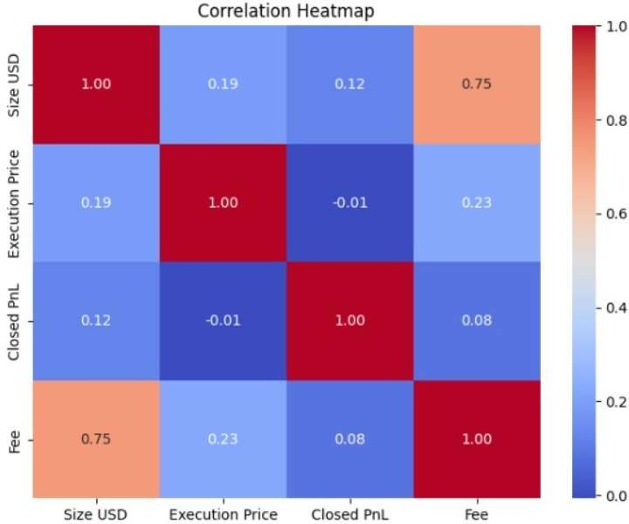
Understanding Relationships: The strongest link in your dataset is between trade size and fees (correlation: 0.75), meaning as trade size grows, fees increase predictably helping forecast trading costs efficiently.
Profit Independence: Closed PnL has almost no correlation with size or price profit depends more on strategy and timing than how much or at what price you trade, so clients should focus on smarter entries and exits over just position size.4-(Closed PnL Distribution for Top 20 Coins)Risk & Reward Dispersion: Most coins see the majority of trades clustered near zero profit/loss, but there are major outliers (big wins and losses) on coins like HYPE and ETH showing that chasing trending coins offers high reward but also much greater risk.

Slide 8
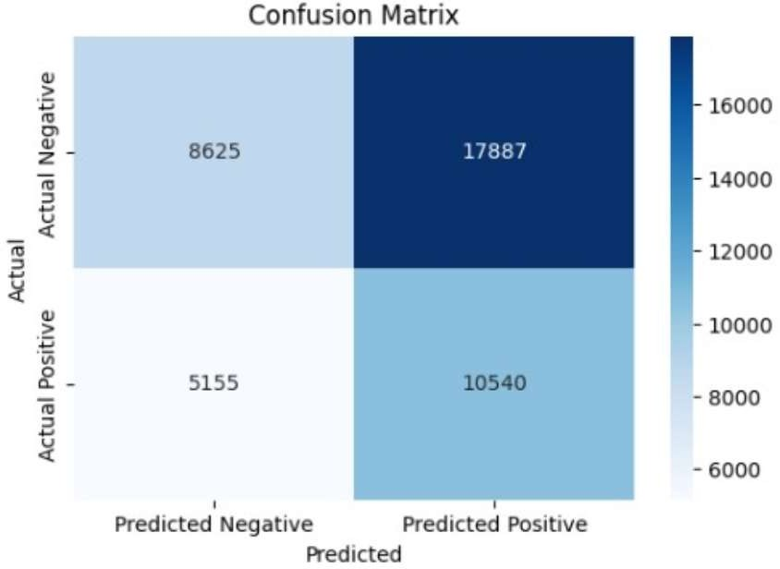
Model Misclassifications: The model has a high number of false positives (17,887), meaning it often predicts a positive when the reality is negative. This could lead to unnecessary trades or hedges based on inaccurate signals.Improvement Area: Focus on recalibrating model thresholds and improving class balance to reduce costly misclassifications, leading to more reliable trading automation.

Slide 9
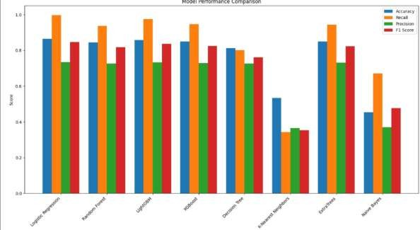
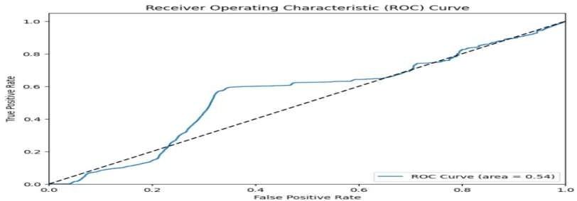
(Model Performance Comparison)Best Model Choices: Tree-based models (Random Forest, LightGBM, XGBoost) consistently deliver high recall and precision, making them top choices for predicting profitable trades or market states.
Practical Takeaway: Prefer these ensemble models in production for trading decision support, and monitor simple models (like KNN, Naive Bayes) closely as they perform much worse and may give misleading results if not managed.
Poor Discrimination: The ROC curve has an area under the curve (AUC) of 0.54—only slightly better than random chance. The model currently does not provide a strong signal for separating market opportunities from risks.Model Tuning Needed: Before using this model for live trading, significant tuning, reengineering, or an alternative approach is needed to achieve effective decision thresholds and minimize false signals.

Slide 10
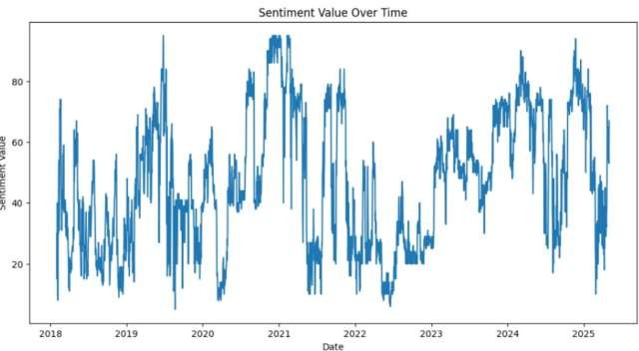
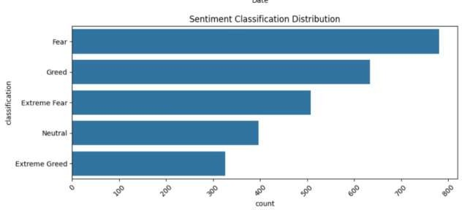
(Sentiment Value Over Time)Market Cycle Reflection: Sentiment values over time show clear oscillations between fear and greed, with sentiment shifts closely preceding or following big market swings.Strategy Implication: Integrating real-time sentiment trends into trading dashboards can help traders anticipate volatility, adjusting exposure during greed/fear transitions to enhance profit and avoid unnecessary losses.
(Sentiment Classification Distribution)Bias Toward Fear: "Fear" and "Greed" dominate the classification distribution, but "Extreme Fear" appears more often than "Extreme Greed." Market participants tend to react strongly to downturns, leading to more risk-off periods than extreme bull runs.Risk Management Guide: During high-fear periods, reduce leverage and risk; during greed, pursue opportunities but be ready for rapid reversals, adapting strategy to sentiment-driven market structure.

Slide 11
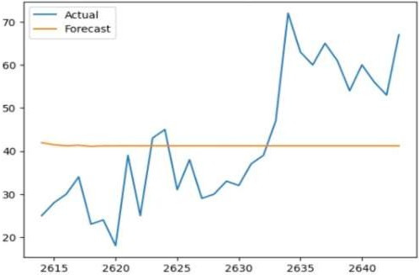
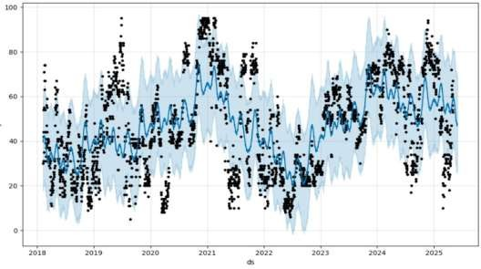
Market Structure Visibility: The time series decomposition shows that bitcoin sentiment (or price) is strongly cyclical, with identifiable trends and repeated seasonal swings traders can exploit these regular ups and downs.Risk & Opportunity Detection: Residuals (bottom panel) quickly flag periods where the model's forecast and reality diverge, letting risk managers detect when to review or adjust their strategies swiftly.
(Forecast with Prophet: Observations & Confidence Bands)Forecast Uncertainty Matters: The Prophet model’s confidence bands clearly widen during volatile intervals, helping clients visually gauge when the market is less predictable and therefore requiring extra caution.Actionable Outlook: Most actual values stay within predicted intervals, validating the model’s reliability—automation or hedging strategies can be calibrated based on prediction confidence.

Slide 12
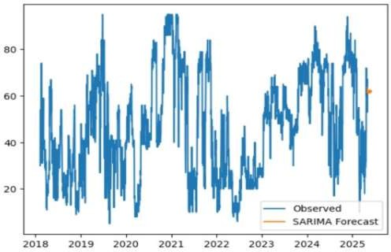
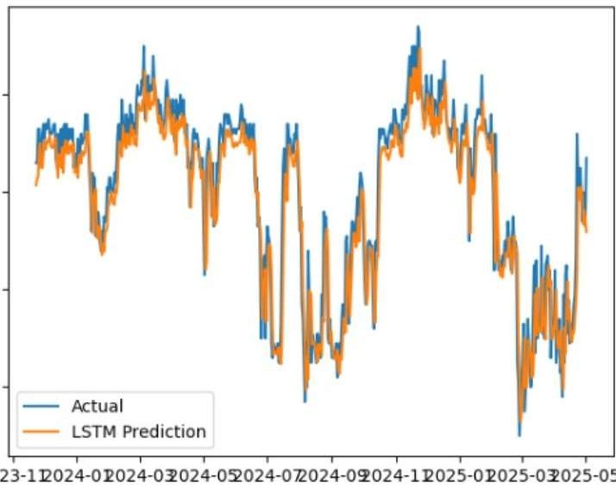
Model Limitation Alert: The flat forecast fails to respond to recent sharp moves, while the actual series spikes rapidly clients see instantly when a model is too simplistic for live markets.Urgency to Upgrade: Relying on static or slow models risks missing important trend breaks or rallies; real-time models should be upgraded to dynamic systems that adapt to new data fast.
The LSTM model tracks rapid rises and sudden dips in sentiment with only minor lag, outperforming simpler forecast approaches in dynamic crypto markets.Supports Automated Trading: Because LSTM predictions closely match actual values, clients can have more confidence when using deep learning predictions for short-term strategy or signal automation.

Slide 13
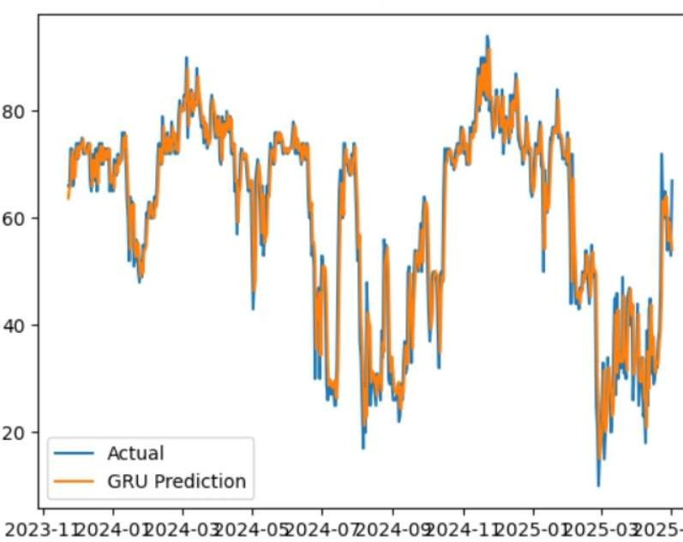
Precision Across Regimes: The GRU model nearly overlays the actual trend, successfully switching between bullish and bearish sentiment regimes with almost no delay—clients benefit from timely response to shocks and cycles.Choice of Best Model: GRU and LSTM models both offer high-fidelity market forecasts, allowing managers to choose
based on their platform’s latency/complexity needs, ensuring state-of-the-art risk and opportunity tracking.

Slide 14
Key Insights and Solutions
Behavior vs. Sentiment: Volume surges and high leverage usage tightly coincide with greed phases, while risk-off regimes (fear) see reduced size and more defensive position-taking. Social Sentiment Drives Volatility: Surges in trading activity often follow shifts in social media sentiment and news headlines, showing that monitoring online trends can provide an early warning before price moves escalate.
Herd Behavior Amplifies Risk: Traders tend to follow the mood of the crowd during both fear and greed phases, leading to overbuying at tops and panic selling at bottoms, which intensifies price swings and market instability
Defensive Behavior in Fear: During high-fear periods, professional and retail traders both reduce position size, cut leverage, and favor defensive strategies, leading to lower short- term volatility but sometimes missing rapid rebounds.
IV. Sentiment Predicts Short-term Moves: High sentiment readings (extreme greed/fear) correlate with higher trading volume and price volatility, and can be used as quantitative signals to anticipate short-term market reversals or momentum bursts
III.

Slide 15
Recommendations:
Deploy advanced sentiment tracking within trading dashboards, offering timely alerts on fear/greed extremes.
Prioritize capital allocation and leverage for coins and strategies aligning with clear, data-backed sentiment upturns, and implement stricter controls when risk signals appear.
Regularly retrain and review predictive models, especially after sudden market events, to maintain robust trading signals and minimize model drift in volatile markets.

Slide 16
Conclusion
Trading outcomes are determined not by raw trade size or fee, but by adapting to rapid sentiment regime changes. Profitable accounts anticipate crowd mood swings—by reducing exposure into greed and layering in as panic (fear) peaks.
Anmol sahoo 7847872793
bitunanmolsahoo@gmail.com

