Slide 1
Compiler Project
By - Soumyadeep Das
Parikshit Gehlaut
Vemula Chandrahaas Reddy
Anmol Kumar Sharma

Slide 2
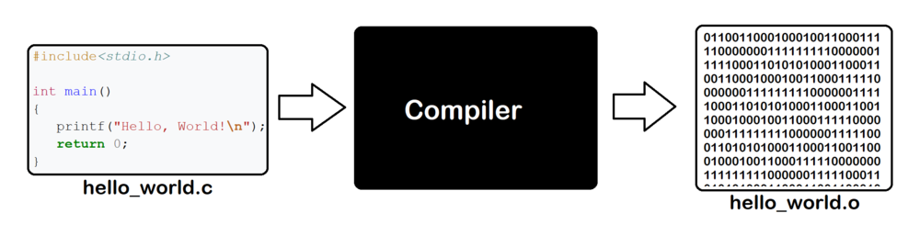
Compiler

Slide 3
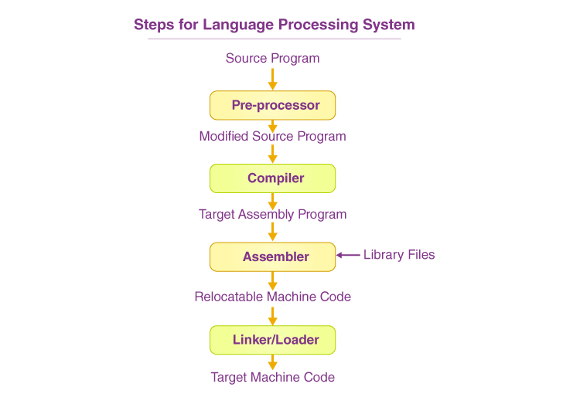
Steps for Language Processing System

Slide 4
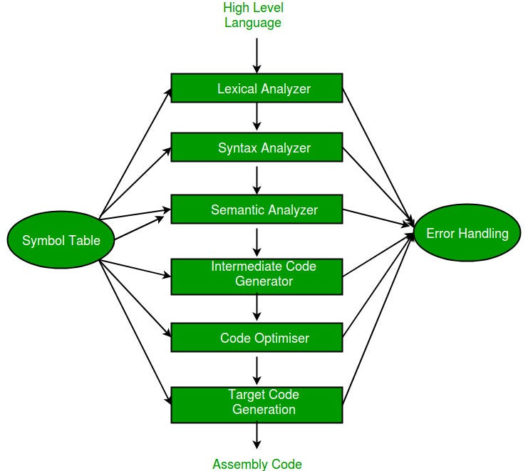
Different phases of compiler

Slide 5
Project
Implementation of lexical and syntax part of the compiler for the c++ language.

Slide 6

Lexical Analysis in c++

Slide 7
Lexical Analyzer in C++: Overview and Purpose
Source Code: 'int main() { float x = 3.14; float y = 3.15; float z = x + y; return 0; }' Serves as primary text
for analysis.
LexicalAnalyzer object is initialized with source code. tokenize() generates a vector of Token objects, processing the
code.
Displays each token's type and value for verification. This step clarifies the tokenization process for debugging.
Illustrates tokenized output: Type: KEYWORD, Value: int, Type: IDENTIFIER, Value: main, Type: PUNCTUATOR,
Value: (, etc.
Supplies structured output that helps in the subsequent stages of parsing in the compiler, streamlining processes.

Slide 8
Implementation Logic
TokenType (enum class): Defines token categories (e.g., KEYWORD, IDENTIFIER, INTEGER_LITERAL).
Token (struct): Pairs token type with its string value.
Private Methods: initKeywords(): Maps reserved words (e.g., “int”, “float”) to TokenType::KEYWORD.
Helper functions: isAlpha(), isDigit(), getNextWord(), getNextNumber().
Public Method: tokenize(): Scans input, categorizes characters, and builds a token vector

Slide 9
Input and Output
Input : "int main() { float x = 3.14; float y=3.15; "
"float z=x+y; return 0; }"
Output:
KEYWORD: int, IDENTIFIER: main, PUNCTUATOR: (, PUNCTUATOR: ), PUNCTUATOR: {
KEYWORD: float, IDENTIFIER: x, UNKNOWN: =, FLOAT_LITERAL: 3.14, PUNCTUATOR: ;
KEYWORD: float, IDENTIFIER: y, UNKNOWN: =, FLOAT_LITERAL: 3.15, PUNCTUATOR: ;
KEYWORD: float, IDENTIFIER: z, UNKNOWN: =, IDENTIFIER: x, OPERATOR: +, IDENTIFIER: y, PUNCTUATOR: ;
KEYWORD: return, INTEGER_LITERAL: 0, PUNCTUATOR: ;, PUNCTUATOR: }

Slide 10
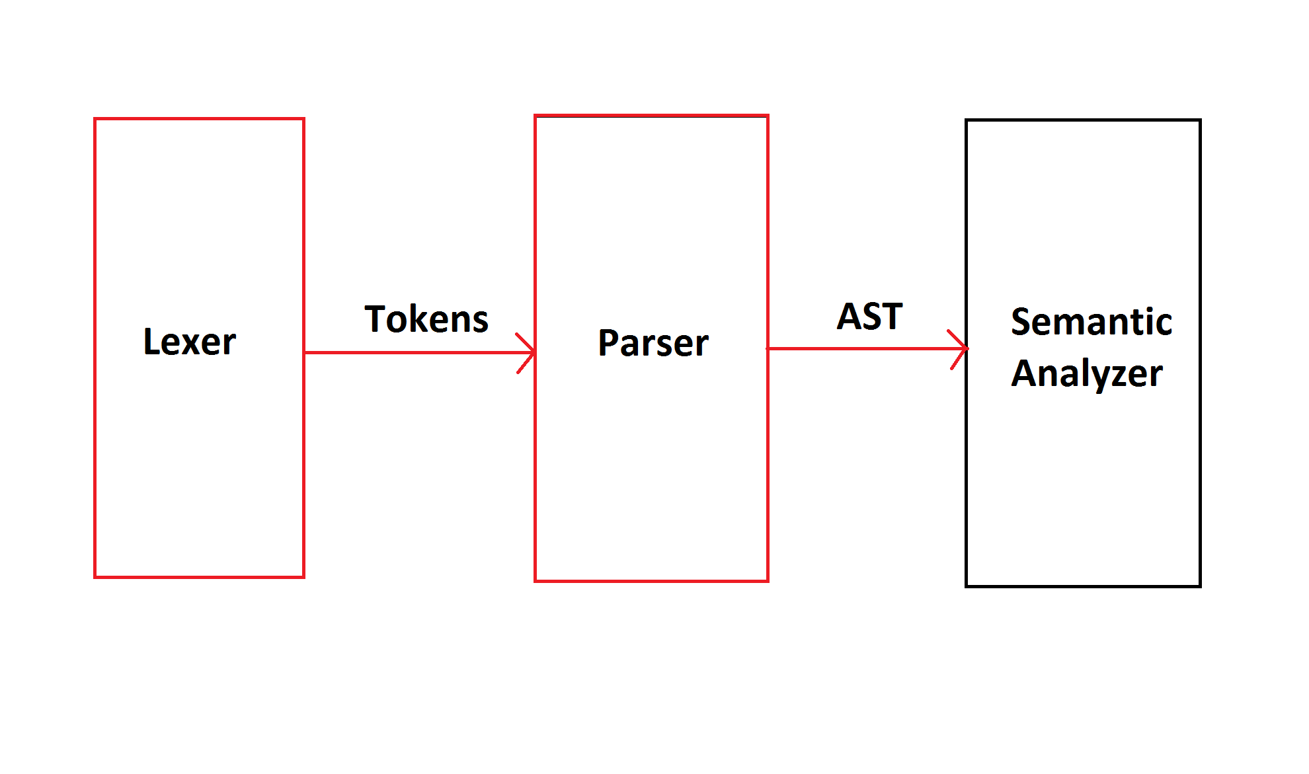
Parser Phase

Slide 11
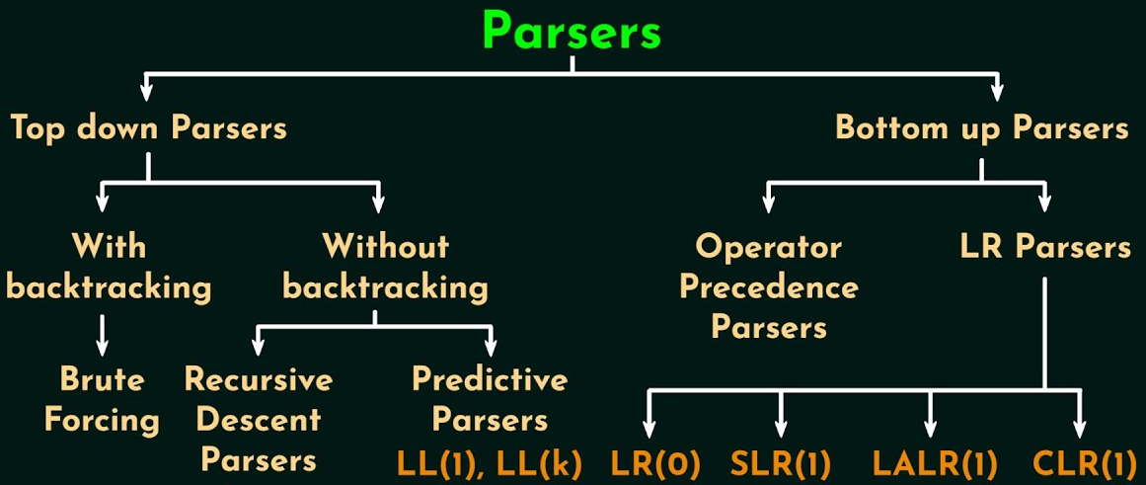
Parser Phase using LL(1)

Slide 12
The Parser's Promise
•
This C++ program's main goal is to make an LL(1) parser. It starts with a context-free grammar and ends by checking if input strings fit that grammar.
The program has parts like grammar rules, terminals, nonterminals, FIRST sets, FOLLOW sets, and a parse table to
check the grammar.
The program reads production rules from a file. It takes these rules to set up the grammar for analysis and
processing.
It can read test strings or accept interactive input, which checks input strings based on grammar.
The program displays the grammar and details. It also displays results from string checking. This gives you a full view of the process.

Slide 13
What It Does
Takes a grammar file, builds a parse table, and checks if input strings match the grammar.
Outputs detailed grammar info and string acceptance results.

Slide 14
Key Components
Grammar struct: Stores productions, terminals, nonterminals, FIRST/FOLLOW sets, and parse table.
Checker: Uses a stack to parse strings based on the table.
Computations: FIRST sets for derivation starts, FOLLOW sets for context, and a predictive parse table.

Slide 15
How It Works
Reads grammar → Computes FIRST/FOLLOW → Builds parse table → Tests strings.
Example: For input ab, it simulates derivations and checks validity.

Slide 16
Thank you

