Slide 1

Presentation on
Identifying Cardiovascular Disorders Through ECG Image Analysis
Sem: 8th
Mentor : Mrs. Himadri Vaidya
Submitted by: Devansh Rautela University Roll no./Section : 2018314/C
Mohit Bajeli University Roll no./Section : 2018491/E
Anmol Kumar University Roll no./Section : 2018185/C

Slide 2

Cardiovascular Diseases(CVDs)
Cardiovascular diseases(CVDs) are disorders that affect the heart and blood vessels and come under the non-communicable disorders category, causing an estimated 17.9 million people to die from CVDs. This represents 31% of all global deaths according to the published in 2020 by the World Health Organisation (WHO). According to the WHO report, the reason for about 85% of deaths was due to heart attacks and strokes. People at high risk of CVDs demonstrate elevated blood pressure, glucose levels, and an imbalance in the ECG or EKG. Early identification of those at the highest risk of CVD can help prevent it.

Slide 3
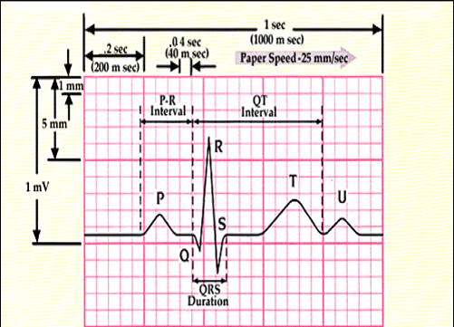
Electrocardiogram(ECG)
An electrocardiogram (ECG) is a crucial tool for assessing the electrical and muscular functions of the heart. It plays a key role in detecting cardiovascular diseases (CVD), which can be challenging to diagnose. Traditionally, ECG charts were maintained in paper form, making manual examination time-consuming and requiring specialized expertise. This research proposes a methodology to digitize ECG records, leveraging them to train machine learning models for cardiovascular disease detection. The primary focus is on identifying four major cardiac abnormalities: abnormal heartbeat, myocardial infarction, history of myocardial infarction, and a normal person class. Due to limited datasets, other categories cannot be classified with high accuracy.

Slide 4

Challenges
Data Collection Challenges: Acquiring diverse ECG datasets with expert-annotated labels poses a significant challenge due to limited availability and the need for specialized knowledge. Imbalanced datasets, where certain conditions are more prevalent, exacerbate the issue, potentially biasing model performance. Techniques such as data augmentation may be necessary to address this imbalance and ensure adequate representation of all classes.
Model Preparation Challenges: Model preparation for ECG analysis involves various hurdles. Preprocessing raw ECG signals is crucial to remove noise and artifacts, enhancing model accuracy. Selecting appropriate machine learning algorithms and optimizing hyperparameters require careful consideration to ensure optimal performance and interpretability. Extracting informative features from ECG signals demands expertise to capture relevant patterns effectively. Balancing model complexity with interpretability and computational efficiency is vital, particularly when handling multiple classes, which may require complex models or ensemble techniques for effective analysis.

Slide 5

Objective
Our project focuses on digitizing electrocardiogram (ECG) records to enhance cardiovascular disease (CVD) detection using machine learning. We aim to develop a system capable of accurately classifying digitized ECG images into various CVD categories. Key emphasis lies on leveraging machine learning techniques to optimize the process. Challenges such as acquiring diverse datasets with expert annotations and addressing data imbalance will be addressed through advanced machine learning algorithms. Preprocessing methods will be applied to refine ECG signals, while feature extraction techniques will capture crucial patterns associated with CVDs. Model selection and optimization will prioritize achieving both high accuracy and interpretability, ensuring clinical acceptance. Ultimately, our goal is to create a reliable system capable of early and precise CVD detection through digitized ECG records, thereby facilitating timely intervention and improving patient outcomes.

Slide 6
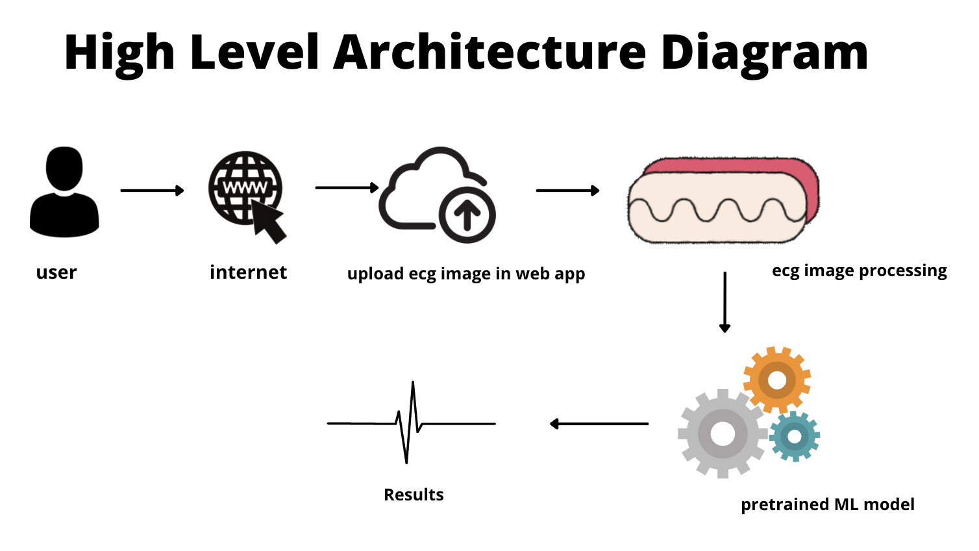
Frame Work

Slide 7
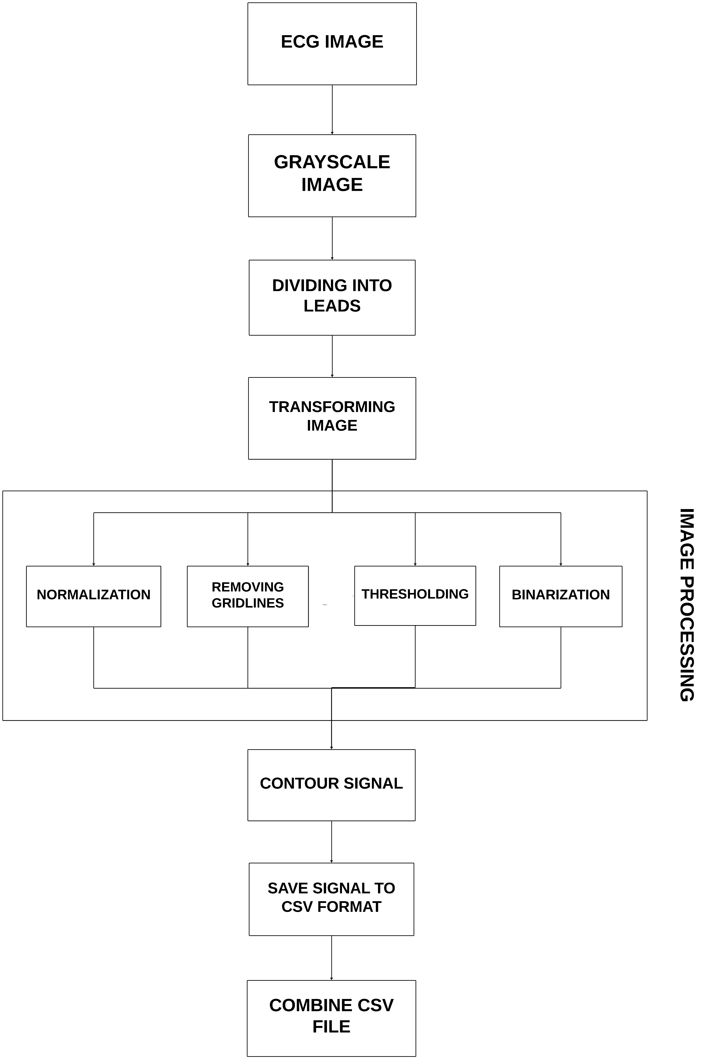
Methodology
Our project focuses on identifying various cardiovascular illnesses through the analysis of electrocardiogram (ECG) images, employing sophisticated preprocessing techniques and machine learning models. We curate a comprehensive dataset from reputable medical institutions, ensuring high quality and accuracy. The dataset comprises ECG images categorized into four classes: Myocardial Infarction, Abnormal Heartbeat, Normal, and History of MI. Preprocessing involves grayscale conversion, image validation, and lead extraction, enabling comprehensive cardiac information capture. Techniques such as smoothing, noise reduction, and thresholding are applied to enhance signal clarity. Signal extraction, normalization, and conversion into 1D signals facilitate subsequent analysis. Principal Component Analysis (PCA) is utilized for dimensionality reduction, aiding in refining the dataset for precise modeling.

Slide 8
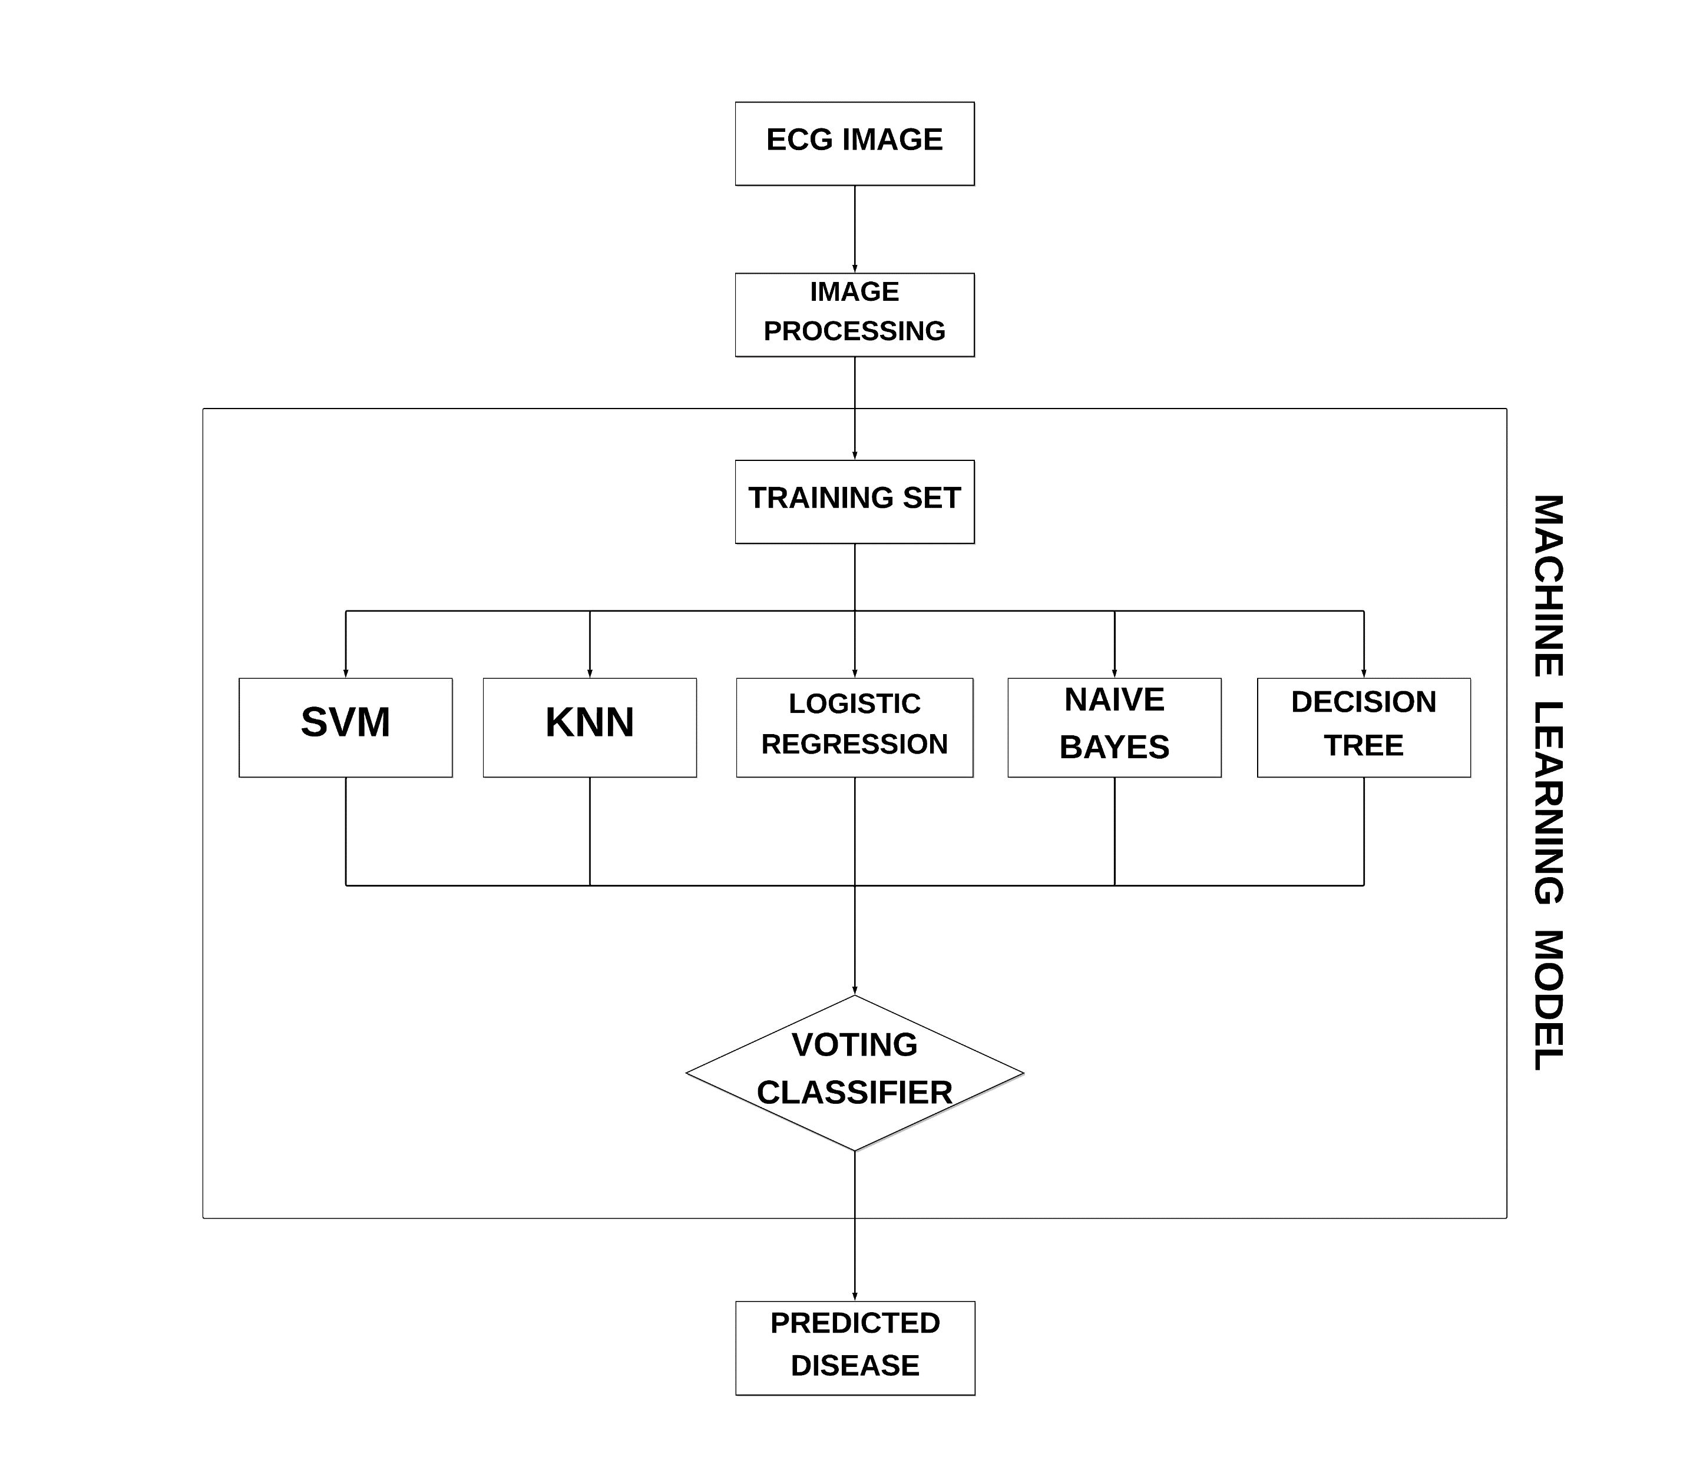
Process Flow
In our research, we employ a robust ensemble technique for accurate classification of cardiovascular disorders from ECG images. The ensemble includes Support Vector Machine (SVM), K-Nearest Neighbors (KNN), Random Forest (RF), Gaussian Naive Bayes (Bayes), Logistic Regression, and XGBoost models. A soft voting classifier combines the predictions of these models, considering the probability of each class. GridSearchCV optimizes hyperparameters to maximize performance. Our ensemble technique achieves 92.47% accuracy, showcasing its ability to leverage the strengths of multiple models for precise disorder identification.

Slide 9
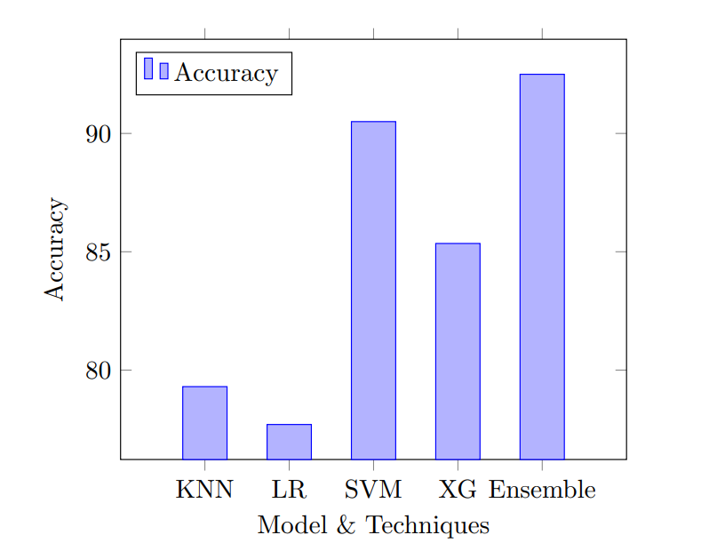
Result and Impact
Utilizing combined 12-lead data significantly enhances model accuracy compared to single-lead data. Consequently, only combined 12-lead data is utilized in our research, resulting in improved model performance. Employing a Voting-based Ensemble Classification with GridSearchCV for hyperparameter tuning achieves an impressive accuracy of 92.5%. Compared to individual models, including SVM (90.5%), KNN (79.3%), Logistic Regression (77.6%), and XGBoost (85.3%), the ensemble approach outperforms, showcasing balanced weaknesses and enhancing cardiovascular disorder detection in ECG data. Comparative analysis reveals higher accuracy due to well-preprocessed ECG datasets and the utilization of various algorithms, contrasting with prior studies limited by data preprocessing and feature complexity.

Slide 10
Summary
In conclusion, our study highlights the consistently robust performance of SVM, especially with the combined 12-leads dataset, showcasing improved prediction capabilities. Integration of ensemble models via Voting Classifier further enhances performance by balancing individual weaknesses and strengths. Utilizing pre-processed ECG data, SVM and XGBoost achieve commendable accuracy. Refined datasets can aid in further development, potentially leveraging deep learning models. Ethical considerations, including data privacy and bias mitigation, are crucial in interpreting and deploying these models for cardiovascular disease detection. Real-time validation underscores their practical efficacy in clinical scenarios, offering promising prospects for application in cardiovascular disorder identification through ECG image analysis.

