Slide 1
Prediction of Human Health Risks to Agrochemicals using Machine Learning
DATA 245: Machine Learning Technologies
Ann Maria John, Padmini Arra, Priyanka Bhyregowda, Sahana Thoravalli Prabhuswamy, Supriya Vasagiri

Slide 2
OBJECTIVE
Exposure to pesticides has many side effects - cancers, renal failures, immune suppression, genetic disorders, etc.
Predominant in Agricultural practices, Pesticide Manufacturing Units, Pesticide Waste treatment plants
Data from the National Health and Nutrition Examination Survey (NHANES) from 2015 to 2016 across the U.S. from different groups
Optimal model to classify people into higher risk and lower risk of diagnosing renal failure and other health issues
Random Forest classifier, KNN, Decision tree classifier, support vector machines (SVM), logistic regression
Feature selection like selectKbest and getting p-significant features
Oversampling - SMOTE, ADASYN, Borderline SMOTE, SMOTENC
Imputation - Mean, Constant, KNN
Accuracy, Precision, F1 score, Recall for metrics

Slide 3
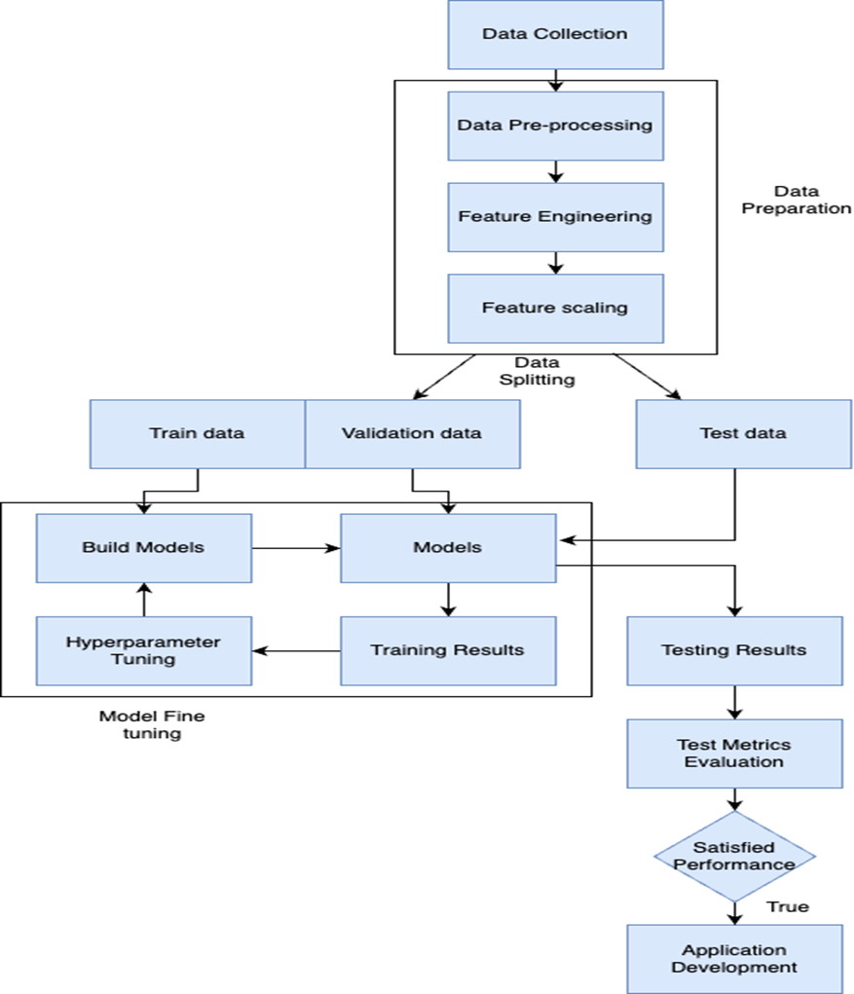
MODEL ARCHITECTURE

Slide 4
LITERATURE SURVEY:
[1] The drive to improve crop yields and lack of agricultural land availability has led to undaunted use of Agrichemicals. Pesticides are Agrochemicals that consist of insecticides, fungicides, herbicides, etc., and have harmful impacts on the environment including animals, birds, and plants.
[2] and [3] A class of pesticide called Highly Hazardous Pesticide poses extreme irreversible health risks to humans and the impact is molecular level interaction with proteins.
[4] Unprecedented use of pesticides has increased cancer cases, infertility, and birth defects such as mental retardation in the Malwa region of Punjab. Machine learning models are becoming popular in risk prediction due to the over-usage of pesticides.
[5] identified pesticide-exposed risky sites in China using two semi-supervised models based on self-learning. [
6] used ANN to predict the quantities of various agrochemicals required for rice cultivation in the Punjab region, Pakistan, such that, there is an increase in rice production with limited usage of agrochemicals. A Poisson regression model was used to confirm that pesticide poisoning caused eye and skin irritation, nausea, and cough during pesticide application. A negative binomial regression model predicted that by using protective measures the health hazards can be significantly reduced.
[7] proposed different machine-learning models to determine severe respiratory failure among patients with acute pesticide poisoning.
[8] provided evidence for chronic kidney condition due to pesticide malathion exposure in the USA. [
9] Involved in predicting the toxicity of hazardous chemicals for human health. So, for this, HNN (Hybrid Neural Network) and CNN (Convolutional Neural Networks) were used along with some machine learning techniques like Random Forest and adaptive Boosting for identifying the toxic chemicals, and the overall performance of the model was evaluated using AUC (Area Under Curve). They also divided the toxins into different categories of severity.
[10] involved in predicting the toxicity of chemical gases. So, for this, the implementation of different machine learning techniques like K-nearest neighbor, BayesNet, and K star classifiers were used. Feature selection technique was used to select the relevant features for the models. Also developed a binary classification model that focused on detecting toxic gases in different scenarios like laboratories, chemical warfares, and hazardous gas leakage incidents.

Slide 5
DATA COLLECTION
The dataset encompasses information about exposure to pesticides and was downloaded from the National Health and Nutrition Examination Survey (NHANES).
There is a total of 39 .csv files related to questionnaires, pesticides, and renal function.
The data was pooled from the 2015-2016 study wave and has details related to pesticides, participant information, and their corresponding lab results.
The laboratory files related to agrochemicals and renal function are downloaded from the NHANES website for 2015-2016 and the pesticide concentrations from urine tests from the respective csv’s are extracted and merged with the questionnaires data on SEQN which is patient id.
Target variable is derived from UACR which is Urine Albumin and creatinine ratio. If the ratio of UACR is >30(mg/g) then it is considered as reduced kidney function.

Slide 6
DATA PREPROCESSING
The merged dataset of questionnaires and laboratory data with renal function as our target variable is used in preprocessing.
Features like SEQN, and columns with only zeros and 1’s are dropped (Drug Addict, Dialysis, asthma, asthma_current, current_chronic bronchitis).
All categorical features are converted using dummy encoding and the first column is dropped to avoid overfitting.
Feature ‘Gender’ is mapped to binary values

Slide 7
EDA
The dataset has 6221 rows and 79 columns.
78 feature variables and ‘UACR’ is the target variable.
The dataset has imbalance w.r.t target
There are 40 columns with missing values(constant imputation, KNN imputation, and median Imputation)
There are 49 features with binary categories, 2 features with more than 2 categories, and 26 features with numerical variables.
The 2 multi-category features are encoded using get_dummy encoding and converted into binary categories.

Slide 8
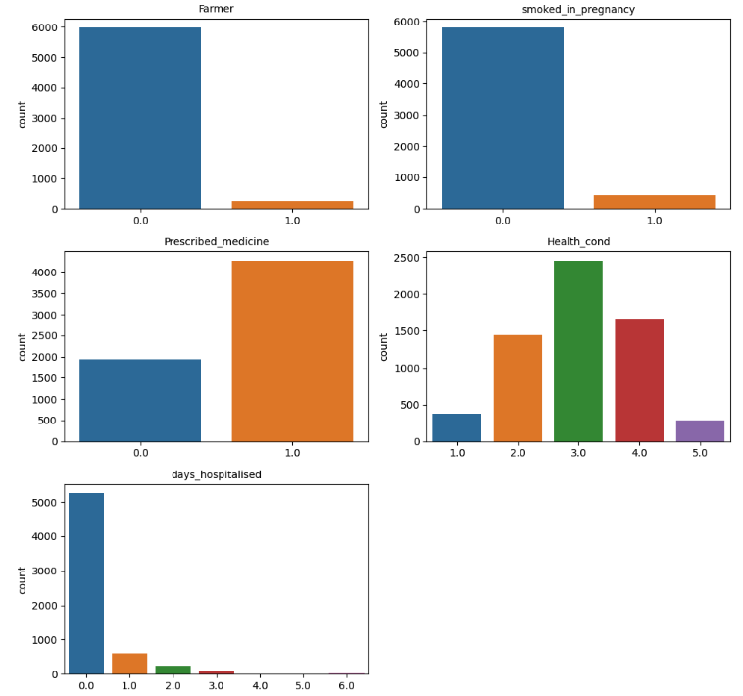
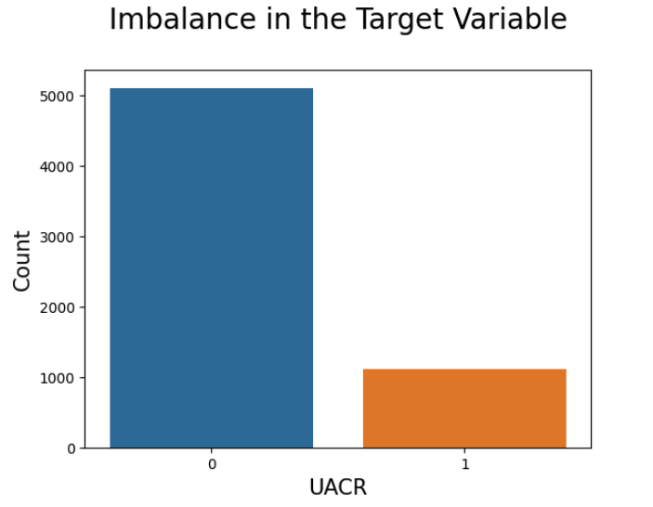
EDA

Slide 9
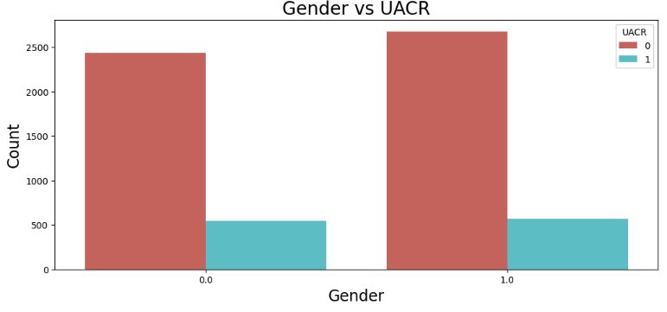
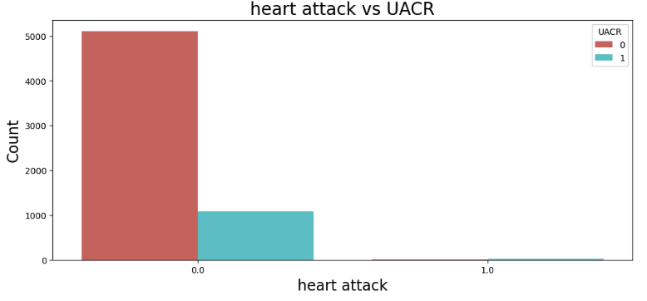
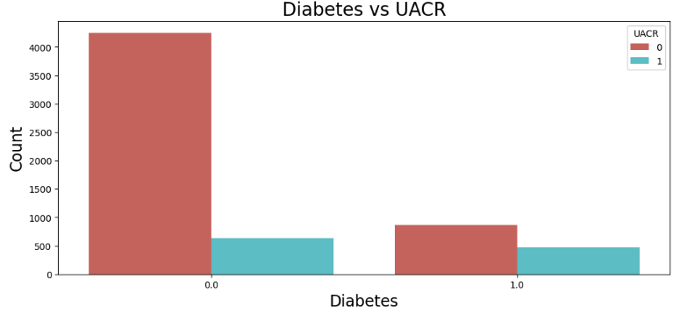
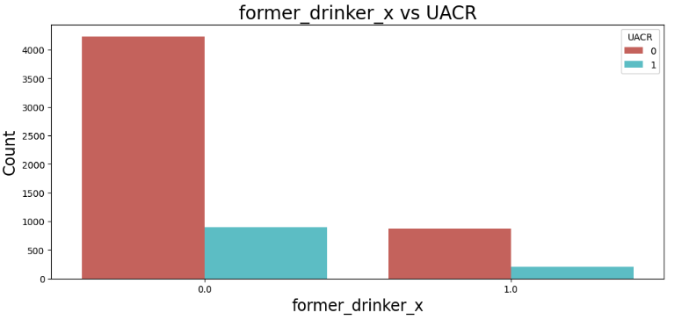
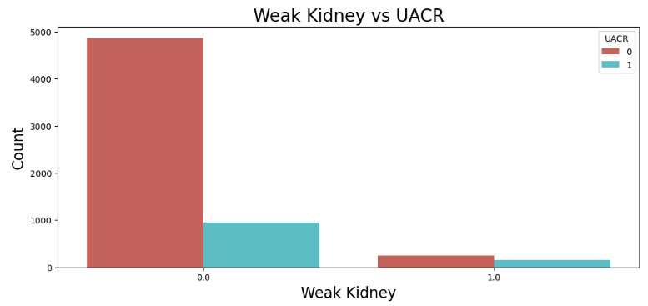
EDA

Slide 10
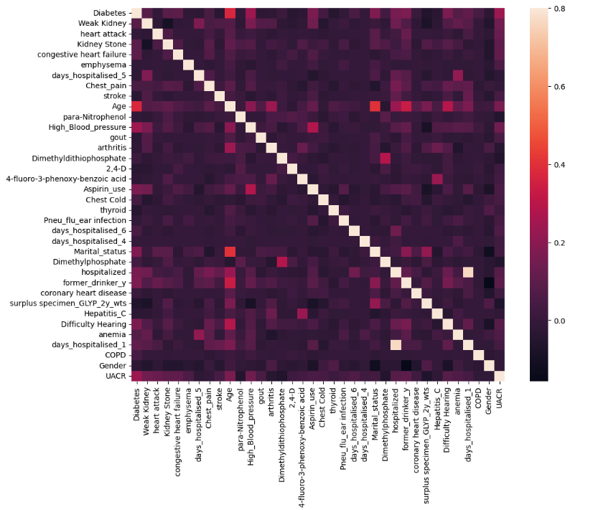
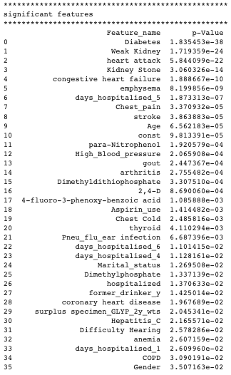
EDA

Slide 11
FEATURE SELECTION
P-value significant feature selection - Ordinary least square method from statsmodel is used to determine the p-values for each feature and features with p-values above 0.05 are ignored because of lack of significance.
SelectKbest - mutual_info_classif parameter is used to find the dependency between features and target variables and rank them to select the k best out of it.
Recursive feature elimination - RandomForest estimator is used to recursively fit the model with a smaller set of features each time and get the feature importance. The process is repeated until we get the desired number of features.

Slide 12
DIMENSION REDUCTION
A Few dimensionality reduction techniques like FAMD (Factor Analysis for Mixed Data) and Kernel PCA (Principal Component Analysis) were employed in the process of model development.
Since the results obtained after applying the dimension reduction techniques were poor, these techniques were not used during the hyperparameter tuning of various models.

Slide 13
STANDARDIZATION
TRAIN-TEST SPLIT
After the train test split is performed, the train data is fitted and transformed using the Column transformer where the numerical features are standardized using the StandardScaler() function from Sklearn, the binary features are bypassed, and the test data is transformed.
It is important to use standardization techniques when we are using Machine learning algorithms such as K nearest neighbors(KNN) and Support Vector Machines(SVM) as these algorithms are sensitive to the scale of input features.
We have used Sklearn train_test_split for splitting the data. The data is split into 80:20 ratio.

Slide 14
MISSING DATA IMPUTATION
Missing data is common in all study and survey designs. We use three methods for missing value imputation:
Replacing with constant value
A constant value of -1 was used to replace the missing values in the dataset.
Using a constant helps simplify the analysis and helps to maintain the consistency of the dataset.
This also prevents the introduction of bias into the analysis.
Replacing with median value
Median is the middlemost value. ‘fillna’ method was used to impute for missing data using median
k-Nearest Neighbor (KNN) Imputer
KNN imputer substitutes missing values using distance functions.
KNN works well with non-linear data.
KNN may provide better performance.
It works well on small to medium-sized datasets owing to the computational cost associated with it.

Slide 15
OVERSAMPLING
The dataset had approximately 5,000 instances where the target variable urine albumin-creatinine ratio(uACR) indicates no effect and about 1,000 instances where it indicates an effect due to pesticide exposure.
Balancing - oversampling and undersampling
Synthetic Minority Oversampling Technique (SMOTE)
For each minority class instance, SMOTE generates a synthetic example by considering its k-nearest neighbors(KNN) and creating new instances along the line segments connecting the instance with its neighbors.
SMOTE-NC
Smote extends the capability to handle datasets with a mix of numerical and continuous features. For numerical features, it uses a similar approach to the original SMOTE by interpolating between existing instances. For categorical features, it handles them in a way that ensures the synthetic instances preserve the categorical characteristics.
Borderline-SMOTE
It identifies instances that are misclassified or near the decision boundary between minority and majority classes and applies SMOTE to them.
ADASYN (Adaptive Synthetic Sampling)
ADASYN applies the KNN algorithm in the minority class that are difficult to classify based on the density of their local neighborhood. Instances in regions with fewer instances are considered to be more challenging.
More synthetic samples are generated in these challenging regions to address the imbalance.

Slide 16
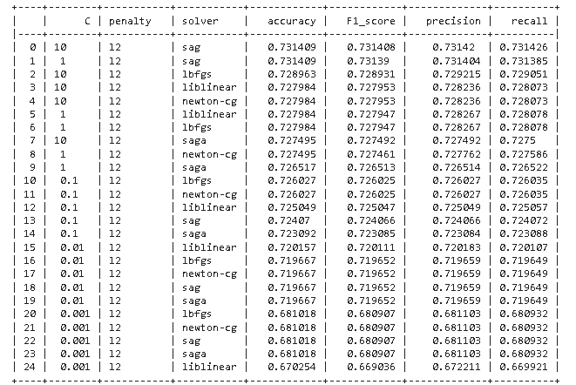
LOGISTIC REGRESSION
The optimal hyperparameter configuration was identified as follows:
Regularization parameter (C) = 10
Penalty term specified as L2 (due to compatibility constraints with the selected solvers—SAG and LBFGS—where L1 was not applicable)
solver = sag
Accuracy, F1 score, Precision, and Recall for different hyperparameters

Slide 17
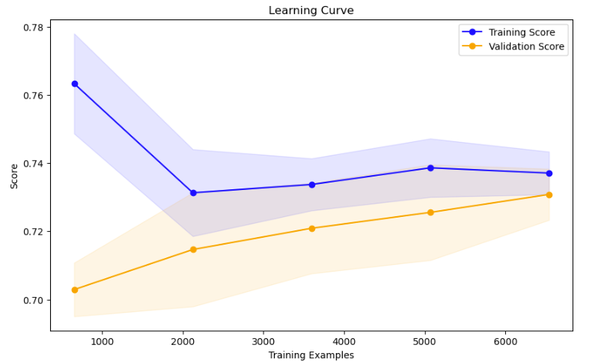
LOGISTIC REGRESSION

Slide 18
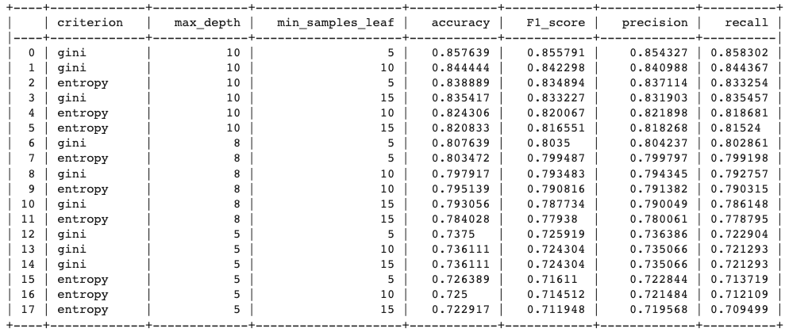
DECISION TREE
The optimal parameters were found to be
max_depth = 10
min_sample_leaf = 5
criterion = gini
Accuracy, F1 score, Precision, and Recall for different hyperparameters
Optimal Decision Tree

Slide 19
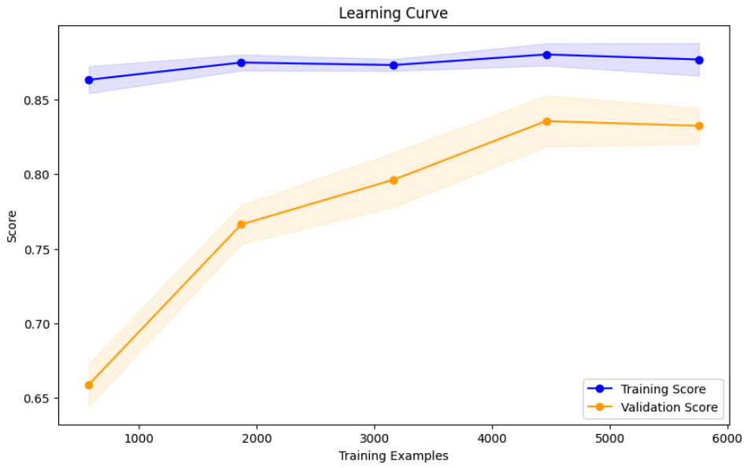
DECISION TREE

Slide 20
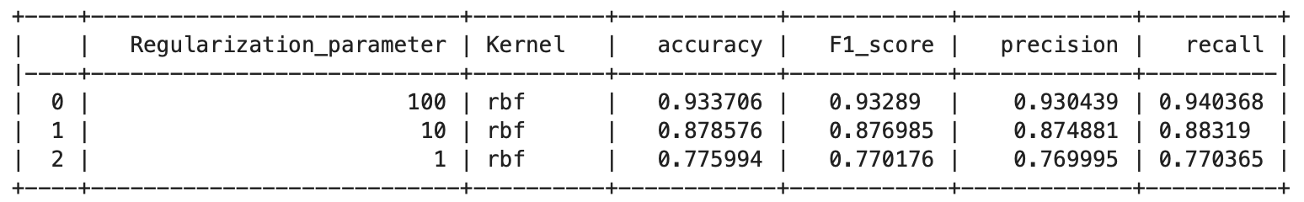
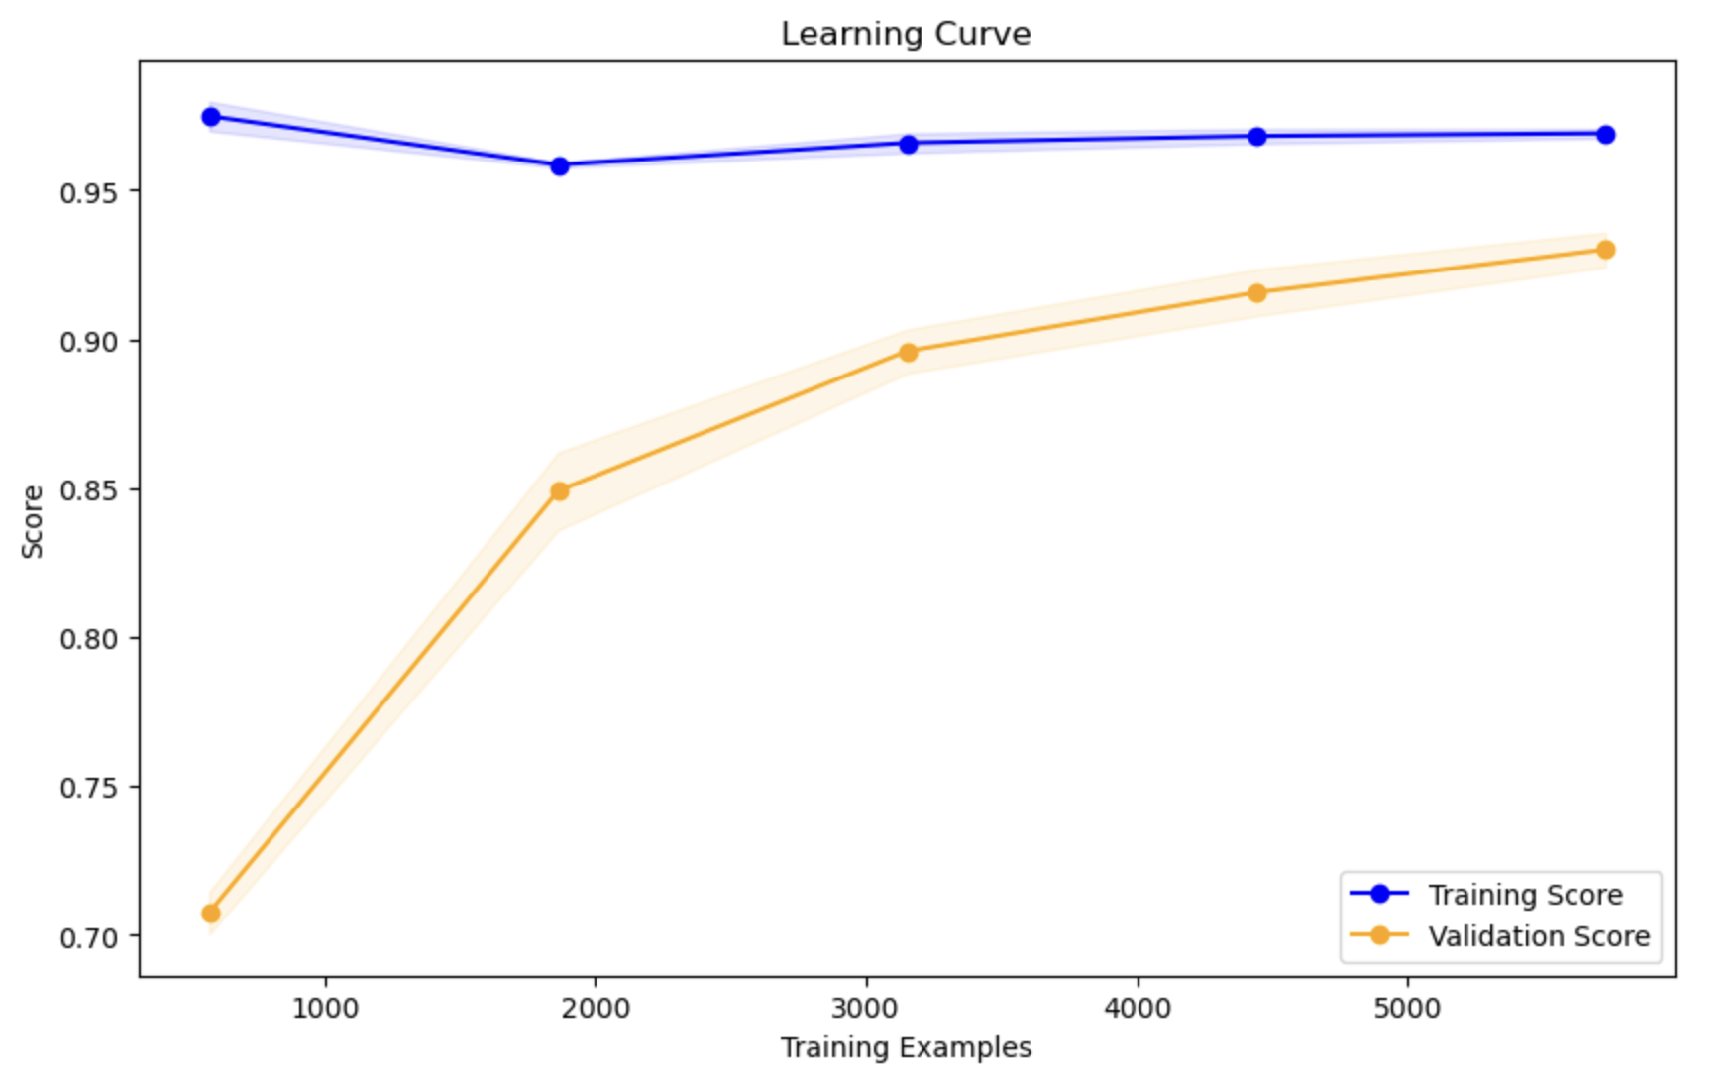
SUPPORT VECTOR CLASSIFIER
The optimal parameters were found to be
c=100
Kernel = rbf

Slide 21
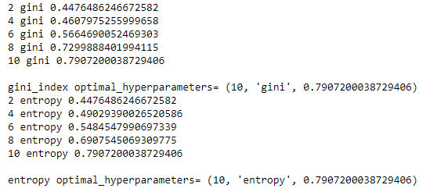
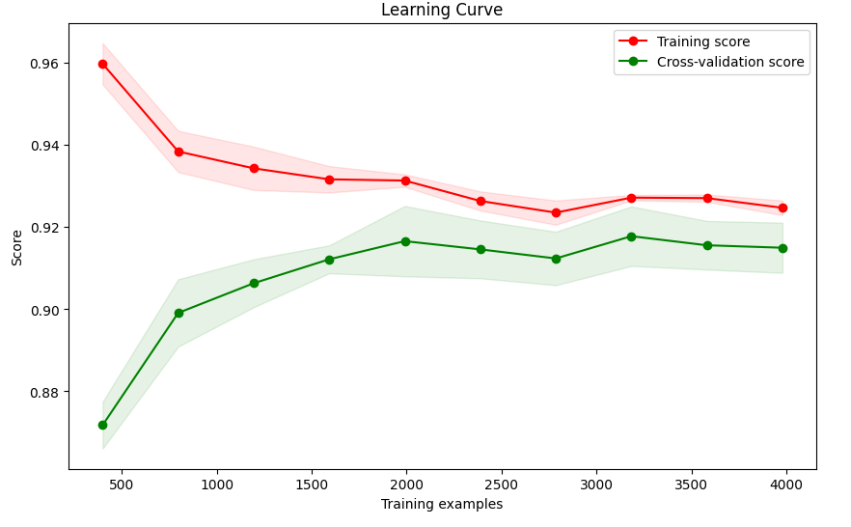
RANDOM FOREST
Optimal hyperparameter
max depth=10 and n_estimators=100

Slide 22
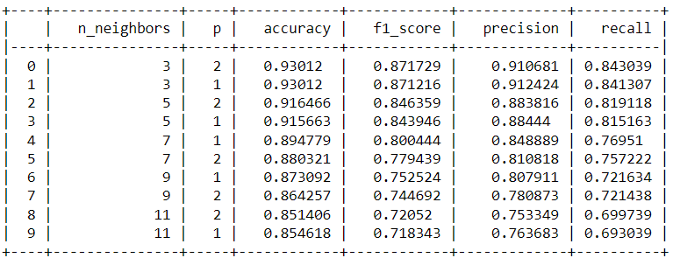
K-Nearest Neighbors (KNN)
Optimal parameter:
n_neighbors = 3
p = 2

Slide 23
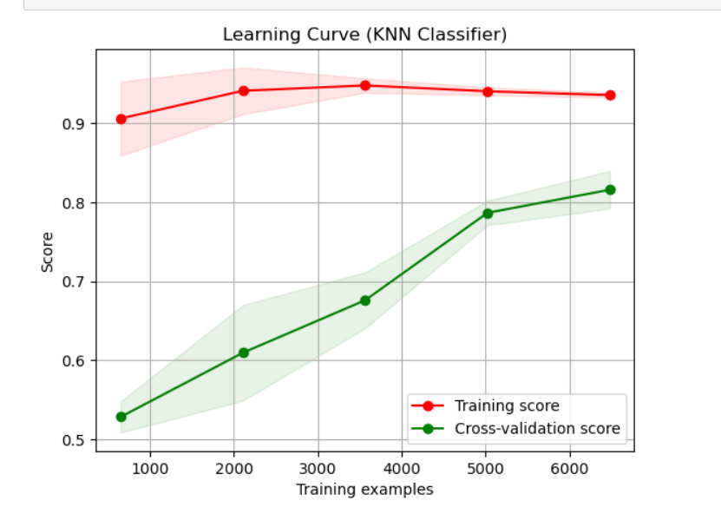
K-Nearest Neighbors (KNN)

Slide 24

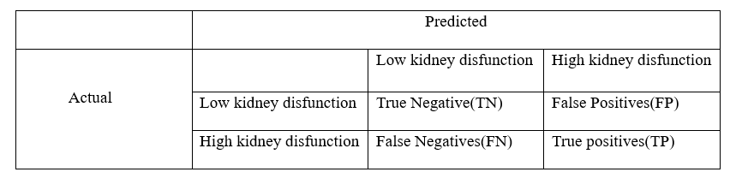
Evaluation Results
Binary classification and imbalance data problem:
Precision, Recall, F1-score is preferred over accuracy
All the metrics covered in class are evaluated
Confusion Matrix

Slide 25
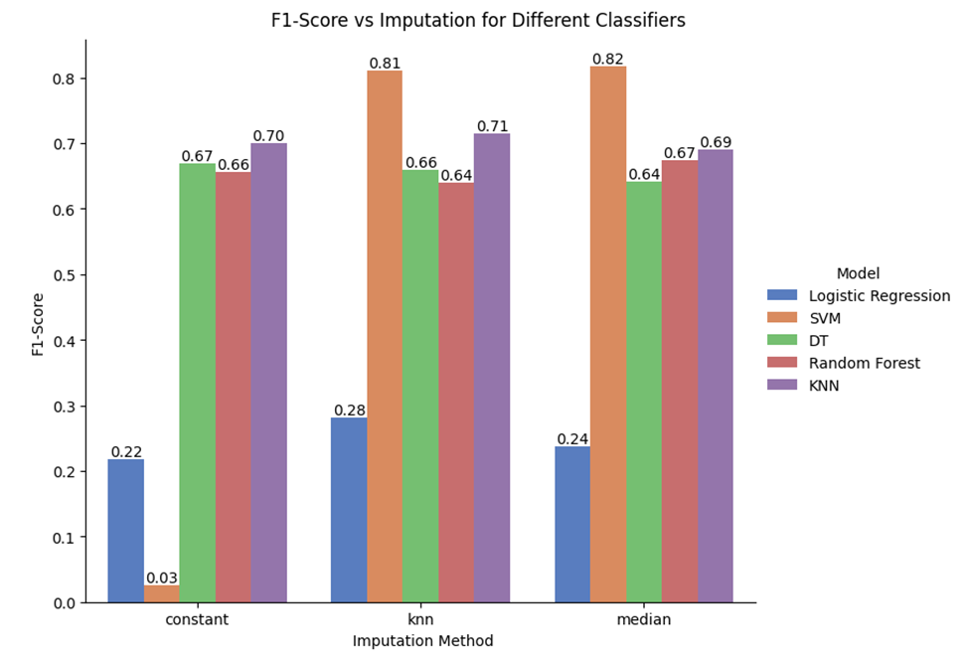
F1-score Vs Imputation techniques

Slide 26
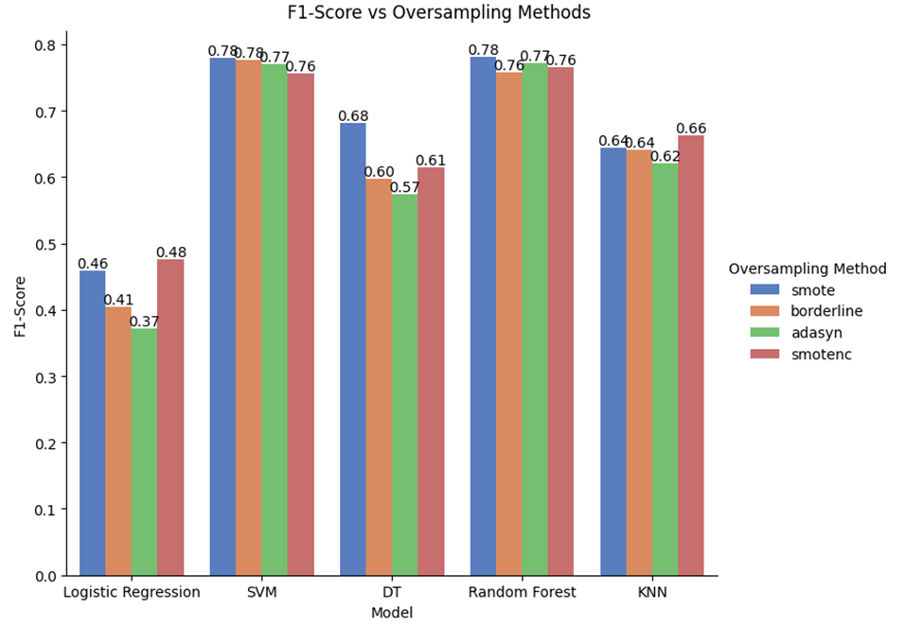
F1-score for different classifier vs Oversampling techniques with KNN Imputation

Slide 27
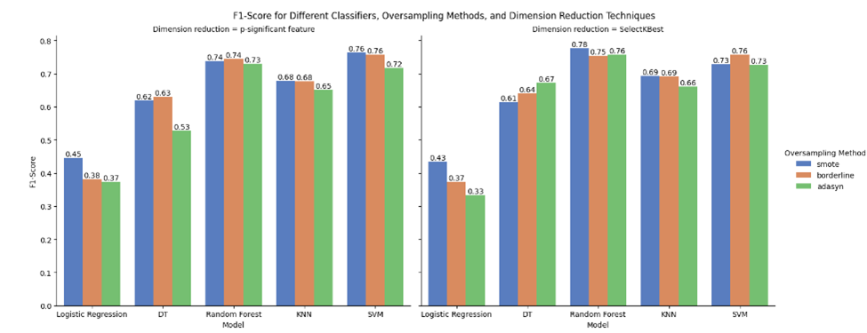
F1-score Vs Oversampling techniques with KNN Imputation for different feature selection methods

Slide 28
Conclusion
Different models such as LR, SVM, DT, KNN and Random Forest were evaluated for pesticide exposure prediction
Different Imputation techniques were explored - Constant, Median, KNN
Different Oversampling techniques were used - SMOTE, SMOTE NC, Borderline SMOTE, ADASYN
Different Feature selection techniques were used - p significance, SelecKbest, RFE
Dimension Reduction - PCA, FAMD explored but performed poorly
SVM and Random Forest classifier performed better for different feature selection methods and oversampling techniques.

Slide 29
KEY LEARNINGS:
If we grow a tree to max depth, overfitting occurs
SVM and Random Forest perform well overall
KNN imputation results in best results - ideal
Different models perform differently for different feature selection methods, imputation methods and oversampling methods.
Hyper-parameter tuning is crucial to get the best results.

Slide 30
REFERENCES
[1] Aktar, M. W., Sengupta, D., & Chowdhury, A. (2009). Impact of pesticides use in agriculture: their benefits and hazards. Interdisciplinary toxicology, 2(1), 1–12. https://doi.org/10.2478/v10102-009-0001-7
[2] WHO/FAO (2014) International Code of Conduct on pesticide management. Food and Agriculture Organization of the United Nations/World Health Organization, Rome/Geneva
[3] Sharma, A. K., Gaur, K., Tiwari, R. K., & Gaur, M. S. (2011). Computational interaction analysis of organophosphorus pesticides with different metabolic proteins in humans. Journal of biomedical research, 25(5), 335–347. https://doi.org/10.1016/S1674-8301(11)60045-6
[4] Mittal, S., Kaur, G., & Vishwakarma, G. S. (2014). Effects of environmental pesticides on the health of rural communities in the Malwa Region of Punjab, India: A review. Human and Ecological Risk Assessment, 20, 366–387.
[5] Wang, X., Yu, D., Ma, L., Lu, X., Song, J., & Lei, M. (2022). Using big data searching and machine learning to predict human health risk probability from pesticide site soils in China. Journal of environmental management, 320, 115798. https://doi.org/10.1016/j.jenvman.2022.115798
[6] Ehsan Elahi, Cui Weijun, Huiming Zhang, Majid Nazeer, Agricultural intensification and damages to human health in relation to agrochemicals: Application of artificial intelligence, Land Use Policy, Volume 83, 2019, Pages 461-474, ISSN 0264-8377. https://doi.org/10.1016/j.landusepol.2019.02.023.
[7] Kim, Yeongmin, Minsu Chae, Namjun Cho, Hyowook Gil, and Hwamin Lee. 2022. "Machine Learning-Based Prediction Models of Acute Respiratory Failure in Patients with Acute Pesticide Poisoning" Mathematics 10, no. 24: 4633. https://doi.org/10.3390/math10244633
[8] Wan, E. T., Darssan, D., Karatela, S., Reid, S. A., & Osborne, N. J. (2021). Association of Pesticides and Kidney Function among Adults in the US Population 2001-2010. International journal of environmental research and public health, 18(19), 10249. https://doi.org/10.3390/ijerph181910249
[9] Sarita Limbu , Cyril Zakka & Sivanesan Dakshanamurthy. (2022). Predicting Environmental Chemical Toxicity using a New Hybrid Deep Machine Learning Method. https://www.mdpi.com/2305-6304/10/11/706
[10] Ahmet Murat Erturan , Gül Karaduman , Habibe Durmaz. (2023). Machine learning-based approach for efficient prediction of toxicity of chemical gases using feature selection. Journal of Hazardous Materials volume 455, 5 August 2023, 131616. https://doi.org/10.1016/j.jhazmat.2023.1316

