Slide 1
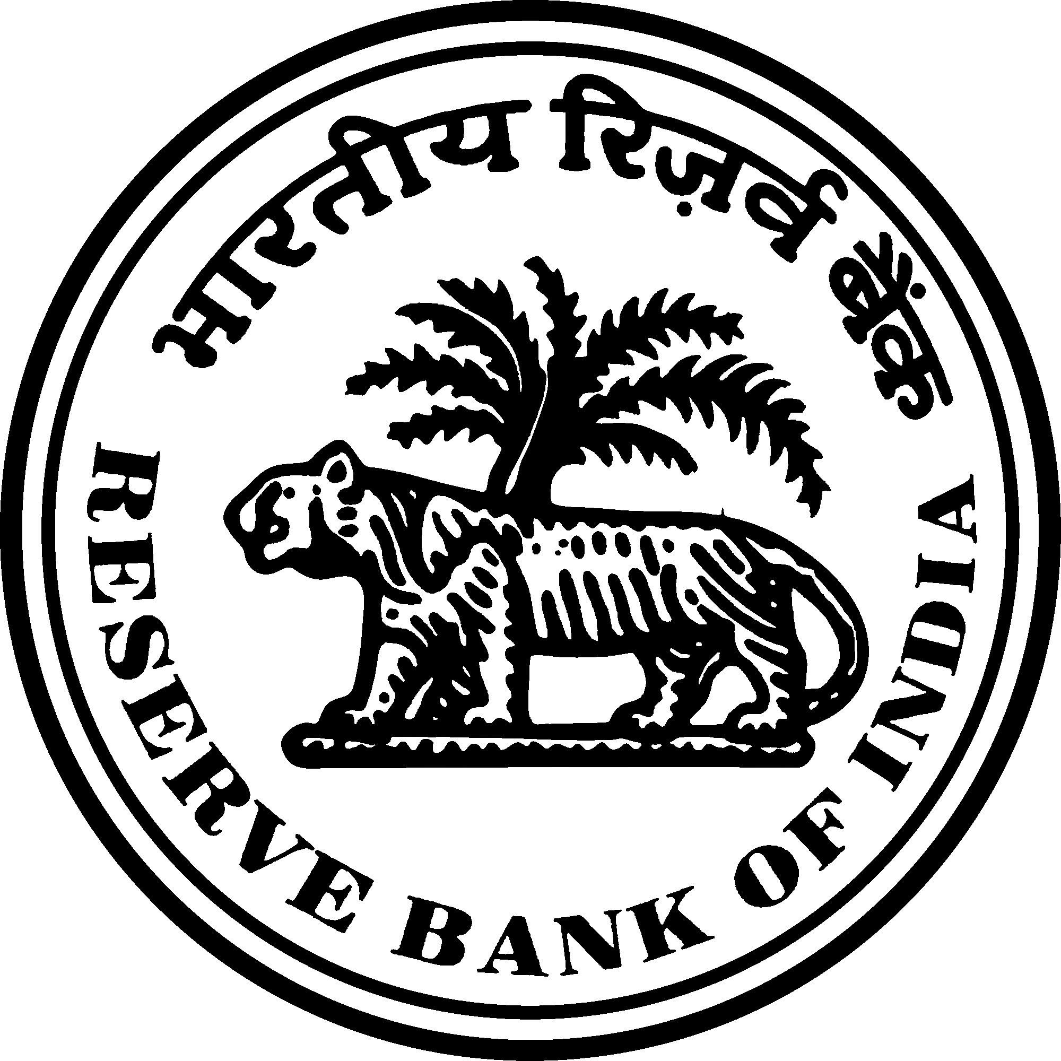
Measuring Financial Inclusion Across Indian States:
A Two-Stage PCA Approach
PRESENTED BY
SUPERVISOR
Anwesha Das
Dr. Avijit Joarder
Master of Arts in Economics (Specialization in Trade and Finance)
Director, Department of Statistics and Information Management (DSIM)
Indian Institute of Foreign Trade (IIFT), Kolkata
Reserve Bank of India

Slide 2
SLIDE 02 · INTRODUCTION
BACKGROUND
Financial inclusion underpins inclusive growth enabling savings, credit access and risk management.
RBI publishes its official Financial Inclusion Index only at the national level.
The National Average Conceals the State-Level Reality
MOTIVATION & RESEARCH GAP
Financial exclusion deepens income inequality and pushes households toward costly informal finance (Honohan, 2008; Sarma & Pais, 2011). No single indicator captures financial inclusion, and national averages hide sharp interstate gaps.
Existing studies rarely test more than one methodology on the same data.
Two-stage PCA remains largely untested at the state level in India. Few Indian indices are validated against the RBI's own Financial Inclusion Index.
India's national progress in financial inclusion masks sharp and persistent disparities across states ,
differences that a single national index cannot reveal.
OBJECTIVES
①
Construct & validate a two-stage PCA-based FII; extend to 28 states
②
Construct state-level FIIs using Sarma's distance-based methodology
③
Compare both methodologies for consistency and robustness
④
Analyse spatial and temporal patterns of interstate disparity
Reserve Bank of India · Department of Statistics and Information Management

Slide 3
SLIDE 03 · DATA & METHODOLOGY
One Indicator Framework, Two Complementary Datasets
NATIONAL DATASET
STATE PANEL DATASET
2004–05 to 2024–25 · Annual, all-India
28 Indian States · 2016–17 to 2024–25
Used to estimate the two-stage PCA framework and derive dimension & composite weights
Validates the resulting national index against the RBI FI-Index
Same ten indicators compiled consistently across states and years
Used for comparative, state-level analysis of financial inclusion
Dimension and composite weights estimated from the national dataset are applied in constructing the state-level index the two datasets remain independent inputs.
THREE DIMENSIONS OF FINANCIAL INCLUSION
PENETRATION
AVAILABILITY
USAGE
Deposit Accounts (DEP_ACC)
Bank Offices (SCB_OFF)
Deposits per Capita (DEP_PC)
Credit Accounts (CR_ACC)
Rural Bank Offices (SCB_OFF_R)
Credit Outstanding per Capita (CR_OUT_PC)
Bank Employees / Deposit A/Cs (EMP)
Insurance Density (INS_DEN)
Insurance Offices (INS_OFF)
Internet Subscribers (INT_SUB)
Sources: RBI · EPWRF · IRDAI · TRAI · UIDAI
Reserve Bank of India · Department of Statistics and Information Management

Slide 4
SLIDE 04 · DATA & METHODOLOGY
Selecting Financial Inclusion Indicators
The study uses a focused set of state-level indicators to capture the multidimensional nature of financial inclusion.
The RBI FI-Index uses 97 indicators for national monitoring. This study selects 10 consistently available state-level indicators that provide broad coverage of the three dimensions of financial inclusion while ensuring comparability across states and over time.
VARIABLE
JUSTIFICATION FOR INCLUSION
Deposit Accounts
Measures banking penetration through account ownership.
Credit Accounts
Captures access to formal credit.
SCB Offices
Reflects the availability of banking infrastructure.
Rural SCB Offices
Measures rural financial outreach.
Bank Employees
Indicates the banking system's service capacity.
Insurance Offices
Captures physical access to insurance services.
Internet Subscribers
Proxies digital financial infrastructure.
Deposits per Capita
Reflects utilisation of formal savings services.
Credit Outstanding per Capita
Measures utilisation of institutional credit.
Insurance Density
Captures utilisation of formal insurance services.
Reserve Bank of India · Department of Statistics and Information Management

Slide 5
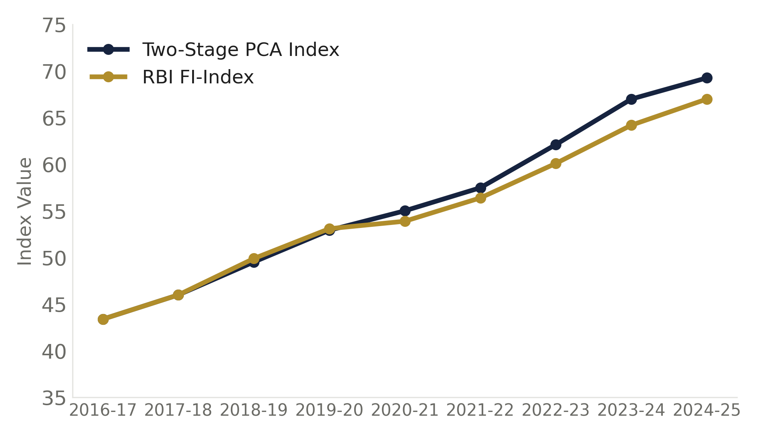
SLIDE 05 · DATA & METHODOLOGY
A Hierarchical Two-Stage PCA Methodology
Each dimension is summarised on its own terms first, so no dimension dominates the index simply by having more correlated indicators.
INPUT
DATA SUITABILITY
10 Financial Inclusion Indicators
verified before estimation
KMO = 0.78
STAGE 1 · ONE PCA PER DIMENSION
adequate sampling adequacy
Penetration Stage 1 PCA PC1 explains 96.3% of variance
Availability Stage 1 PCA PC1 explains 91.7% of variance
Usage Stage 1 PCA PC1 explains 99% of variance
Bartlett's χ² = 608.14
p < 0.001, significant
Determinant ≈ 2.09 × 10⁻¹⁷
strong intercorrelation
STAGE 2 · COMPOSITE PCA
Financial Inclusion Index Weighted composite of the three dimension scores
ROBUSTNESS CHECK
leave-one-variable-out sensitivity
Pearson r: 0.994 – 1.000 across 10 leave-one-out runs Spearman ρ = 1.000 ranking unchanged in every run
SUPPORTING VERIFICATION (Verification after index construction)
KEY TAKEAWAY The proposed methodology closely reproduces the official national Financial Inclusion Index.
VALIDATED vs RBI FI-Index: r = 0.998
CONSTRUCTED STATE INDICES
Using National PCA Weights
Reserve Bank of India · Department of Statistics and Information Management

Slide 6
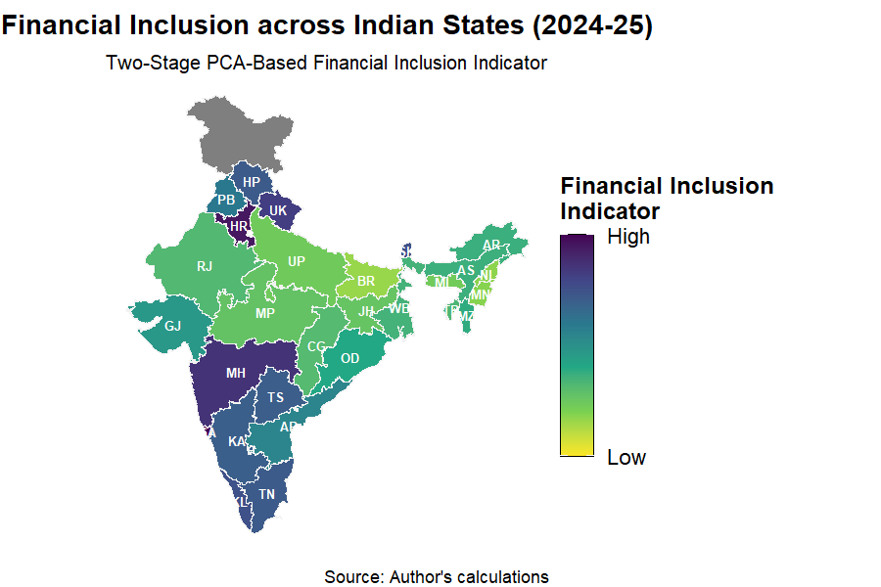
SLIDE 06 · RESULTS AND ANALYSIS
Financial Inclusion Follows a Distinct Geographic Pattern
State-wise Financial Inclusion Index (2024–25) • Two-Stage PCA-Based Methodology
STATE RANKINGS (2024–25)
SPATIAL DISTRIBUTION ACROSS STATES
Rank
State
1 Goa
2 Haryana
3 Maharashtra
4 Uttarakhand
5 Kerala
6 Sikkim
7 Tamil Nadu
8 Himachal Pradesh
9 Telangana
10 Karnataka
11 Punjab
12 Andhra Pradesh
13 Gujarat
14 Odisha
15 Mizoram
16 Arunachal Pradesh
17 Assam
18 West Bengal
19 Tripura
20 Rajasthan
21 Chhattisgarh
22 Madhya Pradesh
23 Jharkhand
24 Uttar Pradesh
25 Meghalaya
26 Manipur
27 Nagaland
28 Bihar
India Financial Inclusion Map (2024–25)
Choropleth map to be inserted manually
Source: [ source note to be inserted ]
•
WHAT THE MAP REVEALS
Higher financial inclusion is concentrated primarily in Western and Southern India, with Goa, Haryana, Maharashtra, Uttarakhand, Kerala, Tamil Nadu and Telangana among the leading states.
•
Lower financial inclusion is concentrated across much of Eastern and Central India, where Bihar, Jharkhand, Uttar Pradesh, Madhya Pradesh and Chhattisgarh remain comparatively weaker.
Reserve Bank of India · Department of Statistics and Information Management

Slide 7
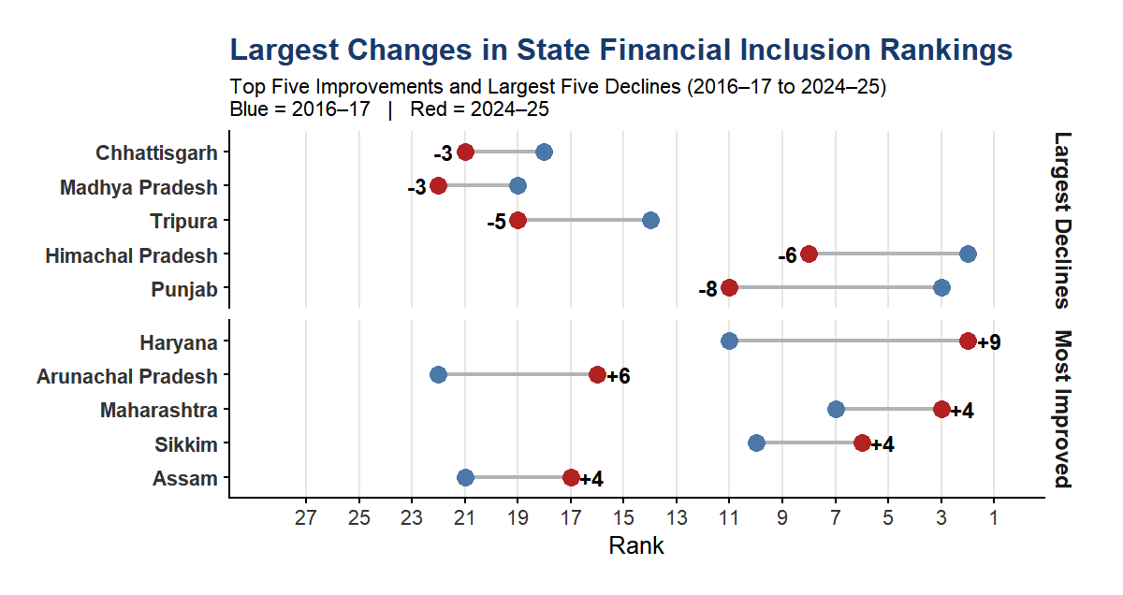
SLIDE 07 · TEMPORAL DYNAMICS
Every State Improved, but Few Changed Places
Financial inclusion rose in every state between 2016–17 and 2024–25 yet the interstate hierarchy remained largely intact.
RANK MOBILITY, 2016–17 vs 2024–25
RANK STABILITY
ρ = 0.911
Spearman rank correlation, 2016–17 vs 2024–25 (p < 0.001)
p = 0.952
Wilcoxon signed-rank test — no significant systematic shift
9 states
retained exactly the same rank throughout
WHAT CHANGED?
Every state improved its Financial Inclusion Index between 2016–17 and 2024–25.
Rank changes reflected relative improvement, not declines in financial inclusion.
Most movement was modest, with only a few states recording substantial upward or downward shifts.
Despite this, the interstate hierarchy remained largely unchanged.
RANK MOBILITY
SUMMARY
↑ Improved Rank: 9 states
→ No Change: 9 states
↓ Declined Rank: 10 states
Most rank changes were limited to fewer than five positions.
Reserve Bank of India · Department of Statistics and Information Management

Slide 8
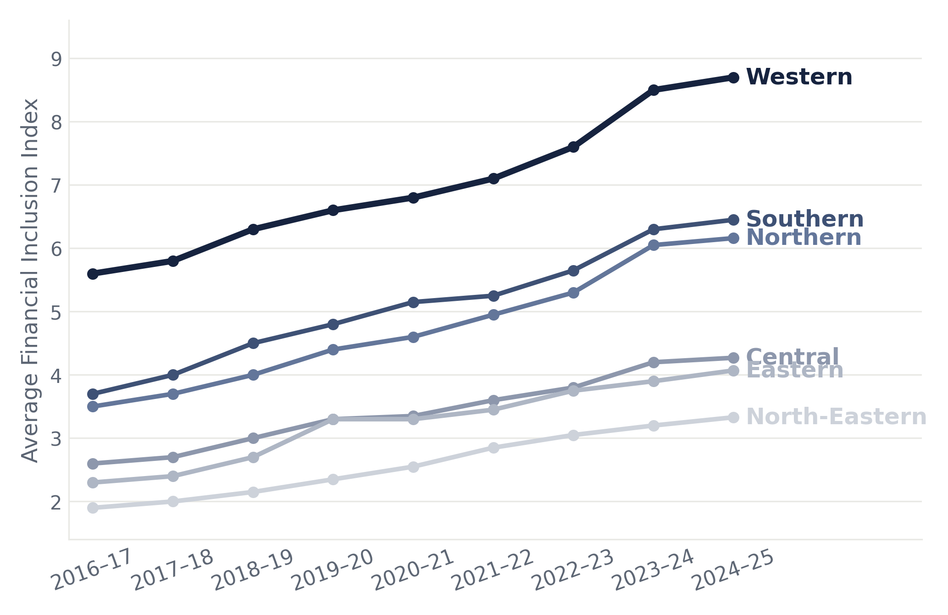
SLIDE 08 · REGIONAL PATTERNS
All Regions Advanced, Yet the Hierarchy Held Firm
Western India led throughout 2016–17 to 2024–25; the North-East remained the lowest-performing region.
AVERAGE FINANCIAL INCLUSION INDEX BY REGION, 2016–17 TO 2024–25
REGIONAL HIERARCHY, 2024–25
STATISTICAL EVIDENCE
1
Western
8.70
Kruskal–Wallis
χ² = 12.52 p = 0.028
2
Southern
6.45
3
Northern
6.16
✓ Significant regional differences
4
Central
4.27
5
Eastern
4.07
ANOVA
F = 4.28 p = 0.007
✓ Same conclusion
6
North-Eastern
3.33
WHAT THE TRENDS REVEAL
Every region recorded sustained improvement over the study period.
Western India remained the consistent leader; while the North-East remained the lowest-performing region.
Despite broad-based progress, the regional hierarchy changed very little.
Reserve Bank of India · Department of Statistics and Information Management

Slide 9
SLIDE 09 · REGIONAL ANALYSIS
Regional Financial Inclusion Differs in Internal Dispersion
How evenly is financial inclusion distributed among states within each region (2024–25)?
REGIONAL DISPERSION SUMMARY (2024–25)
Western
Southern
•
Highest average financial inclusion.
•
High financial inclusion with the lowest dispersion (SD = 0.63).
Region
Mean FII
SD
•
Highest internal dispersion (SD = 4.46).
SD
•
•
Goa outperformed Gujarat and Maharashtra.
Most balanced regional development.
Western
8.71
4.46
Southern
6.45
0.63
Northern
Central
•
•
Moderate financial inclusion but relatively high dispersion.
Northern
6.16
2.10
Strong regional performance with moderate dispersion.
•
•
Uttarakhand increasingly outpaced neighbouring states.
Central
4.27
2.21
Haryana emerged as the regional leader.
Eastern
4.07
1.78
Eastern
North-Eastern
North-Eastern
3.33
0.73
•
Moderate regional performance.
•
Lowest regional average.
•
Sikkim remained ahead of the remaining Eastern states.
•
Most states remained relatively close in performance, leading to relatively low internal dispersion
WHAT THE ANALYSIS REVEALS
•
Regional averages conceal substantial heterogeneity among constituent states.
•
High regional financial inclusion does not necessarily imply balanced regional development.
•
Southern India combines strong financial inclusion with the most balanced state-level performance.
•
Internal regional disparities are driven primarily by exceptional state performance.
Reserve Bank of India · Department of Statistics and Information Management

Slide 10
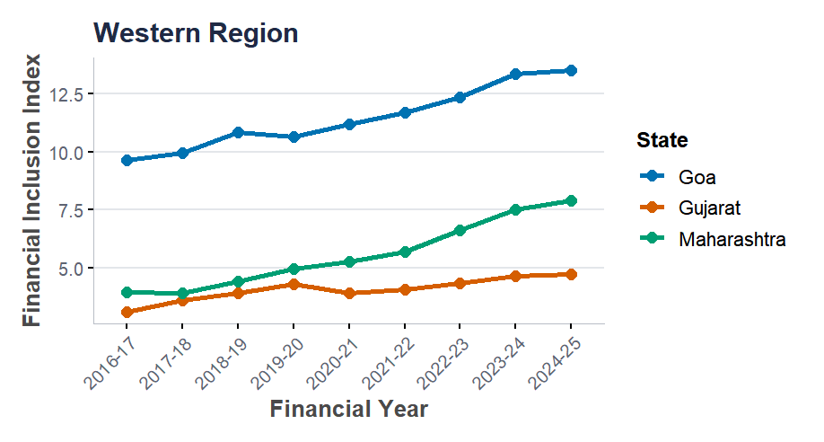
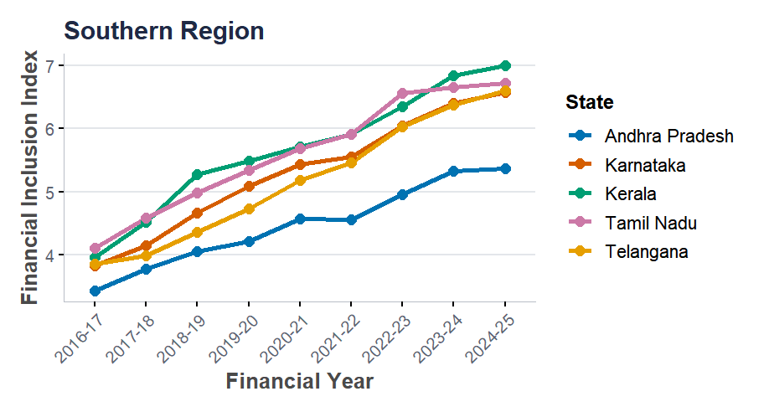
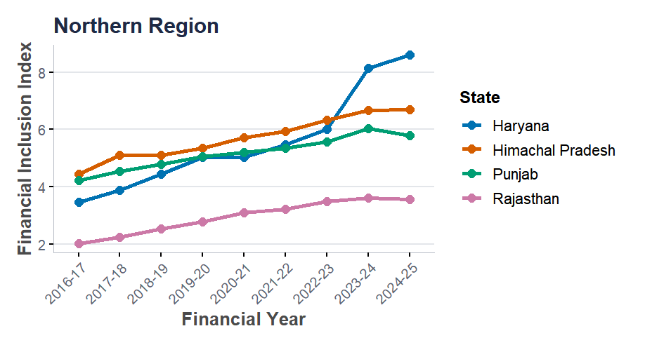
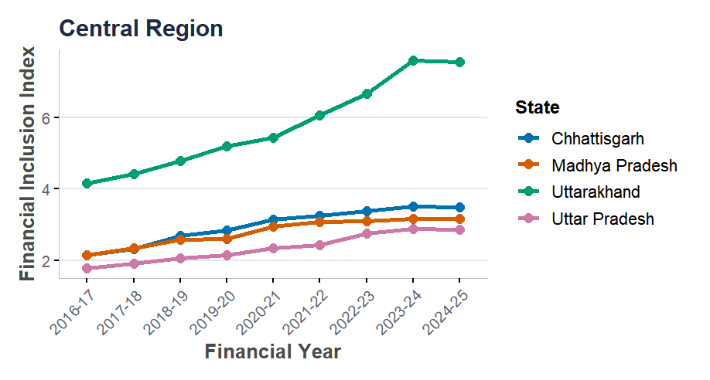
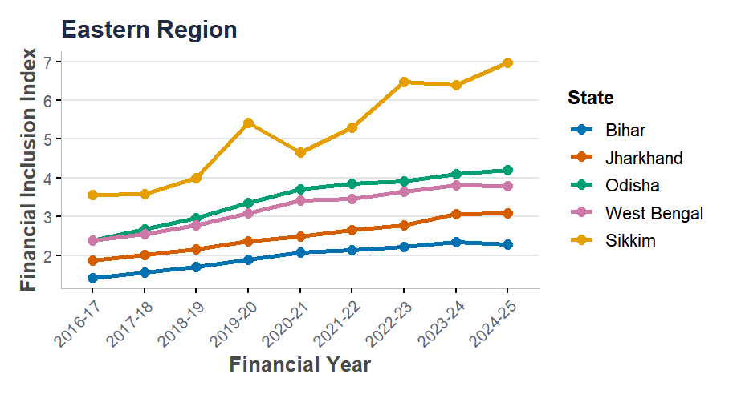
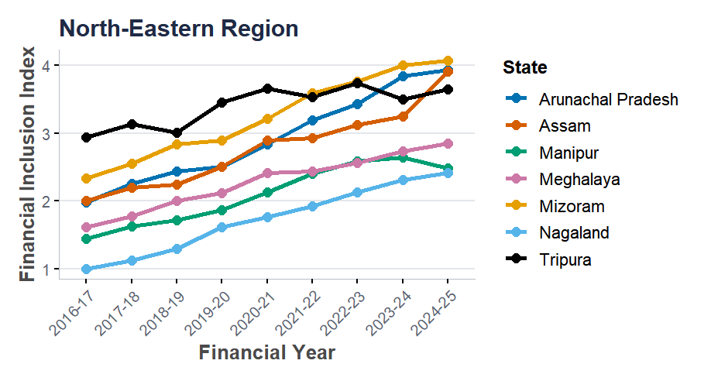
SLIDE 10 · REGIONAL ANALYSIS
State-Level Trajectories Explain Regional Differences in Financial Inclusion
Financial Inclusion Index trends of states within each region (2016–17 to 2024–25)
Western Region
Chart to be inserted
Chart to be inserted
Southern Region
Northern Region
Chart to be inserted
Chart to be inserted
Chart to be inserted
Central Region
Eastern Region
North-Eastern Region
WHAT THE STATE TRAJECTORIES REVEAL
Regional disparities arise primarily from differences in individual state trajectories rather than uniform regional trends. Regions with low dispersion exhibit parallel growth paths, whereas high-dispersion regions are characterised by one or two states pulling markedly ahead of their neighbours.
Reserve Bank of India · Department of Statistics and Information Management

Slide 11
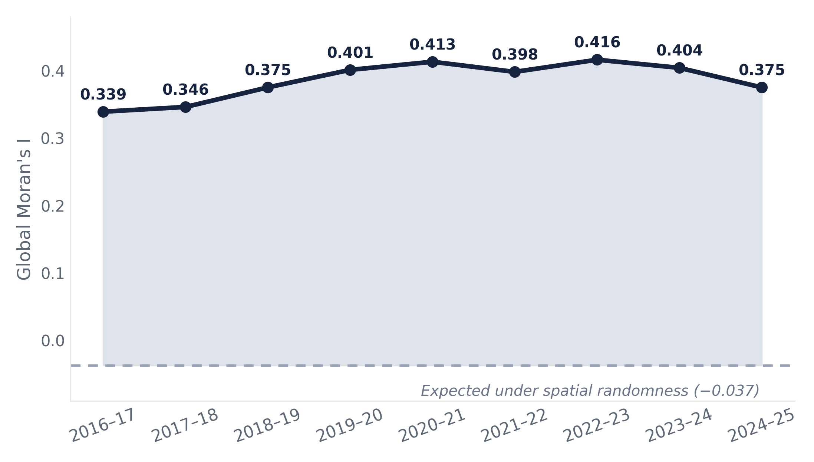
SLIDE 11 · REGIONAL PATTERNS
Financial Inclusion Clusters in Space, Not by Chance
Neighbouring states consistently show similar levels of financial inclusion
GLOBAL MORAN'S I, 2016–17 TO 2024–25
SPATIAL AUTOCORRELATION
0.339 → 0.416 → 0.375 2016–17 → peak (2022–23) → 2024–25, always significant (p < 0.001)
LOCAL CLUSTERS (LISA), 2024–25
High–High: Karnataka
Low–Low: Jharkhand, Assam
No significant High–Low or Low–High outliers.
WHAT THE ANALYSIS REVEALS
Financial inclusion shows persistent positive spatial autocorrelation.
Neighbouring states tend to share similar levels of financial inclusion.
Geography continues to shape its spatial distribution across India.
Positive and statistically significant in every year ( p < 0.001) — far above what random chance would produce.
Reserve Bank of India · Department of Statistics and Information Management

Slide 12
SLIDE 12 · ROBUSTNESS & VALIDATION
Two Different Methods, One Consistent Story
Comparison of the Hierarchical Two-Stage PCA and Sarma Financial Inclusion Indices
ALTERNATIVE BENCHMARK
AGREEMENT BETWEEN INDICES
Sarma Distance-Based Index
r = 0.919
ρ = 0.979
τ = 0.828
Builds a multidimensional index from Penetration, Availability and Usage.
Normalises indicators and aggregates using a distance-from-ideal approach.
Used as an alternative benchmark to test the robustness of the PCA results.
Pearson correlation
Spearman correlation
Kendall’s tau
Strong agreement across all 252 state-year observations
Consistently high agreement despite fundamentally different methodologies
RANK AGREEMENT BETWEEN METHODS
CONSISTENT FINDINGS
Exact
20.6%
✓
Goa ranked 1st under both methods.
Within ±1
54.8%
✓
Bihar ranked last under both methods.
Within ±3
83.3%
✓
Western, Southern and Northern regions retained their hierarchy.
Within ±5
94.0%
✓
Only the closely ranked Central and Eastern regions exchanged positions.
WHAT THE COMPARISON REVEALS
Despite fundamentally different construction methods, the Two-Stage PCA and Sarma indices produce highly consistent state rankings and regional patterns. The limited differences are concentrated among a few states, confirming that the study's principal findings are robust to the choice of methodology.
Reserve Bank of India · Department of Statistics and Information Management

Slide 13
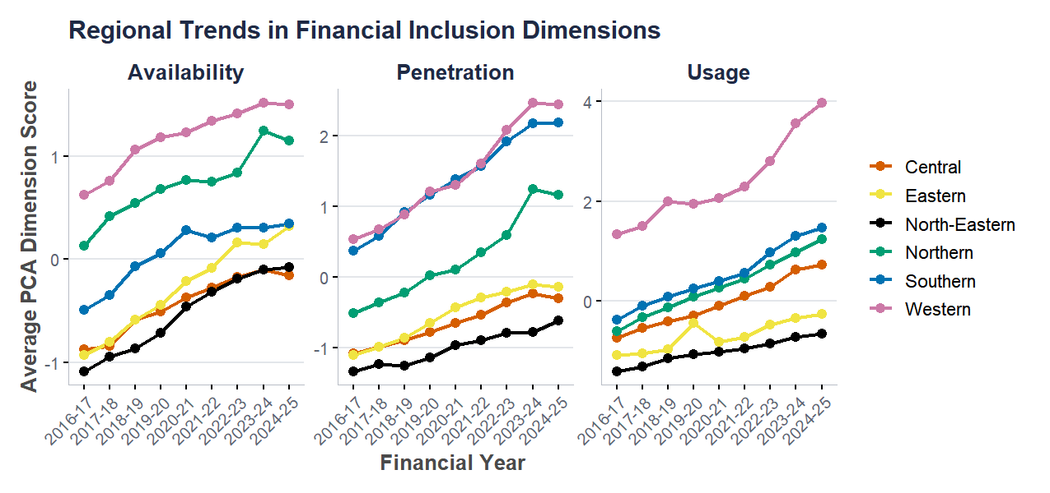
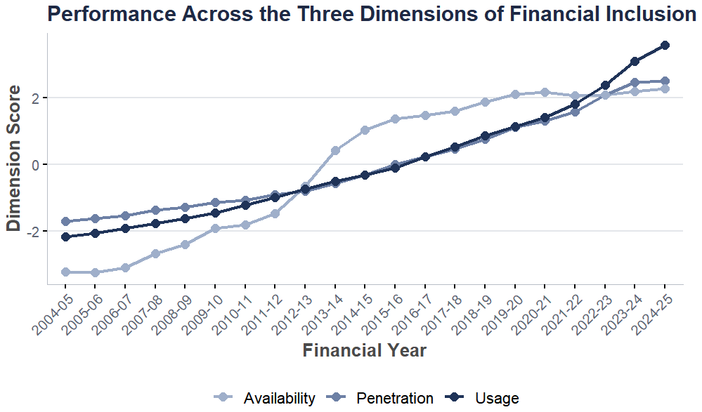
SLIDE 13 · DIMENSIONAL ANALYSIS
Financial Inclusion Has Shifted from Access to Active Usage
National performance across the three dimensions of financial inclusion (2016–17 to 2024–25)
REGIONAL HIERARCHY, 2024–25
DIMENSION GROWTH, 2016–17 → 2024–25
1
Western Strongest across all dimensions, especially Usage after 2020–21
Usage
2
Southern High Penetration with consistently, strong overall performance.
Penetration
3
Northern Most balanced profile across, all three dimensions.
Availability
NATIONAL TRANSITION
↓
4
Central Moderate improvement over time, but remained below the national average.
2016–17 Availability was the strongest dimension
2024–25 Usage became the strongest dimension
5
Eastern Gradual progress, particularly in Availability, but continued to lag in Penetration and Usage.
WHAT THE TRENDS REVEAL
6
North-Eastern Lowest-performing, persistently weak scores across all,despite modest improvement.
Financial inclusion has evolved from expanding financial access to increasing the active use of formal financial services. However, this transition has been uneven across regions, with the Western region driving much of the improvement while Central, Eastern and North-Eastern regions continue to lag across all three dimensions.
Reserve Bank of India · Department of Statistics and Information Management

Slide 14
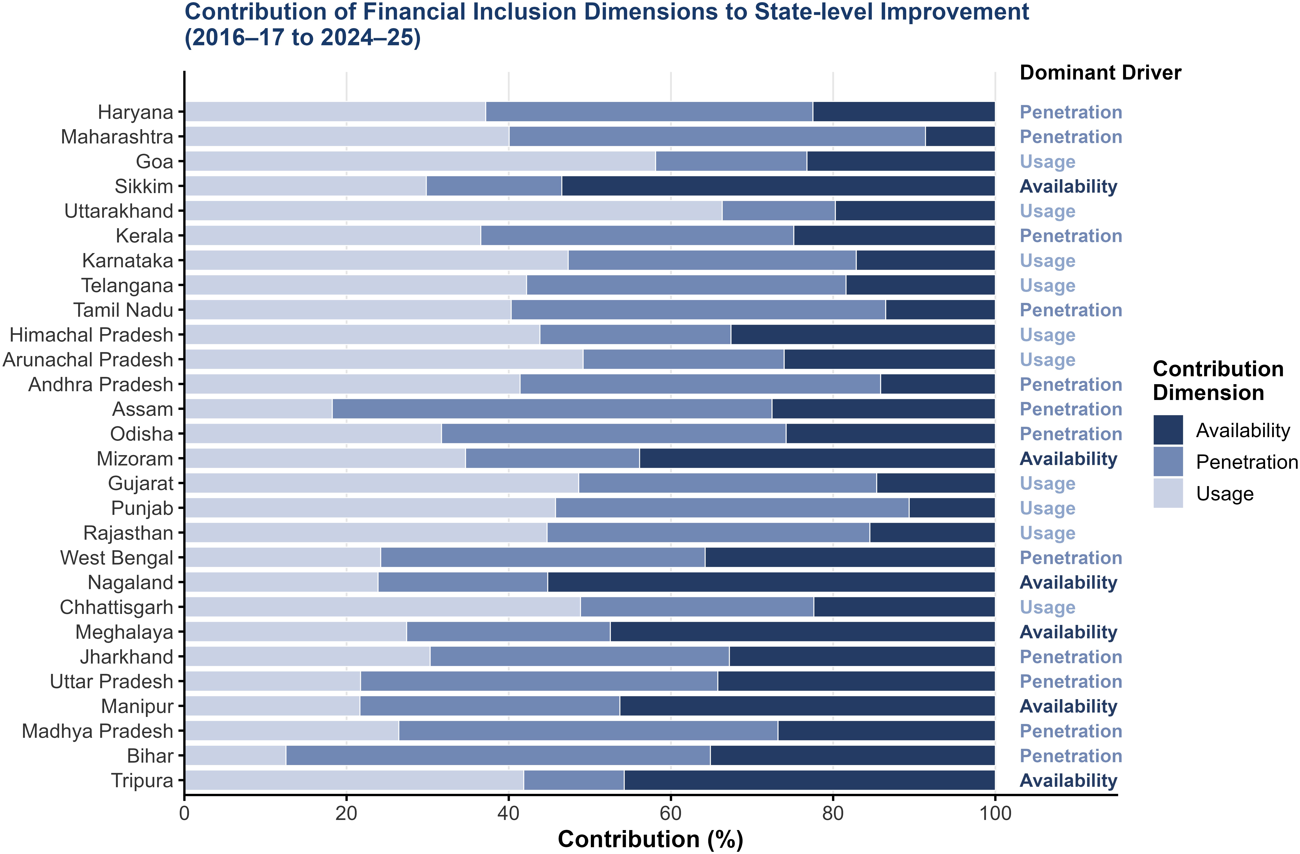
SLIDE 14 · DIMENSIONAL ANALYSIS
States Improvements Reflect Different Financial Inclusion Pathways
Contribution of Penetration, Availability and Usage to state-level FII growth (2016–17 to 2024–25)
THREE GROWTH PATHWAYS
Usage-led (10)
Highest contributors: Uttarakhand 66.3%, Goa 58.1%, Arunachal Pradesh 49.2%, Others:Chhattisgarh, Gujarat, Karnataka, Punjab, Rajasthan, Himachal Pradesh, Telangana
Penetration-led (12)
Highest contributors: Assam 54.2%, Bihar 52.3%, Maharashtra 51.3%,
Others: Madhya Pradesh, Tamil Nadu, Andhra Pradesh, Uttar Pradesh, Odisha, Haryana, West Bengal, Kerala, Jharkhand
Availability-led (6)
Nagaland 55.2%, Sikkim 53.5%, Meghalaya 47.5%, Manipur 46.3%, Tripura 45.8%, Mizoram 43.9%
KEY INSIGHTS
✓
Usage dominates many leading and faster-improving states.
✓
Penetration remains the most widespread pathway across different levels of financial inclusion.
✓
Availability-led growth is concentrated largely in the North-Eastern region.
WHAT THE ANALYSIS REVEALS
States with similar improvements followed markedly different pathways. Usage increasingly drives many leading states, Penetration remains the most widespread pathway, and Availability continues to underpin progress across the North-East. These distinct pathways demonstrate that states with similar financial inclusion outcomes may require different policy priorities.
Reserve Bank of India · Department of Statistics and Information Management

Slide 15
SLIDE 15 · METHODOLOGY
Financial Inclusion Development Typology (FIDT):
A Three-Stage Classification Framework
A multidimensional framework integrating financial inclusion level, dominant growth pathway and driver strength (2024–25)
STAGE 1 · LEVEL
2024–25 FI Index
Quartile split: Leaders (Q1), Emerging(Q2-Q3), Priority(Q4)
→
STAGE 2 · PATHWAY
Dimension contribution
Dominant driver: Usage, Penetration, Availability
→
STAGE 3 · STRENGTH
Dominance gap (Largest − Second Largest Contribution)
Quartile split: Strong, Moderate, Weak
→
Financial Inclusion Development Typology (FIDT)
Usage-driven
Penetration-driven
Availability-driven
Financial Inclusion Leaders
Strong
Goa, Uttarakhand
Moderate
Maharashtra, Tamil Nadu
Strong
Sikkim
Weak
Haryana, Kerala
Emerging Financial Inclusion States
Karnataka, Himachal Pradesh, Gujarat, Rajasthan, Chhattisgarh
Moderate
Moderate
Odisha, West Bengal
Moderate
Mizoram
Arunachal Pradesh
Strong
Assam
Weak
Tripura
Strong
Weak
Andhra Pradesh
Weak
Telangana, Punjab
Financial Inclusion Priority States
—
Uttar Pradesh, Madhya Pradesh, Bihar
Moderate
Moderate
Manipur
Weak
Jharkhand
Strong
Nagaland, Meghalaya
KEY FINDINGS
POLICY DIRECTION
✓
6.24 Usage
All three pathways appear among Financial Inclusion Leaders.
Leaders:
Deepen quality, innovation and active usage.
✓
Usage dominates the Emerging group (8 of 14 states).
Emerging:
Strengthen complementary dimensions while sustaining current momentum.
✓
No Financial Inclusion Priority State is Usage-driven.
✓
4.90 Penetration
Priority:
Address foundational outreach and infrastructure gaps before scaling usage.
Driver Strength distinguishes states with clearly dominant pathways from
those exhibiting more balanced multidimensional growth.
✓
No Usage-driven states recorded the highest average Financial Inclusion
Index (6.24), followed by Penetration (4.90) and Availability (3.74).
3.74 Availability
WHAT THE FIDT REVEALS
The FIDT extends conventional financial inclusion classification by combining financial inclusion level, dominant growth pathway and pathway strength into a unified framework for targeted policy design.
Reserve Bank of India · Department of Statistics and Information Management

Slide 16
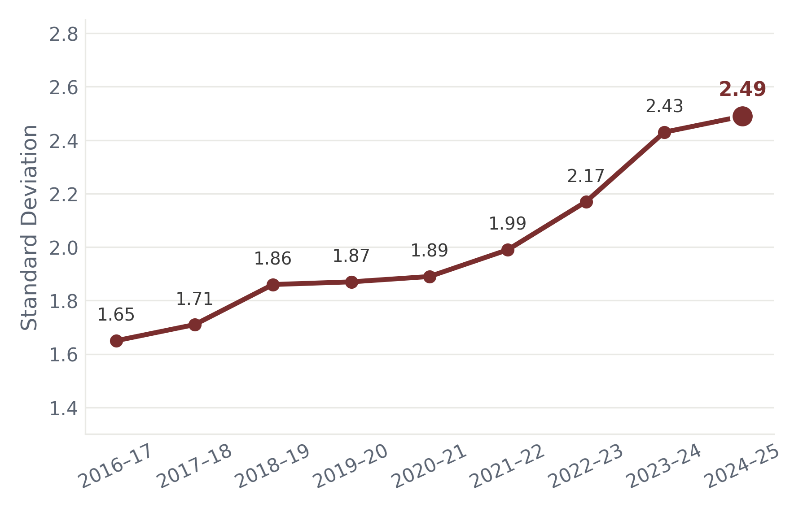
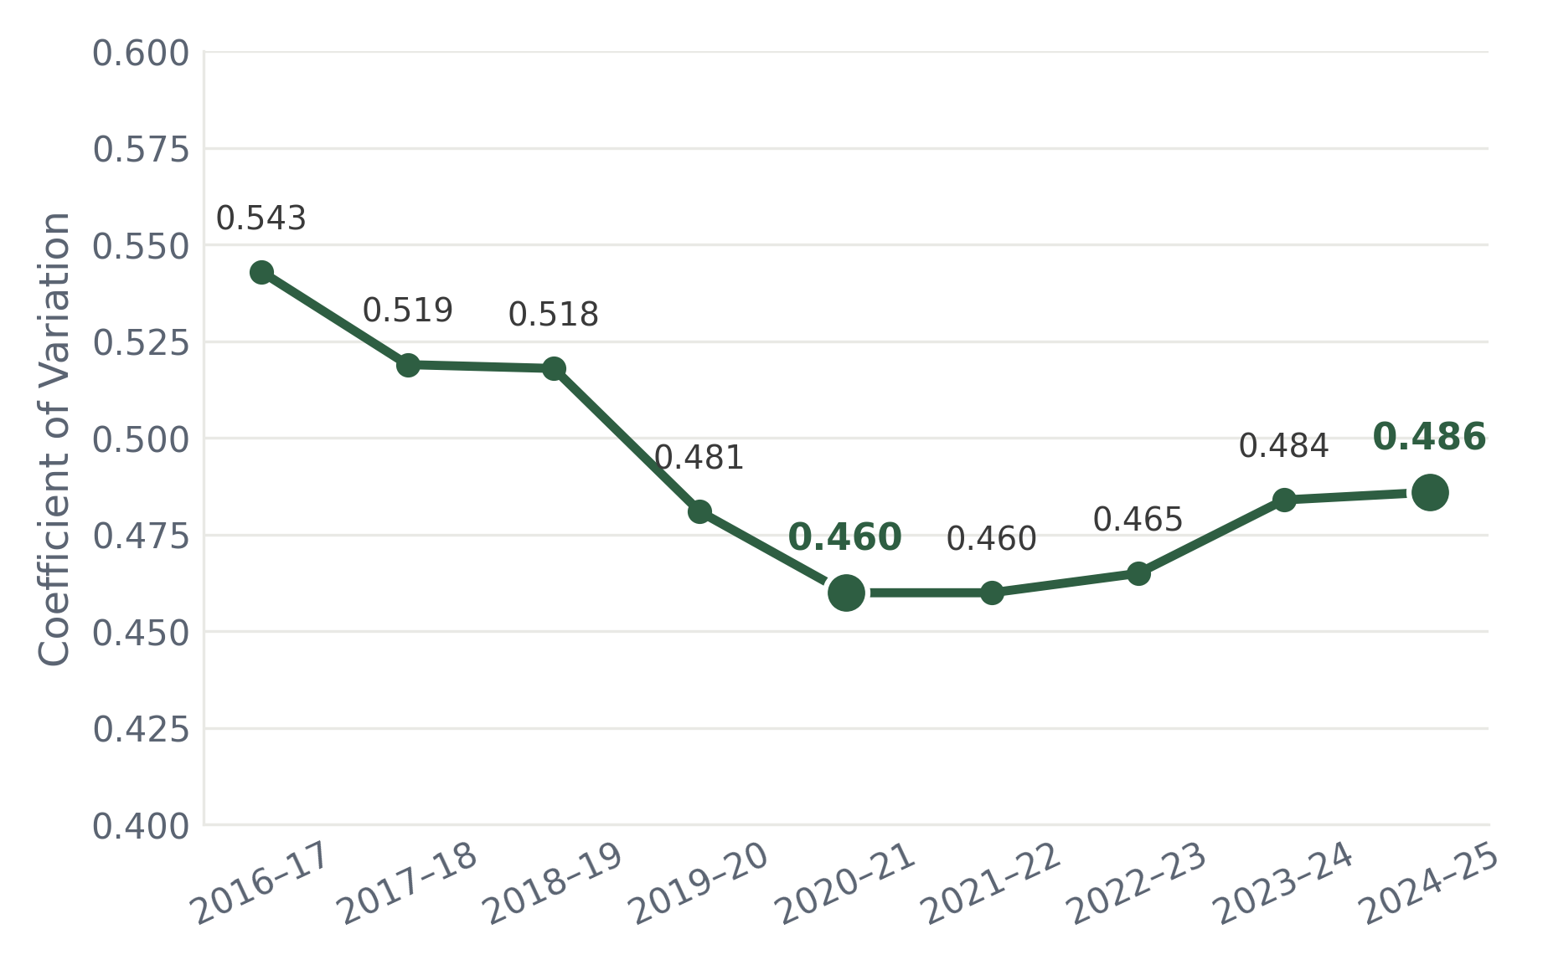
SLIDE 15 · CONVERGENCE ANALYSIS
Sigma Convergence: Did Interstate Financial Inclusion Gaps Narrow Over Time?
Examining whether interstate disparities in financial inclusion became smaller as overall financial inclusion improved (2016–17 to 2024–25).
ABSOLUTE SIGMA CONVERGENCE · STANDARD DEVIATION OF THE FII
RELATIVE SIGMA CONVERGENCE · COEFFICIENT OF VARIATION OF THE FII
Absolute interstate disparities widened steadily.
No evidence of absolute sigma convergence.
ABSOLUTE CONVERGENCE
RELATIVE CONVERGENCE
Relative disparities narrowed initially.
Mild divergence emerged after 2021–22.
Still below the 2016–17 level overall.
1.65 → 2.49
Standard Deviation
0.543 → 0.460 → 0.486
CV
WHAT THE ANALYSIS REVEALS
Financial inclusion improved across all states, but these gains did not produce sustained convergence. Absolute interstate disparities widened continuously, while relative disparities narrowed only temporarily before increasing modestly in the later years. Overall, the evidence indicates limited sigma convergence across Indian states.
Reserve Bank of India · Department of Statistics and Information Management

Slide 17
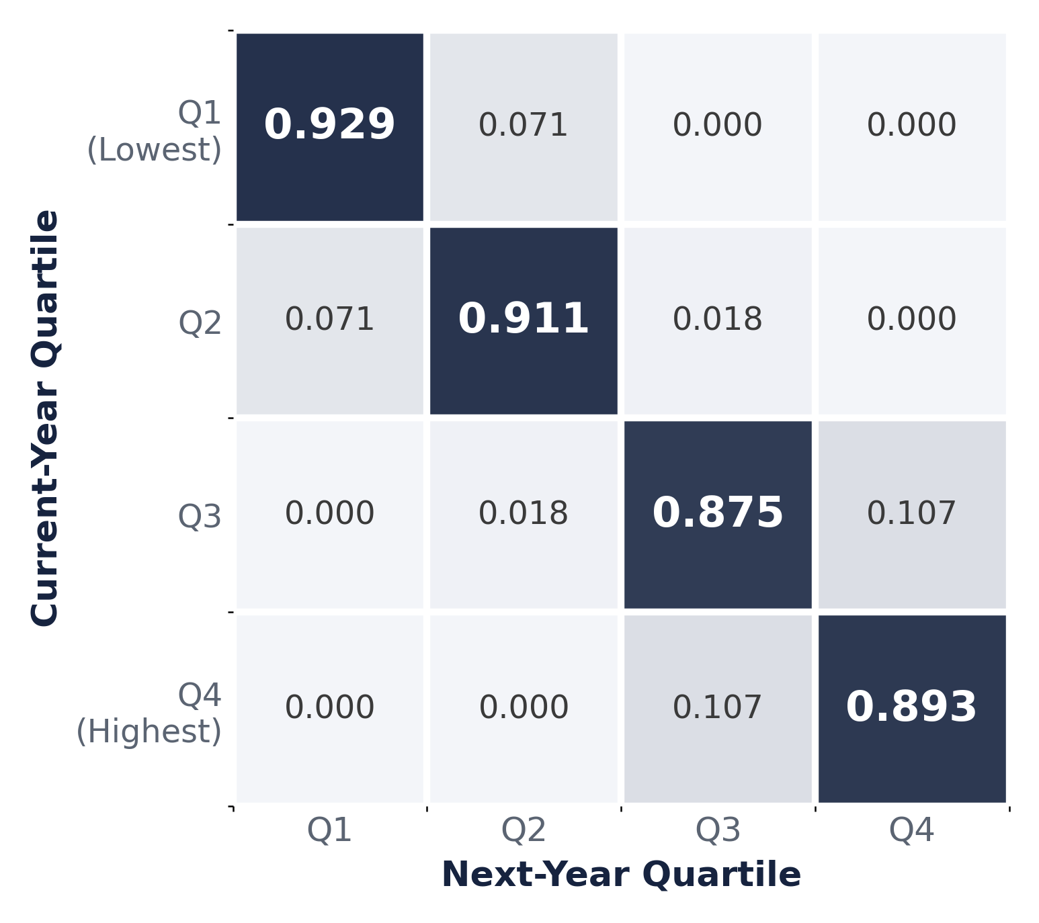
SLIDE 16 · CONVERGENCE ANALYSIS
Markov Transition Analysis: Did States Change Their Relative Position Over Time?
Examining interstate mobility across financial inclusion quartiles between 2016–17 and 2024–25.
MARKOV TRANSITION PROBABILITY MATRIX
Understanding the Transition Matrix
EXAMPLE INTERPRETATION
Q1 → Q1 = 92.9%
A state in Quartile 1 has a 92.9% probability of remaining in Quartile 1 in the next year..
The same interpretation applies to every cell in the transition matrix.
WHAT THE MATRIX SHOWS
Q1 → Q1 (92.9%)
A state in Quartile 1 has a 92.9% probability of remaining in Quartile 1 in the next year.
Q2 → Q2 (91.1%)
Very limited movement.
Q3 → Q3 (87.5%)
Moderate persistence.
Q4 → Q4 (89.3%)
High-performing states largely retained their position
OBSERVED MOBILITY Q1→Q2: 7.1% · Q2→Q3: 1.8% · Q3→Q4: 10.7%
No direct transitions occurred between non-adjacent quartiles (e.g., Q1→Q3 or Q1→Q4) —No direct transitions occurred between non-adjacent quartiles, indicating that interstate financial inclusion evolved gradually rather than through abrupt jumps.
87–93%
Persistence exceeded 87% across every quartile.
Highest persistence occurred in Q1 (92.9%).
Transitions were almost entirely confined to adjacent quartiles.
0.131
Indicates low interstate mobility.
Very few states changed quartiles.
The interstate hierarchy remained largely unchanged.
Quartile
Persistence
Shorrocks
Mobility Index
WHAT THE ANALYSIS REVEALS
Interstate mobility remained limited: most states stayed within their original quartile, and the few transitions observed occurred almost exclusively between adjacent quartiles , indicating gradual rather than abrupt changes.
Reserve Bank of India · Department of Statistics and Information Management

Slide 18
SLIDE 18 · CONCLUSIONS
Key Findings
Six principal findings emerging from the Two-Stage PCA analysis of financial inclusion across Indian states (2016–17 to 2024–25).
Persistent Interstate Disparities
Regional & Spatial Patterns
✓
Robust Methodology
Financial inclusion improved in every state, 2016–17 to 2024–25.
Goa consistently ranked highest, Bihar lowest, throughout.
Interstate rankings changed only modestly despite progress.
Higher inclusion concentrated in western and southern India.
Southern region most internally homogeneous
Central, Eastern and North-Eastern India remained lower.
Significant spatial clustering, not a random distribution.
The Two-Stage PCA index closely tracked the RBI FI-Index.
Results remained highly stable under sensitivity analysis.
Strong agreement with Sarma methodology.
Beyond Composite Indices
Financial Inclusion Development Typology (FIDT)
Limited Interstate Convergence
National inclusion shifted from Availability-led to Usage-led.
States reached similar levels via different dimension mixes.
Driver Strength further distinguishes pathway intensity.
Availability dominates lower-performing states, Usage dominates higher-performing states, and Penetration occupies an intermediate position.
Availability-driven states exhibit the strongest driver dominance. Penetration-driven mostly Moderate/Weak. Usage-driven states exhibit a more balanced distribution across Moderate and Strong Driver Strength
Disparities persisted despite improvement across all states.
Rank mobility remained limited, with strong persistence.
Broad progress, without sustained convergence.
OVERALL CONTRIBUTION
Financial inclusion has expanded across every Indian state, but progress has remained uneven. Persistent regional disparities, limited interstate mobility and diverse development pathways suggest that future policy should move beyond one-size-fits-all approaches toward differentiated, state-specific financial inclusion strategies.
Reserve Bank of India · Department of Statistics and Information Management

Slide 19




SLIDE 19 · POLICY IMPLICATIONS
Policy Implications & Recommendations
The empirical findings support a differentiated, pathway-based approach to advancing financial inclusion across Indian states.
National Policy Priorities
Differentiated State Strategies
Access → Usage
Differentiated Strategies
Expand Digital Payment usage, Savings, Credit, Insurance and Pension and nationwide.
Reserve infrastructure expansion for states where access constraints remain.
Shift focus from banking outreach toward financial deepening.
Leaders: Innovation, product diversification and service quality.
Emerging States: Convert access into sustained usage via productive credit, insurance and digital payments.
Priority States: Expand outreach, Business Correspondent networks and digital infrastructure.
Pathway-Based Policy Design
Institutional & Regional Priorities
FIDT Framework
Regional Targeting
Tailor interventions to each state's dominant development pathway.
Use Driver Strength to o decide whether a balanced or a targeted intervention makes more sense.
Move towards pathway-based policy design.
Strengthen support for persistently lagging states.
Encourage regional coordination among structurally similar states.
Publish an official state-level multidimensional FI Index (Penetration, Availability, Usage).
Reserve Bank of India · Department of Statistics and Information Management

Slide 20
Thank You

